Slide 1

Unit 1
It’s a Good Deal, Isn’t It?

Slide 2

Unit 1
It’s a Good Deal, Isn’t It?

Slide 3

The objectives of the lesson :
At the end of this session, the students will be able to :
Rephrase a text
Produce the rising intonation

Slide 4
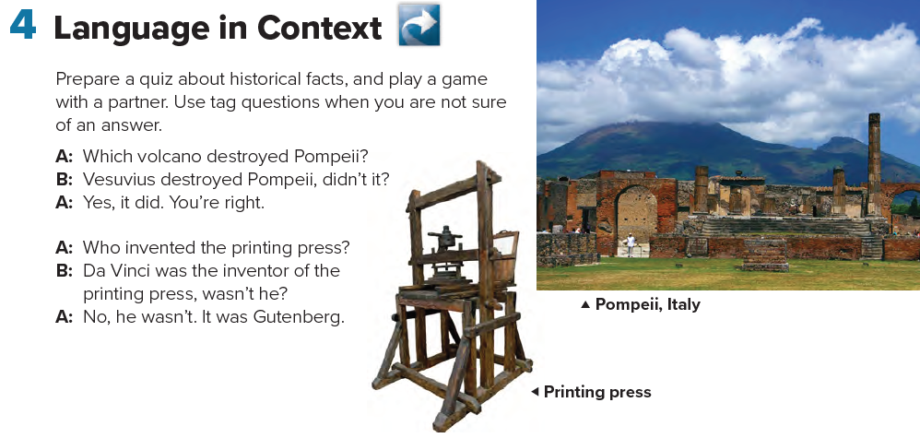

Slide 5

Can you think of more !
important people, places, and events in history

Slide 6

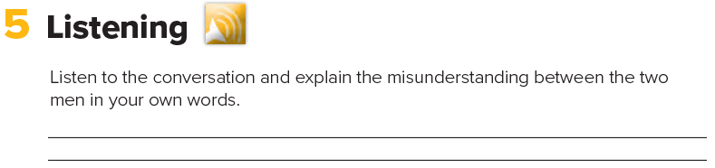
George Scott thinks the man is a famous author named Melvin Dupont.
Is the man happy or annoyed when the stranger talks to him?

Slide 7
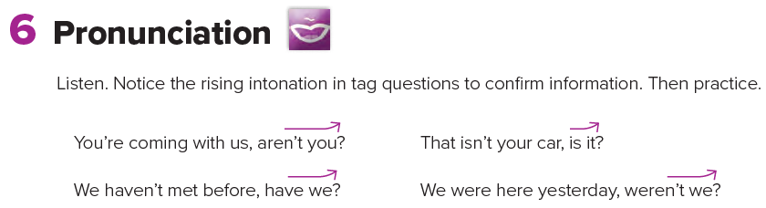

Slide 8



