Slide 1

Unit 7
It’s a good deal, isn’t it?
Conversation

Slide 2
بسم الله الرحمن الرحيم
Day:
Date:

Slide 3
Learning Objectives
listen for specific information in a conversation
practice using real talk phrases
answer questions about the conversation

Slide 4
Where are the people?
Where do you think the people are from?
Page 73

Slide 5
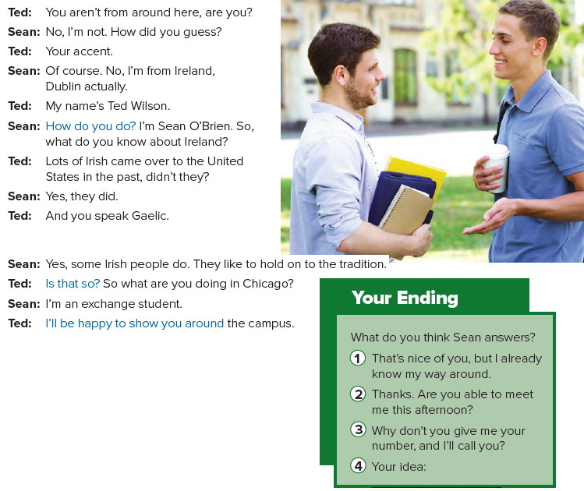

Page 73

Slide 6
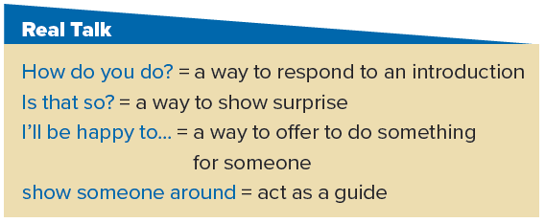
Page 73

Slide 7
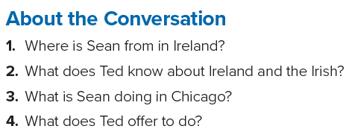
Answers
1. Sean is from Dublin.
2. He knows that many Irish came to the United States in the past, and he knows they speak Gaelic.
3. He is an exchange student.
4. Ted offers to show Sean around the campus.
Page 73

Slide 8
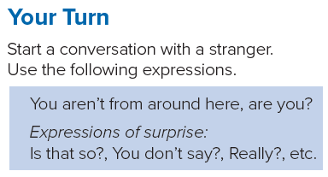
Page 73

Slide 9
Page 212
Homework

Slide 10
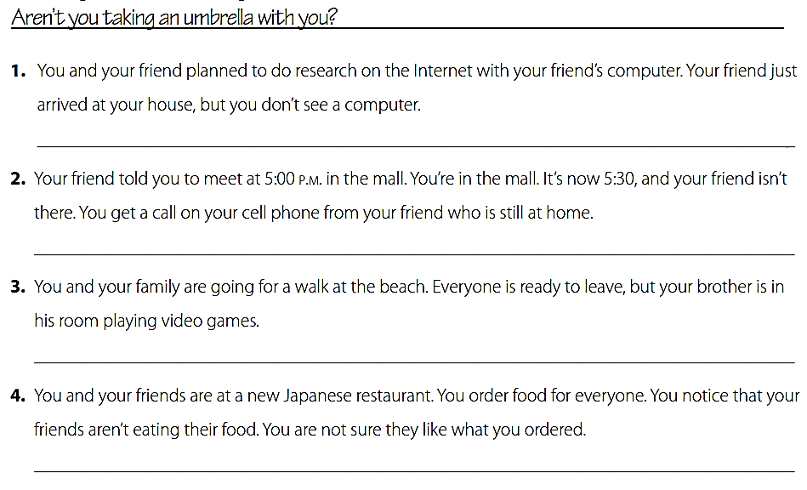
Didn’t you bring your computer ?
Haven’t you left yet ?
Aren’t you coming with us ?
Don’t you like your food ?

Slide 11
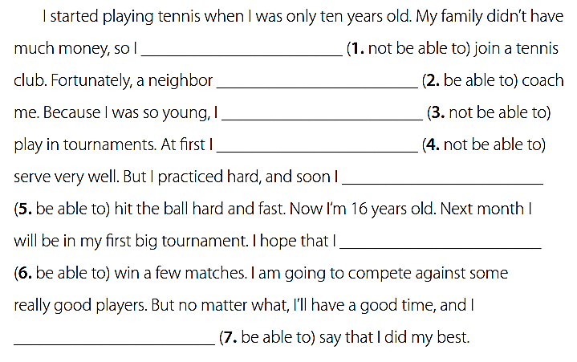
wasn΄t able to
was able to
wasn΄t able to
wasn΄t able to
was able to
will be able to
will be able to

