Slide 1
Unit 7
It’s a good deal, isn’t it?
Revision

Slide 2
Choose the correct answer:
1- You were in Jeddah, ( wasn't- weren't- aren't ) you?
2- She studied in Dammam, ( didn't- don't - doesn't) she?
3-They aren't from Abha, ( are they - are not they – do they) ?
4- Majed is able to ( drive – drives – driving ) a car.
5- Sara should ( see – saw – seen ) the doctor.
6- She is cute, (isn’t she – is she – is it)?
7- Ahmad writes an essay, (do he – doesn’t he – isn’t he)?
8- You aren’t a doctor , ( is you – are you – do you )?

Slide 3
Choose the correct answer:
9-They are able to (speak – speaks –speaking) Spanish.
10-Sarah (is –are- were) able to drive a car.
11-He is able to (fixing – fixes – fix) his bike.
12-You could (using – use – used) my laptop.
13-They should (wash – washed- washing) their hands.
14-Should I (talked- talking – talk) to her?
15- Why don’t we (goes – go –went) on a picnic!
16- Let's (help – helping – helped) Mona.

Slide 4
Do as shown between brackets
1- go \ Let's \ shopping (reorder).
Let’s go shopping.
2- Why\ we \ order \a pizza \ don't \ ? ( reorder).
Why don’t we order a pizza?

Slide 5
Do as shown between brackets
3- He should (staying ) at home ( correct)
4- Ahmaed is able to ( fixes ) the car ( correct)
5- She reads this novel, (do) not she ? ( correct)
She read this novel, doesn’t she?
He should stay at home.
Ahmad is able to fix the car.

Slide 6
Make a suggestion
1- Clean the house . ( Let’s)
Let’s clean the house!
2- We travel to Dubai ( Why don’t )
Why don’t we travel to Dubai?

Slide 7
Match the words with their meanings
1- orphan |  | a- think wrongly that a person is someone else
2- confuse |  | b- what you get from your parent
3- coincidence |  | c- having a strong emotional effect
4- triplet |  | d- a child who has lost his parents
5- heredity |  | e- by chance
6- touching |  | f- three children born at the same time
2
5
6
1
3
4

Slide 8
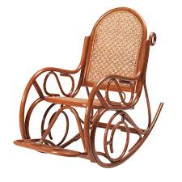
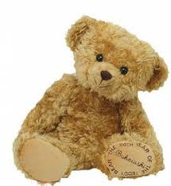
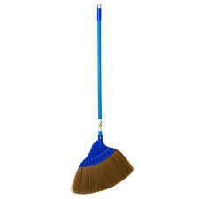
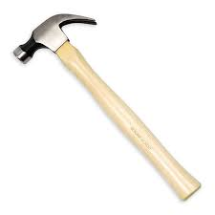
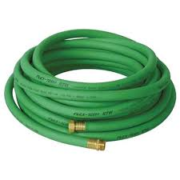
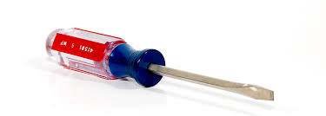
Identify the following objects
broom- screw driver- teddy bear- hose – pot- rocking chair -hammer
rocking chair
teddy bear
broom
hammer
hose
screw driver

