Slide 1
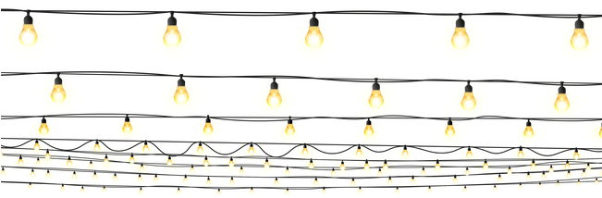

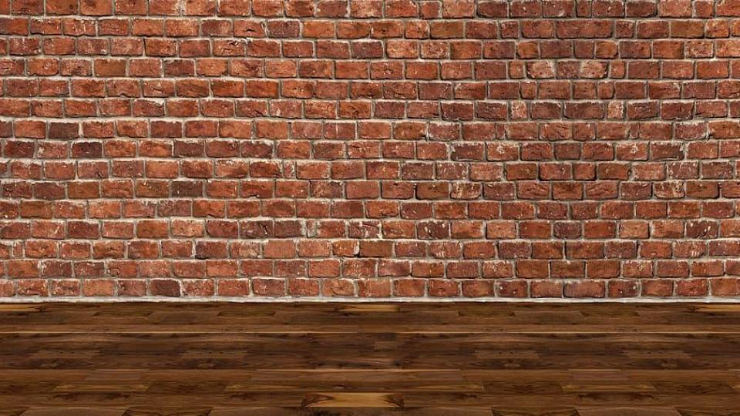
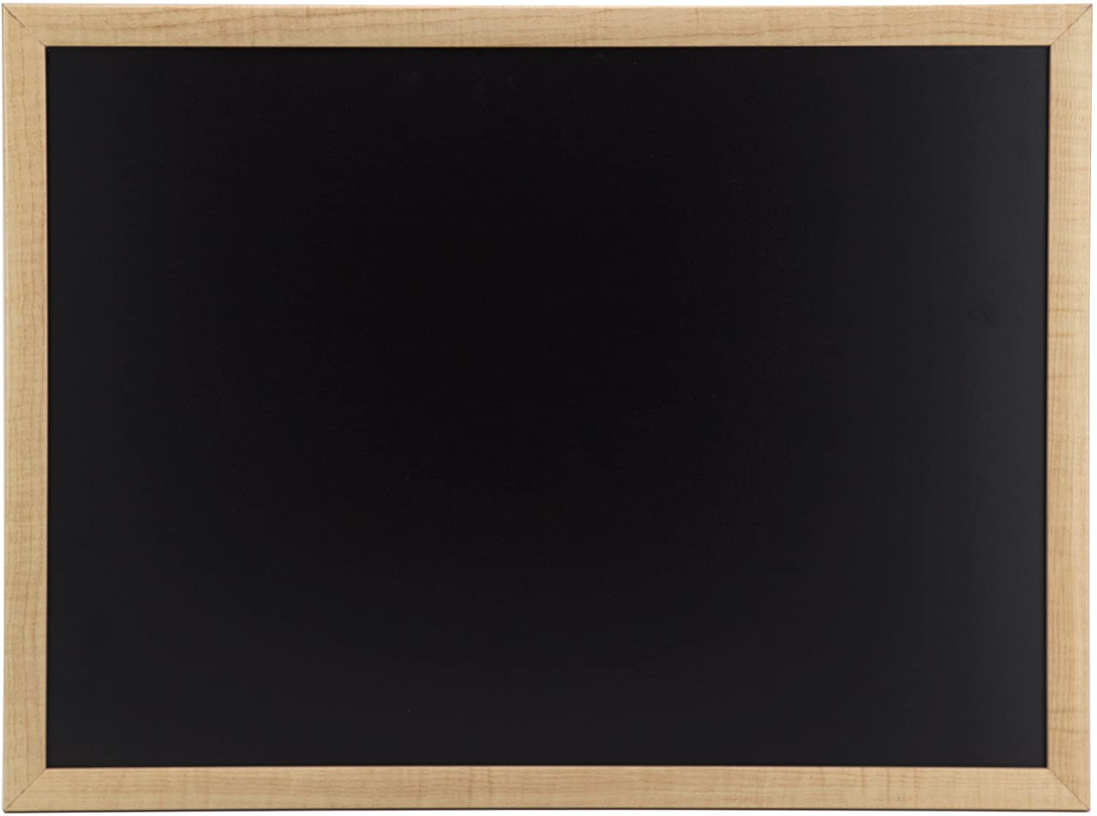
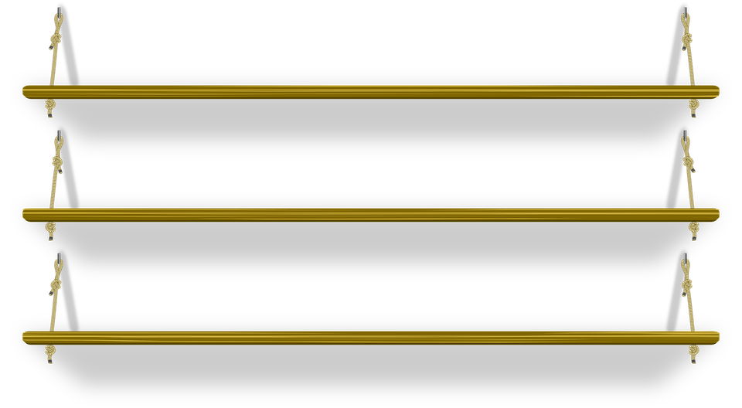
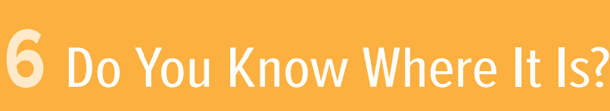
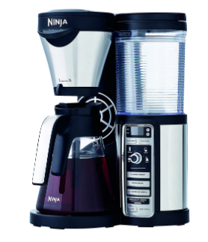
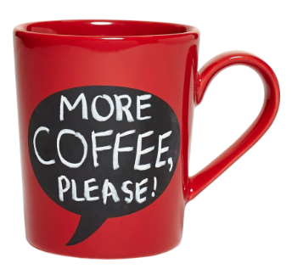
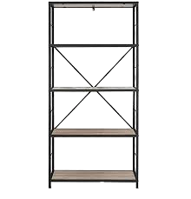
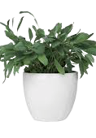
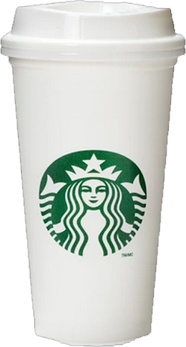
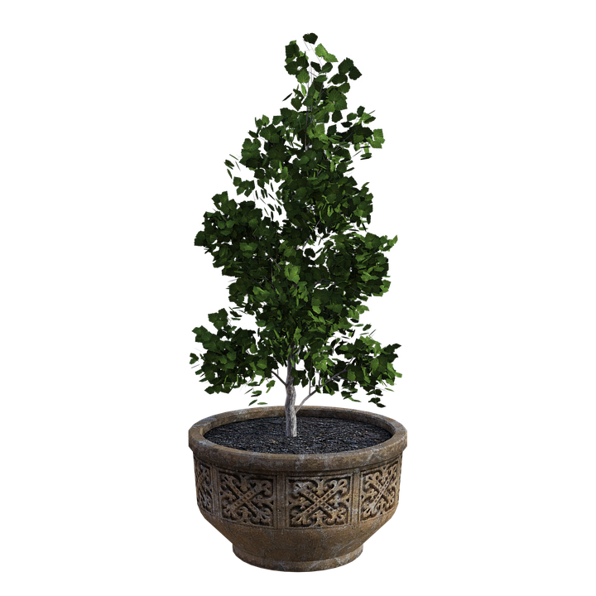

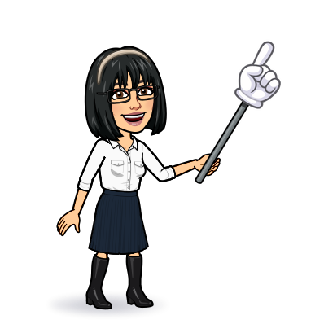
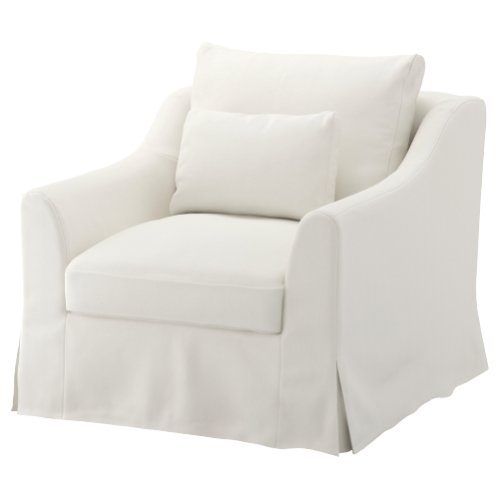
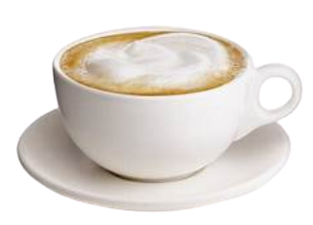
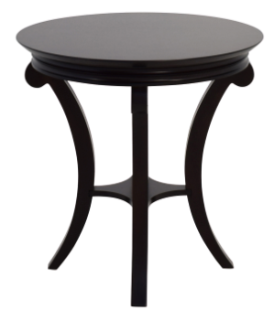
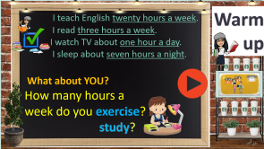
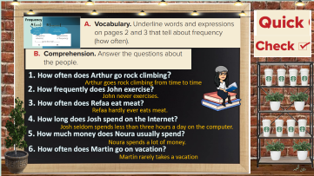

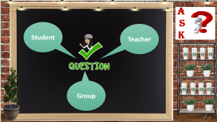
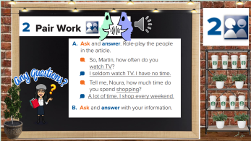
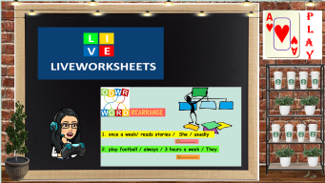
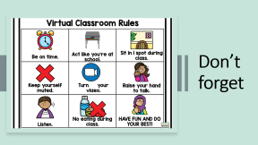
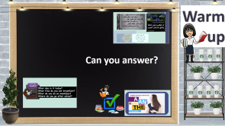
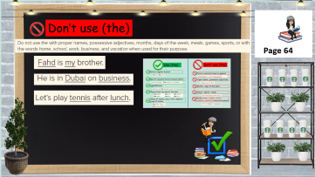
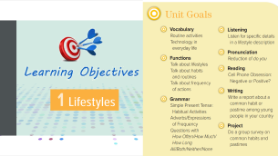
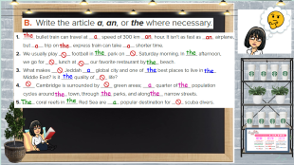
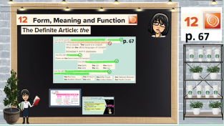
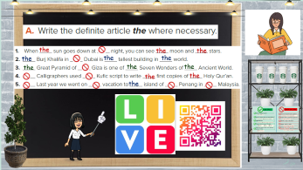
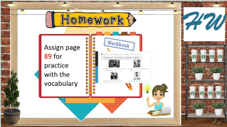
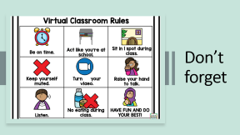
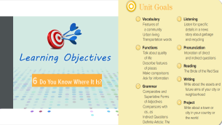
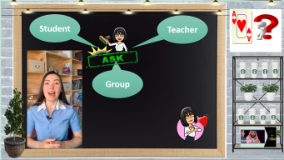
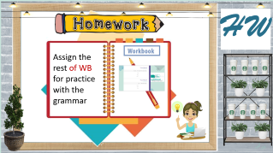
Match each paragraph with its main idea
Match each paragraph with its main idea
Form, meaning & function
Today:
date: / / 1443
Goals:
use definite article: the
Differentiate between (the) – (a – an )
Identify when NOT to use (the).

Slide 2
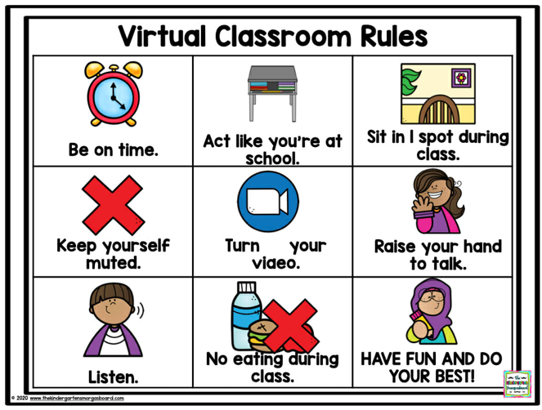
Don’t forget

Slide 3

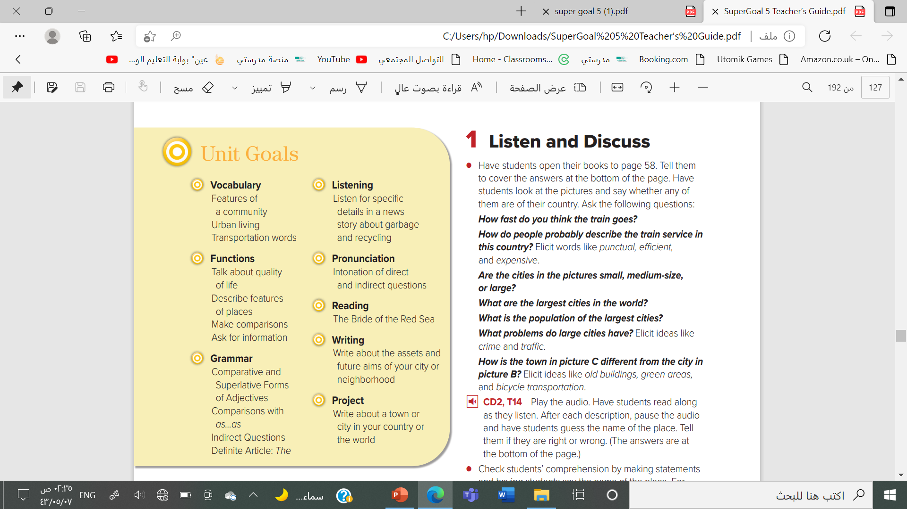


Slide 4
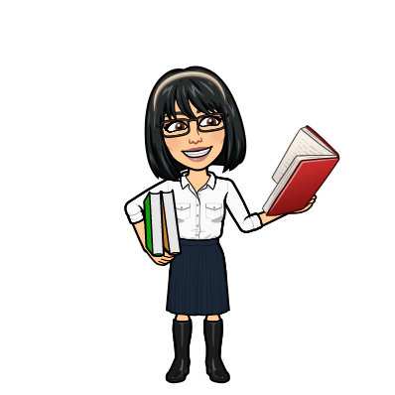


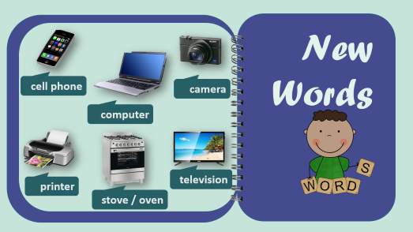
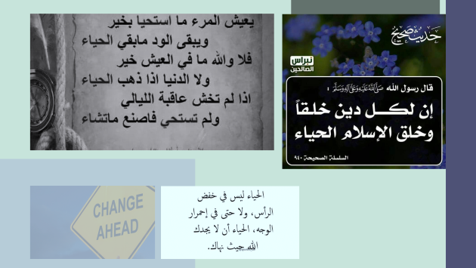
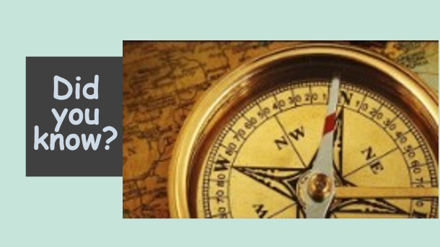

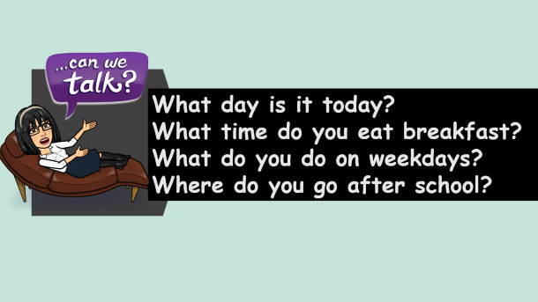

Warm up
Can you answer?
تصميم: اماني التركي
دلال الجعيد

Slide 5
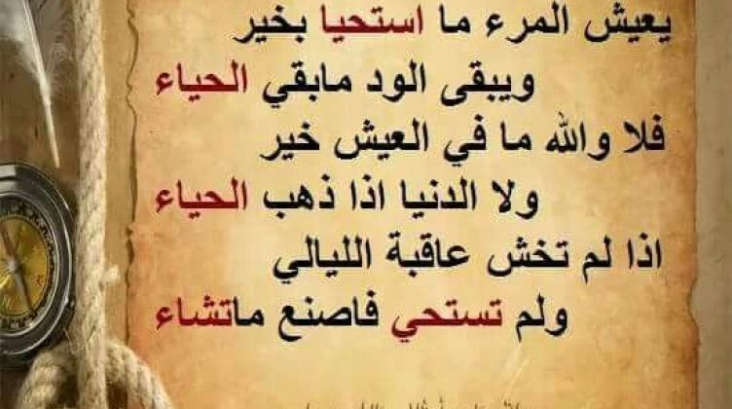


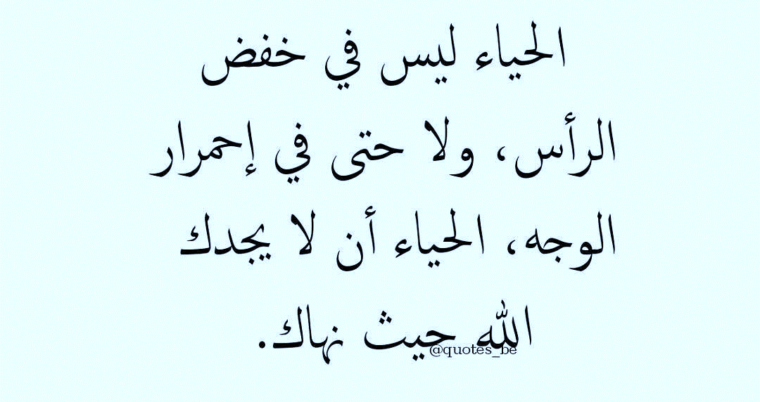

Slide 6

What day is it today?
What time do you eat breakfast?
What do you do on weekdays?
Where do you go after school?

Slide 7
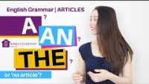

Slide 8
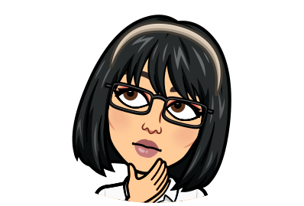

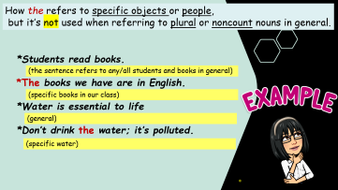
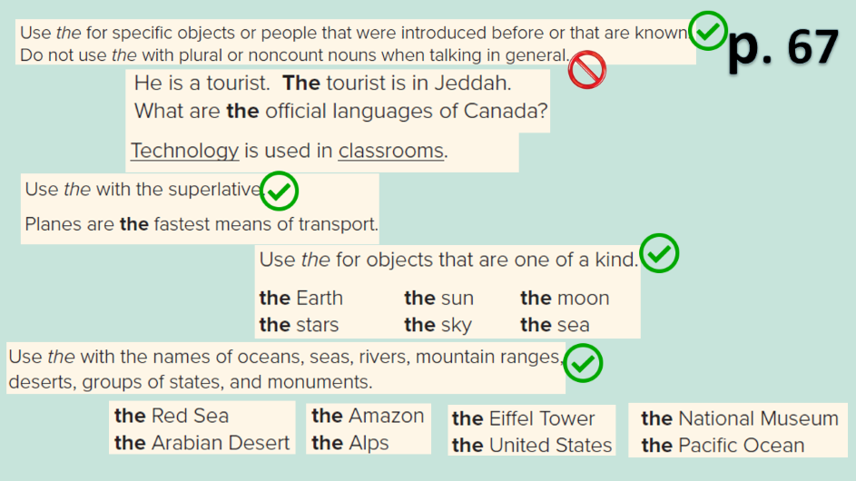
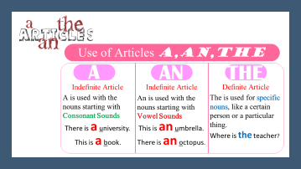

p. 67
تصميم: اماني التركي
دلال الجعيد

Slide 9

How the refers to specific objects or people,
but it’s not used when referring to plural or noncount nouns in general.
*Students read books.
*The books we have are in English.
*Water is essential to life
*Don’t drink the water; it’s polluted.
(the sentence refers to any/all students and books in general)
(specific books in our class)
(general)
(specific water)

Slide 10
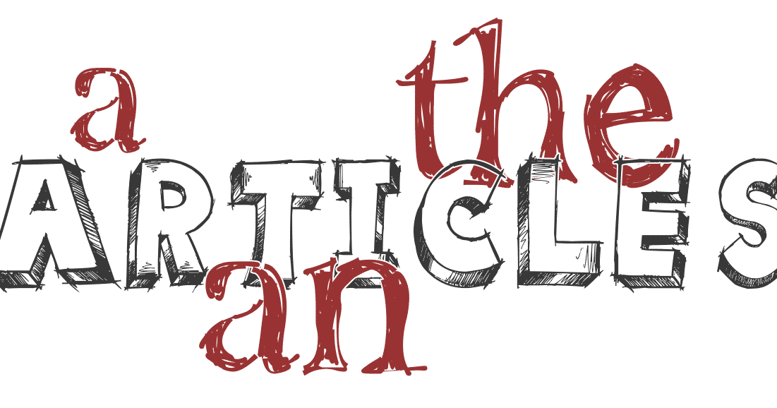
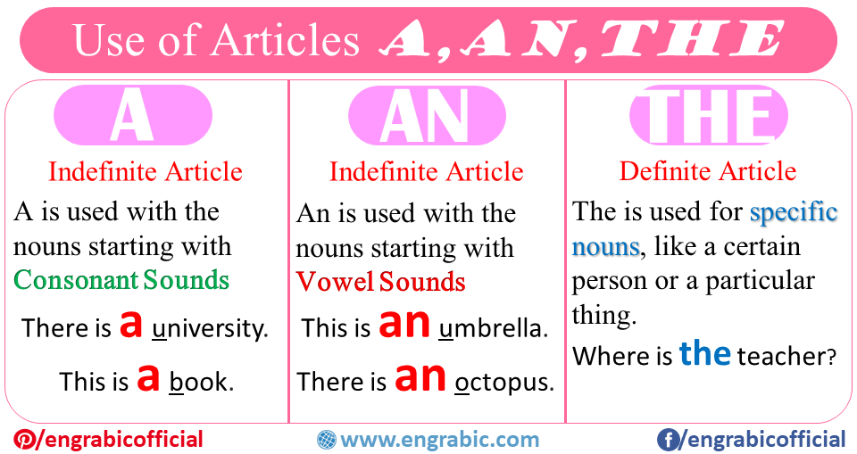

Slide 11



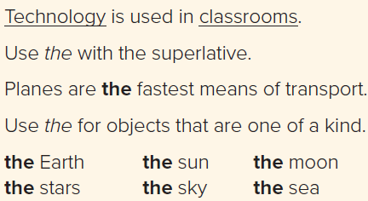






p. 67

Slide 12





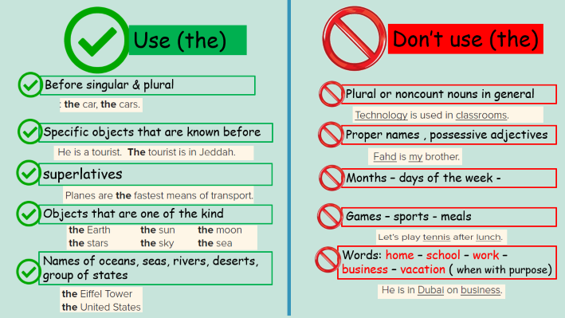






Don’t use (the)
Page 64
تصميم: اماني التركي
دلال الجعيد

Slide 13
Use (the)
Don’t use (the)
Before singular & plural
Plural or noncount nouns in general
Specific objects that are known before
Proper names , possessive adjectives
superlatives
Months – days of the week -
Objects that are one of the kind
Games – sports - meals
Names of oceans, seas, rivers, deserts, group of states
Words: home – school – work – business – vacation ( when with purpose)

Slide 14






the
the
the
the
the
the
the
the
the
the
the
the
تصميم: اماني التركي
دلال الجعيد

Slide 15





the
a
an
an
a
the
a
the
the
the
a
the
the
the
a
the
the
the
the
The
the
a
تصميم: اماني التركي
دلال الجعيد

Slide 16








Student
Teacher
Group
تصميم: اماني التركي
دلال الجعيد

Slide 17



Slide 18





H W
Assign the rest of WB for practice with the grammar
تصميم: اماني التركي
دلال الجعيد

Slide 19



