Slide 1

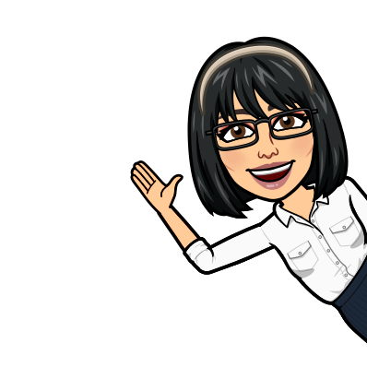


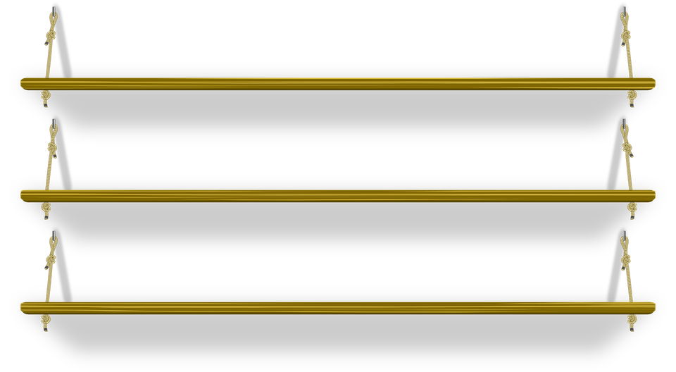
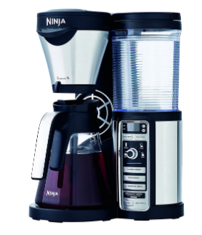

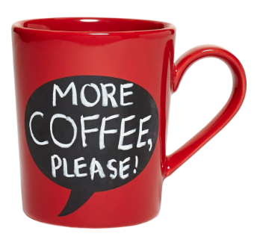
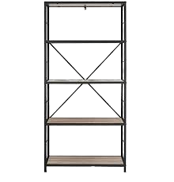
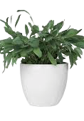
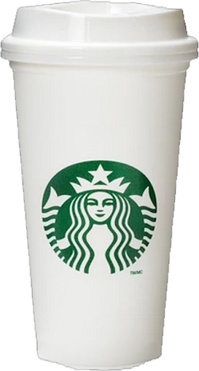
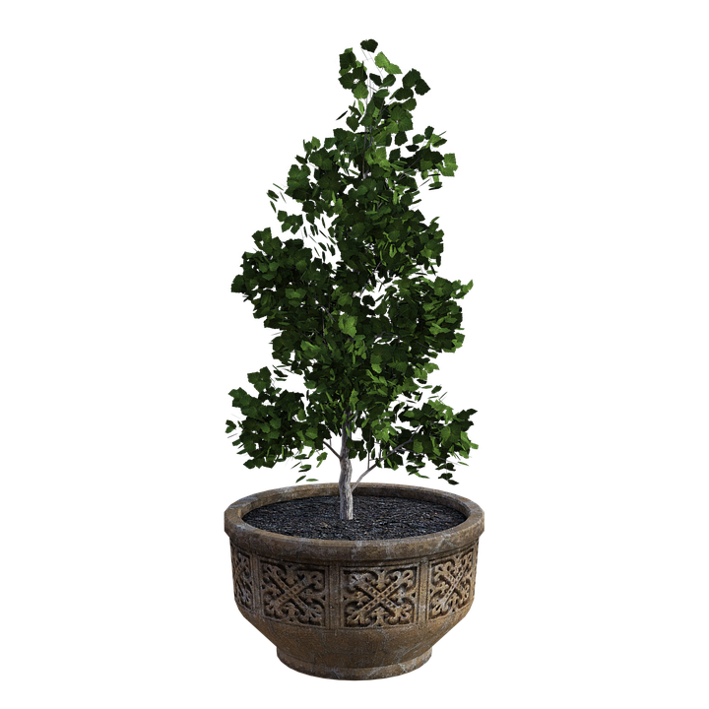

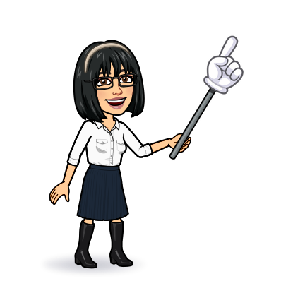

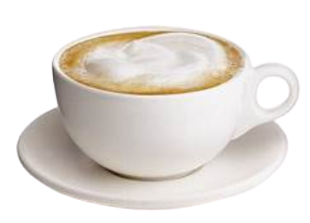
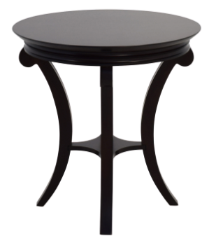
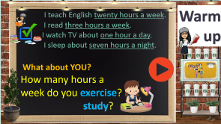
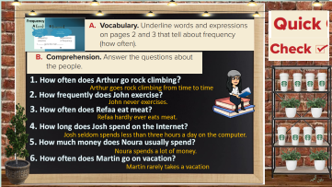

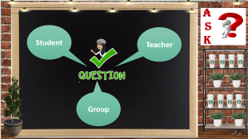
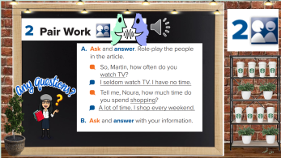
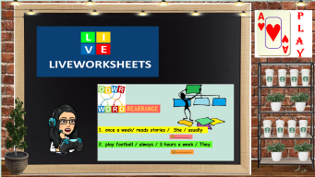
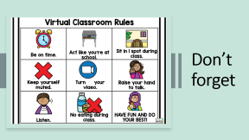
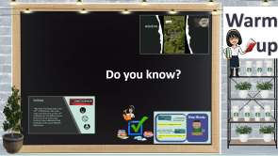
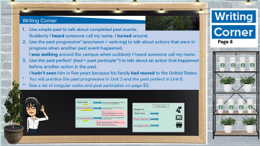
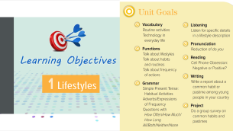
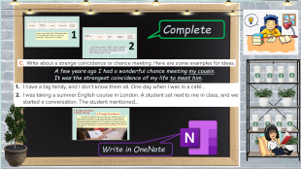
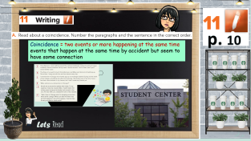
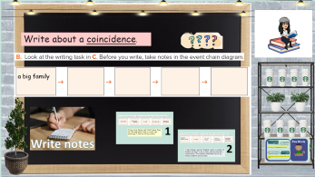
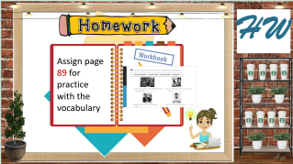
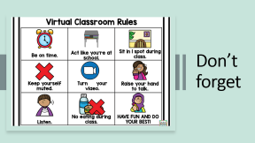
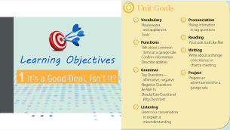
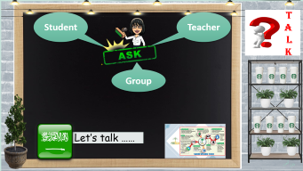
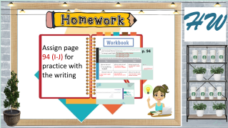
Writing
Today:
date: / / 1443
Goals:
Reorder a paragraph
Differentiate between past tenses
Write about a strange coincidence

Slide 2
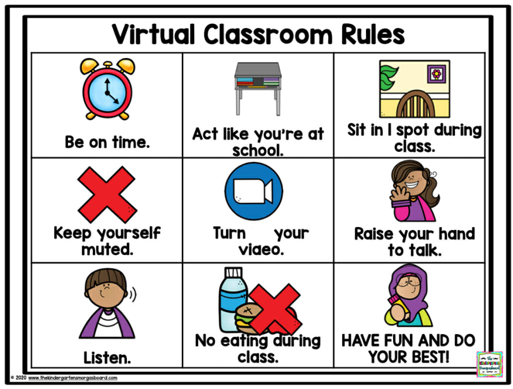
Don’t forget

Slide 3

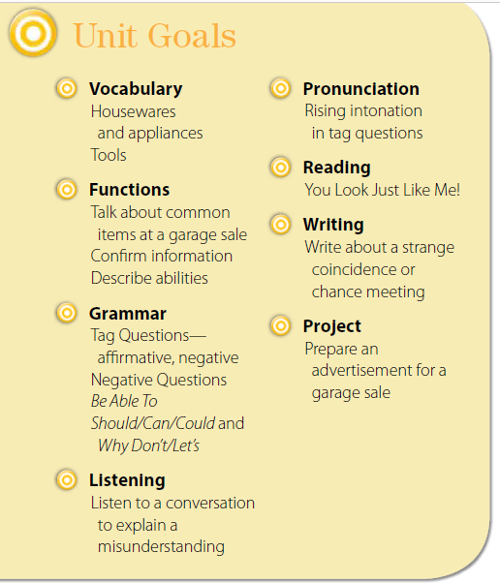


Slide 4
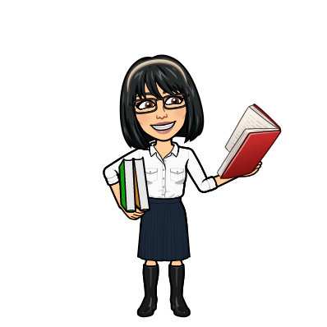


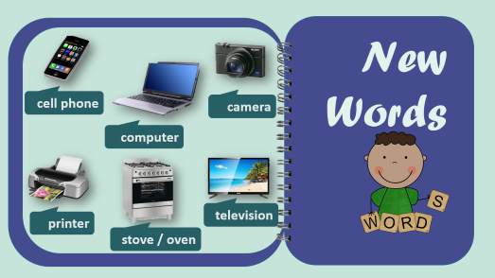
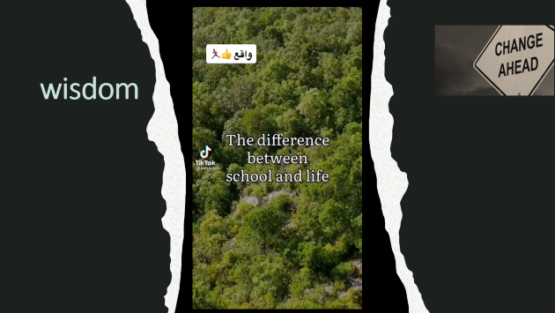
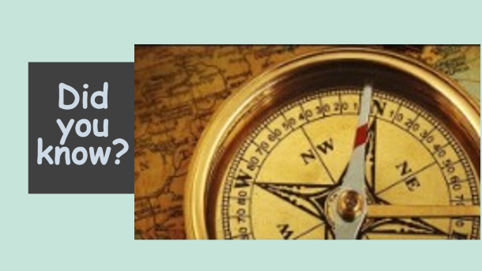
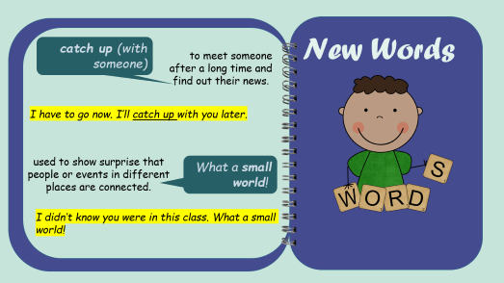
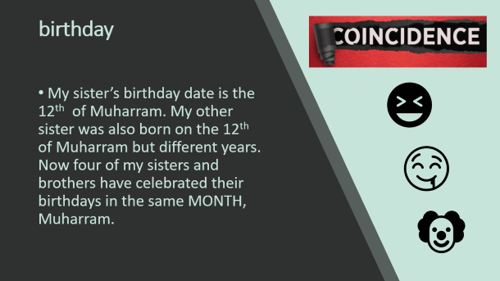
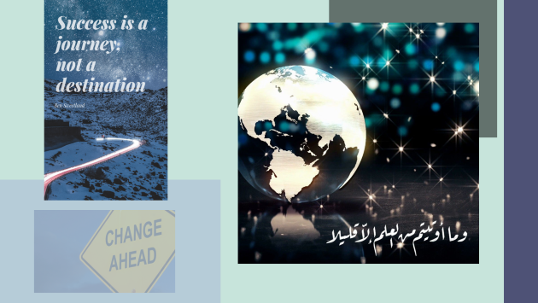
Warm up
Do you know?
تصميم: اماني التركي
دلال الجعيد

Slide 5

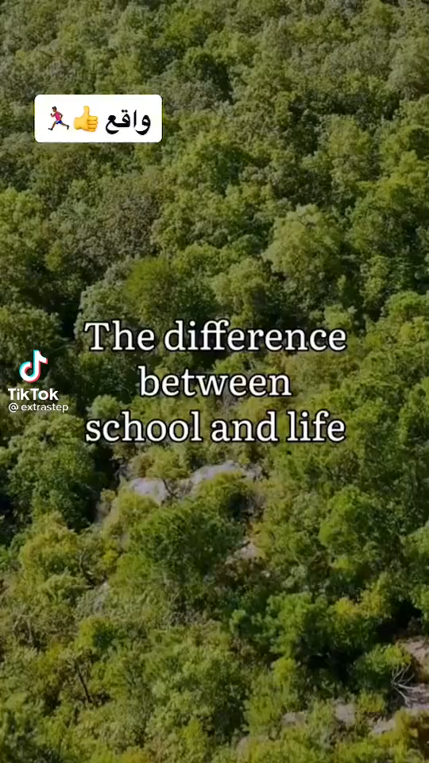

wisdom

Slide 6




birthday
My sister’s birthday date is the 12th of Muharram. My other sister was also born on the 12th of Muharram but different years. Now four of my sisters and brothers have celebrated their birthdays in the same MONTH, Muharram.

Slide 7
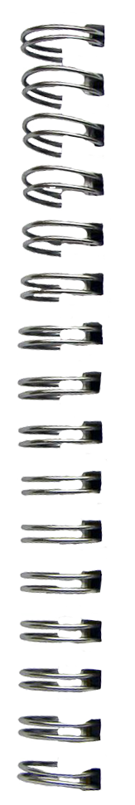
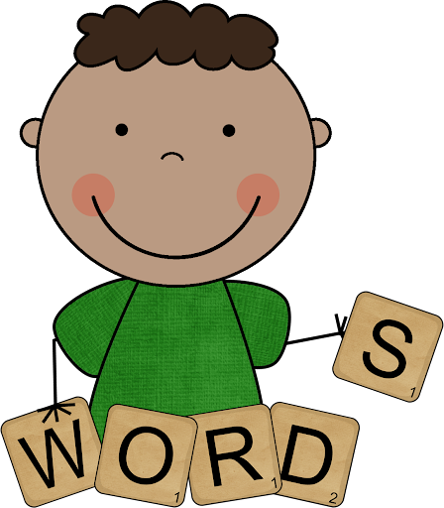
New Words
catch up (with someone)
to meet someone after a long time and find out their news.
I have to go now. I’ll catch up with you later.
used to show surprise that people or events in different places are connected.
What a small world!
I didn’t know you were in this class. What a small world!

Slide 8
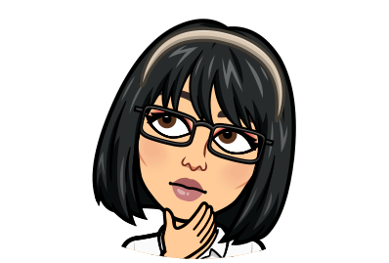


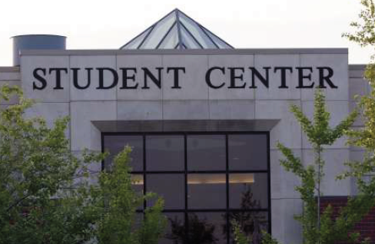
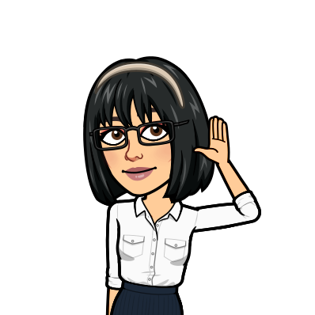
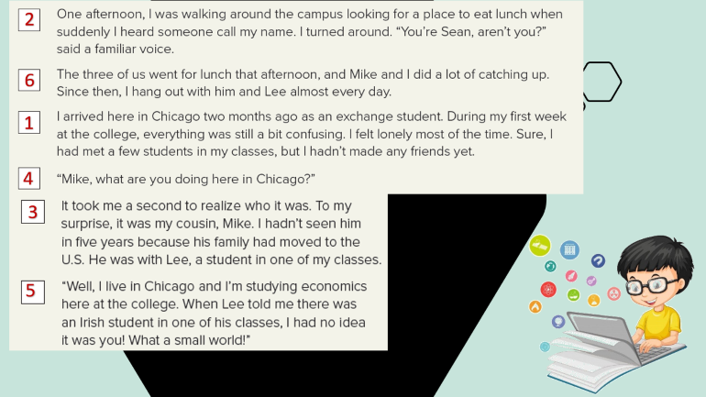
p. 10
Coincidence = two events or more happening at the same time
events that happen at the same time by accident but seem to have some connection
تصميم: اماني التركي
Lets Read
دلال الجعيد

Slide 9
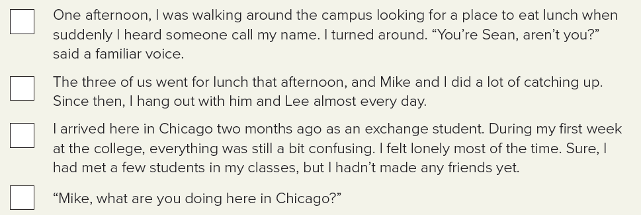
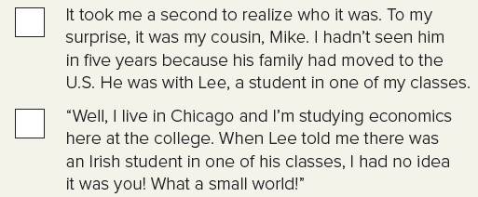
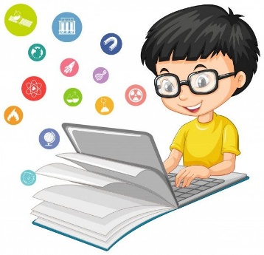
2
6
1
4
3
5

Slide 10
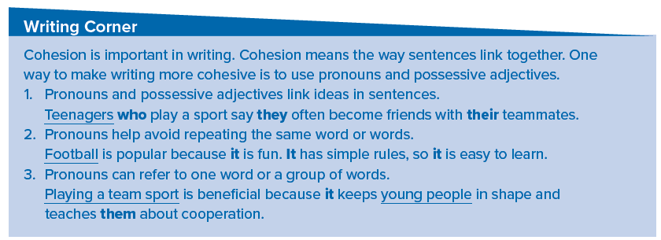
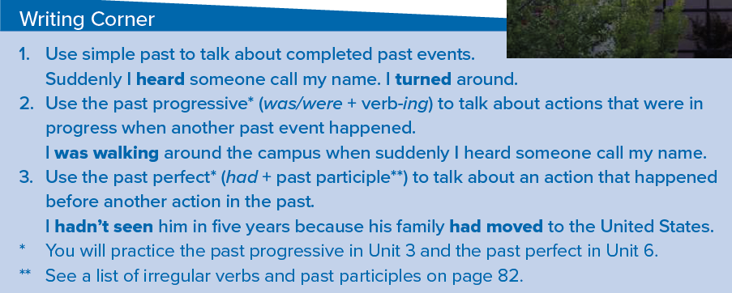
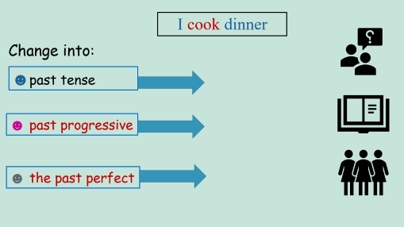




Page 8
تصميم: اماني التركي
دلال الجعيد

Slide 11
☻past tense
☻to describe things that happened and finished
in the past, that is, completed actions.
(V2 ) -ed.
☻ past progressive
☻ to talk about an action that started and was
continuing in the past
(was/were + verb + -ing).
e.g.
(cook dinner / phone rang)
(She was cooking dinner when the phone rang.)
sit in a café / saw an old friend
(I was sitting in a café when I saw an old friend.)
☻ the past perfect
☻ to show that the one action happened before another past action.
(had + V3)
e.g.
he couldn’t open the door because / forgot keys
(He couldn’t open the door because he had forgotten his keys.)
train left / when I got to the station
(The train had left when I got to the station.)

Slide 12



I cook dinner
Change into:
☻past tense
☻ past progressive
☻ the past perfect

Slide 13










Write about a coincidence.
a big family
Write notes
تصميم: اماني التركي
دلال الجعيد

Slide 14
a big family
don’t know
them all
saw one of
my cousins
in a café
two years ago
1
I have a big family, and I don’t know them all. One day when I was in a café, two years ago, I saw one of my cousins.

Slide 15
a summer
English course
mentioned
my family
and my town
sat next
to me
started a
conversation
in London
2
I was taking a summer English course in London. A student sat next to me in class, and we started a conversation. The student mentioned one of my family members and my town.

Slide 16







Complete
A few years ago I had a wonderful chance meeting my cousin.
It was the strangest coincidence of my life to meet him.
تصميم: اماني التركي
Write in OneNote
دلال الجعيد

Slide 17

A Strange Coincidence
A Chance Meeting
A Strange Coincidence
One day last week. My father and I were out shopping in town. We were looking for a present for my uncle. So we went to a mug shop. My father saw a really nice mug on the shelf. My father said your uncle will like that because he drinks a lot of tea. I picked it up to look for the price and it was the shop assistant's own mug. I was very happy to know that the shop assistant is my cousin. It was the strangest coincidence of my life to meet him.

Slide 18






T
A
L
K
Student
Teacher
Group
Let’s talk ……
تصميم: اماني التركي
دلال الجعيد

Slide 19



Slide 20








H W
Assign page 94 (I-J) for practice with the writing
تصميم: اماني التركي
دلال الجعيد

Slide 21



Slide 22



p. 94
I’m learning to play tennis.
I’m learning to cook.
I’m learning to surf.
I am able to have a conversation in English.
I will be able to speak fluently.
I wasn’t able to speak English.
I am not able to understand every word.
I won’t be able to speak without an accent..

Slide 23


Three years ago I wasn’t able to speak English. I was only able to say the alphabet. Now I’m able to speak English and have a conversation. It’s fun! I’m still not able to understand every word. But I’m patient. Soon I’ll be able to speak fluently. I know I won’t be able to speak English exactly like an American because I’ll always have an accent. But that’s OK. It’s still a lot of fun!

