Slide 1


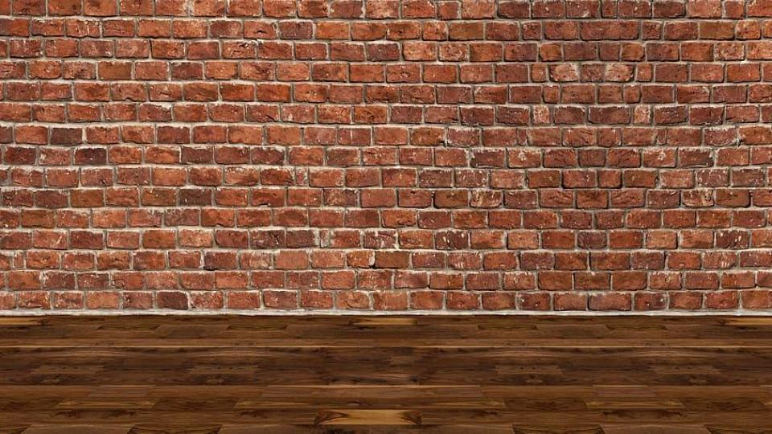

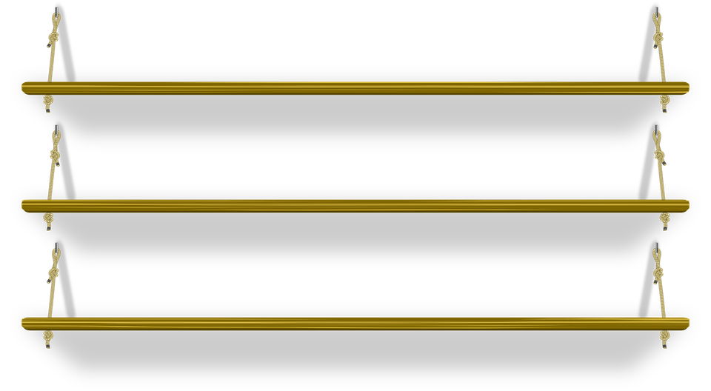
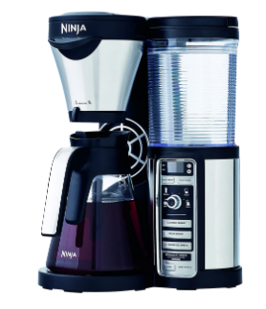


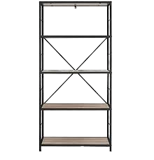
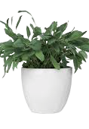
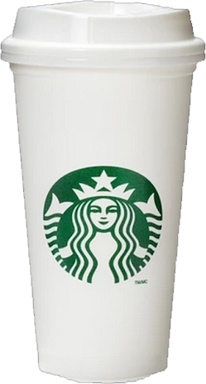
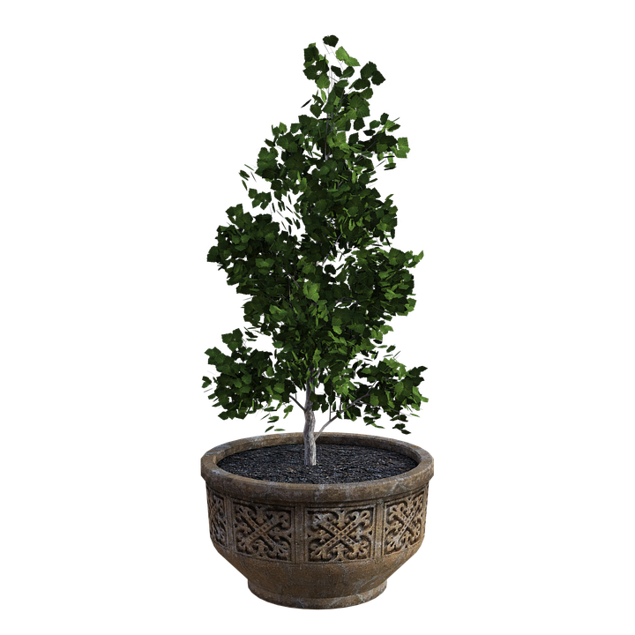




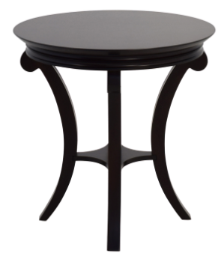
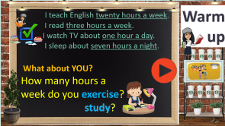
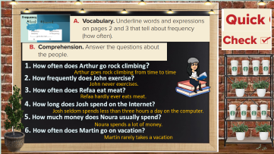

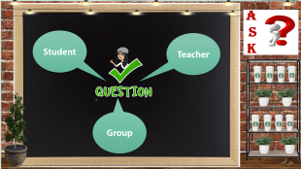
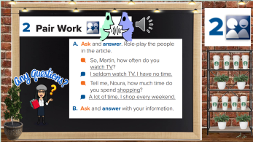
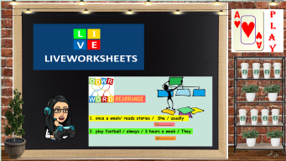
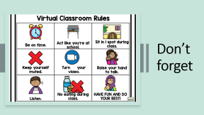
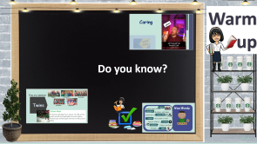
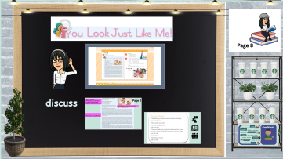
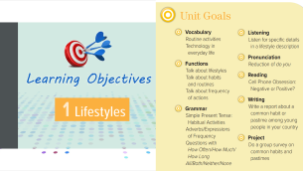
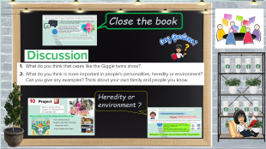
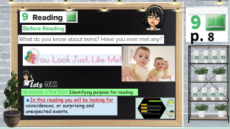
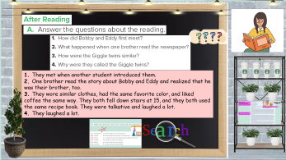
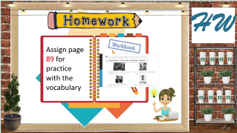
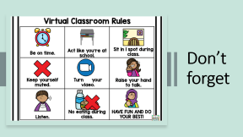
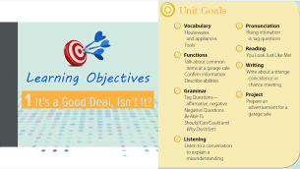
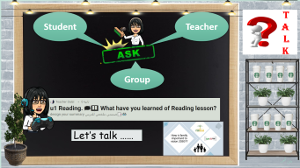
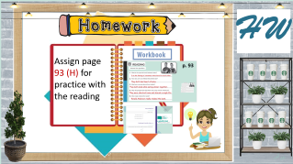
Reading
Today:
date: / / 1443
Goals:
Read a text to find the meaning of new words.
Answer questions about a text
Design a garage sale advertisement

Slide 2
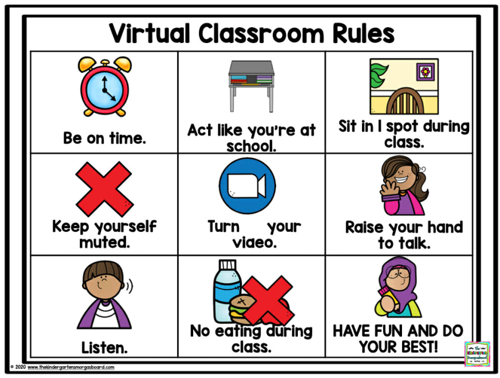
Don’t forget

Slide 3

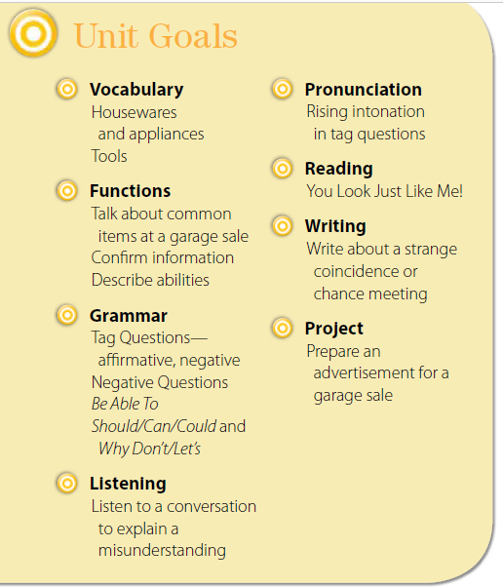


Slide 4
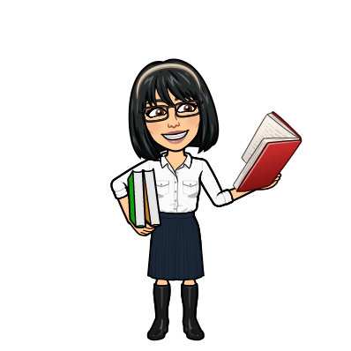


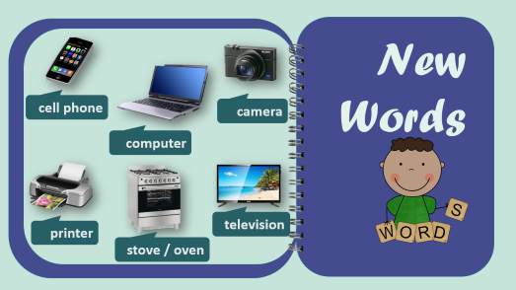
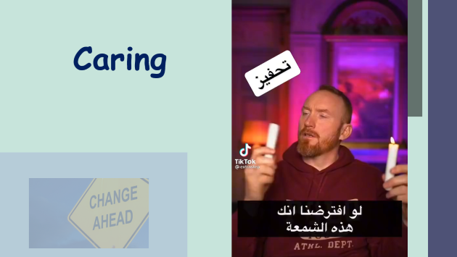
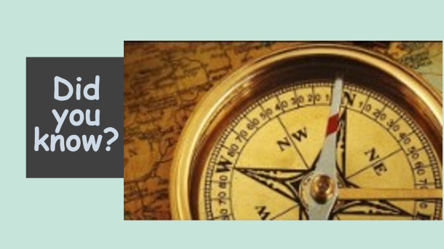
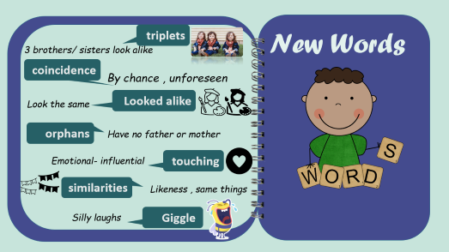
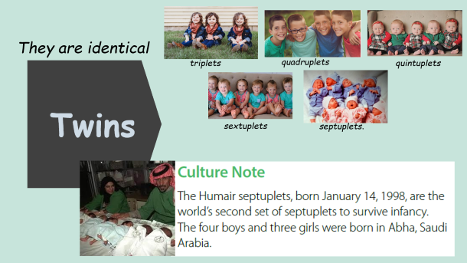

Warm up
Do you know?
تصميم: اماني التركي
دلال الجعيد

Slide 5
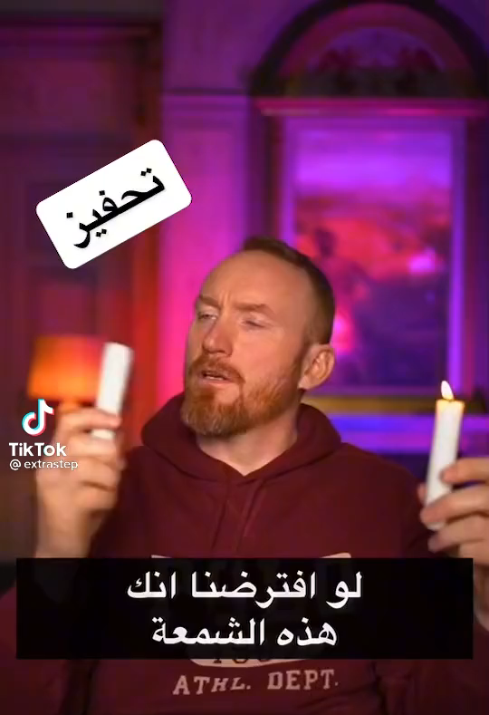

Caring

Slide 6
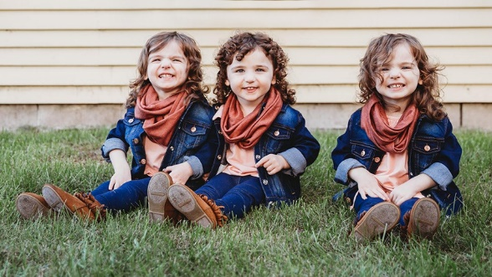
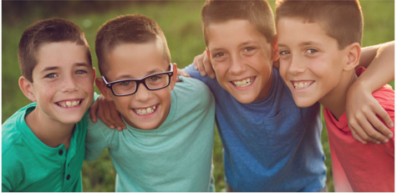
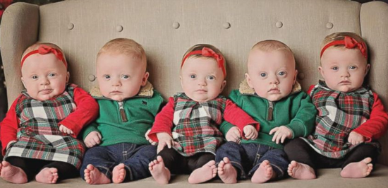
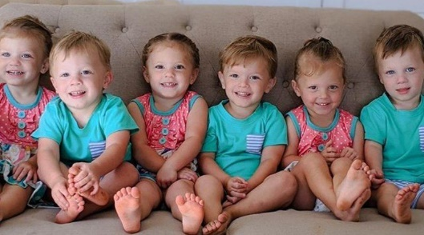
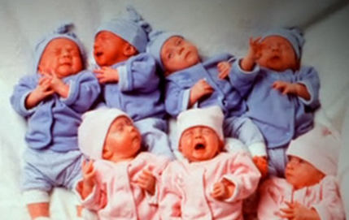
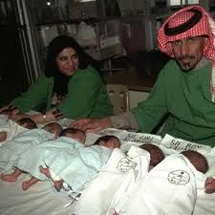
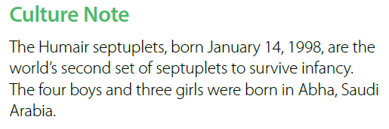
They are identical
triplets
quadruplets
quintuplets
Twins
sextuplets
septuplets.

Slide 7
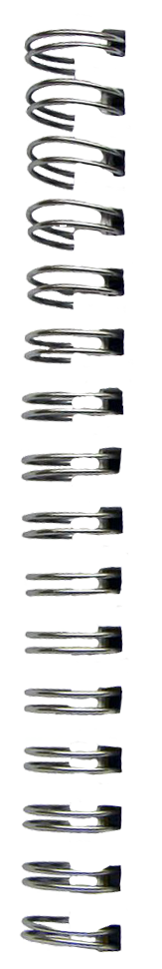
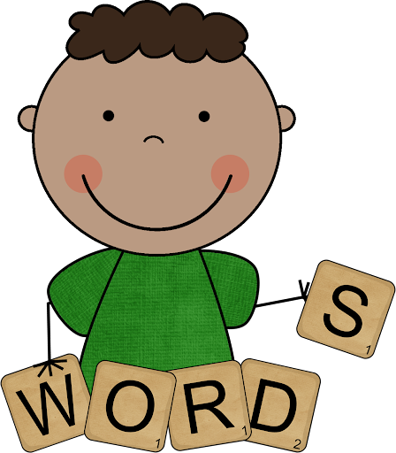






triplets
New Words
3 brothers/ sisters look alike
coincidence
By chance , unforeseen
Looked alike
Look the same
orphans
Have no father or mother
Emotional- influential
touching
similarities
Likeness , same things
Silly laughs
Giggle

Slide 8

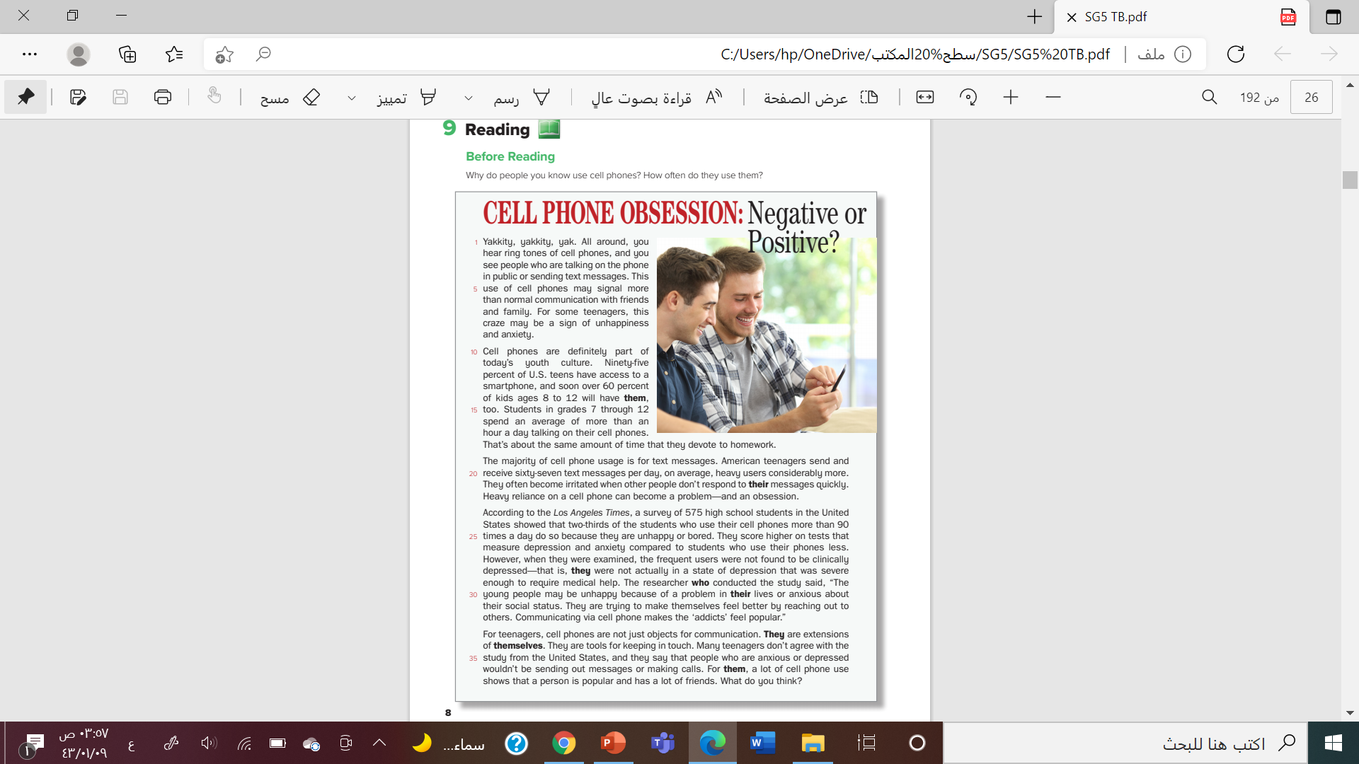



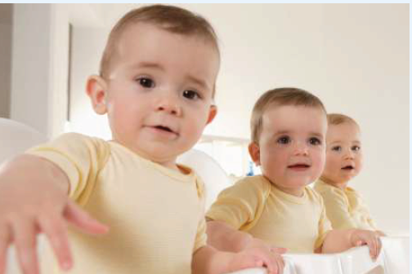


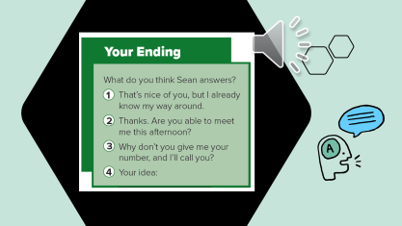
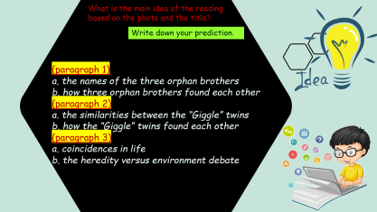
p. 8
Lets GUESS
READING STRATEGY Identifying purpose for reading
☻In this reading you will be looking for
coincidences, or surprising and unexpected events.
تصميم: اماني التركي
دلال الجعيد

Slide 9



What is the main idea of the reading
based on the photo and the title?
Write down your prediction.
(paragraph 1)
a. the names of the three orphan brothers
b. how three orphan brothers found each other
(paragraph 2)
a. the similarities between the “Giggle” twins
b. how the “Giggle” twins found each other
(paragraph 3)
a. coincidences in life
b. the heredity versus environment debate

Slide 10

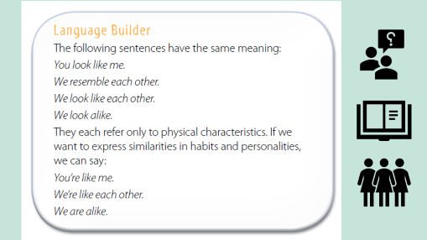

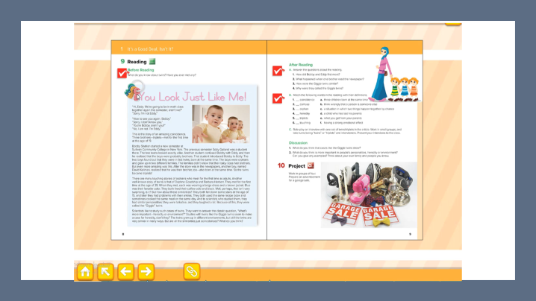
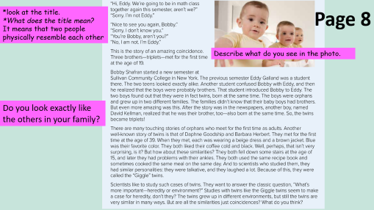

Page 8
discuss
تصميم: اماني التركي
دلال الجعيد

Slide 11


Slide 12

*look at the title.
*What does the title mean?
It means that two people
physically resemble each other
Page 8
Describe what do you see in the photo.
Do you look exactly like the others in your family?

Slide 13





Slide 14








1. They met when another student introduced them.
2. One brother read the story about Bobby and Eddy and realized that he was their brother, too.
3. They wore similar clothes, had the same favorite color, and liked coffee the same way. They both fell down stairs at 15, and they both used the same recipe book. They were talkative and laughed a lot.
4. They laughed a lot.
تصميم: اماني التركي
دلال الجعيد

Slide 15



c
b
d
e
a
f

Slide 16








Close the book
Heredity or environment ?
تصميم: اماني التركي
دلال الجعيد

Slide 17


1.They had similar personalities:
Genetics has more influence than parents do on shaping our personality
2.The common environments and experiences that children in a family share don’t make them as similar to each other as we might expect.
For examples
There are certain activities that kids in a family share—they all went together on a family vacation last year and they all had dinner with the family last night.
*Both genetic or heredity and environmental affect the personality

Slide 18

1- What are the good and bad points about being a twin?
2- Is your twin your best friend?
1. *They will attract attention from friends, family, and strangers wherever they go.
*Twins have the benefit of sharing clothes
*People that don’t know their identical twins well, or don’t see them often, have a difficult time distinguishing the pair apart.
2. Yes, she\he is.
I always hear people talk about how “my twin sister/brother is my best friend.” They always talk about how they're so close, do everything together, never want to be apart,

Slide 19






When and where to hold the garage sale and what to sell.
Pick a Good Location
Organize and Clean All Items
Advertise Online
Direct People With Signs

Slide 20







T
A
L
K
Student
Teacher
Group
Let’s talk ……
تصميم: اماني التركي
دلال الجعيد

Slide 21



How is family important to vision 2030??

Slide 22








H W
Assign page 93 (H) for practice with the reading
تصميم: اماني التركي
دلال الجعيد

Slide 23



Slide 24





p. 93
It is the feeling of closeness twins have for each other.
They both had heart attacks.
They both died while eating dinner together.
They were identical twins and shared a single life.
Ronald Anderson really robbed the bank.

Slide 25




