Slide 1

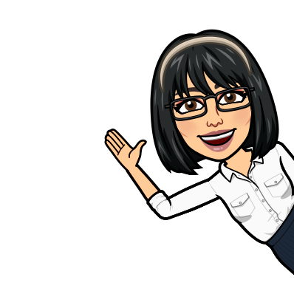
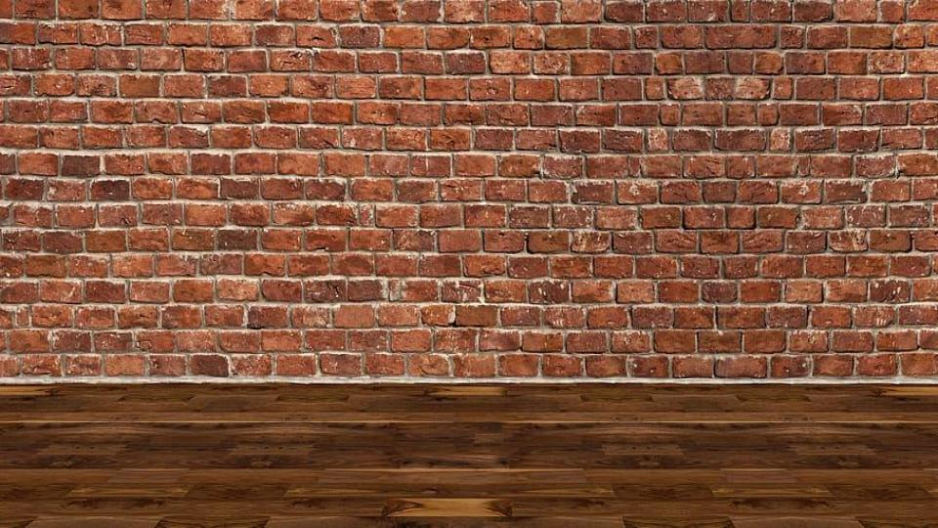

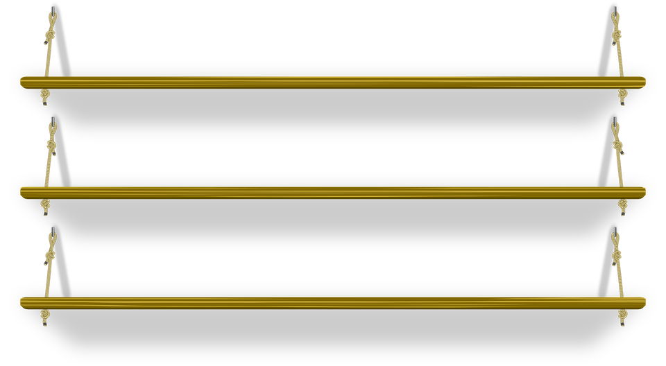
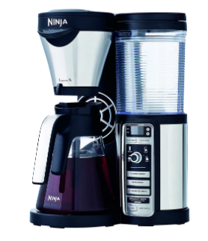

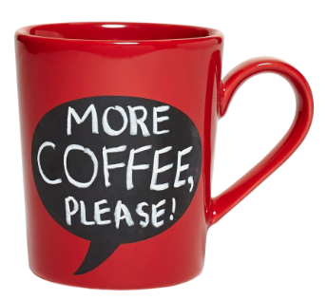
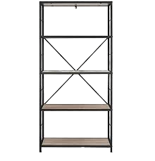
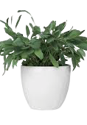
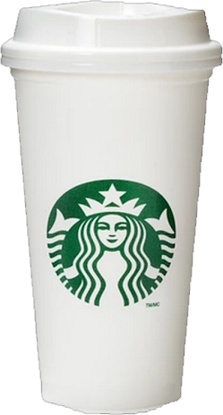
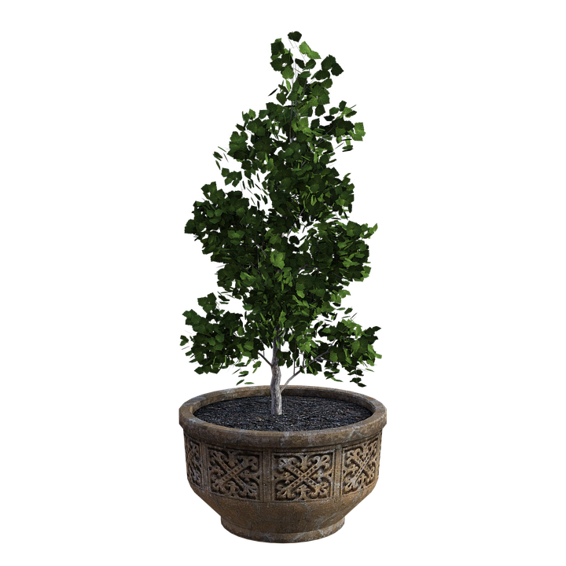

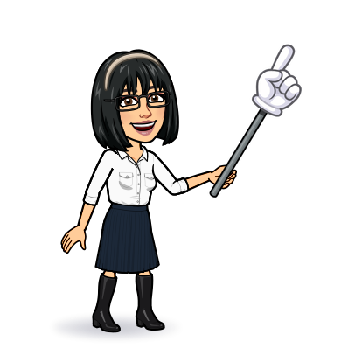

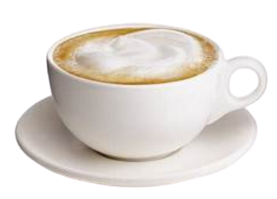
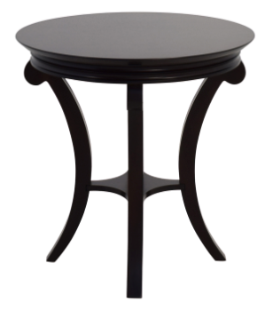
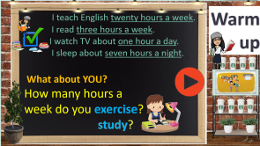
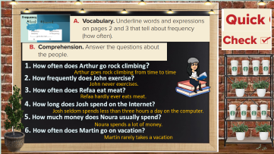

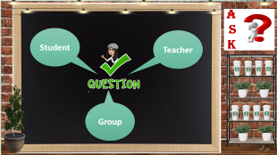
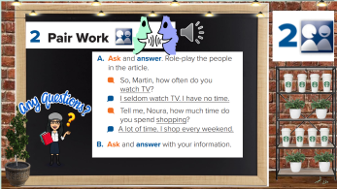

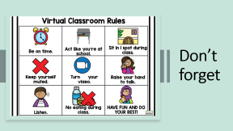
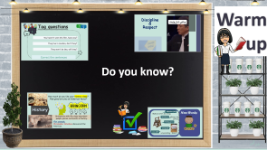
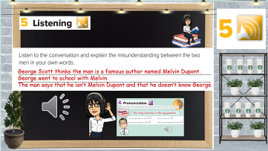
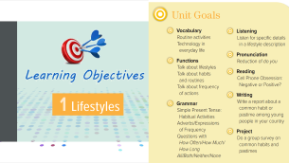
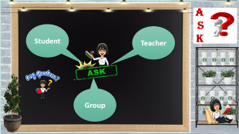
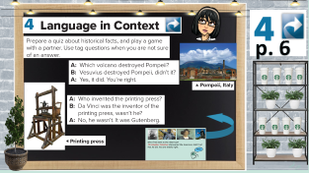
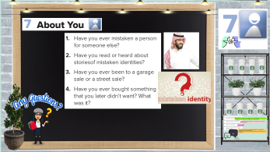

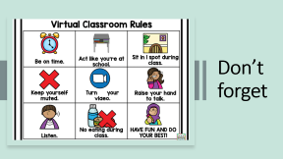
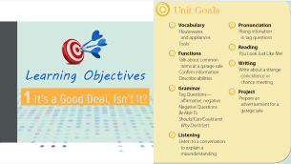
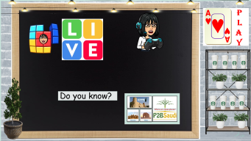
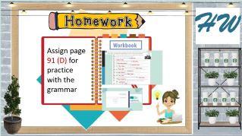
Language in context- listening
Today:
date: / / 1443
Goals:
Rephrase a text
Produce the rising intonation in tag questions
Practice a conversation

Slide 2
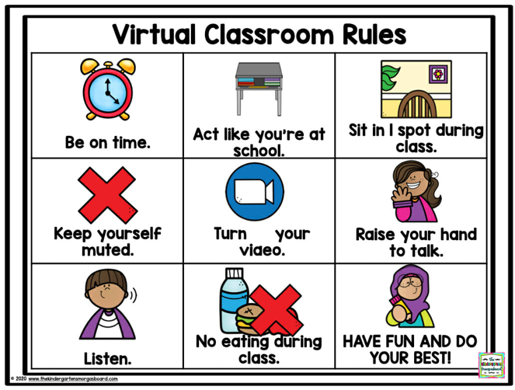
Don’t forget

Slide 3

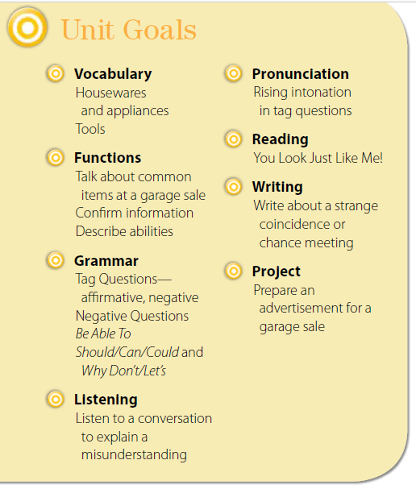


Slide 4
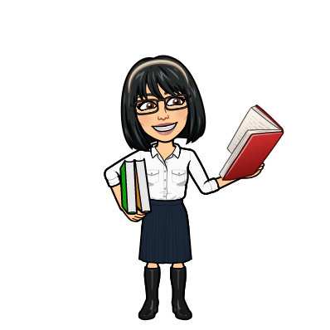


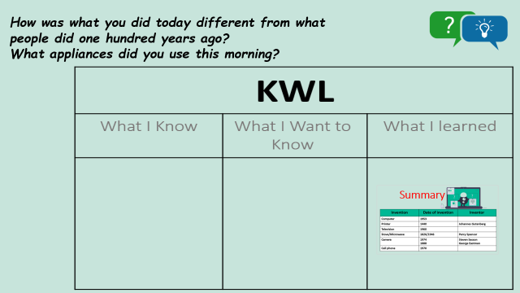
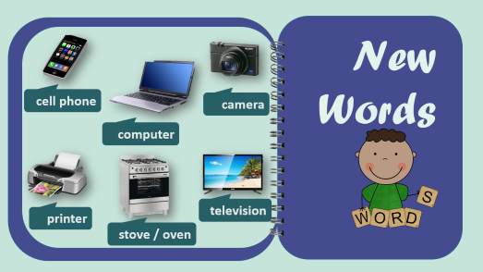
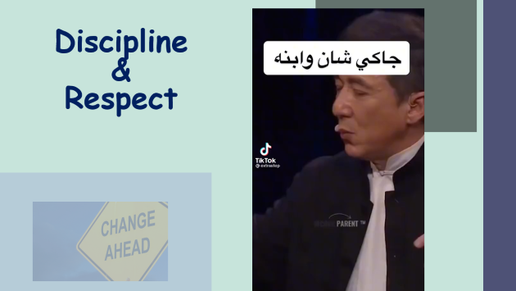
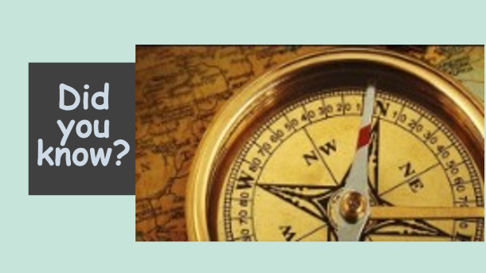
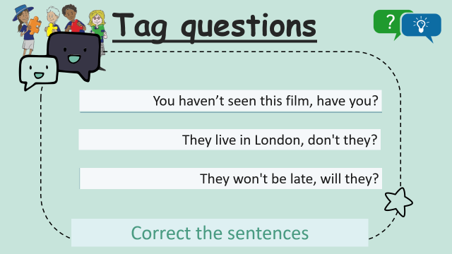
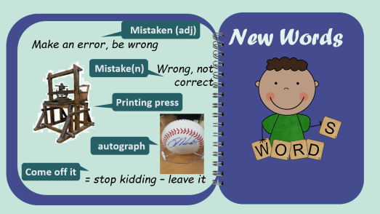
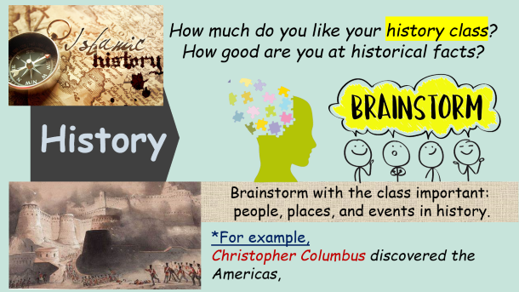

Warm up
Do you know?
تصميم: اماني التركي
دلال الجعيد

Slide 5
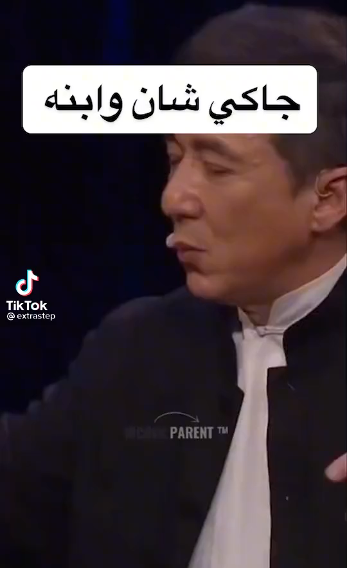

Discipline
&
Respect

Slide 6


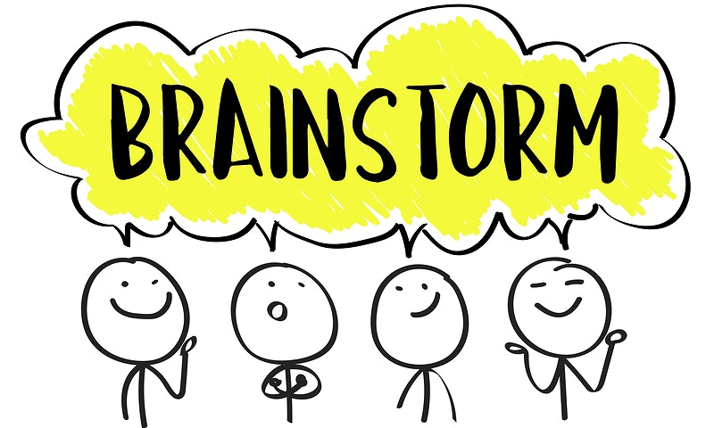
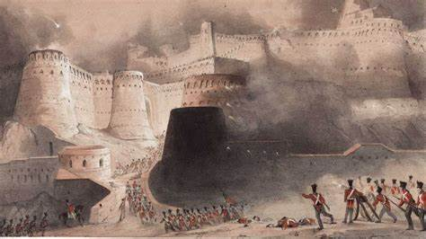

How much do you like your history class?
How good are you at historical facts?
History
Brainstorm with the class important:
people, places, and events in history.
*For example,
Christopher Columbus discovered the Americas,

Slide 7
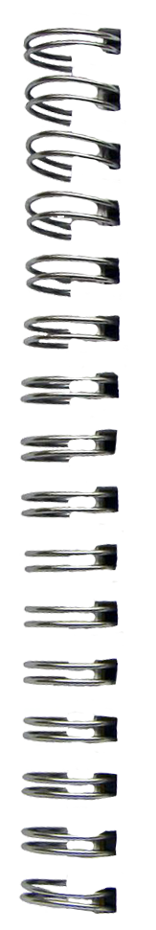
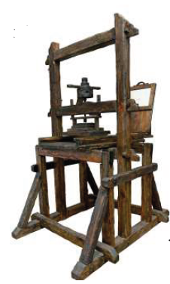
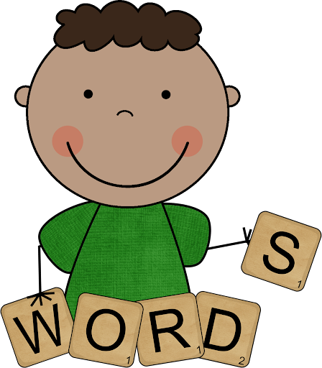
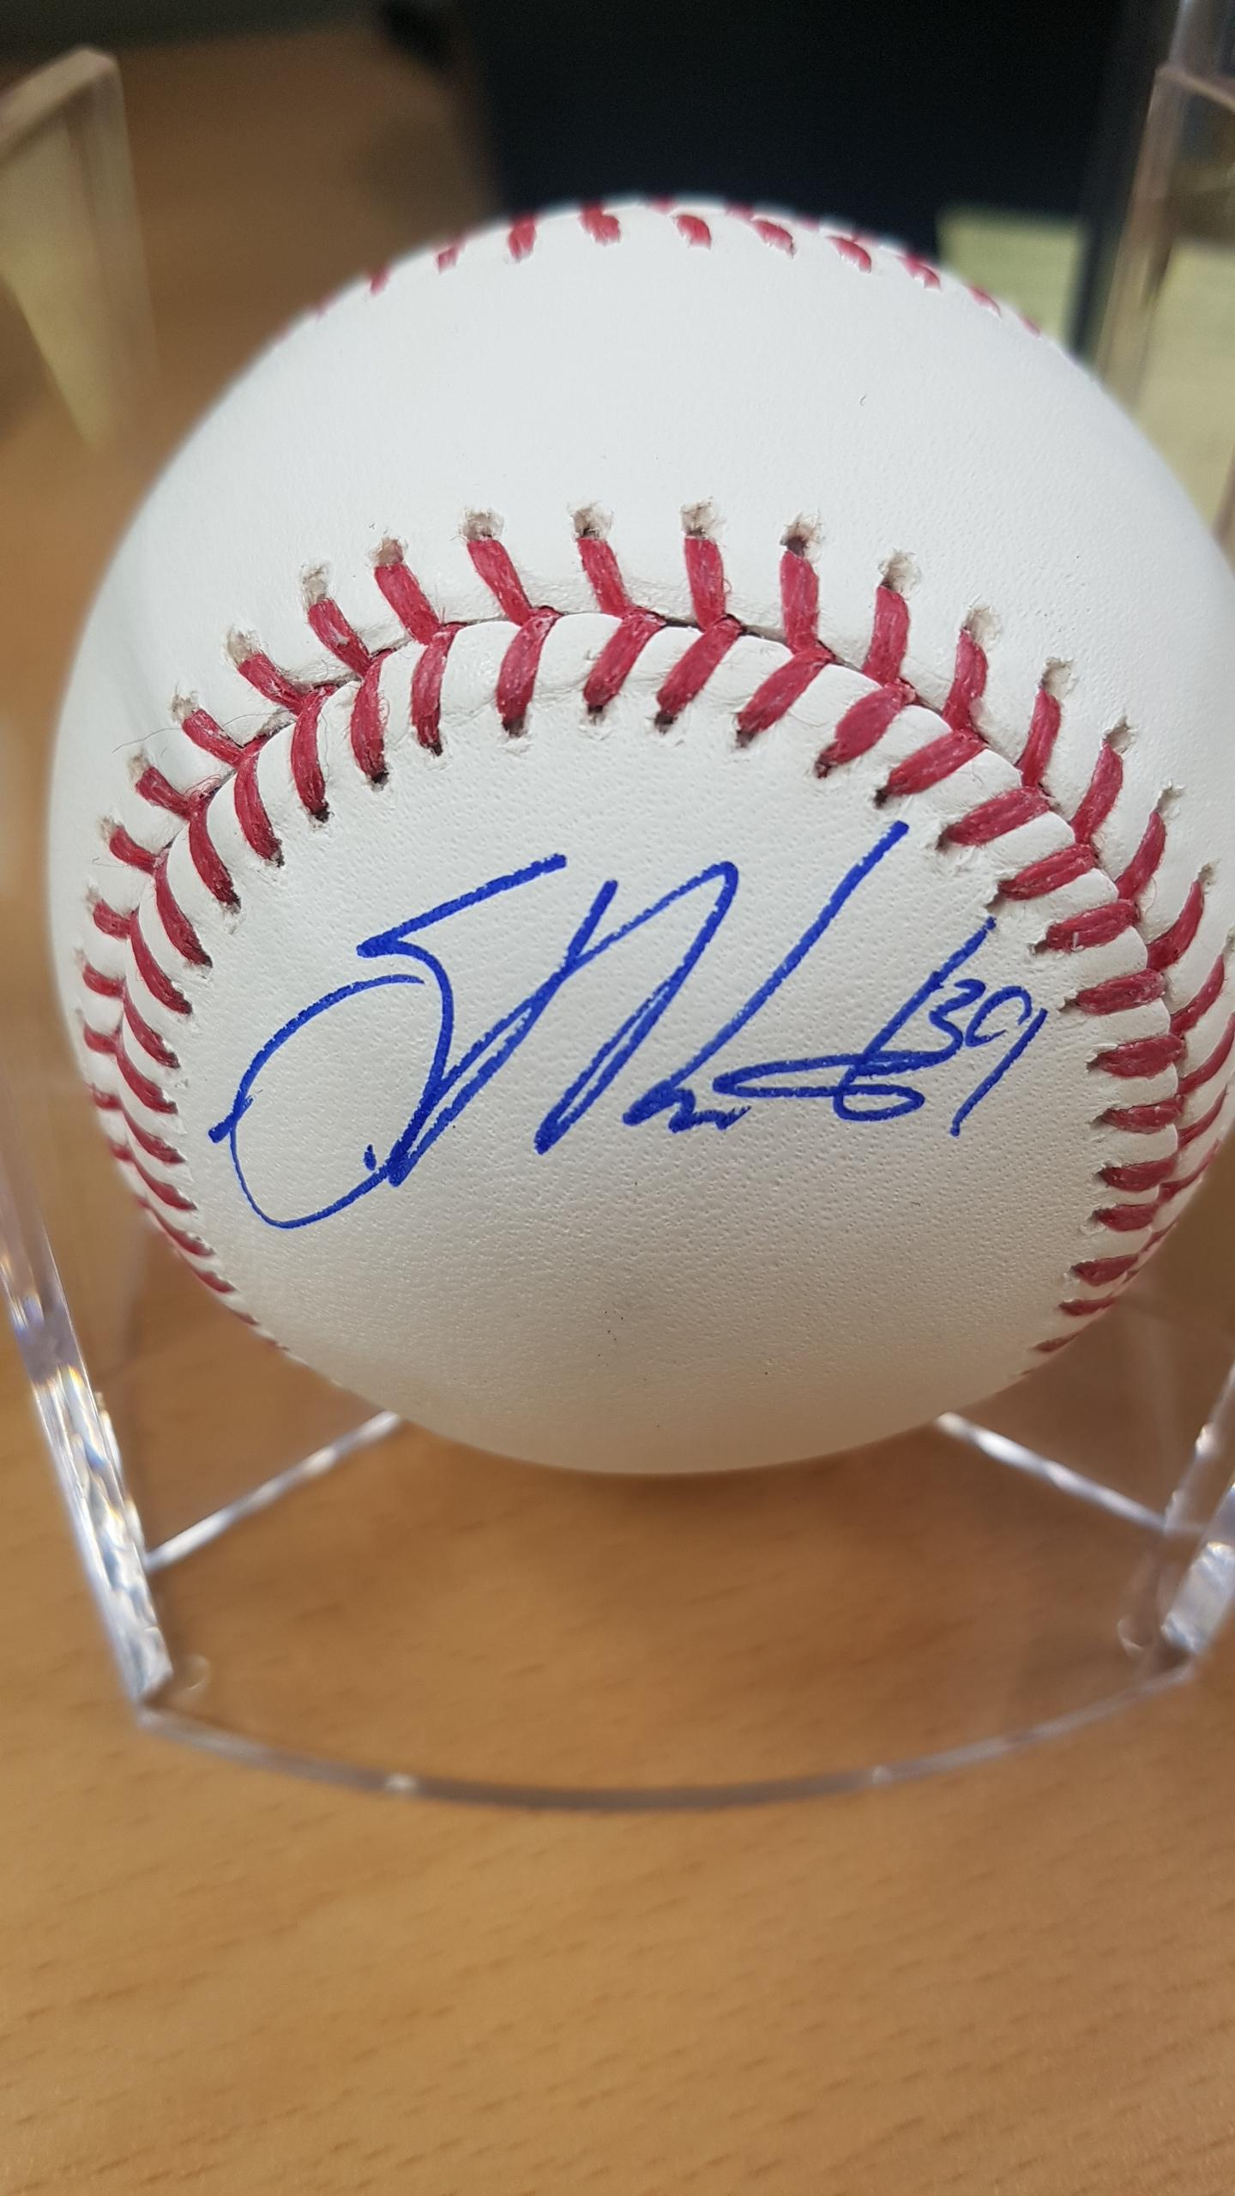
Mistaken (adj)
New Words
Make an error, be wrong
Mistake(n)
Wrong, not correct
Printing press
autograph
Come off it
= stop kidding – leave it

Slide 8
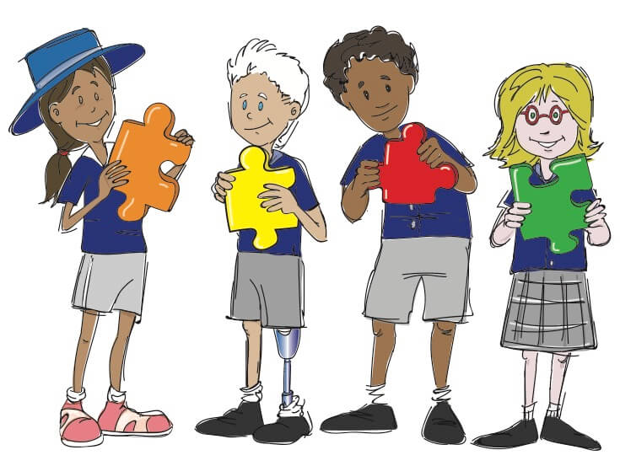

Tag questions
You haven’t seen this film, have you?
You have seen this film, have you?
They live in London, don't they?
They don’t live in London, don't they?
They won't be late, will they?
They won't be late, will she?
Correct the sentences

Slide 9
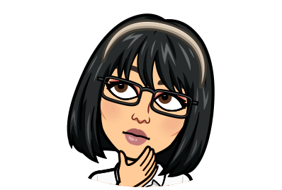
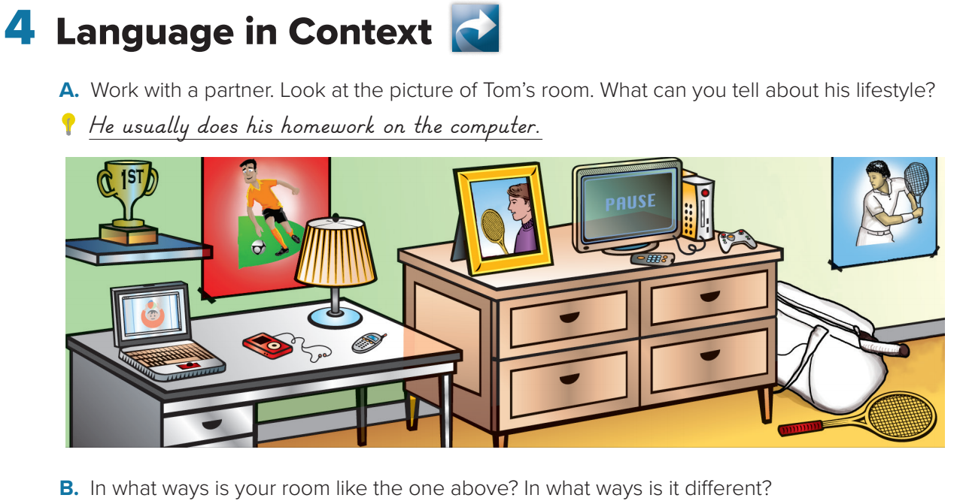


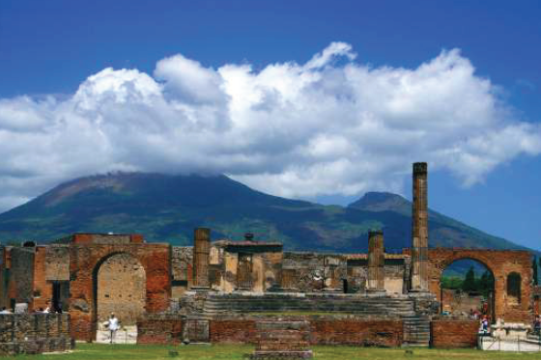
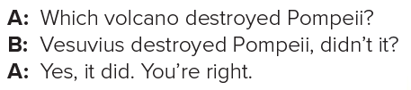

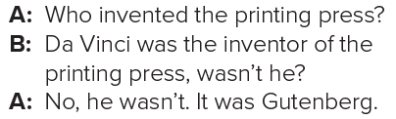


p. 6
تصميم: اماني التركي
دلال الجعيد

Slide 10




Who first went to the Americas?
Christopher Columbus discovered the Americas, didn’t he?
Yes, he did. You are totally right.

Slide 11








George Scott thinks the man is a famous author named Melvin Dupont.
George went to school with Melvin.
The man says that he isn’t Melvin Dupont and that he doesn’t know George.
تصميم: اماني التركي
دلال الجعيد

Slide 12





The rising intonation in the tag questions.

Slide 13









تصميم: اماني التركي
دلال الجعيد

Slide 14
1.Yes I have. A woman met me in a grocery store and thought I was her daughter.
I smiled and said I think you’re mistaking me for someone else.
2. The police arrested someone, but it turned out to be a case of
mistaken identity.
3. No, I haven’t.
4.Yes, I have. There are many things I bought that I regretted it
immediately. I love to try new stuff.
I bought a shoe pair online. It was wonderful but it was not fitting well on my feet

Slide 15




A
S
K
Student
Teacher
Group
تصميم: اماني التركي
دلال الجعيد

Slide 16







P
L
A
Y
Do you know?
تصميم: اماني التركي
دلال الجعيد

Slide 17




AlMasmaq
Where are these places?
AlDaryiah
AlOula

Slide 18








H W
Assign page 91 (D) for practice with the grammar
تصميم: اماني التركي
دلال الجعيد

Slide 19



Slide 20


hasn’t it.
Yes, it has.
are they
No, they aren’t.
weren’t you.
Yes, I was.
didn’t you.
Yes, I did.
do you
No, I don’t.
don’t you.
Yes, I do.
have you.
No, I haven’t.
can’t you.
I can

