Slide 1

Drive Slowly
Unit 8
Revision

Slide 2
بسم الله الرحمن الرحيم
Day:
Date:

Slide 3
Choose the correct answer:
1- Can you (opened – open –opening) the door please?
2-Would you (help – helps –helped ) your sister ?
3-Will you (made – making – make ) me coffee ?
4-Don’t (drives- drive –driving ) so fast.
5-( Turned –Turns – Turn ) right .

Slide 4
Choose the correct answer:
6-Driver must (stop –stopped –stops) at the traffic light.
7-People mustn’t ( smoking –smokes –smoke) in the hospital.
8-You should (study – studies –studying) hard next time.
9-Sara shouldn’t ( eats – eat –ate ) a lot of fast food.
10-Ahmad drives ( careful – carefully – care ) .

Slide 5
Report the following:
1- Clean the house.
She told me to clean the house.
2-Could you close the door?
She asked me to close the door.
3-Don’t swim in the river.
She told me not to swim in the river.

Slide 6
Make a request:
1- Go to the supermarket. ( Could)
Could you go to the supermarket?
2- Close the door. ( Would)
Would you close the door?

Slide 7
Correct the mistakes:
1-Ali writes (quick).
Ali writes quickly.
2-You must (wearing) a uniform .
You must wear a uniform.
3-She speaks (good)
She speaks well.
4-Would you (lending) me money .
Would you lend me money?

Slide 8
Match words with their meaning:
5
1- exterior |  | a- something that is usually done
2- interior |  | b- the outer part of something
3- investigate |  | c- uncertainty about what happened
4- confusion |  | d- a direction of change
5- custom |  | e- search or study
6- trend |  | f- the inside part of something
1
4
6
3
2

Slide 9


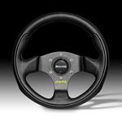

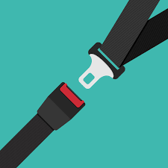
Match words with pictures:
No Parking – Danger- steering wheel- Parking area - stop – seat belt
Parking Area
Danger
Steering Wheel
No Parking
Seat belt

Slide 10
THANK YOU

