Slide 1

It’s a good deal,
Isn’t it?
Unit 7

Slide 2
12. Form, Meaning
& function
Objectives
Make suggestions.

Slide 3


Slide 4
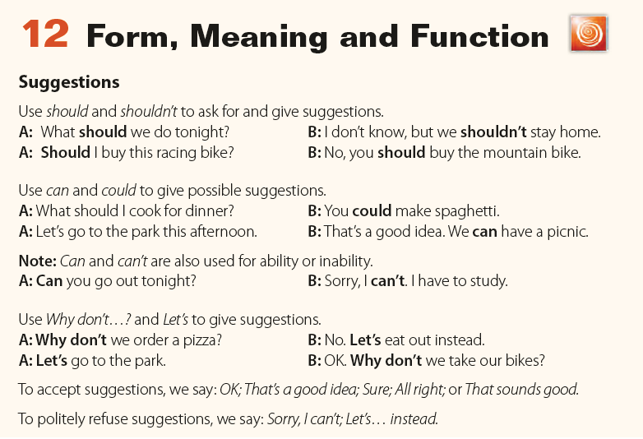

Slide 5
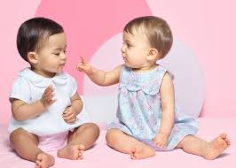
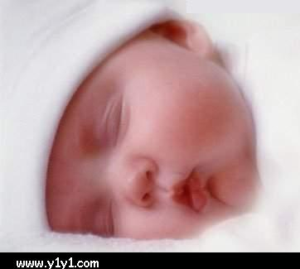
That’s a good idea.
What should we do?
Let’s sleep.

Slide 6
What did she suggest?
Sleeping
Did he accept? Did he say yes?
Yes, he did.

Slide 7
Making suggestions:
watch
TV.
* Let’s …………………..
watch
TV
* Why don’t we ……………………?
watch
TV
* Should we ………………………….?
watch
TV
* We can ……………………?
watch
TV
* You could ………………………?
watching
TV
* What about ..…………………………?
watching
TV
* How about ……..……………………?

Slide 8
Accept the suggestions:
1- Let’s read Quran.
2- Why don’t we go to Abha?
3- What about travelling abroad?
That’s a good idea.
Sounds great.
I’d love to.

Slide 9
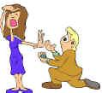
Now refuse the suggestions:
1- Let’s read a novel.
2- Why don’t we go to Abha?
3- What about travelling abroad?
It’s a greet idea, but ………
I’d love to, but ………
I’m sorry, I can’t because ……
I don’t think I can because ………

Slide 10
Choose the correct word:
Let's [ have – had – having ] a picnic.
2. [ Why –Where – When ] don’t we go fishing?
3. Let's [ arranged – arranging – arrange ] these flowers.
4. What about [ watched – watch – watching ]
an English film?

Slide 11

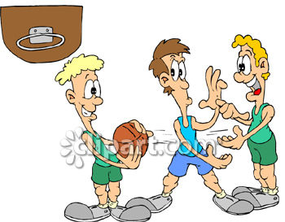
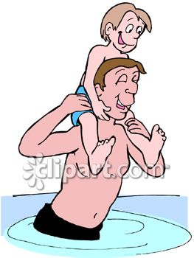
Complete the conversations:
travel
1-Asma: Let’s …………………………………
Rogaya: ………………………………………………
[Refuse, give an excuse]
I’d love to but I have school.
about swimming?
2- Waleed: How …………………………………… .
Faisal: ……………………………………………… . [ Accept ]
Sounds great.
don’t we play basketball?
3- Ahmad: Why ………………………………………………………
Majid: …………………………………………………………
[Refuse, give an excuse ]
I’m sorry I can’t because I have to study.

Slide 12
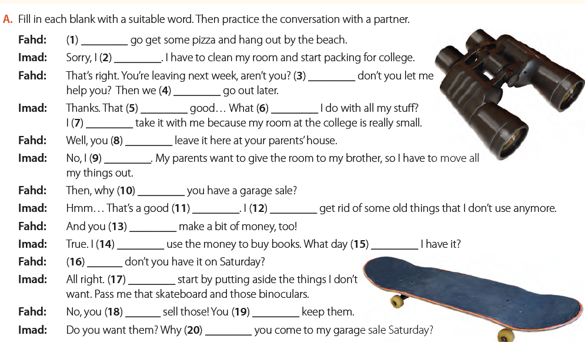
Let’s
can’t
why
can/could
sounds
should/ can
can’t
can/could/ should
can’t
don’t
idea
can/could/ should
can/could
can/could
should
why
Let’s
can’t / shouldn’t
should
don’t

Slide 13
قال تعالى:
} ليحملوا أوزارهم كاملة يوم القيامة ومن أوزار الذين يضلونهم بغير علم إلا ساء ما يزرون {…

Slide 14
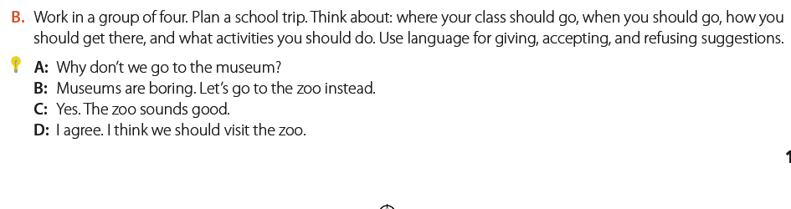
A. Let’s go to the shopping mall.
B. Shopping is boring . Why don’t we go camping ?
C. Camping is a good idea.
D. I agree. I think we should go camping.

