Slide 1

It’s a good deal,
Isn’t it?
Unit 7

Slide 2
5-8: Conversation
Objectives
Rephrase a text.
2. Pronounce tag questions correctly with rising
intonation.
Answer questions about the conversation.

Slide 3

P. B. p. 72
Listening
Listen to the conversation and explain the misunderstanding between the two
men in your own words.
George mistook a man for his famous friend Melvin Dupont.

Slide 4
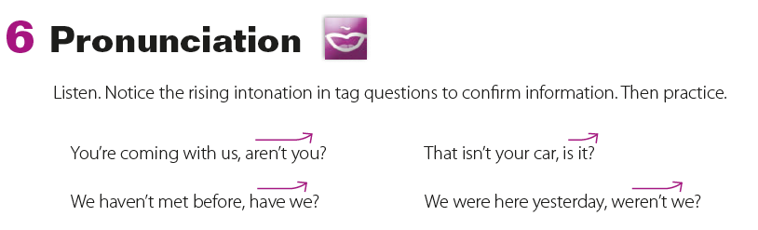
P. B. p. 72
Pronunciation
Notice the rising intonation in tag questions to confirm information.

Slide 5
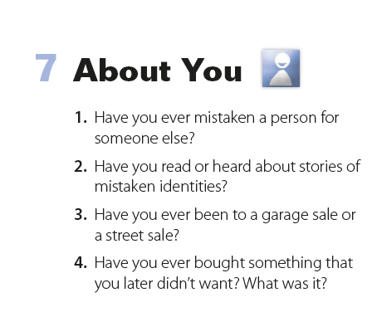

P. B. p. 72

Slide 6

Where are the people?
Where do you think the people are from?

Slide 7
Where is Sean from?
What city are the two people in now?

Slide 8

Ted: You aren’t from around here, are you?
Sean: No, I’m not. How did you guess?
Ted: Your accent.
Sean: Of course. No, I’m from
Ireland, Dublin actually.
Ted: My name’s Ted.
Sean: How do you do? I’m Sean. So,
what do you know about Ireland?
Ted: Lots of Irish came over to the
United States in the past, didn’t they?
Sean: Yes, they did.
Ted: And you speak Gaelic.
Sean: Yes, some Irish people do. They like to hold on to the
tradition.
Ted: Is that so? So what are you doing in Chicago?
Sean: I’m an exchange student.
Ted: I’ll be happy to show you around the campus.
P. B. p. 73

Slide 9
About the Conversation
1. Where is Sean from in Ireland?
2. What does Ted know about Ireland and the Irish?
3. What is Sean doing in Chicago?
4. What does Ted offer to do?
P. B. p. 73
1. Sean is from Dublin.
2. He knows that many Irish came to the
United States in the past, and he knows
they speak Gaelic.
3. He is an exchange student.
4. Ted offers to show Sean around the
campus.

Slide 10
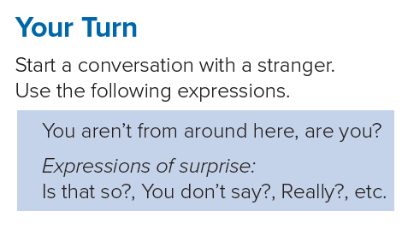

Slide 11


