Slide 1

It’s a good deal,
Isn’t it?
Unit 1

Slide 2
1. Reading
Objectives
Answer questions about a text.
2. Read a text to answer questions.
3. Design a graphic sale advertisement.

Slide 3
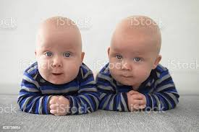
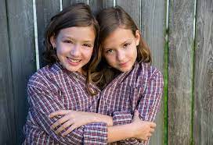
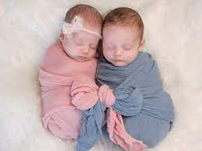
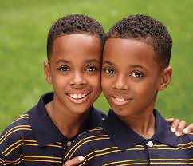
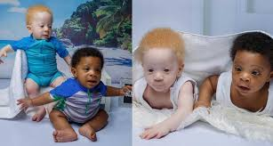
What do you notice?
What make them special?

Slide 4
1. What do you know about twins?
2. Have you ever met any?

Slide 5
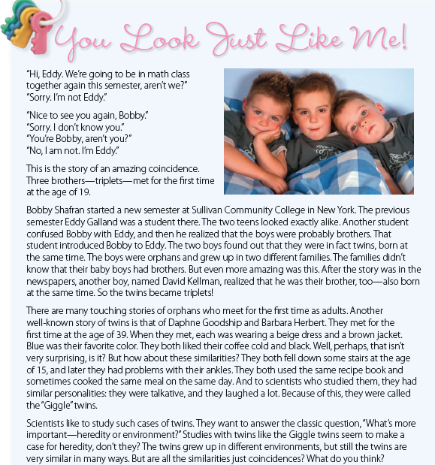

P. B. p. 74

Slide 6
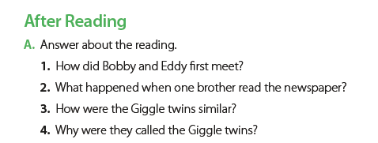
P. B. p. 75
They met when another student introduced them.
One brother read the story about Bobby and Eddy and realized that he was their brother, too.
They wore similar clothes, had the same favorite color, and liked coffee the same way. They both fell downstairs at 15, and they both used the same recipe book. They were talkative and laughed a lot.
They laughed a lot.

Slide 7
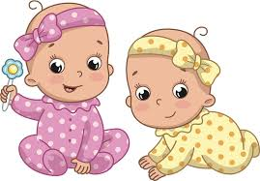

Read the passage in your student's book page 8
then answer the following:
The main idea of the passage is:
a) twins b) separated children
c) Look a likes
[ Their ] in line 16 refers to:
The families didn’t know that their baby boys had brothers.
a) the boys b) the families c) brothers
Choose [ T ] or [ F ]:
1. The triplets met at the age of 19. [ T / F ]
2. Bobby with Eddy met first. [ T / F ]
2. The giggle twins were a boy and a girl. [ T / F ]
3. The giggle twins met at the age of 29. [ T / F ]
Match the following words in the reading with their definitions.
1. __ coincidence a. three children born at the same time
2. __ confuse b. think wrongly that a person is someone else
3. __ orphan c. a situation in which two things happen together by chance
4. __ heredity d. a child who has lost his parents
5. __ triplets e. what you get from your parents
6. __ touching f. having a strong emotional effect
c
b
d
e
a
f

Slide 8
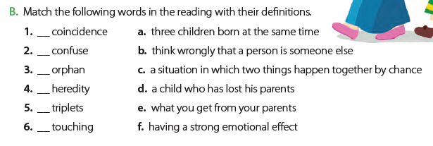

P. B. p. 75
c
b
d
e
a
f

Slide 9
Role-play an interview with one set of twins/triplets in the article.
Work in small groups, and
take turns being “twins” or “triplets” and interviewers.
Present your interviews to the class.

Slide 10
Discussion
What do you think that cases like the Giggle twins show?
2. What do you think is more important in people’s personalities, heredity or environment?
Can you give any examples?
Think about your own family and people you know.

Slide 11
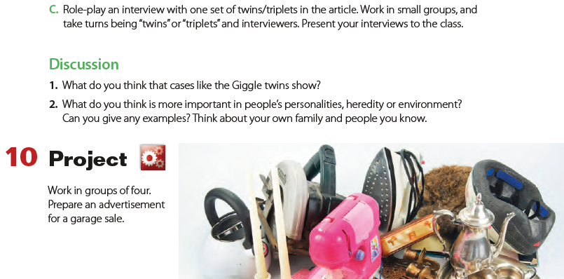

Slide 12
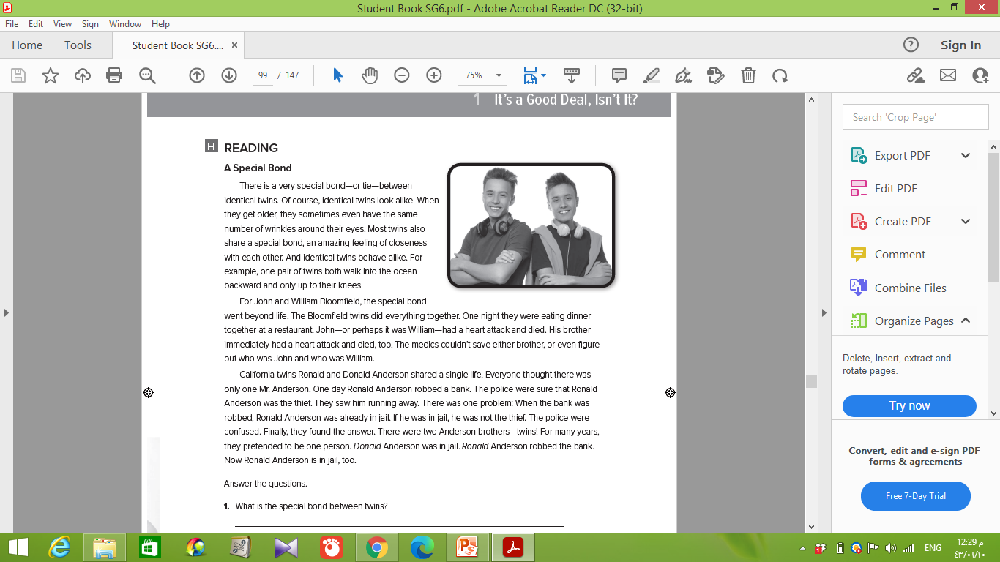
W. B. p. 213

Slide 13
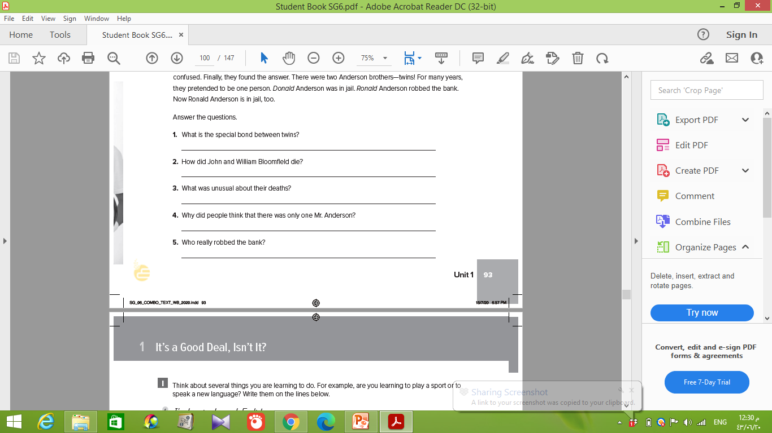
It is the feeling of closeness twins have for each other.
They both had heart attacks.
They both died while eating dinner together.
They were identical twins and shared a single life.
Ronald Anderson really robbed the bank

Slide 14


