Slide 1
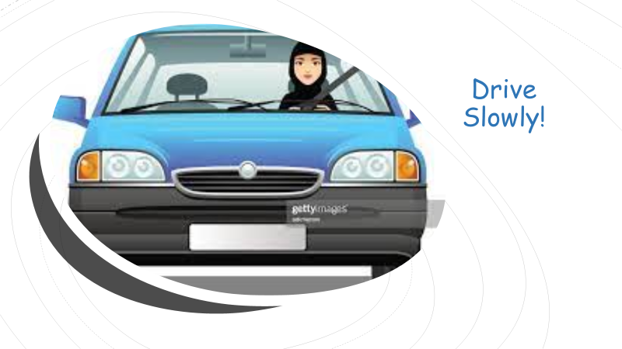
Drive Slowly!
3. Grammar
Objectives:
Use model auxiliaries
Forms sentences using adverbs of manner.

Slide 2

Modal Auxiliaries

Slide 3

Modals
can
could
will
would
may
might
must
have to
should

Slide 4
must obligation
We must pray 5 times a day.
You must obey your parents
mustn’t prohibition
You mustn’t speak during the lesson.
You mustn’t use your phone while driving.

Slide 5
Read the following
People should use cars less.
We should save plant earth.
They shouldn’t play with fire .
We shouldn’t dump rubbish in the street.

Slide 6
should advice
Ask for advice
What should I do?
Give advice
You should see a doctor.
Give opinion
I think you should try talking to Amal again.

Slide 7
Use a model:
1. He ………………… obey your parents.
2. You ……………………… speak Arabic in
the English class.
must
shouldn’t

Slide 8
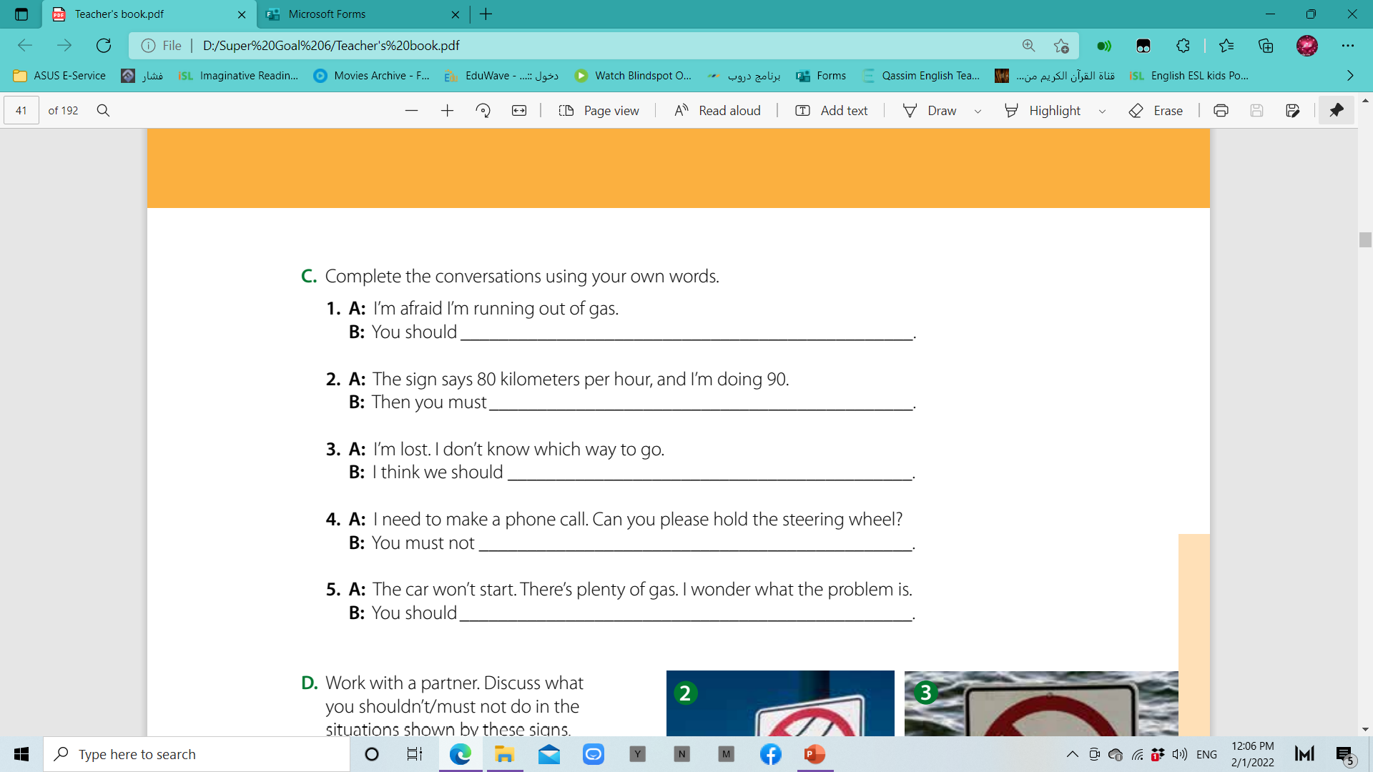
P. B. p.81. Ex: C
stop at a gas station
slow down
stop and ask someone for directions
make a call when you’re driving
call a mechanic

Slide 9
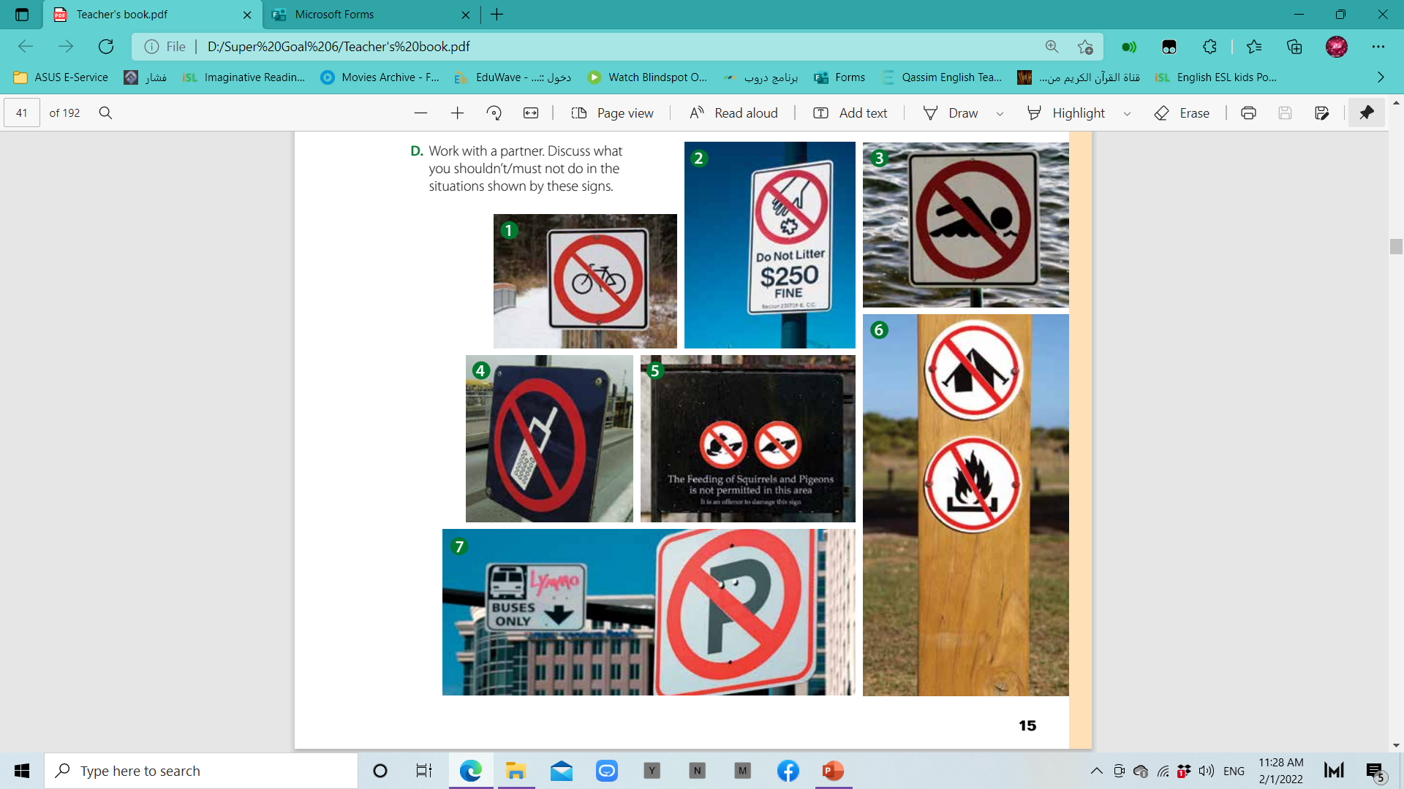
P. B. p.81. Ex: C
1.You shouldn’t ride your bike here.
2. You must not litter.
3. You shouldn’t swim here.
4. You shouldn’t use your cell phone here.
5. You must not feed the squirrels and pigeons.
6. You should not camp or have a campfire here.
7. You must not park here.

Slide 10
Adverbs
adj.
Ali is slow.
adv.
Ali writes slowly.
adj.
Amani is quick.
adv.
Amani reads quickly.
adj.
They were happy.
adv.
They walked happily along the beach.

Slide 11
Adverbs
adj.
Sami is a fast driver.
adv.
Sami drives fast.
adj.
She is a hard worker.
adv.
He works hard.
adj.
They are good painters.
adv.
They paint well.

Slide 12
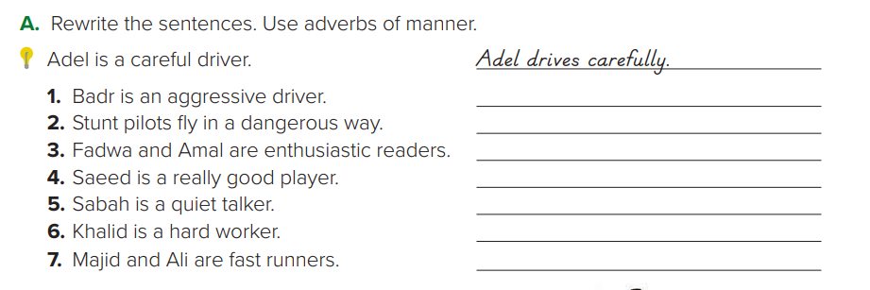
P. B. p.80. Ex: A
Badr drives aggressively.
Stunt pilots fly dangerously.
They read enthusiastically.
Saeed plays really well.
Sabah talks quietly.
Khalid works hard.
They run fast

Slide 13
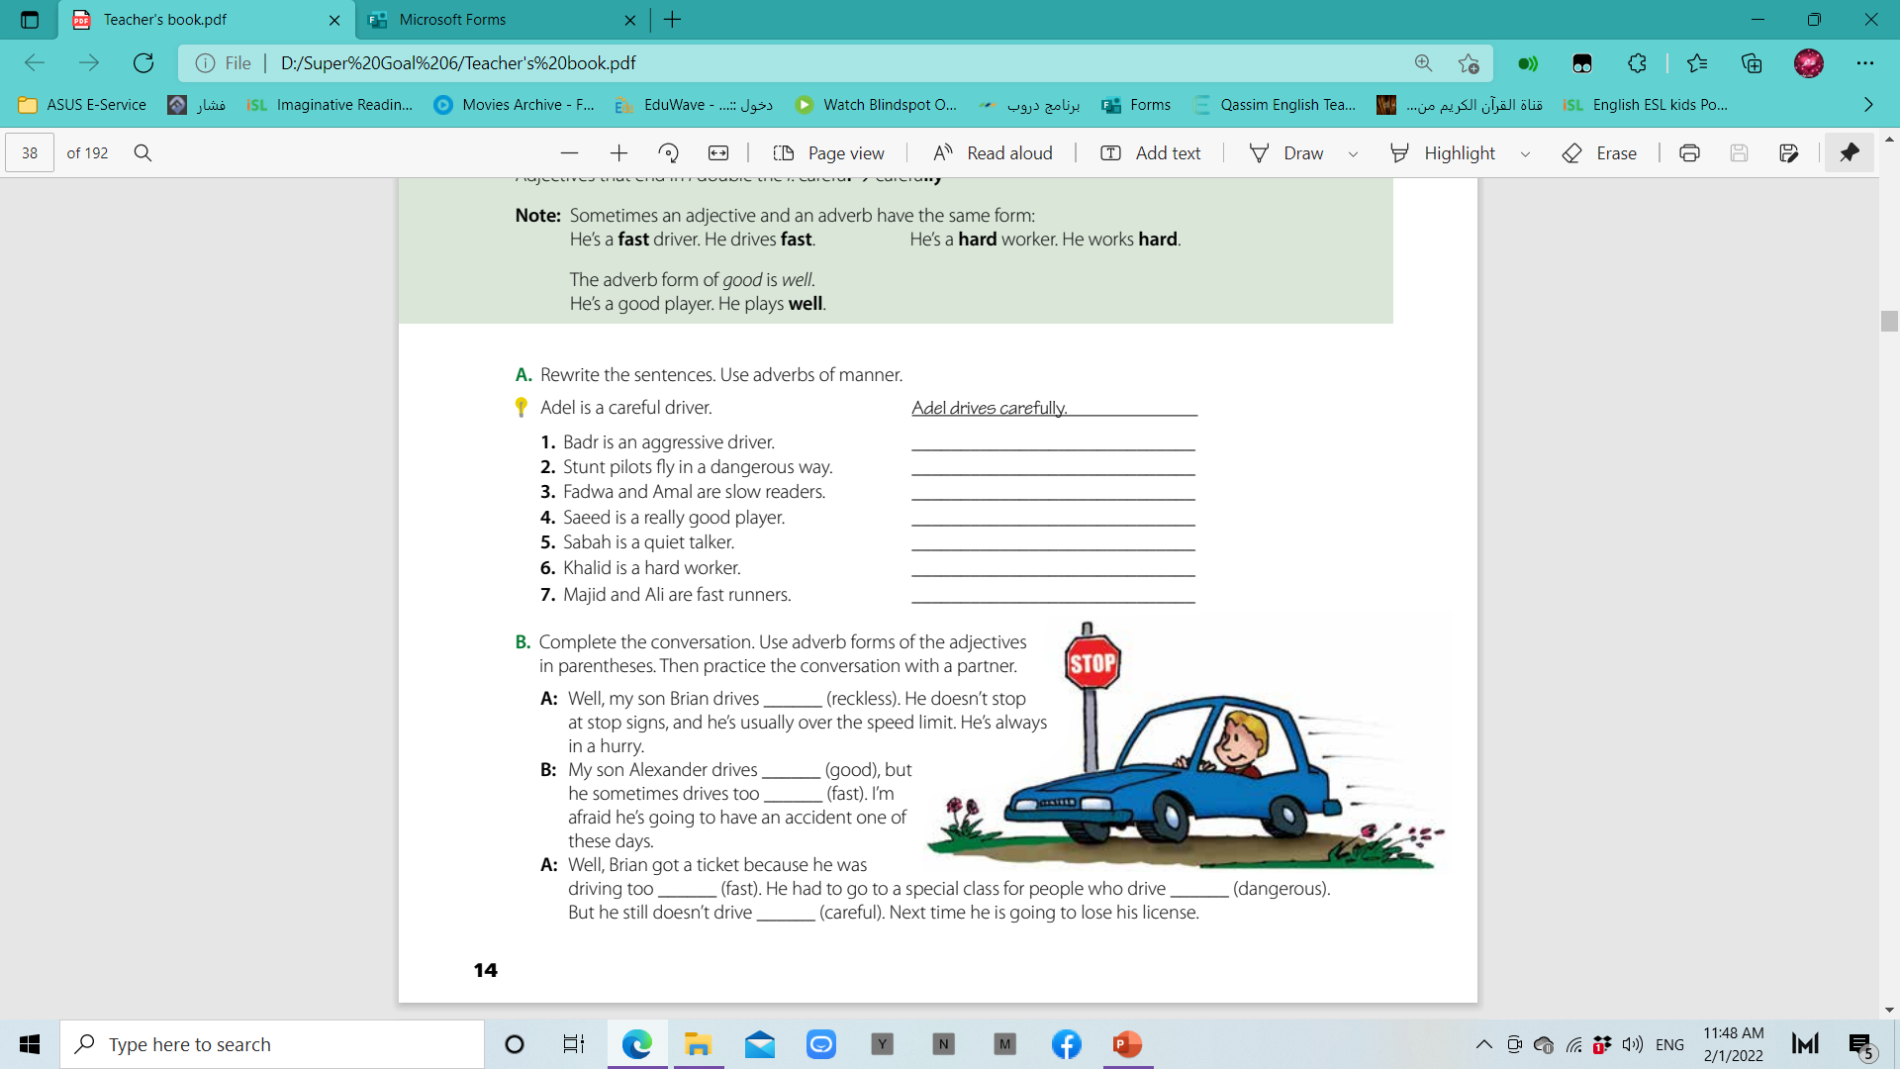
P. B. p.13. Ex: B
recklessly
well
fast
dangerously
fast
carefully

Slide 14
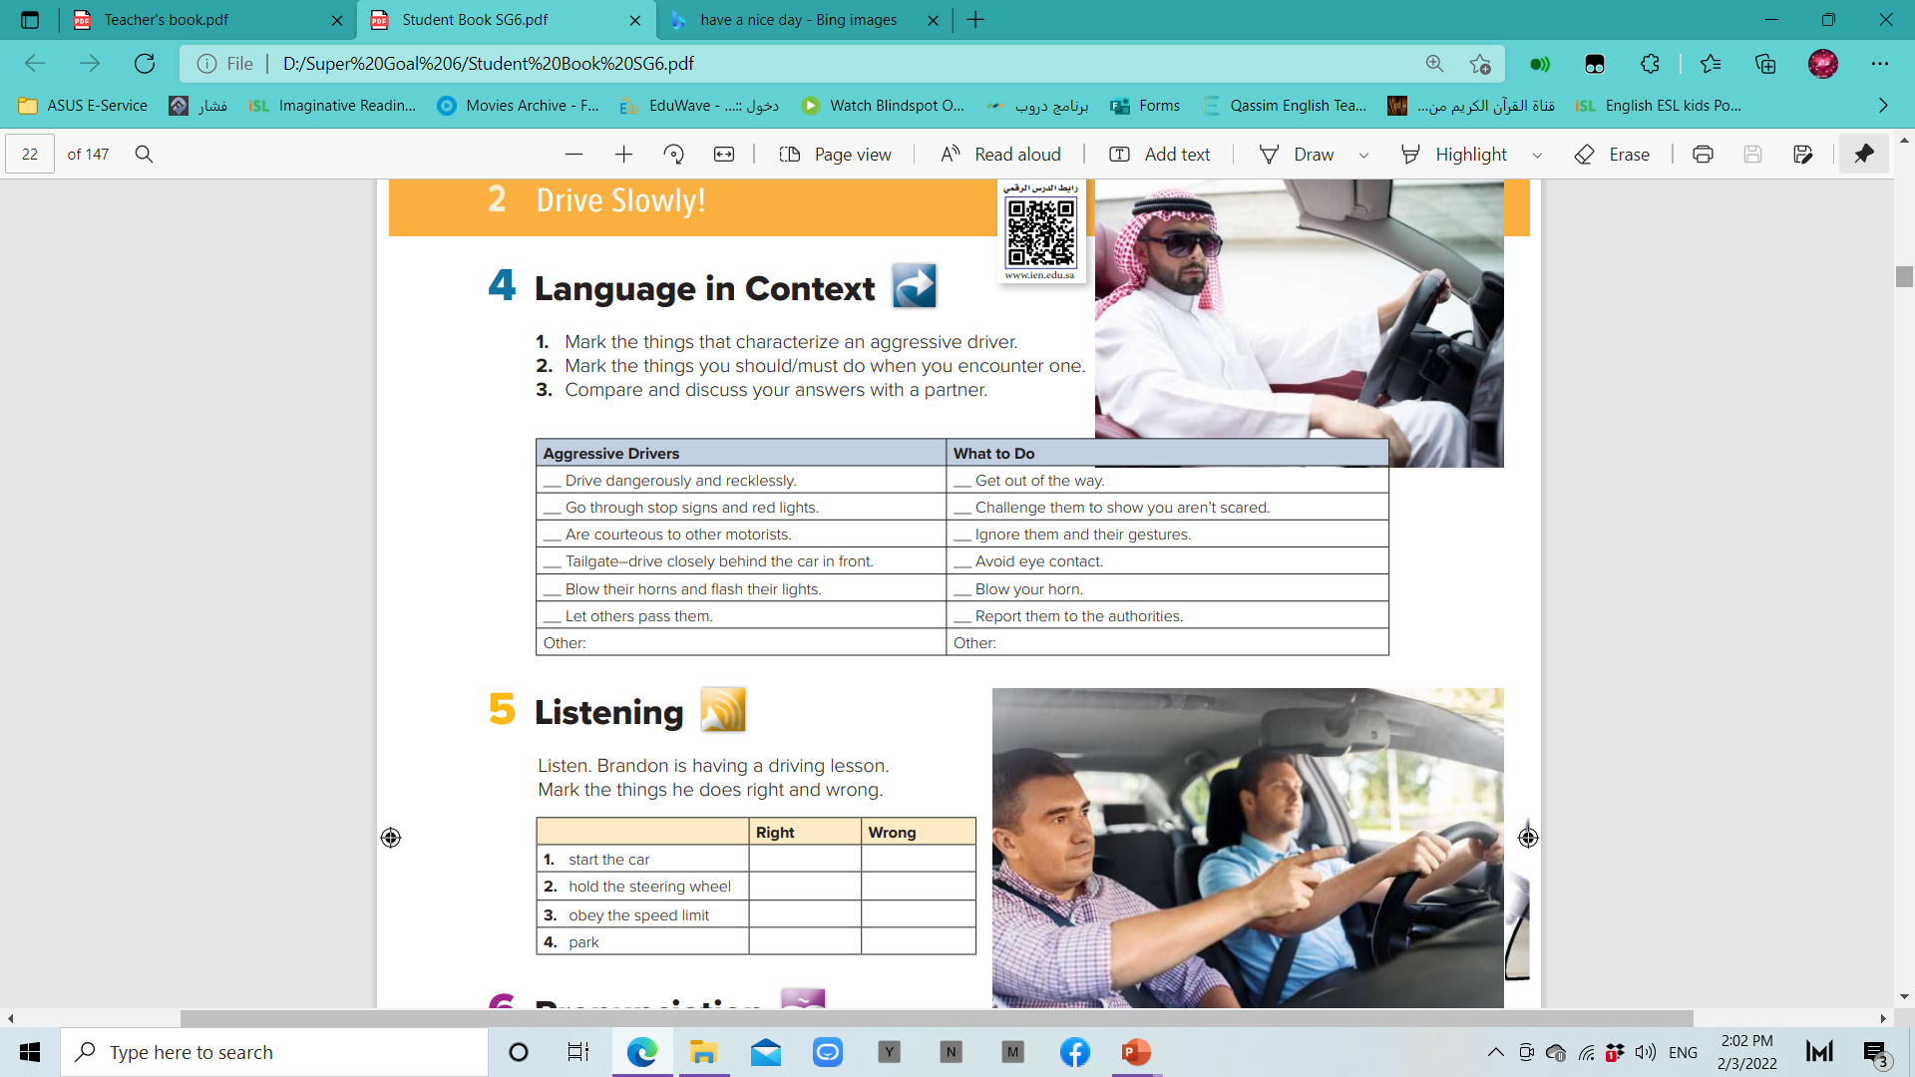
*
*
*
*
*
*
*
*

Slide 15

Create your mind map
Use models
Talk about driving rules

Slide 16
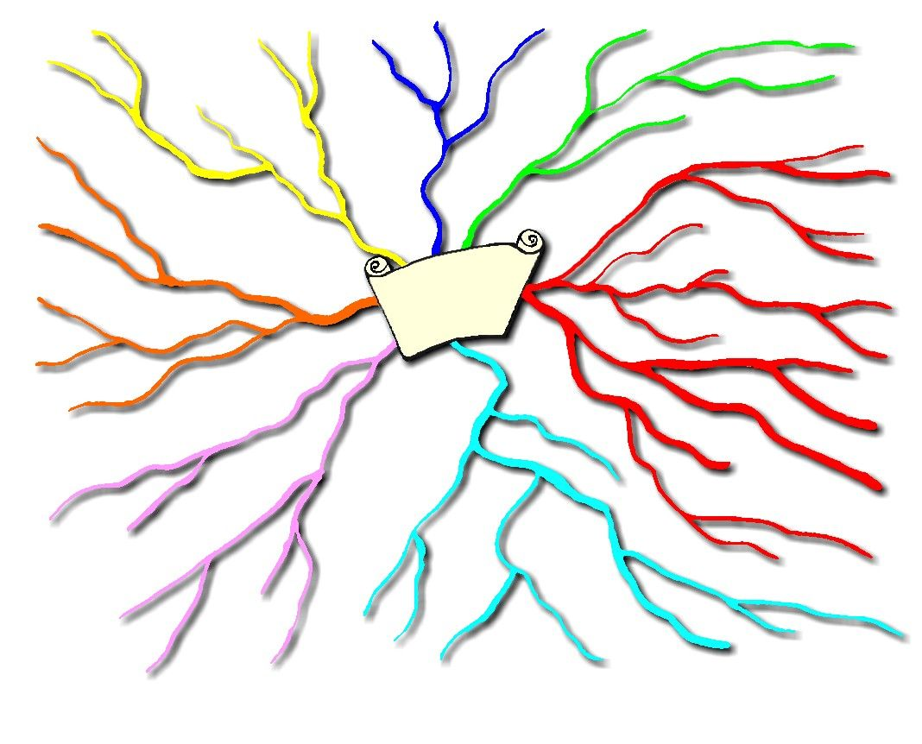

Slide 17
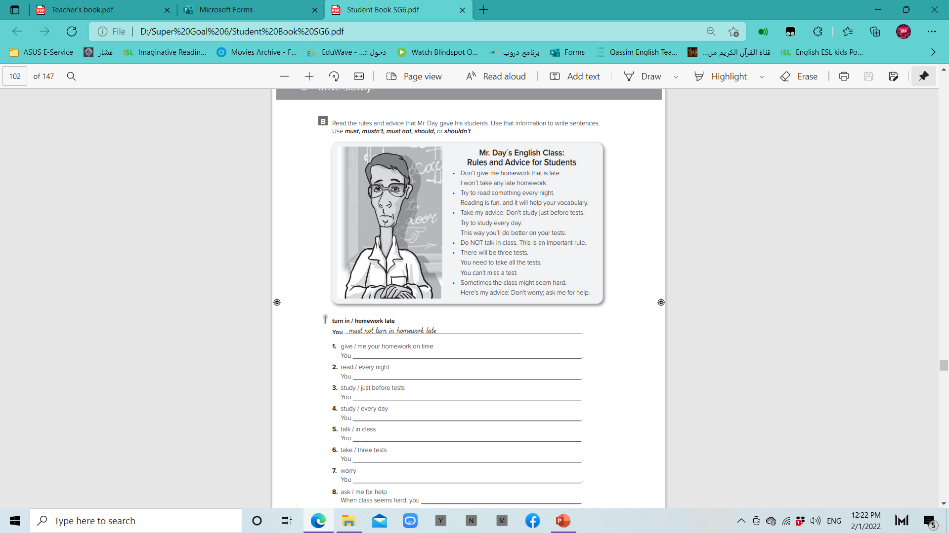
W. B. p.96. Ex: B
must give me your homework on time
should read every night
shouldn’t study just before tests
should study every day
must not talk in class
must take three tests
shouldn’t worry
should ask me for help

Slide 18
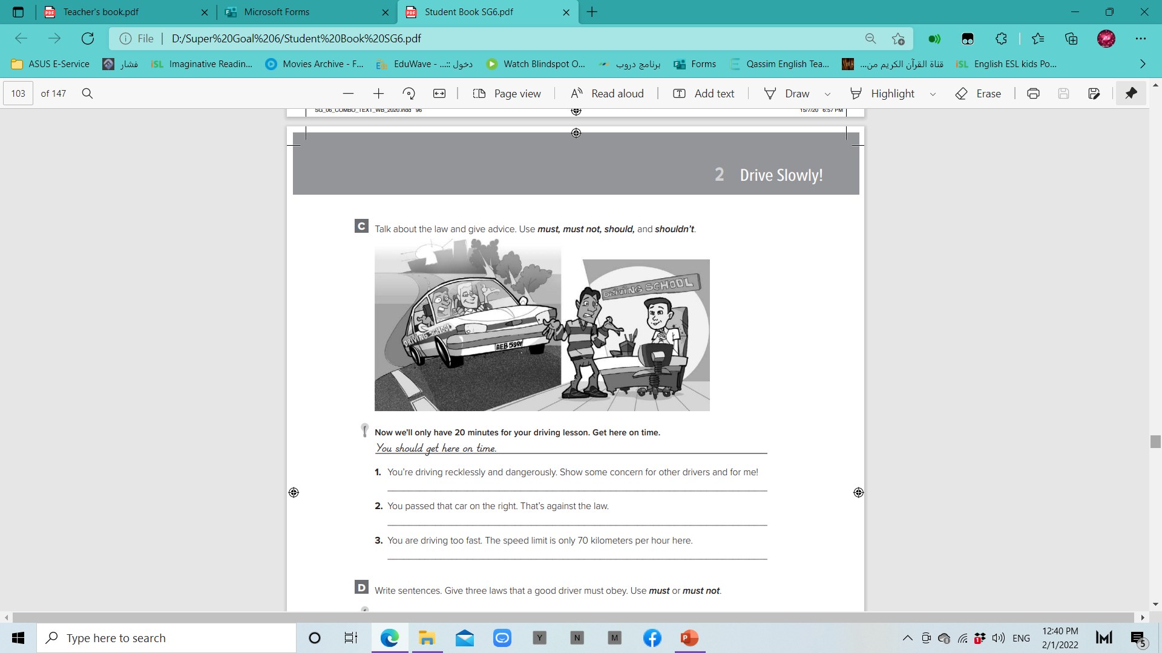
W. B. p.97
You shouldn’t drive recklessly and dangerously.
You should show some concern for other drivers and for me!
You must pass cars on the left. That’s the law.
You shouldn’t drive too fast. You must obey the speed limit.

Slide 19
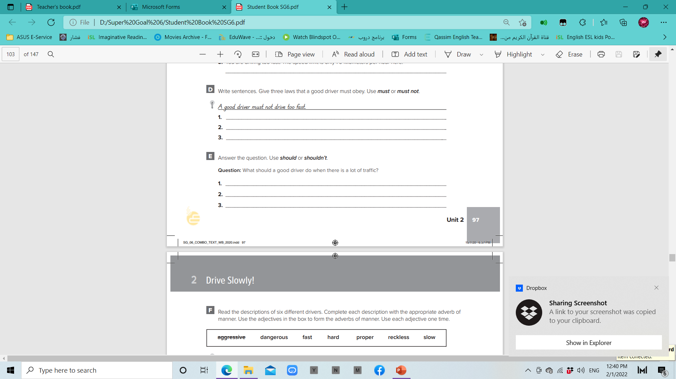
W. B. p.97
A good driver must stop at stop signs.
A good driver must obey all traffic signs.
A good driver must not pass on the right.
A good driver should slow down.
A good driver shouldn’t talk on a cell phone.
A good driver should watch the other cars carefully.

Slide 20
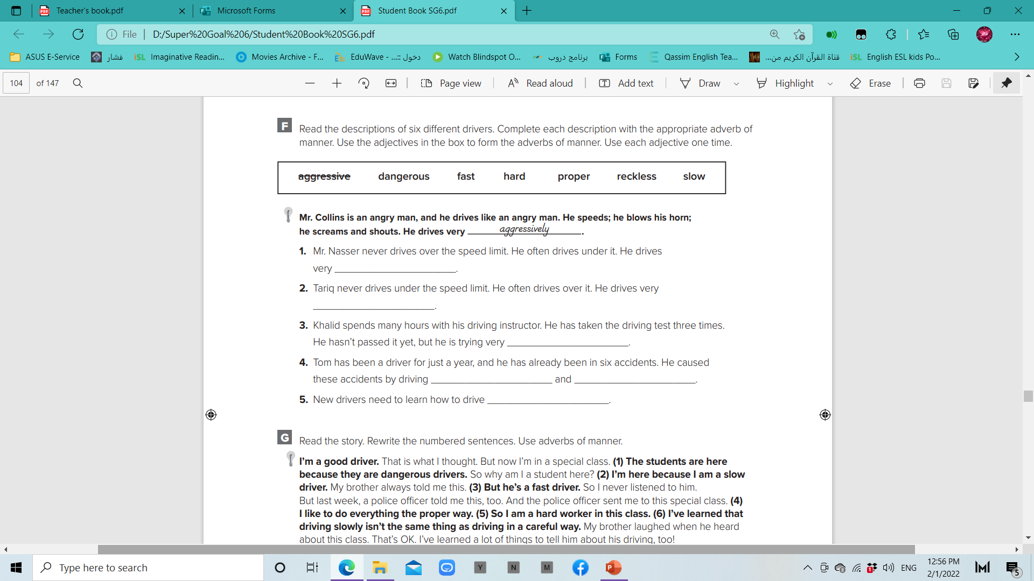
W. B. p.98
slowly
hard
fast
recklessly
dangerously
properly

Slide 21
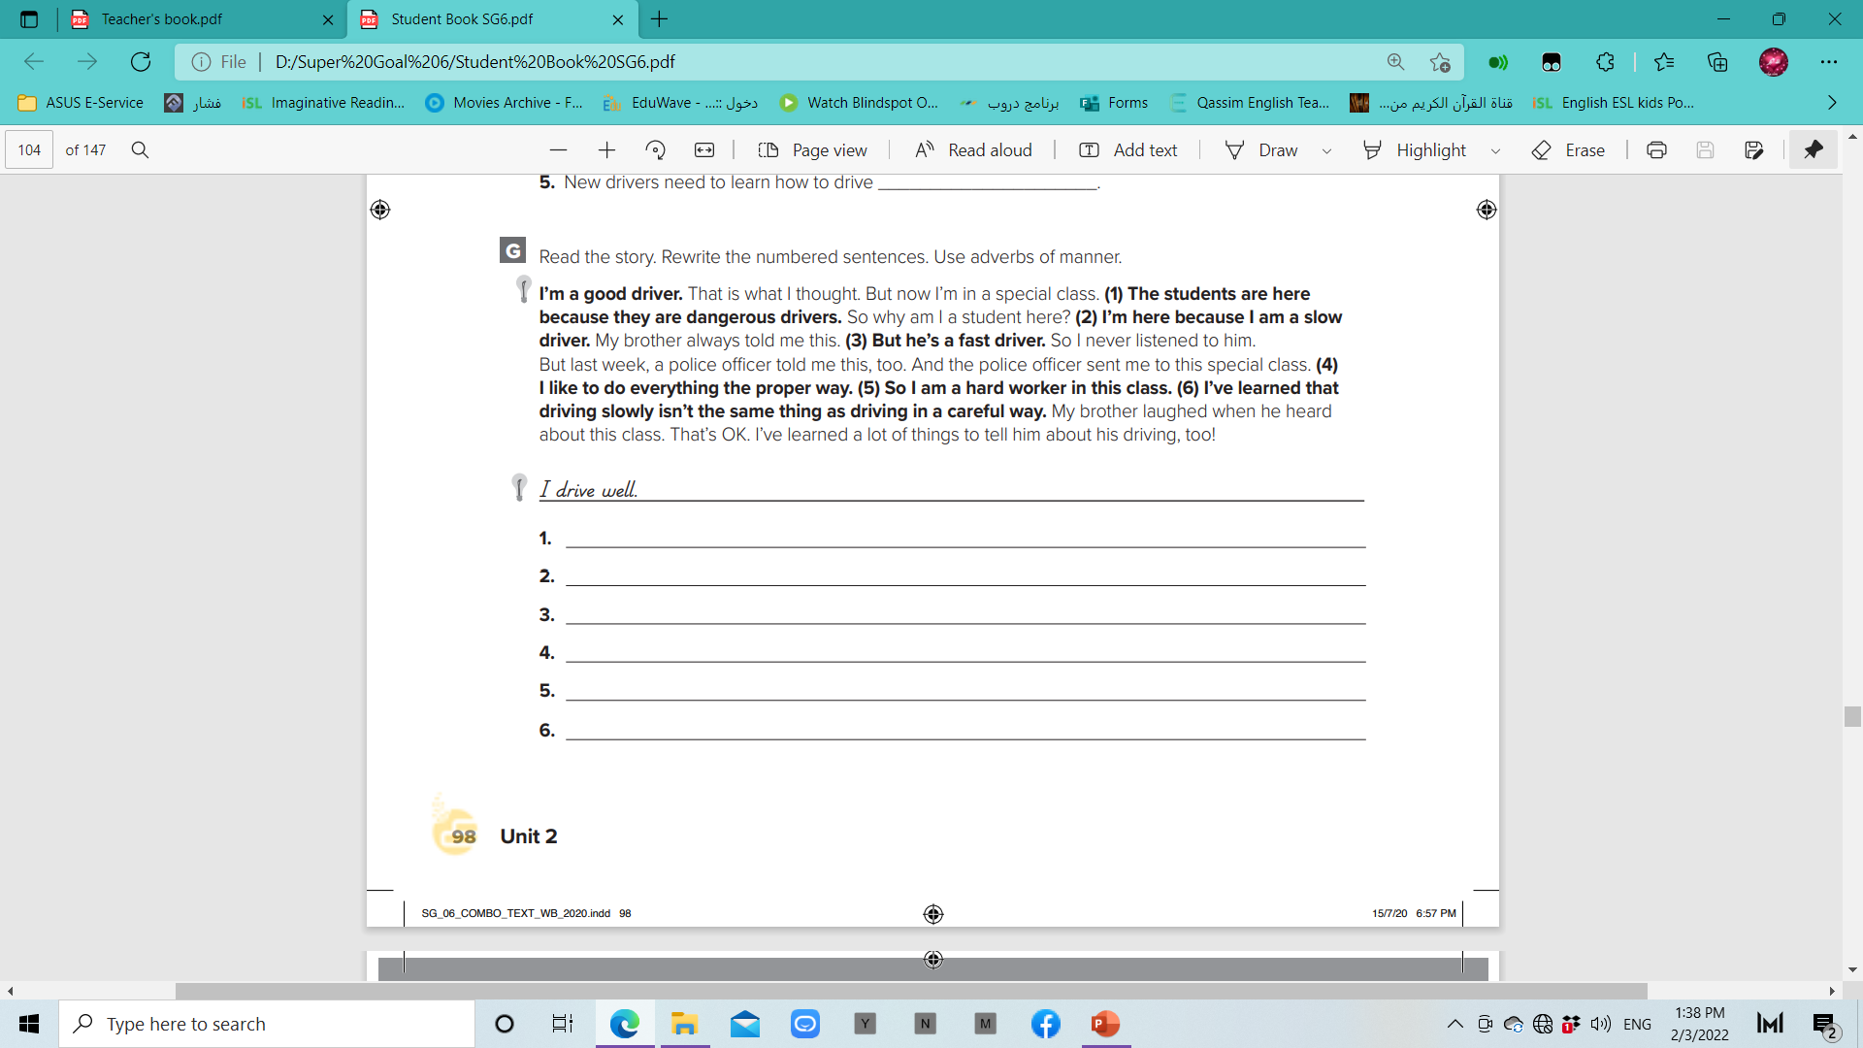
The students are here because they drive dangerously.
I’m here because I drive slowly.
But he drives fast.
I like to do everything properly.
So I work hard in this class.
I’ve learned that driving slowly isn’t the same thing as driving carefully.

Slide 22


