Slide 1


Slide 2
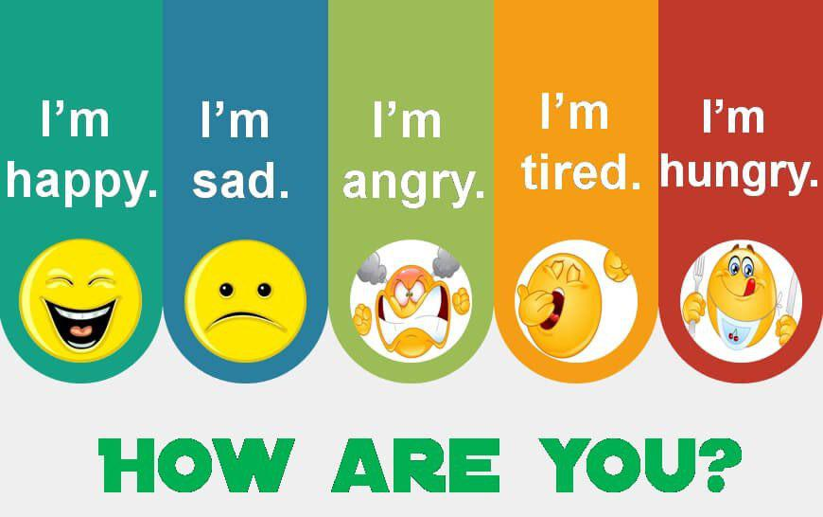

Slide 3

What day is it today?
What is the date?

Slide 4


Slide 5
Match
How do you do? | ( ) act as a guide
2. Is that so? | ( ) a way to show surprise
3. I’ll be happy to... | ( ) a way to respond to an introduction
4. show someone around | ( ) a way to offer to do something for someone
4
2
1
3

Slide 7
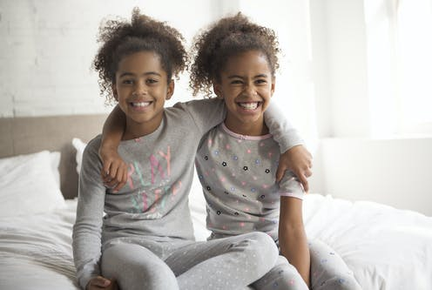
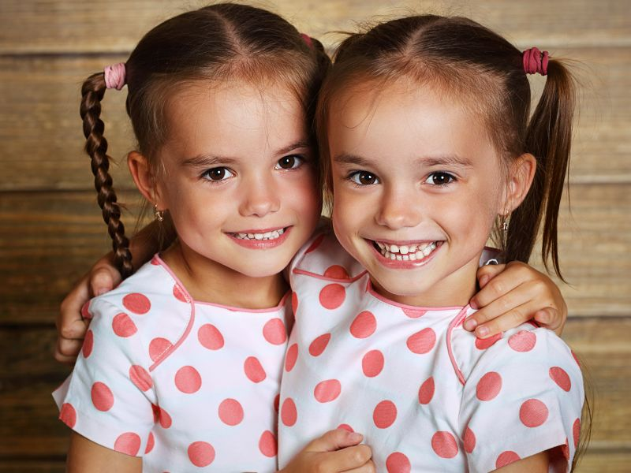
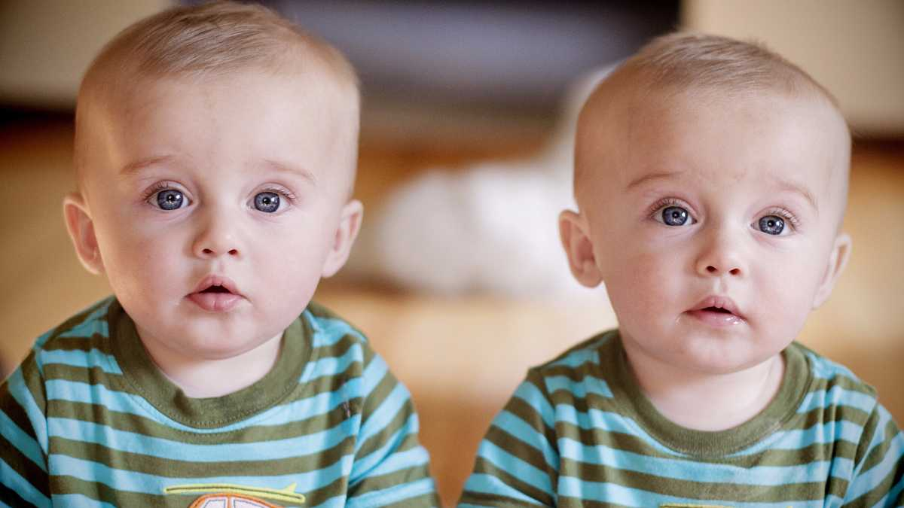
What can you see?
Introduction

Slide 8
Twins

Slide 9
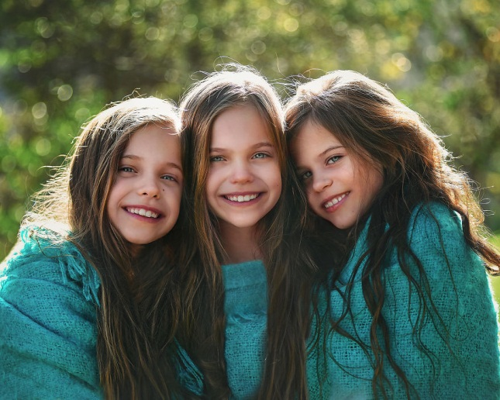
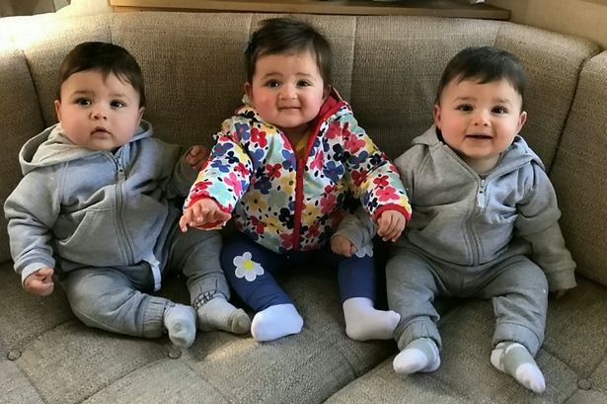
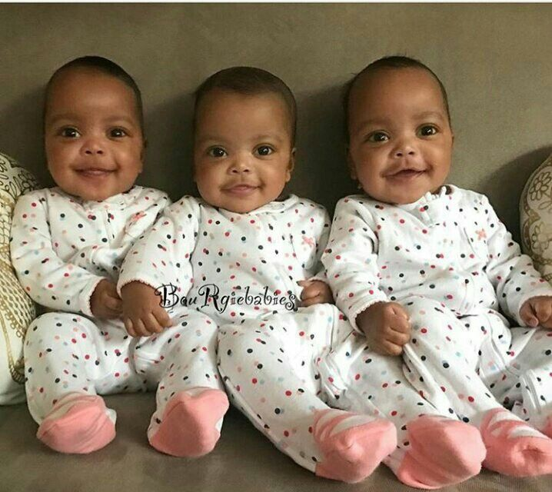
Triplets

Slide 10
Objectives
In this lesson you are going to:
read the text.
learn new words.
answer the questions about the text.
role-play an interview with one set of twins/triplets in the article.
discuss the questions.
prepare an advertisement for a garage sale.

Slide 11

Open your student’s book

Slide 13
Describe what you see in the photo
Are they twins?
They are triplets.
No

Slide 14
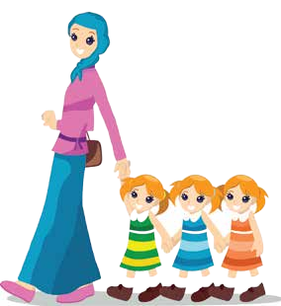
triplets

Slide 15
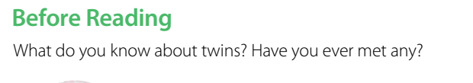

Slide 16

What does the title mean?
It means that two people physically resemble each other.

Slide 17
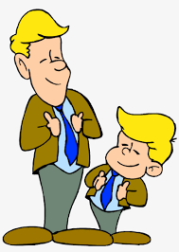
They look like each other.

Slide 18


Slide 20
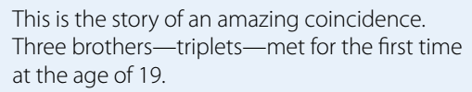

Slide 21
When did the three brothers meet for the first time?
At the age of 19.

Slide 23
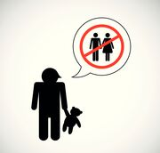
Bobby and Eddy were orphans.
Each one was grew up in in two different families.
The families didn’t know that their baby boys had brothers.

Slide 24
Orphan

Slide 25

Where were Bobby and Eddy students at ?
They were students at Sullivan Community College in New York.
Another student confused Bobby with Eddy, and then he realized that the boys were probably brothers. That student introduced Bobby to Eddy. The two boys found out that they were in fact twins, born at the same time.
knew

Slide 26
confused

Slide 27


After the story was in the newspapers, another boy, named David Kellman, realized that he was their brother, too—also born at the same time. So the twins became triplets
knew

Slide 28
What is the name of the third brother?
David Kellman

Slide 29
What is the main idea of the paragraph?
a. the names of the three orphan brothers
b. how three orphan brothers found each
other.
✔

Slide 31
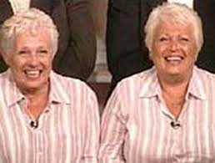
Daphne Goodship and Barbara Herbert

Slide 32
When did Daphne Goodship and Barbara Herbert meet for the first time?
They met for the first time at the age of 39.

Slide 33
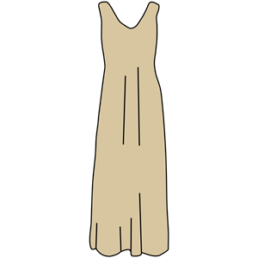
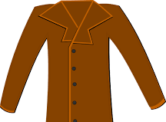
What were they wearing when they met?
a beige dress and a brown jacket.

Slide 34
What was their favorite color?
Blue
Did they both liked their coffee cold and black?
Yes.

Slide 35
What are the similarities between Daphne Goodship and Barbara Herbert ?
They both fell down some stairs at the age
of 15, and later they had problems with their ankles.
They both used the same recipe book and
sometimes cooked the same meal on the same day.
They were talkative, and they laughed a lot

Slide 36

Whey were they called the “Giggle” twins?
Because they laughed a lot

Slide 37
giggle

Slide 38
What is the main idea of the paragraph?
a. the similarities between the “Giggle” twins
b. how the “Giggle” twins found each other
✔

Slide 40
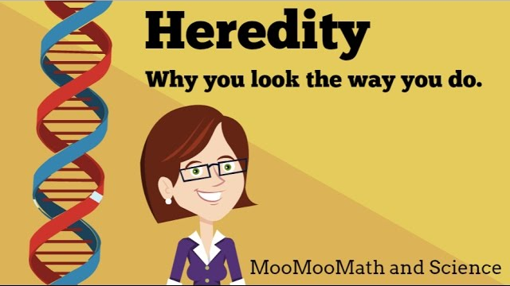
heredity

Slide 41
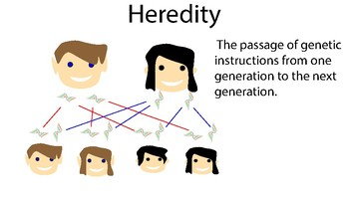
heredity

Slide 42

In which school subject can you talk about heredity?

Slide 43
What is the main idea of the paragraph?
a. coincidences in life
b. the heredity versus environment debate
✔

Slide 44
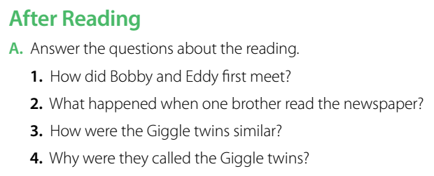

Group work Strategy

Slide 45
They met when another student introduced them.
2. One brother read the story about Bobby and Eddy and realized that he was their brother, too.
3. They wore similar clothes, had the same favorite color, and liked coffee the same way. They both fell down stairs at 15, and they both used the same recipe book. They were talkative and laughed a lot.
4. They laughed a lot

Slide 46
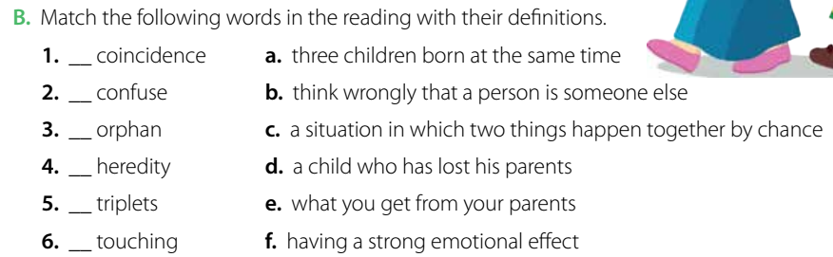
Group work Strategy
c
b
d
e
a
f

Slide 47

Role play strategy

Slide 48
Group work Strategy
What are the good and bad points about being a twin?
Is your twin your best friend?

Slide 49
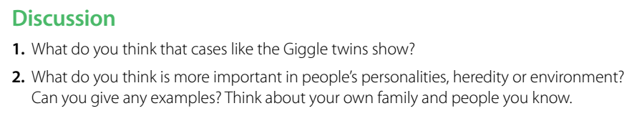
Group work Strategy

Slide 50
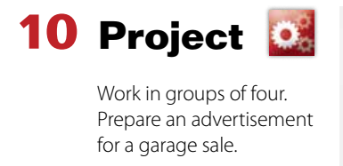
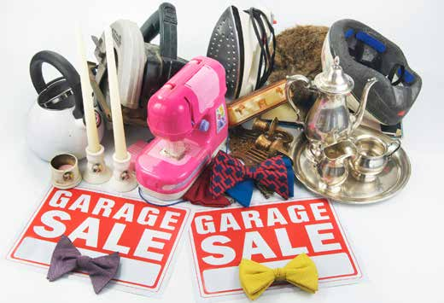
Group work Strategy

Slide 51


Are there any places in your country that take care of orphans?

Slide 52


Slide 53
Open your workbook

Slide 57


Slide 58

https://t.me/englishteacher350

