Slide 1

Unit 6
Is There a view?
Writing

Slide 2
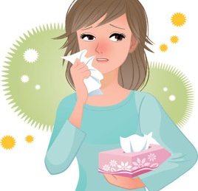
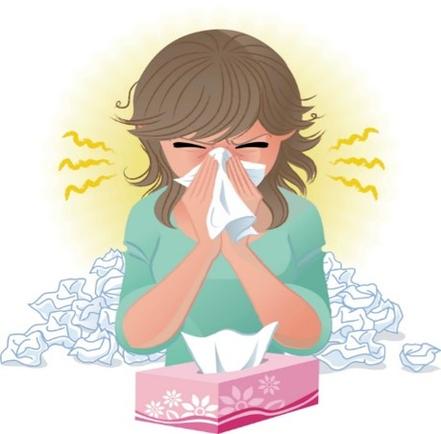
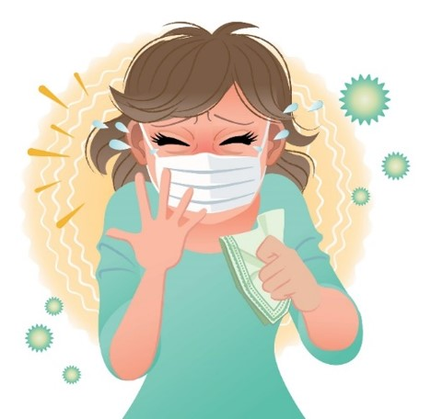
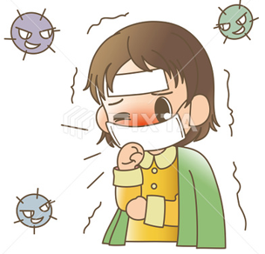

COVID 19
☺ Avoid gathering !
☺ wear a mask before going out
☺ Social distancing is not a choice, it is a must!
☺ Keep a distance of 2 meters to avoid accountability
☺ Wash hands constantly

Slide 3
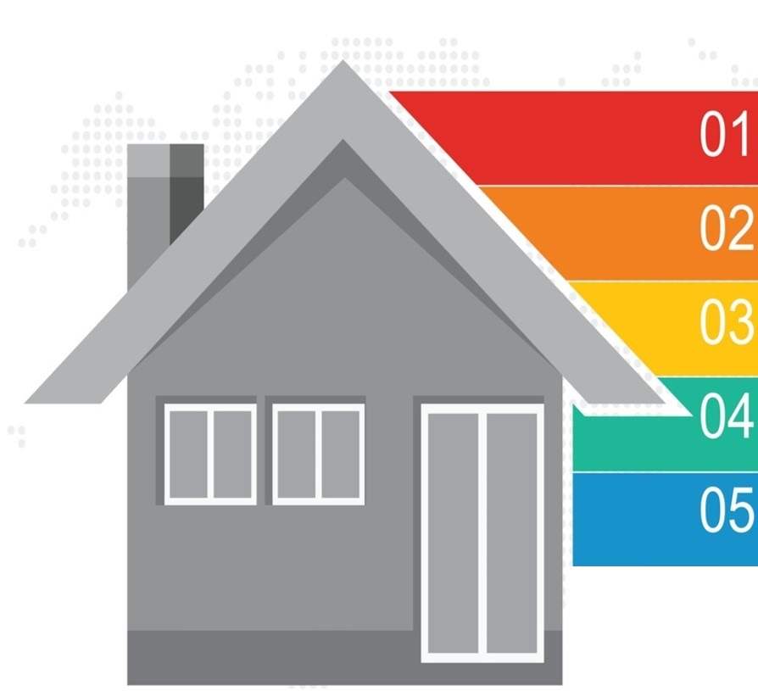
Learning Objectives
Name house rooms
Name each room contents
Describe the house correctly
Use words correctly
Value the blessing of having a house

Slide 4

بسم الله الرحمن الرحيم
Day:
Date:

Slide 5
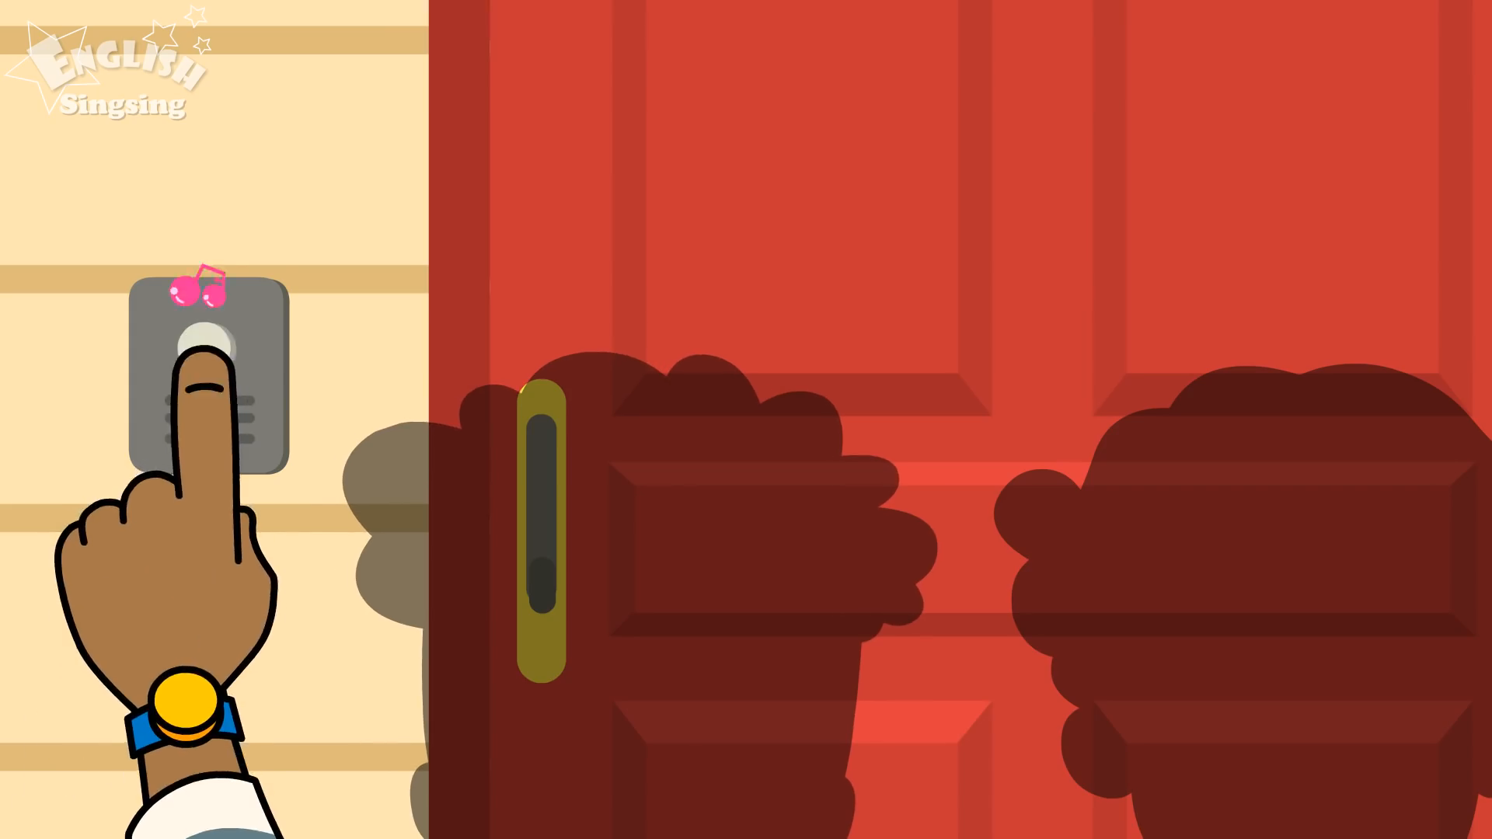
Let’s play a video

Slide 6
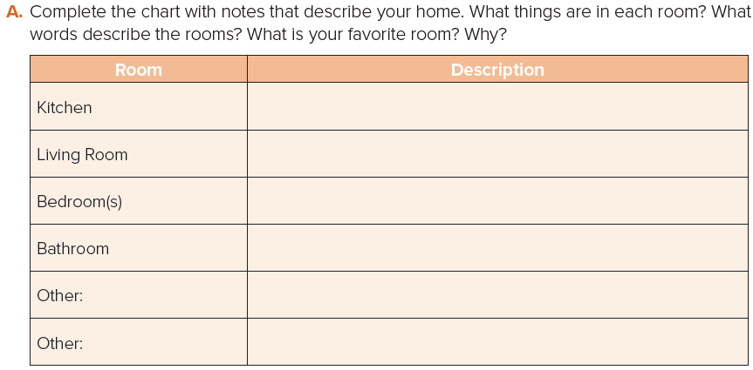
Writing
There are cabinets. There is a microwave, a sink and a stove.
There is a sofa, a Tv and a rug.
There is a bed, a closet and a desk.
There is a toilet, a shower and a mirror.
Laundry Rooms
There is a washer and a dryer.
Garden
There are some flowers.

Slide 7
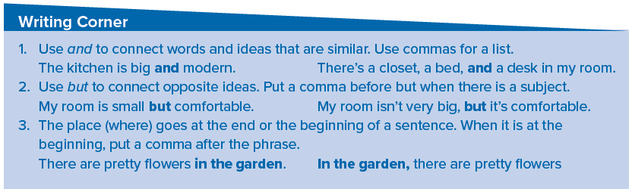
Writing

Slide 8
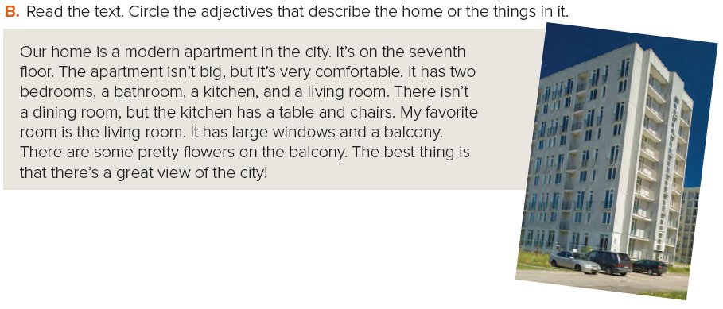
Writing
Where is the apartment?
What floor is it on? Is it big?
How many bedrooms are there?
What furniture is in the kitchen?
What is the writer’s favorite room? Why?

Slide 9
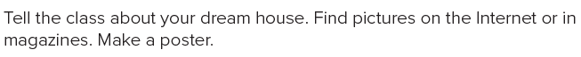

Project

Slide 10
Homework
Page 114 (E)
3

Slide 11
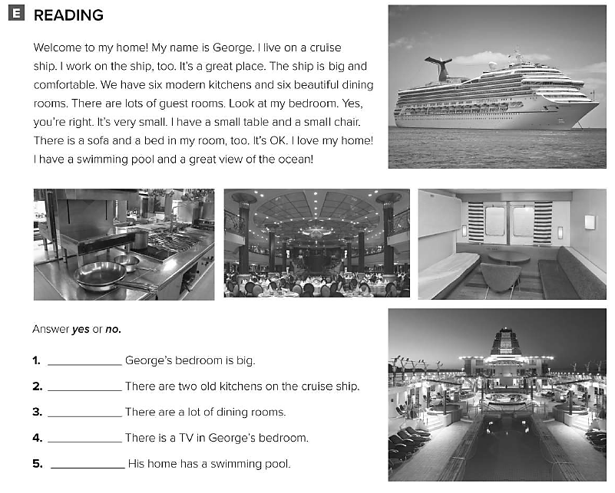
No
No
Yes
No
yes

