Slide 1

Unit 6
Is There a view?
Form, meaning & Functions

Slide 2
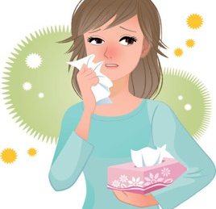
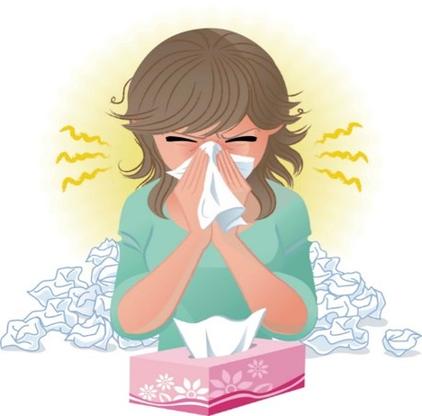
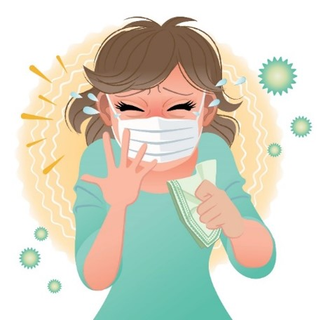
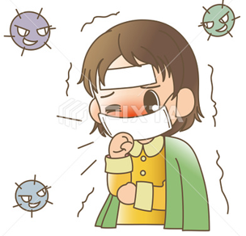

COVID 19
☺ Avoid gathering !
☺ wear a mask before going out
☺ Social distancing is not a choice, it is a must!
☺ Keep a distance of 2 meters to avoid accountability
☺ Wash hands constantly

Slide 3
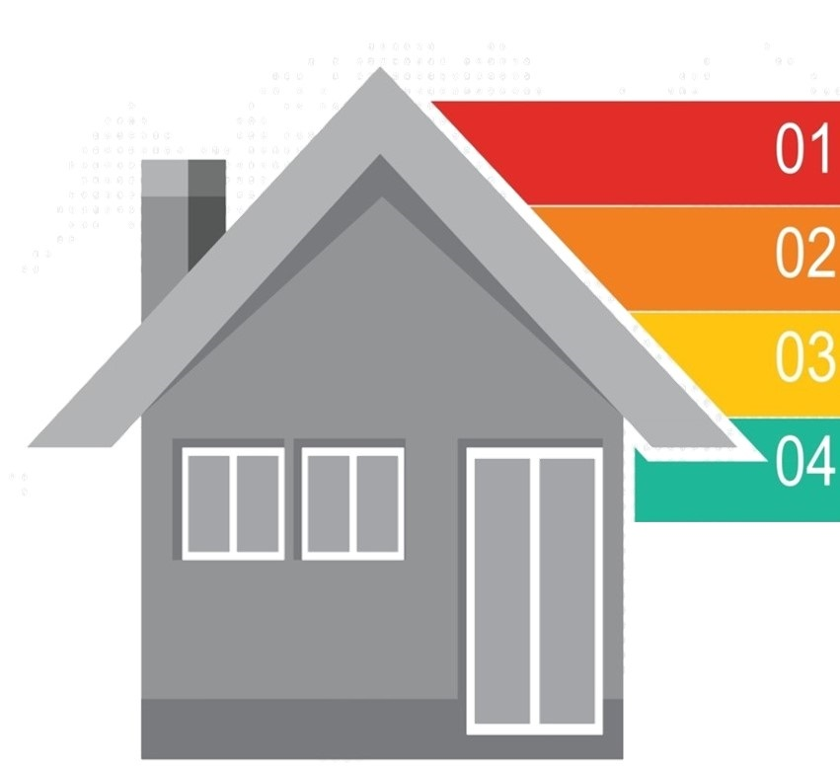
Learning Objectives
Differentiate between conjunctions correctly
Use conjunctions correctly.
Ask questions about a room and the house
Answer questions about a room an the house

Slide 4

بسم الله الرحمن الرحيم
Day:
Date:

Slide 5
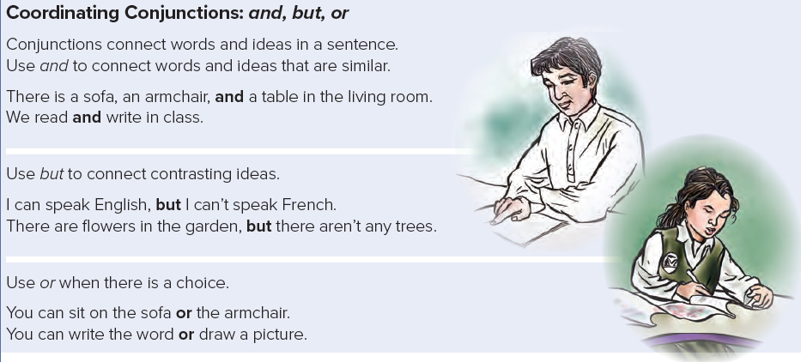
Form, Meaning and Function

Slide 6
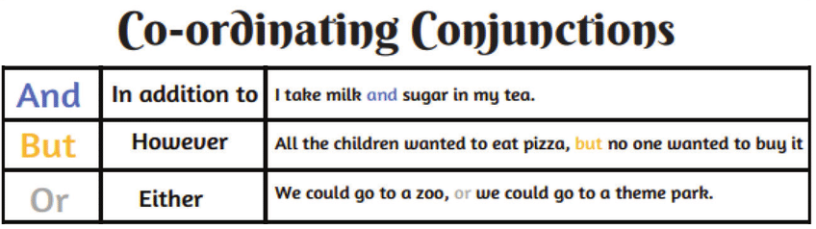

Slide 7
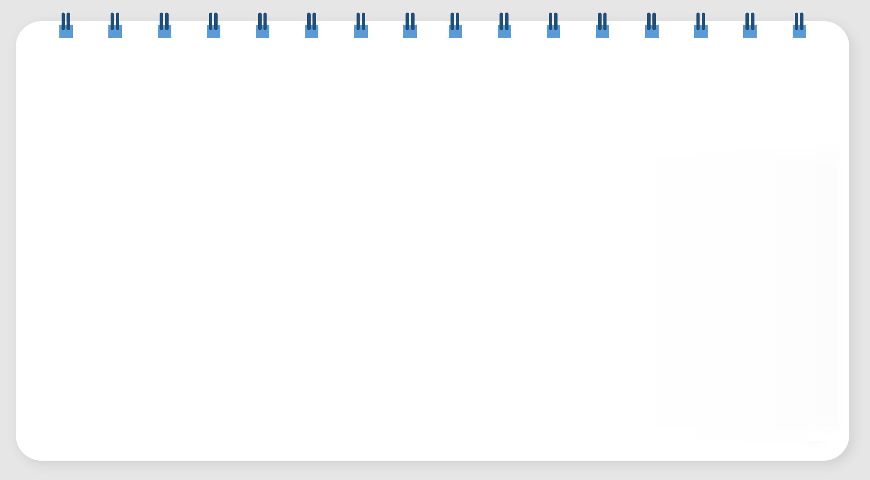
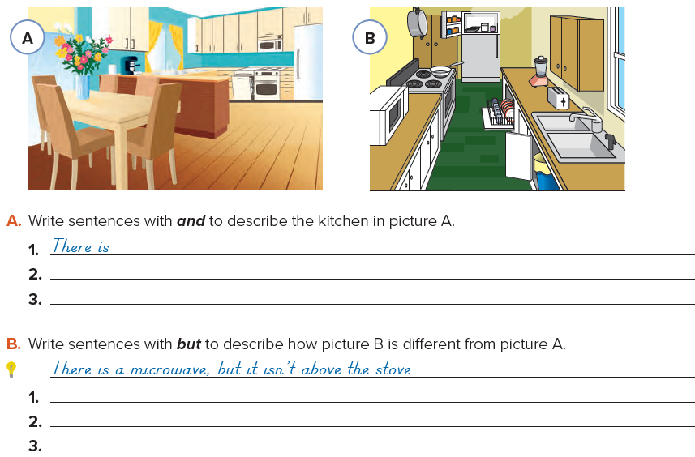
a stove, a dishwasher, and a refrigerator.
There are flowers and a vase on the table.
There is a table and chairs.

Slide 8
There is a window, but there aren’t any curtains.
There is a refrigerator, but there isn’t a table and chairs.
There is a dishwasher, but it isn’t next to the stove.

Slide 9
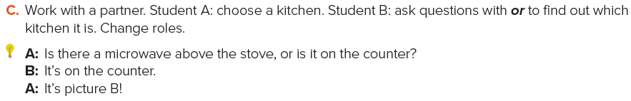

Slide 10

Practice
Ps

Slide 11
Homework
Page 114 (F)
3

Slide 12
