Slide 1
Super Goal 1

Slide 2
Unit 6

Slide 3

The objectives of the lesson :
At the end of this session, the students will be able to :
Read about unusual houses around the world
Make a discussion about unusual houses in your country

Slide 4


Slide 5
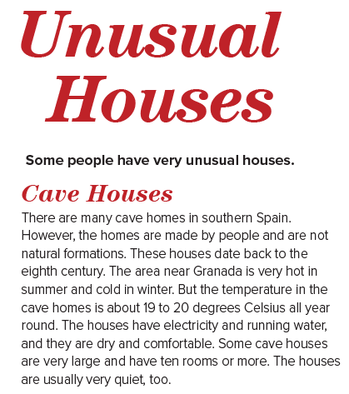

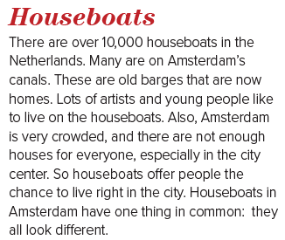

Slide 6
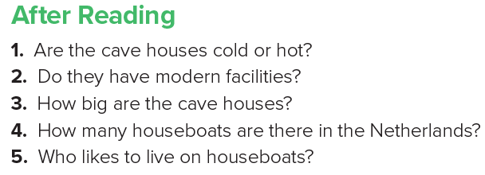
1. The cave houses aren’t cold or hot. They’re the same temperature all the time. They’re always comfortable.
2. Yes, they do. They have electricity and running water.
3. Some are very large and have ten rooms or more.
4. There are over 10,000 houseboats.
5. Artists and young people like to live on houseboats

Slide 7



