Slide 1

Unit 7
Where do you live?
Conversation & Reading

Slide 2
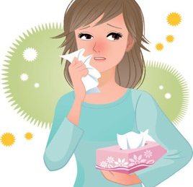
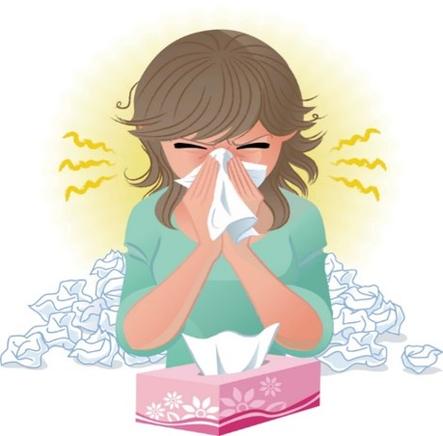
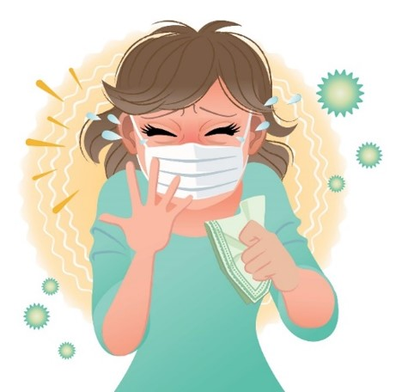
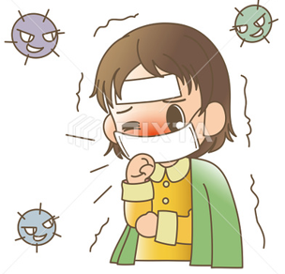

COVID 19
☺ Avoid gathering !
☺ wear a mask before going out
☺ Social distancing is not a choice, it is a must!
☺ Keep a distance of 2 meters to avoid accountability
☺ Wash hands constantly

Slide 3
بسم الله الرحمن الرحيم
Day:
Date:

Slide 4
Learning Objectives
1.read a conversation correctly
2.practice making a conversation correctly
3. give information about their neighborhood.
4. Identify the main idea of reading
5. answer questions after reading about it.

Slide 5
Conversation
Where are the people?
What do you think the boy is asking?
Pages 60 & 61

Slide 6
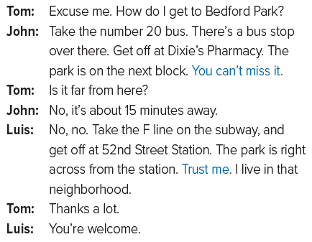

Conversation

Slide 7
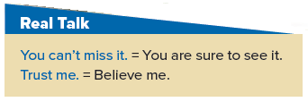
Conversation

Slide 8
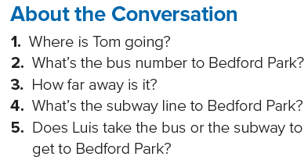
Conversation
Answers
1. He’s going to Bedford Park.
2. It’s the number 20 bus.
3. It’s about 15 minutes away by bus.
4. The F line goes to Bedford Park.
5. Luis takes the subway.

Slide 9
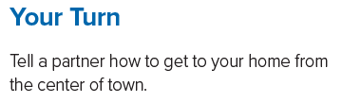
Conversation

Slide 10
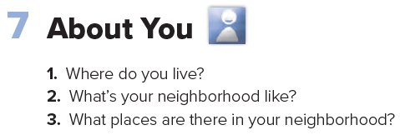
Conversation

Slide 11
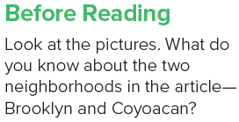
Reading

Slide 12
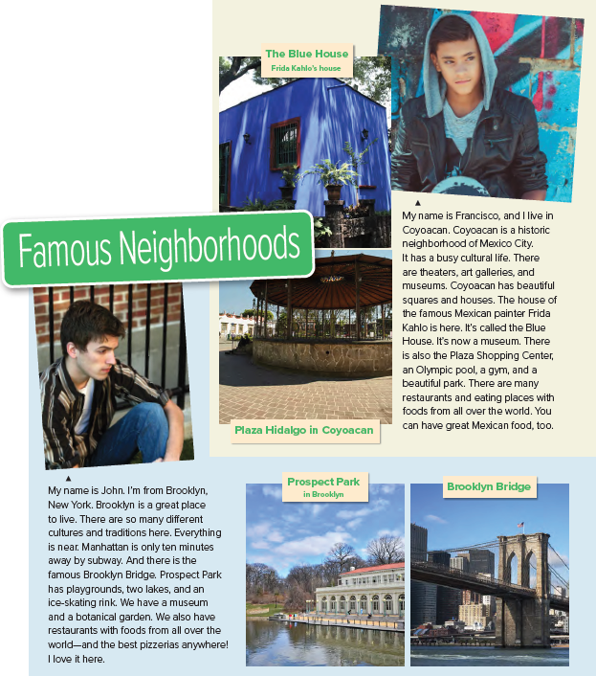
Reading

Slide 13
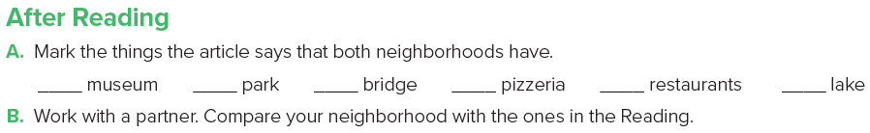

Reading

Slide 14
Homework
Page 117

Slide 15
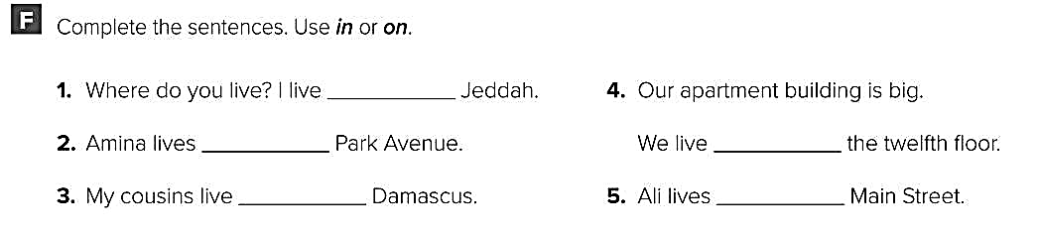
in
on
in
on
on

Slide 16
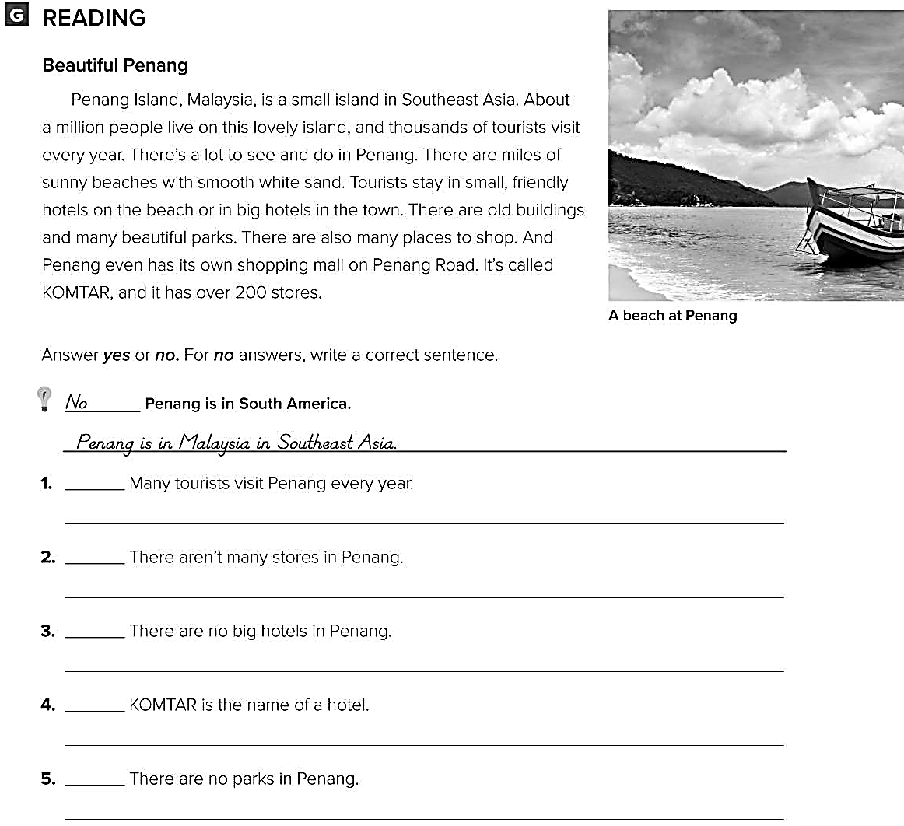
Yes
No
There are over 200 stores in Penang.
No
There are big hotels in the town.
No
KOMTAR is the name of shopping mall.
No
There are many beautiful parks in Penang.

