Slide 1

Unit 8
What are you doing?
part 4

Slide 2
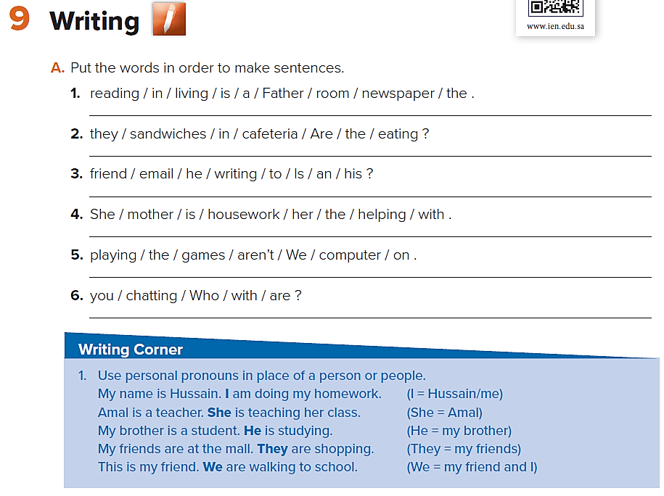
Father is reading the newspaper in the living room.
Are they eating sandwiches in the cafeteria?
Is he writing an email to his friend?
She is helping her mother with the housework.
We aren’t playing games on the computer.
Who are you chatting with?

Slide 3
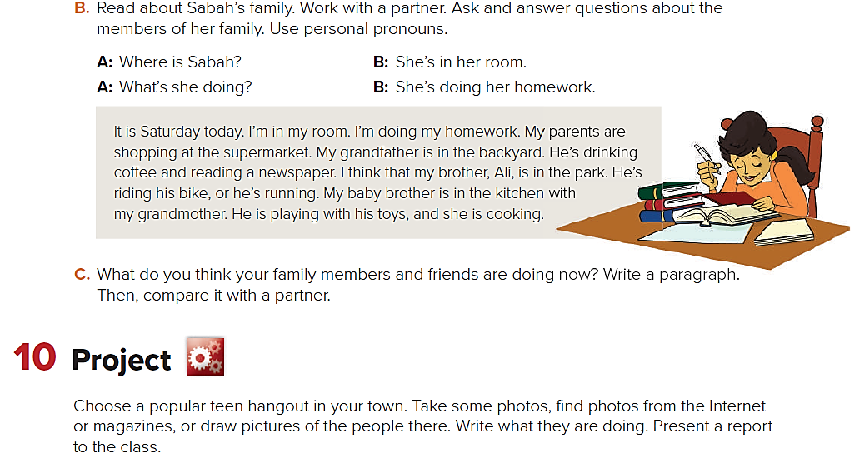
Sample answers:
A: Where are her parents?
B: They’re at the supermarket.
A: What are they doing?
B: They’re shopping.
A: Where is her grandfather?
B: He’s in the backyard.
A: What’s he doing?
B: He’s drinking coffee and reading a newspaper.
Ask and answer questions about the following people:
Ali (her brother)
her baby brother
her grandmother?

Slide 5
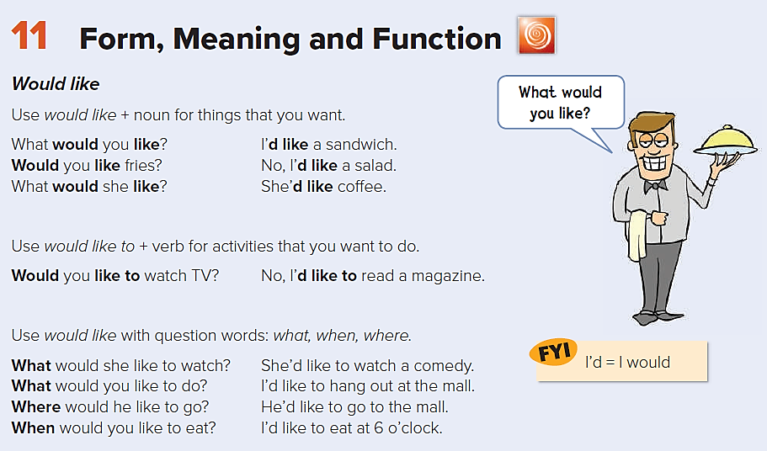

Slide 6
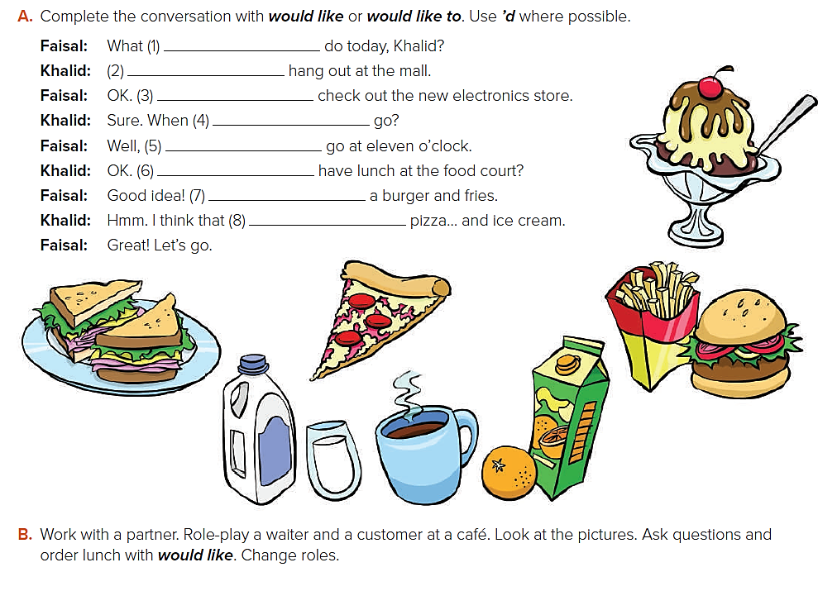
would you like to
I’d like to
I’d like to
would you like to
I’d like to
Would you like to
I’d like
I’d like
A: What would you like to eat?
B: I’d like a burger, please.
A: Would you like fries?
B: No, thank you.
A: Would you like a drink?
B: Yes, I’d like orange juice.
A: OK. Thank you.

Slide 7
A: What would you like to eat?
B: I’d like a burger, please.
A: Would you like fries?
B: No, thank you.
A: Would you like a drink?
B: Yes, I’d like orange juice.
A: OK. Thank you.

Slide 8
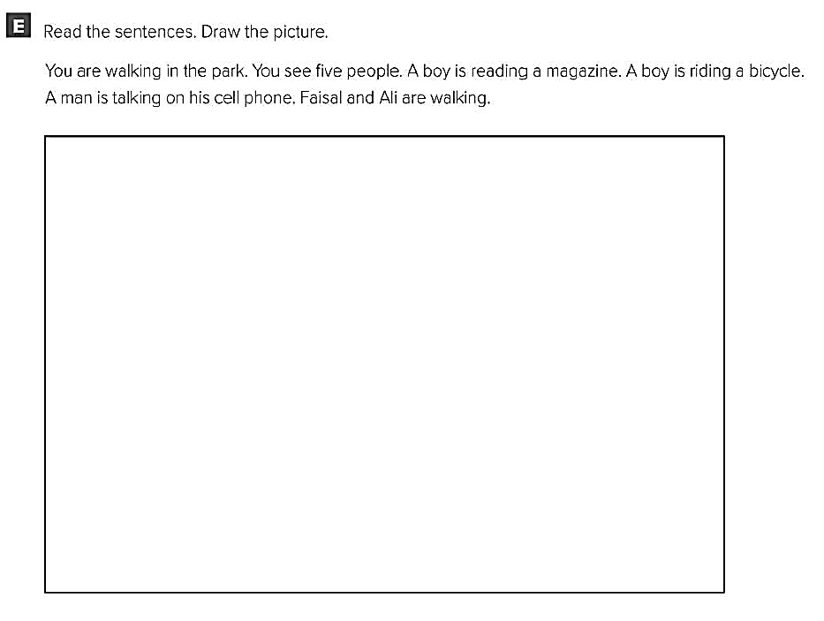
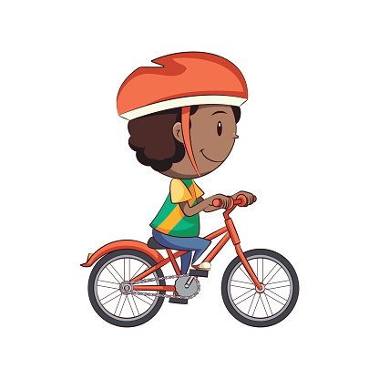
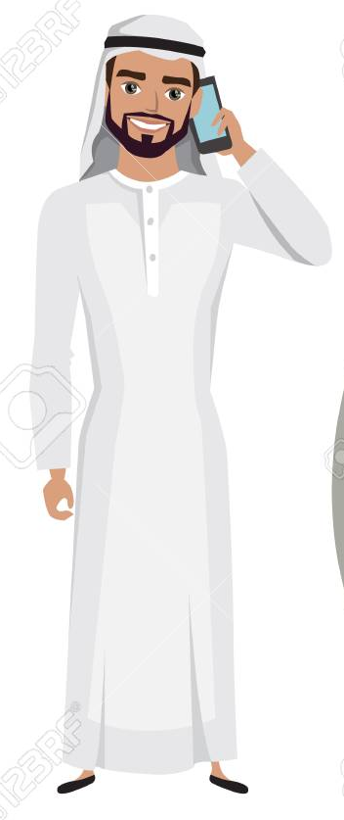
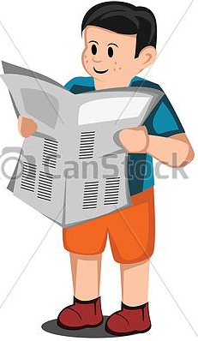
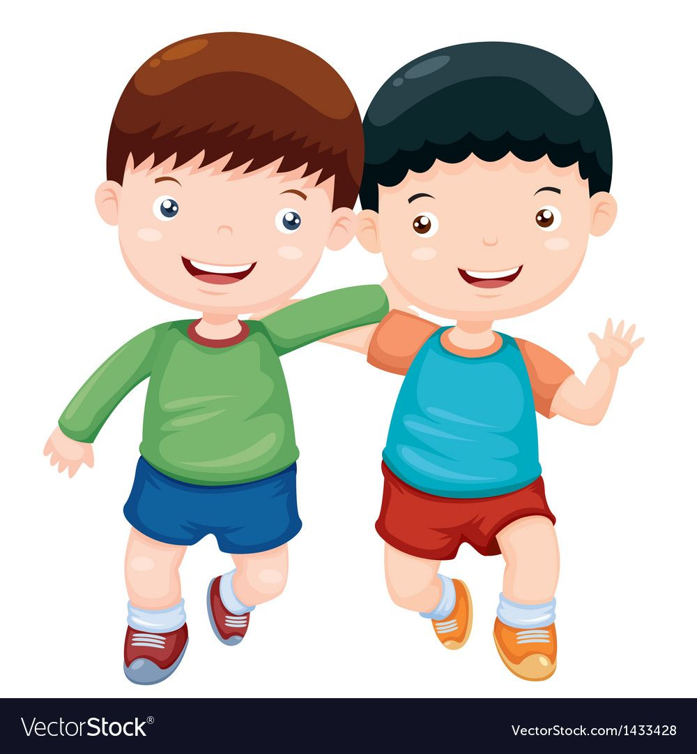

Slide 9
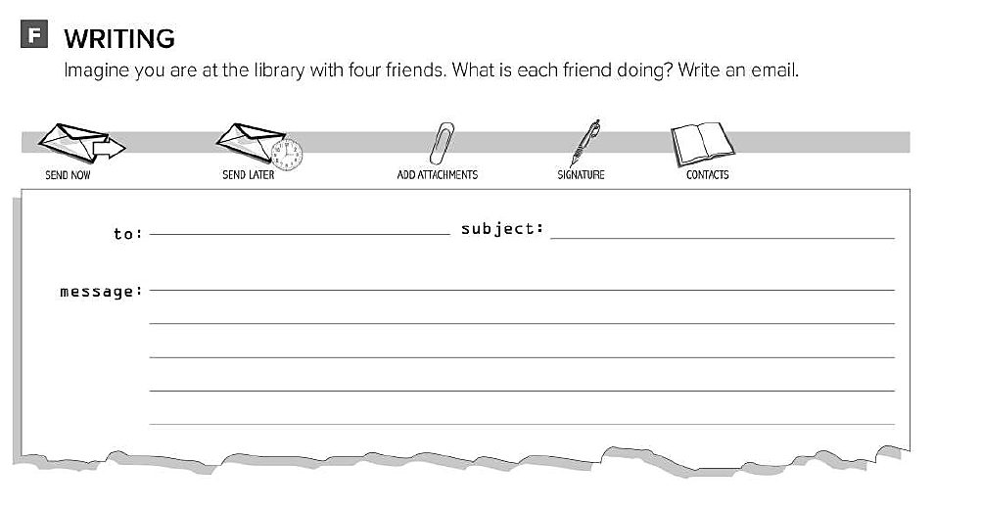
Ali fun at the library
Hello Ali , I’m writing to you from the school library . I’m here with my friends . Faisal is reading a story . Fahad is doing his homework . Omar is studying for his exam . And I’m surfing the internet . What are doing ?

