Slide 1

Unit 8
What are you doing?
Conversation & Reading

Slide 2
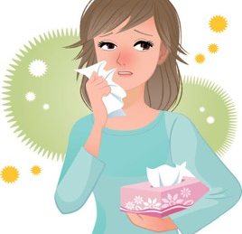
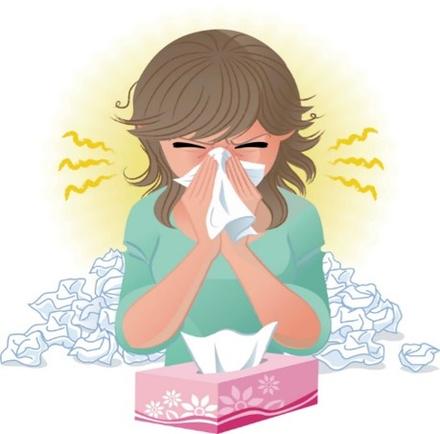
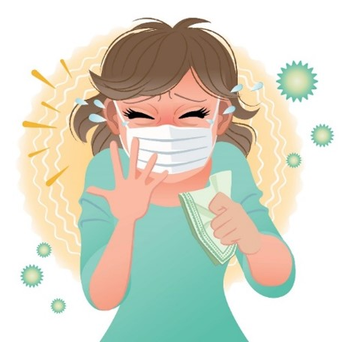
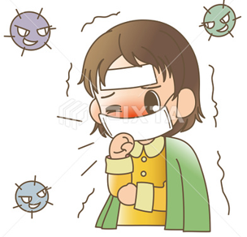

COVID 19
☺ Avoid gathering !
☺ wear a mask before going out
☺ Social distancing is not a choice, it is a must!
☺ Keep a distance of 2 meters to avoid accountability
☺ Wash hands constantly

Slide 3
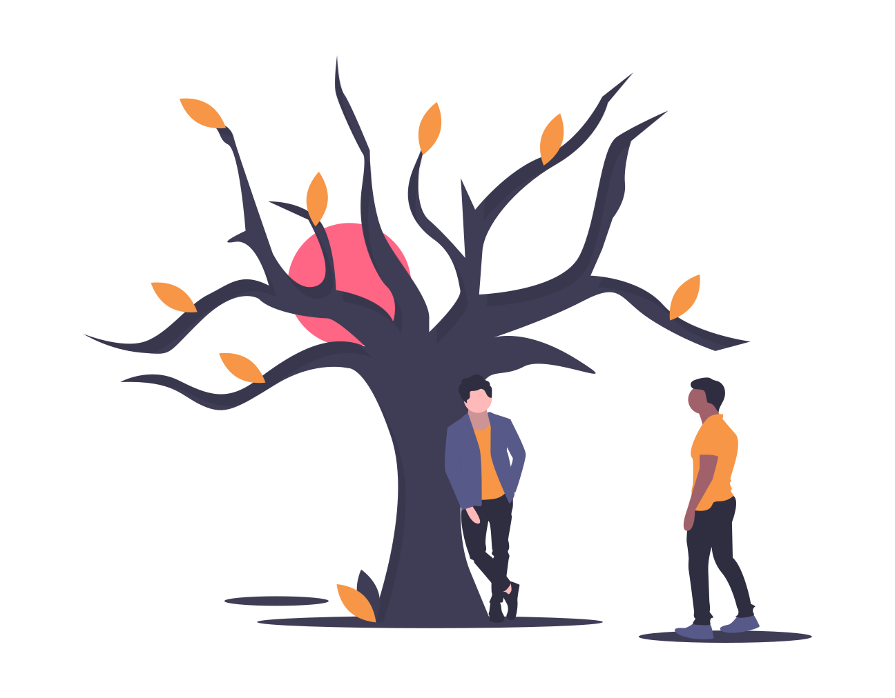
بسم الله الرحمن الرحيم
Day:
Date:

Slide 4
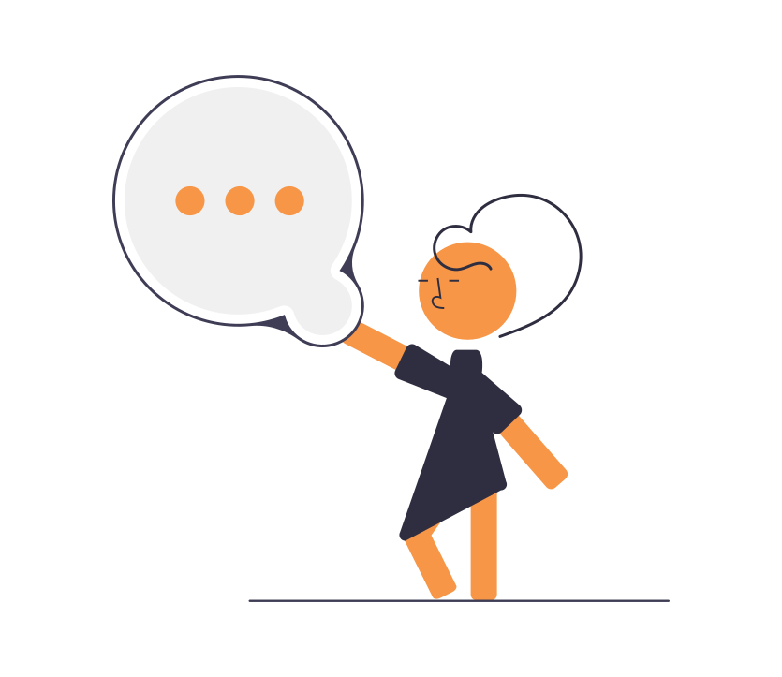
Learning Objectives
1. Read a conversation correctly.
2. Practice making a conversation correctly.
3. Answer questions about films.
4. Identify the main idea of reading.
5. Answer questions after reading about it.

Slide 5
What is the boy doing?
What is the name of the city?

Slide 6

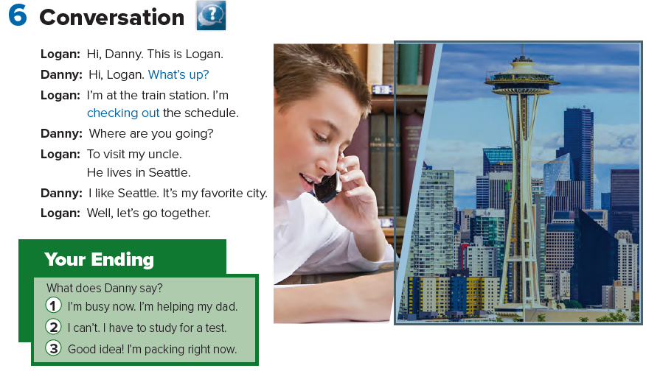

Slide 7
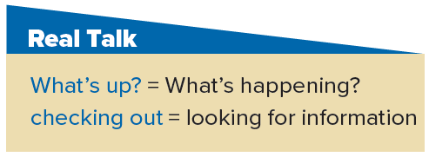

Slide 8
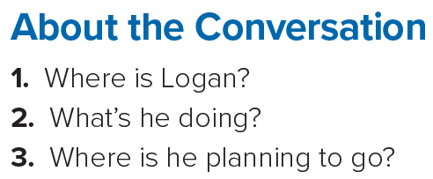
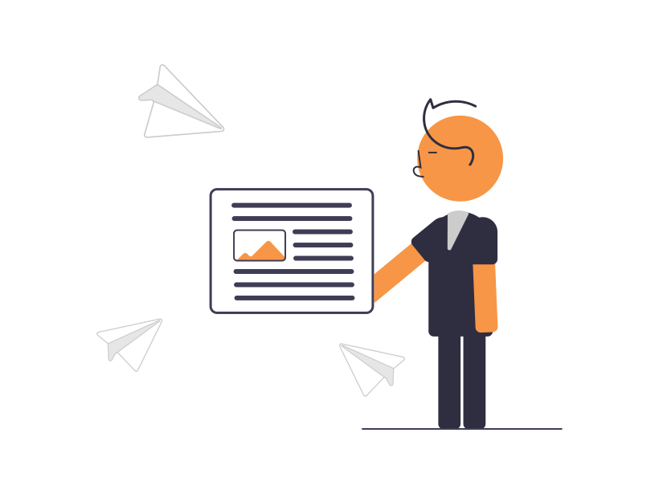
Answers
1. He’s at the train station.
2. He’s checking out the train schedule.
3. He’s planning to go to Seattle.

Slide 9
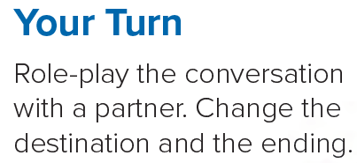
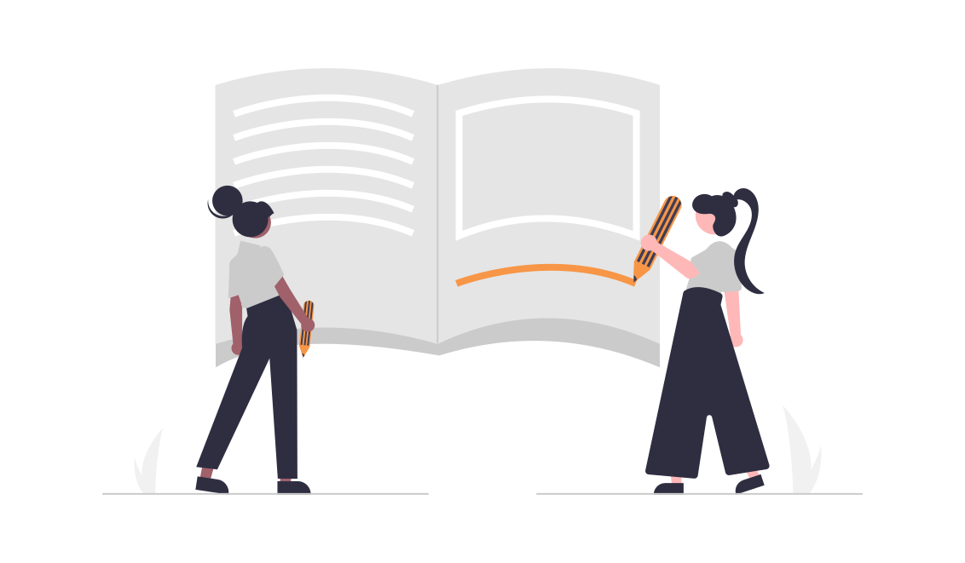

Slide 10
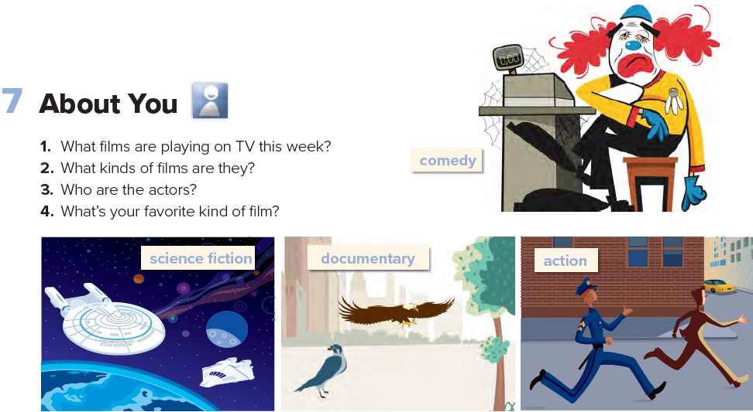

Slide 11
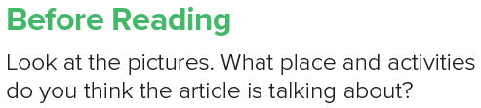

Slide 12
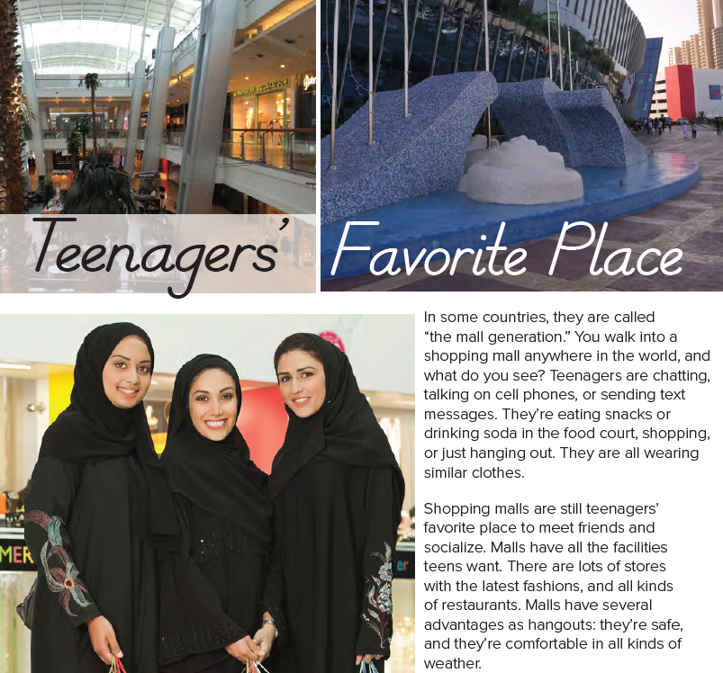

Slide 13
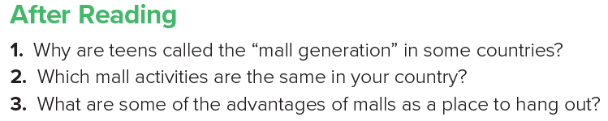
Answers
1. Because teenagers’ favorite place to meet friends and socialize is the mall.
2. Answers will vary.
3. Malls are safe, and they’re comfortable in all kinds of weather.

Slide 14
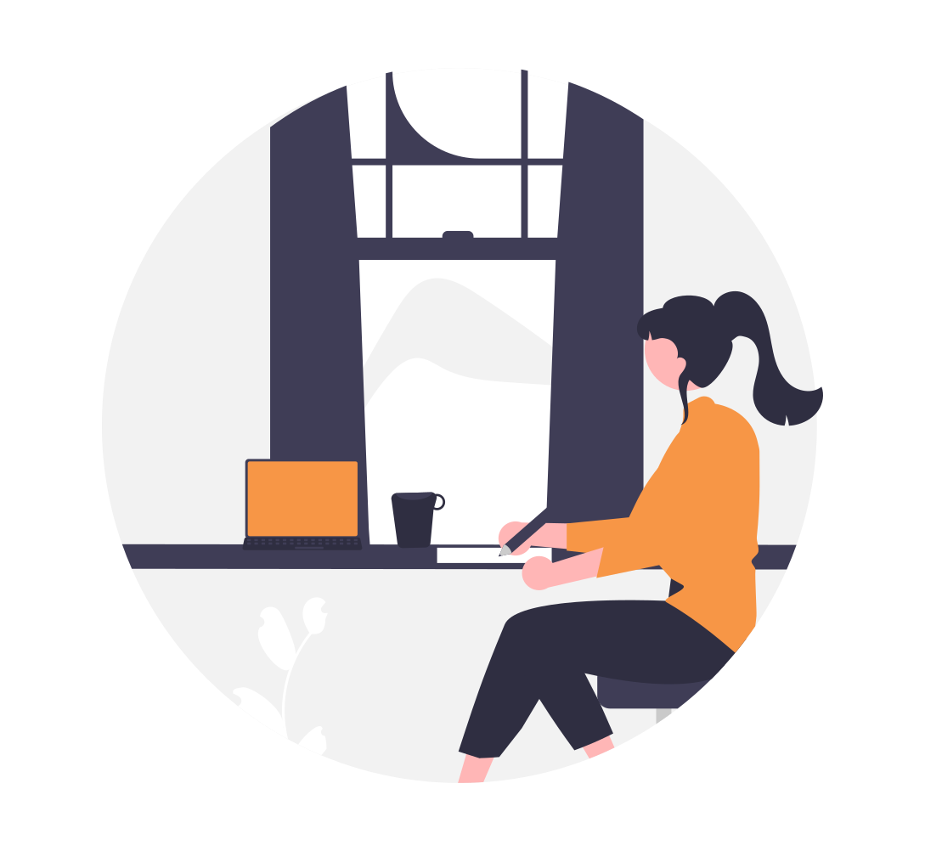
Homework
Page 121

Slide 15
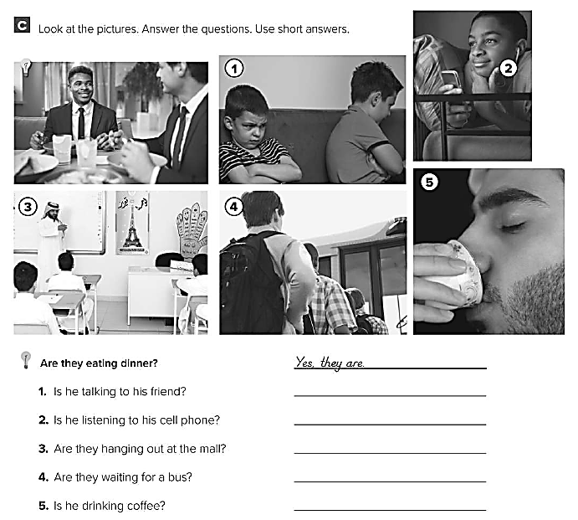
No , he isn’t
Yes , he is
No , they aren’t
Yes , they are
Yes , he is

Slide 16
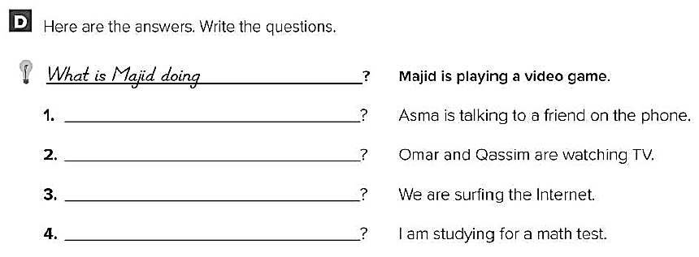
What is Asma doing ?
What are they doing ?
What are you doing ?
What are you doing ?

