Slide 1

Unit 8
What are you doing?
Form, Meaning & Function

Slide 2
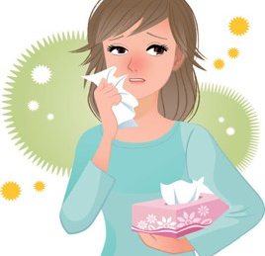
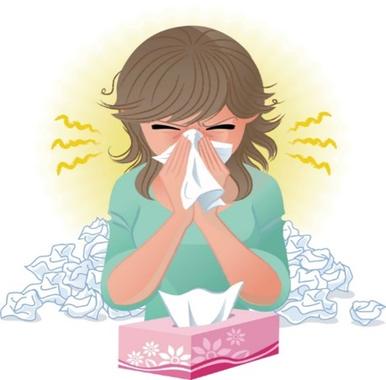
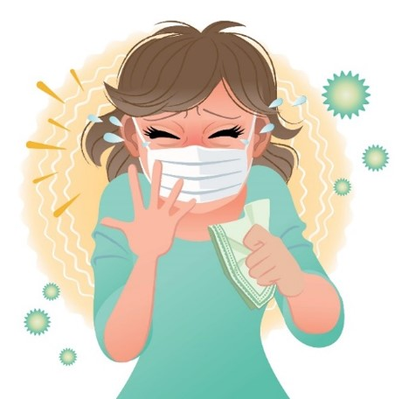
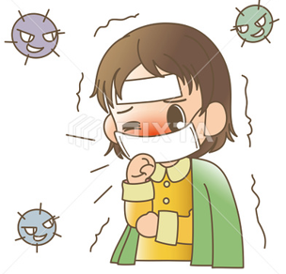

COVID 19
☺ Avoid gathering !
☺ wear a mask before going out
☺ Social distancing is not a choice, it is a must!
☺ Keep a distance of 2 meters to avoid accountability
☺ Wash hands constantly

Slide 3
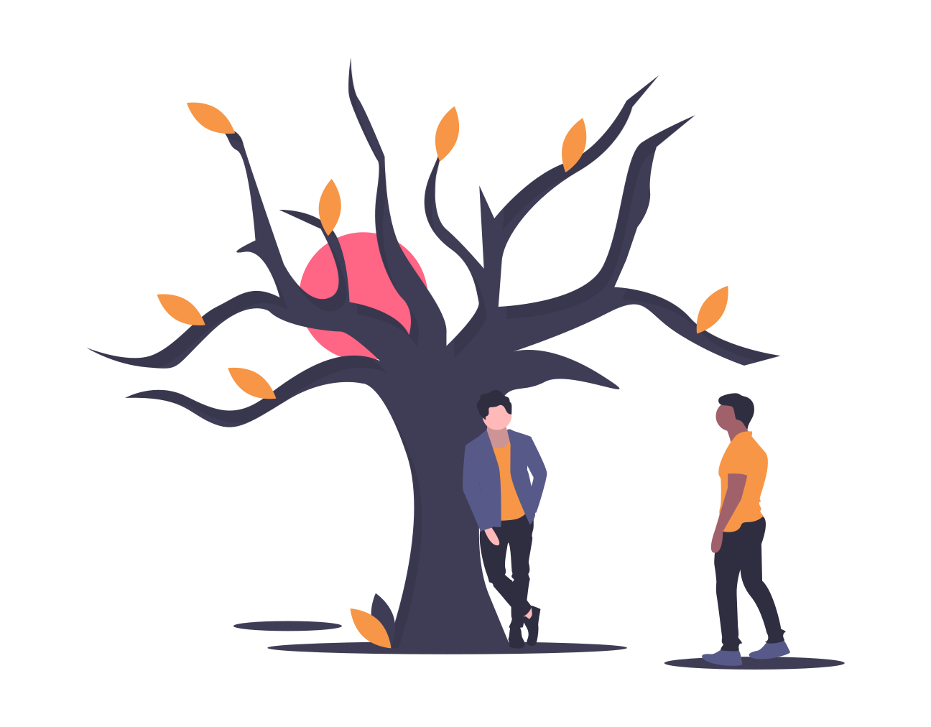
بسم الله الرحمن الرحيم
Day:
Date:

Slide 4
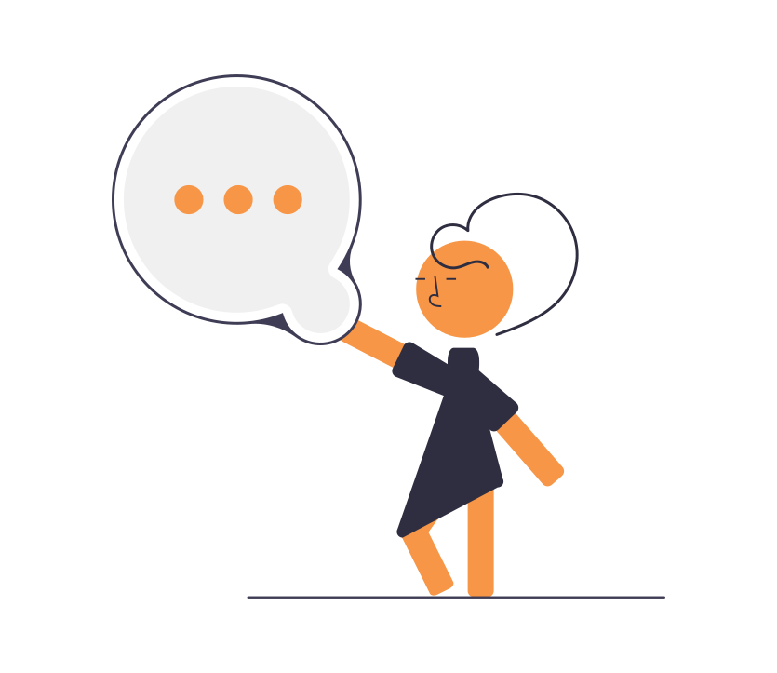
Learning Objectives
1. Use “would like” with a noun correctly.
2. Use “would like” with a verb correctly.
3. Use “would like” in questions correctly.
4. Complete a conversation correctly.

Slide 5



Slide 6
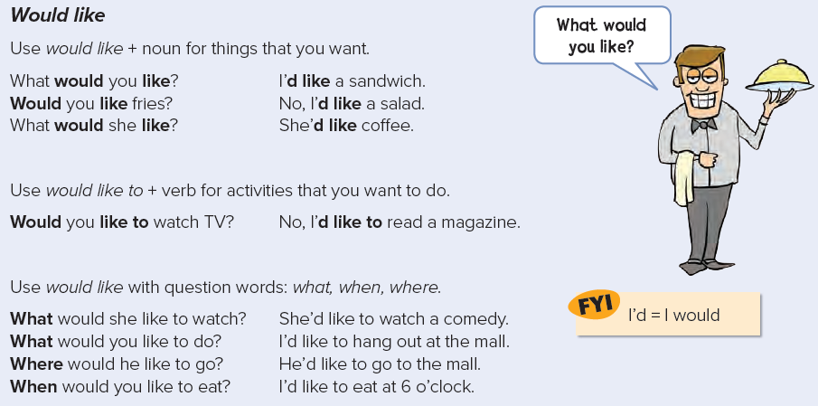
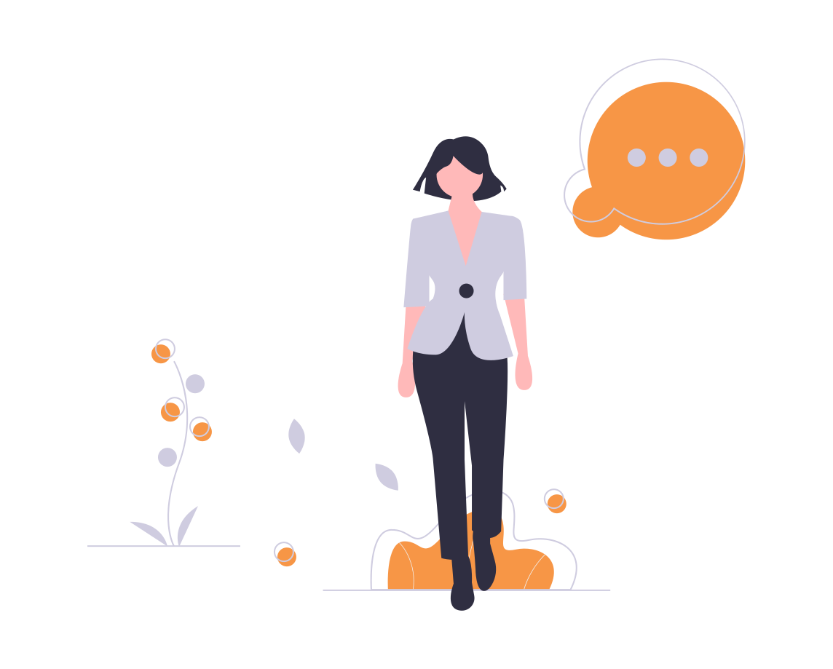

Slide 7

Practice

Slide 8
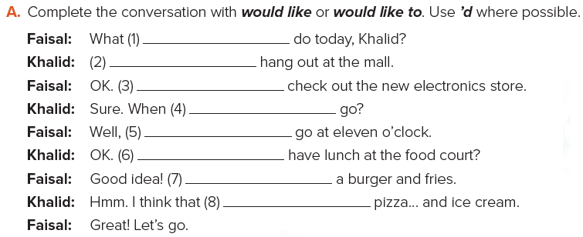
would you like to
I’d like to
I’d like to
would you like to
I’d like to
Would you like to
I’d like
I’d like

Slide 9
Answers
A: What would you like to eat?
B: I’d like a burger, please.
A: Would you like fries?
B: No, thank you.
A: Would you like a drink?
B: Yes, I’d like orange juice.
A: OK. Thank you.

Slide 10

Homework
Page 122(F)

Slide 11
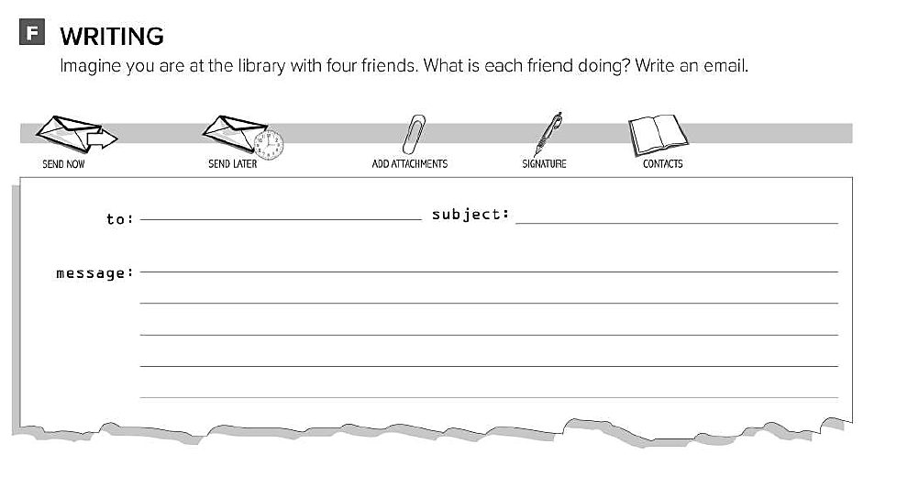
Ali fun at the library
Hello Ali , I’m writing to you from the school library . I’m here with my friends . Faisal is reading a story . Fahad is doing his homework . Omar is studying for his exam . And I’m surfing the internet . What are doing ?

