Slide 1

Unit 7
Where do you live?
part 3

Slide 2
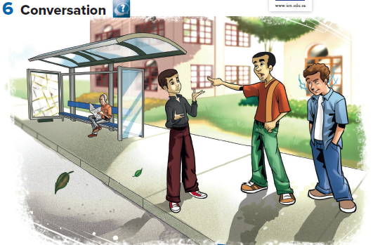

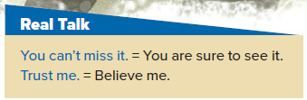
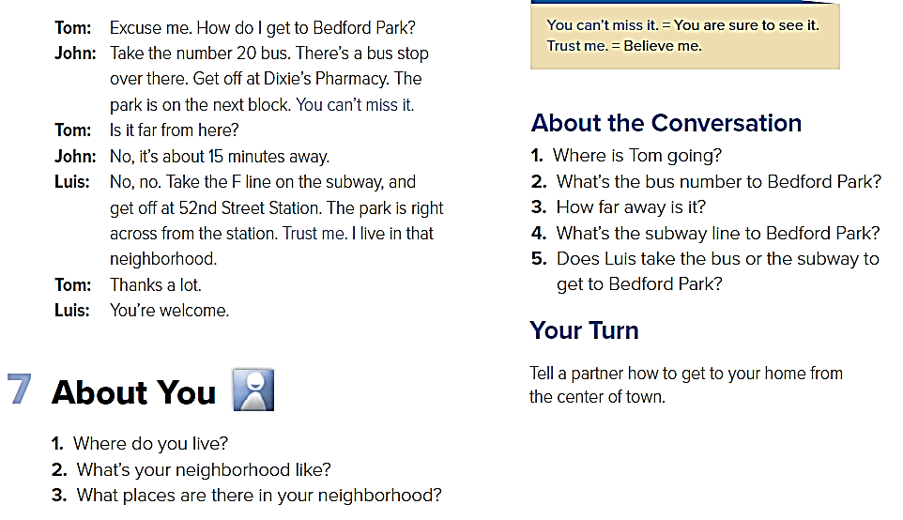
He’s going to Bedford Park.
It’s the number 20 bus.
It’s about 15 minutes away by bus.
The F line goes to Bedford Park.
Luis takes the subway.

Slide 3

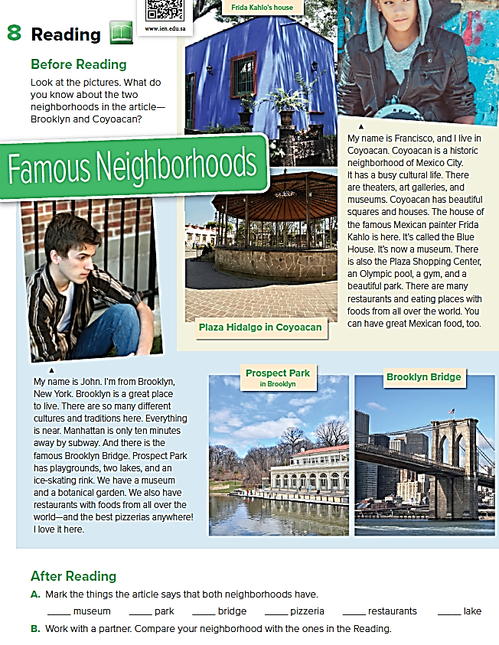



Slide 4
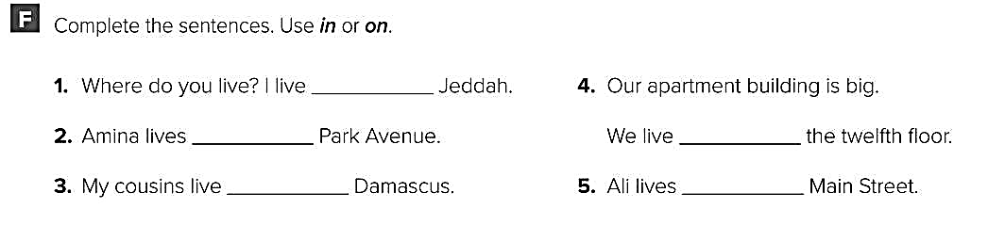
in
on
in
on
on

Slide 5
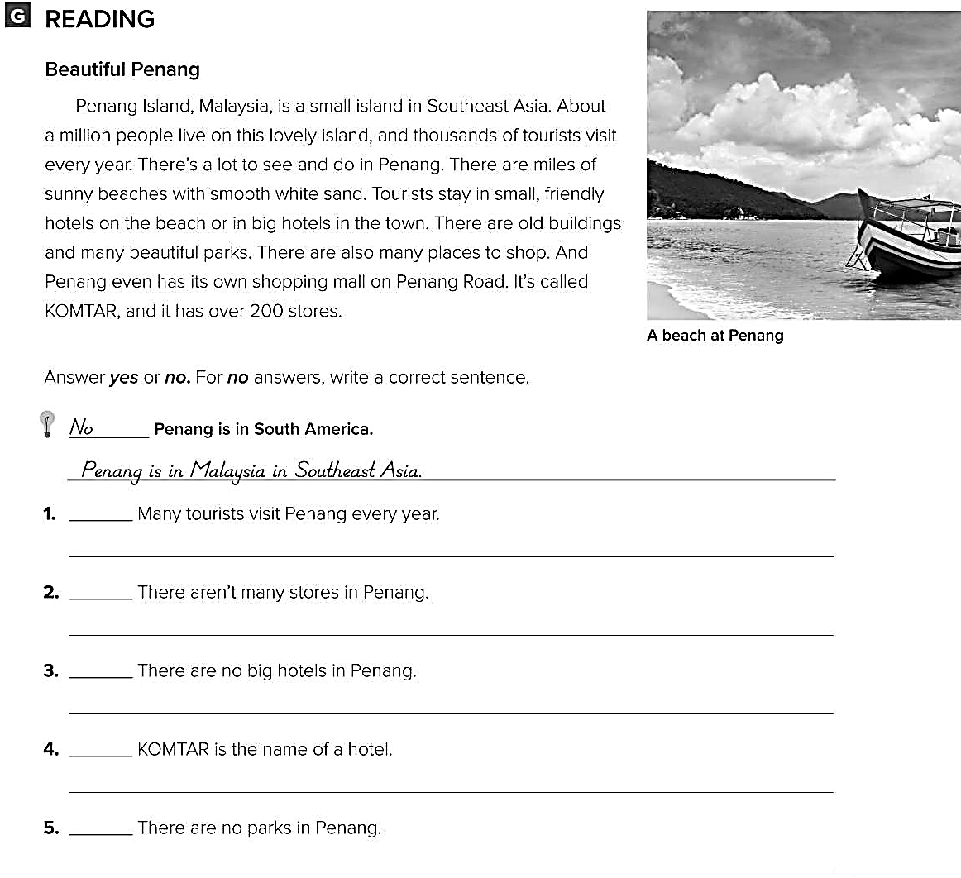
Yes
No
There are over 200 stores in Penang.
No
There are big hotels in the town.
No
KOMTAR is the name of shopping mall.
No
There are many beautiful parks in Penang.

