Slide 1

Unit 1
What Do You Do ?
part 2

Slide 2
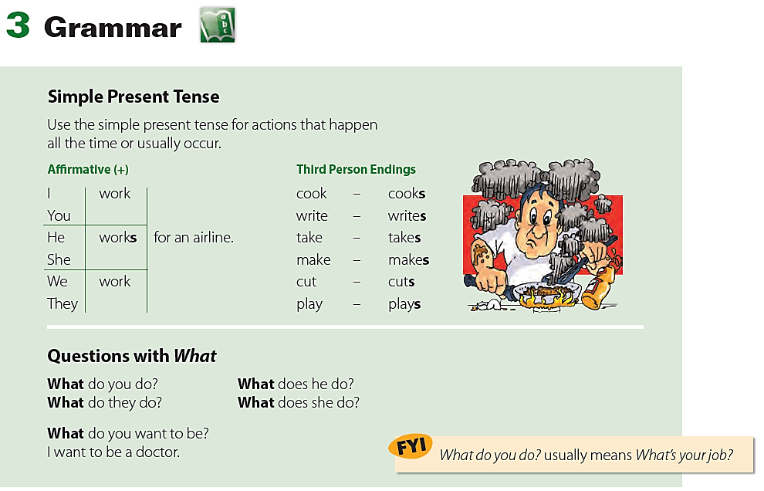

Slide 3
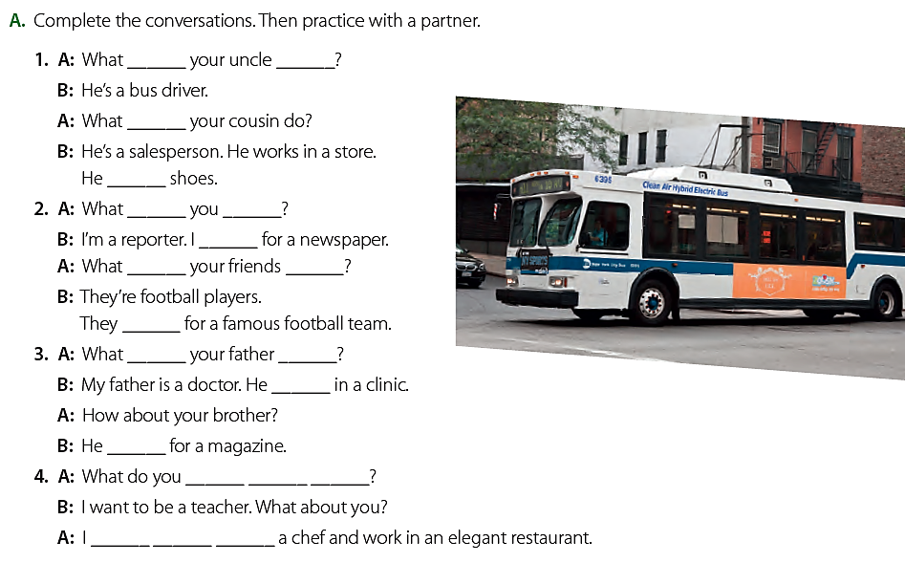
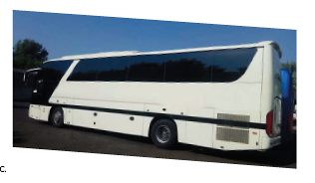
does
does
sells
do
write
do
play
does
works
works
want to be
want to be
do
do
do
do

Slide 4
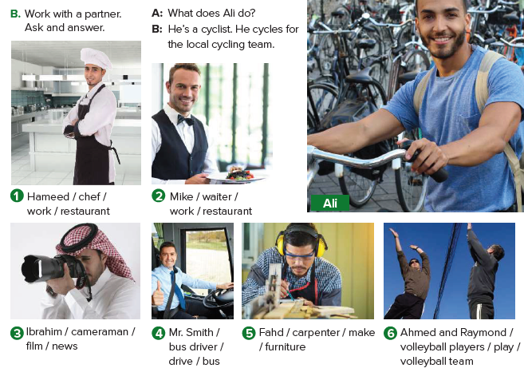
1. A: What does Hameed do?
B: He’s a cook. He works in a restaurant.
2. A: What does Mike do?
B: He’s a waiter. He works in a restaurant.
3. A: What does Ibrahim do?
B: He’s a cameraman. He films the news.
4. A: What does Mr. Smith do?
B: He’s a bus driver. He drives a bus.
5. A: What does Fahd do?
B: He’s a carpenter. He makes furniture.
6. A: What do Ahmed and Raymond do?
B: They’re volleyball players. They play for a volleyball team.

Slide 5
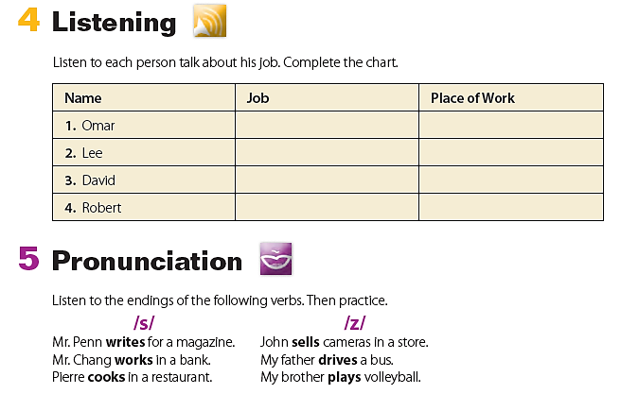

chef
salesperson
teacher
doctor
restaurant
store
school
hospital

Slide 6
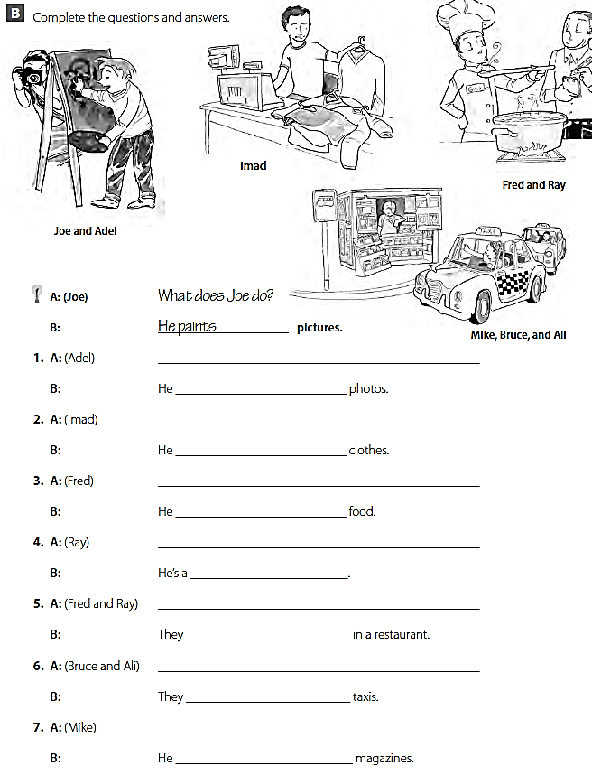
What does Adel do ?
takes
What does Imad do ?
sells
What does Fred do ?
cooks
What does Ray do ?
waiter
What do Fred and Ray do ?
work
What do Bruce and Ali do ?
drive
What does Mike do ?
sells

