Slide 1


Super goal 2
Unit 1
Lesson 2 Grammar+ listening+ pronunciation
اعداد المعلم / يحيى المنقري متوسطة المأمون بالهفوف

Slide 2

Learning Objectives
*By the end of this lesson, Ss will be able to:
1- Use present simple tense in sentences .
2- Build up questions and answers using ( what) .
3- produce the different "s" sounds at the verb endings .
4- complete a chart from a listening material .

Slide 3
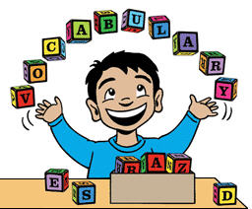

Slide 4
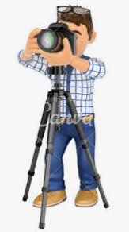
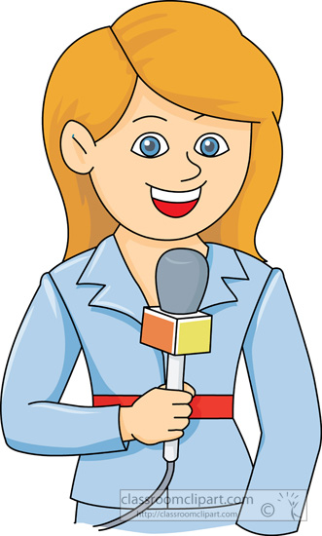


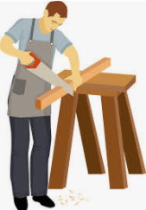
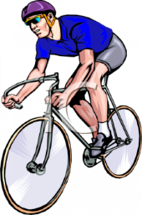
Reporter
Cameraman
Carpenter
Cyclist

Slide 5
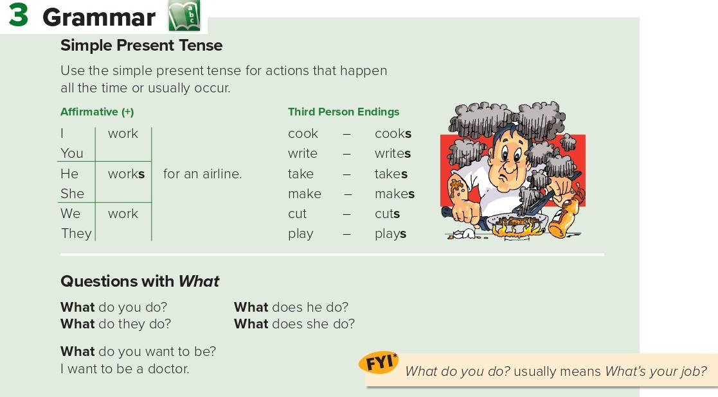
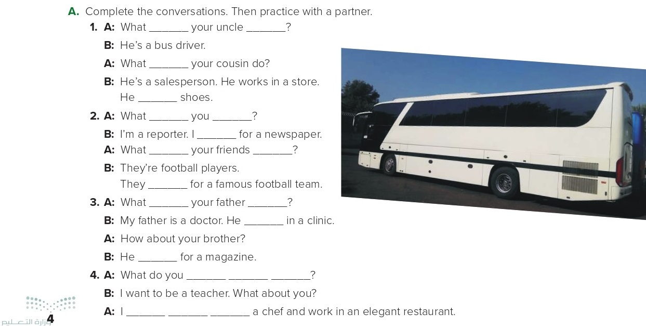
does
do
does
sells
do
do
write
do
do
play
does
do
works
works
want to be
want to be

Slide 6
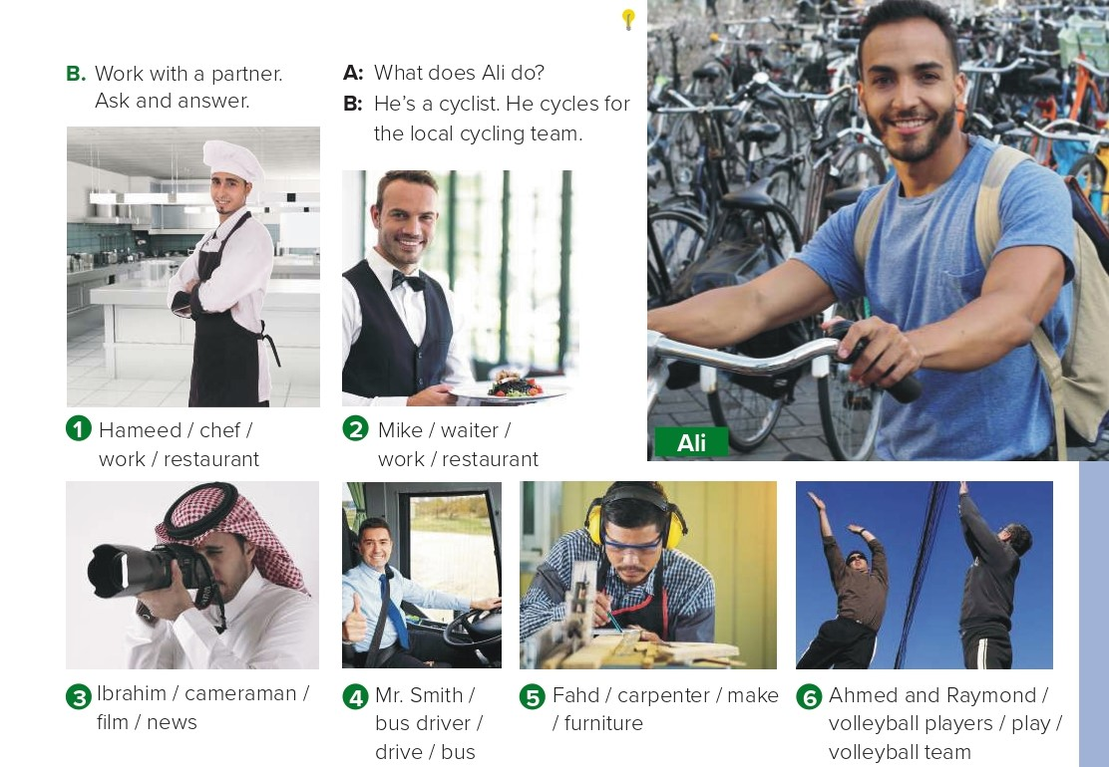
1- A: What does Hameed do ?
B: He’s a cook. He works in a restaurant.
2. A: What does Mike do ?
B: He’s a waiter. He works in a restaurant.
3. A: What does Ibrahim do ?
B: He’s a cameraman. He films the news.
.
4. A: What does Mr. Smith do ?
B: He’s a bus driver. He drives a bus.
5. A: What does Fahd do ?
B: He’s a carpenter. He makes furniture.
6. A: What do Ahmed and Raymond do ?
B: They’re volleyball players. They play for a volleyball team

Slide 7
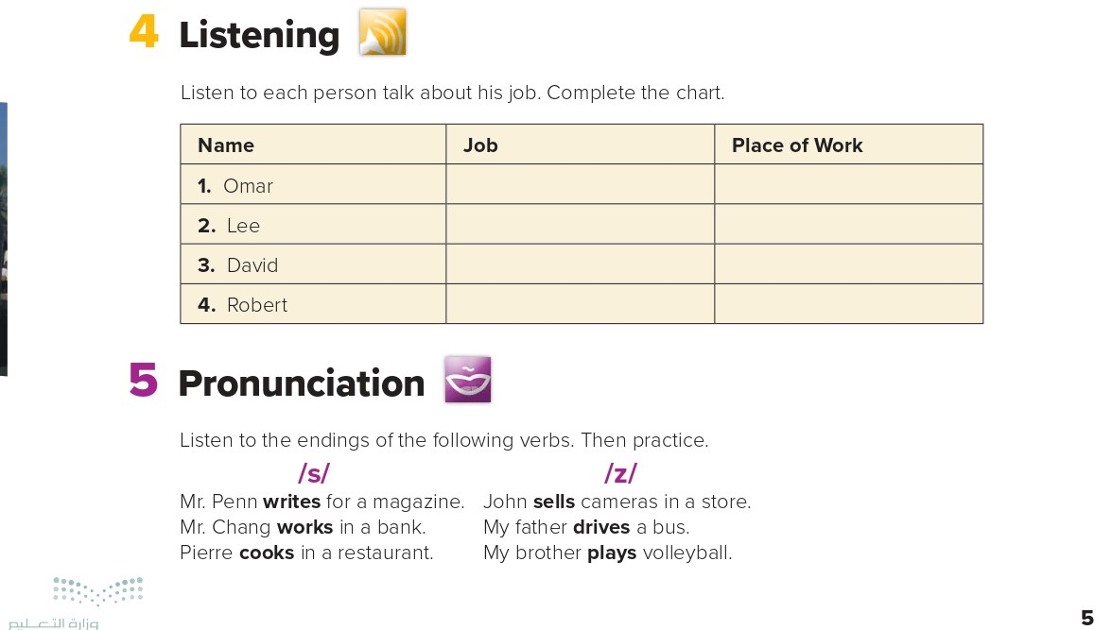
chef
restaurant
salesperson
store
teacher
school
doctor
hospital

Slide 8
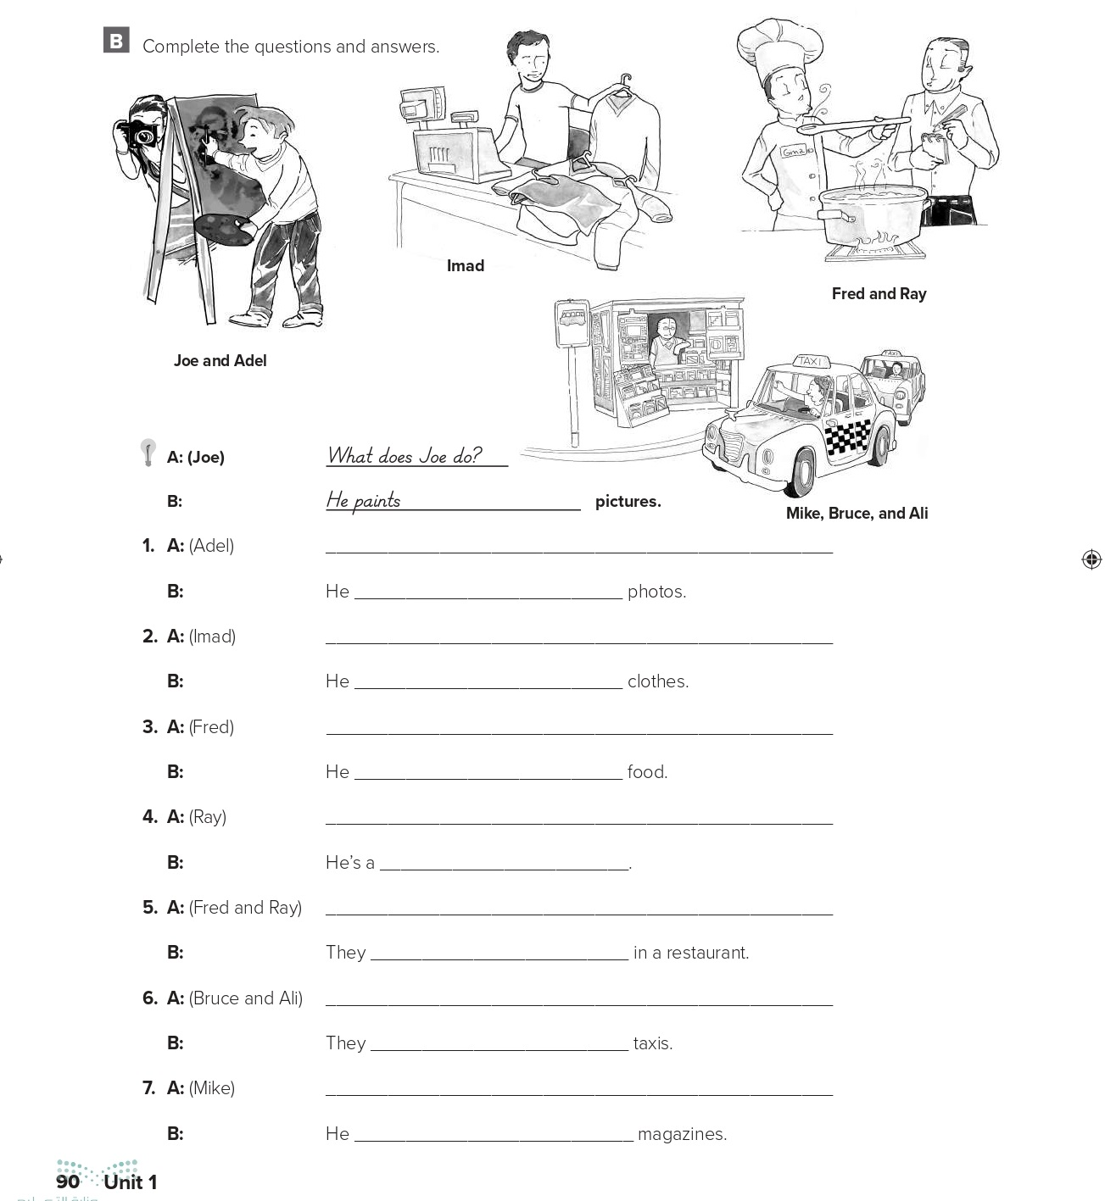
What does Adel do ?
takes
What does Imad do ?
sells
What does Fred do ?
cooks
What does Ray do ?
waiter
What do Fred and Ray do ?
work
What do Bruce and Ali do ?
drive
What does Mike do ?
sells

Slide 9
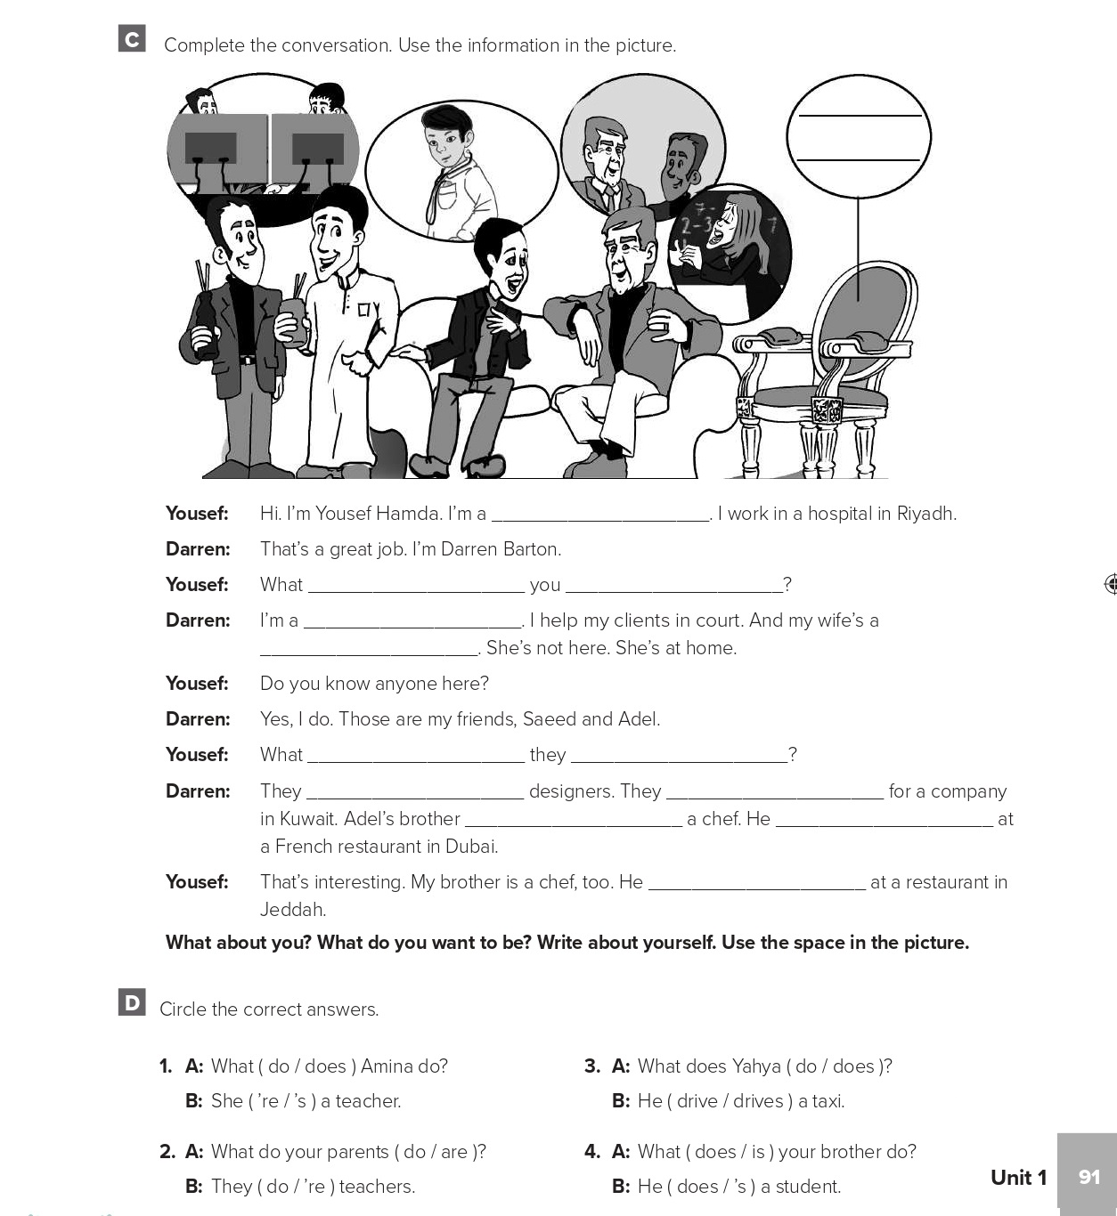
doctor
do
do
lawyer
teacher
do
do
are
work
is
works
works

Slide 10
Choose the correct answer :
1-
He ………. In a hospital
works
work
2-
We ……………….. football
plays
Play
3-
4-
Reporter
Cameraman
Carpenter
Cyclist

Slide 11


Slide 12


Back

Slide 13


Back

