Slide 1

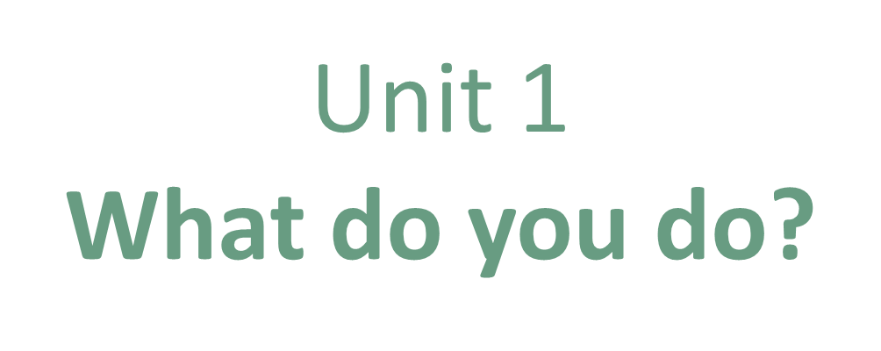
Writing

Slide 2
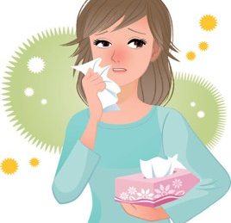
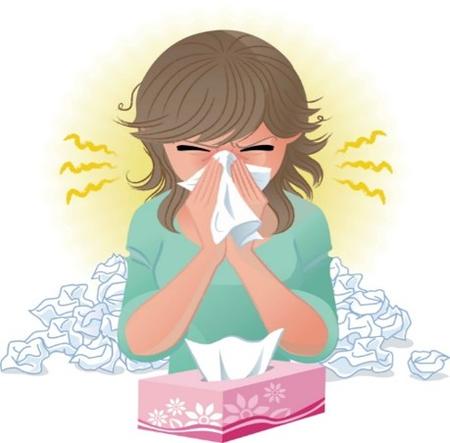
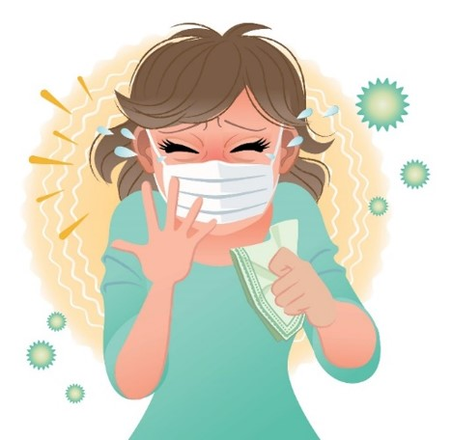
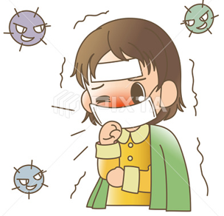

COVID 19
☺ Avoid gathering !
☺ wear a mask before going out
☺ Social distancing is not a choice, it is a must!
☺ Keep a distance of 2 meters to avoid accountability
☺ Wash hands constantly

Slide 3
Day
بسم الله الرحمن الرحيم
Date

Slide 4

LEARNING OBECTIVES
01 answer questions about dream job correctly.
02 differentiate between conjunctions correctly
03 use conjunctions correctly
04 write about dream job correctly

Slide 5
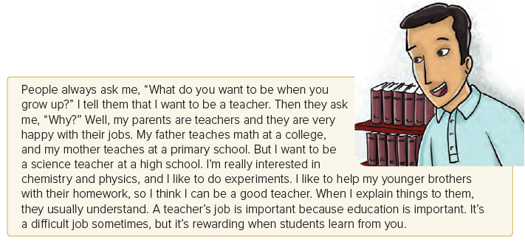

Slide 6
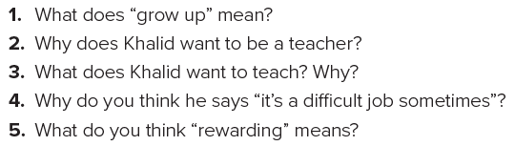
1. become an adult
2. His parents are teachers and they are happy with their jobs.
3. He wants to teach science because he’s interested in chemistry and physics, and he likes to do experiments.
4. Answers will vary.
5. satisfying; pleasing
Answers

Slide 7
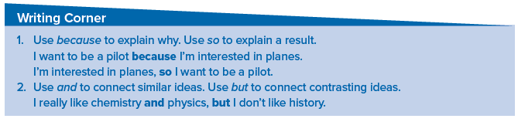

Slide 8

Practice

Slide 9
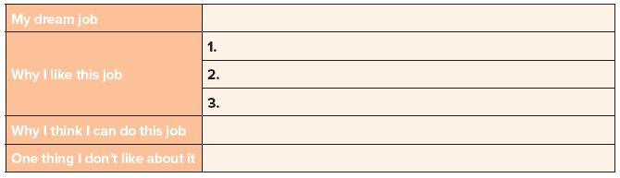
I want to be a doctor
I can save lives
The salary is satisfying
People respect doctors
I study hard to get into the medical college
It can be stressful job

Slide 10
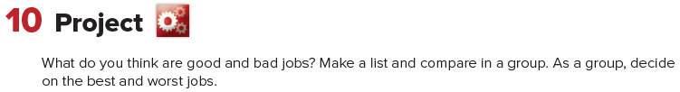
Bad Jobs | Good Jobs

Slide 11
Homework
Page 91 E

Slide 12
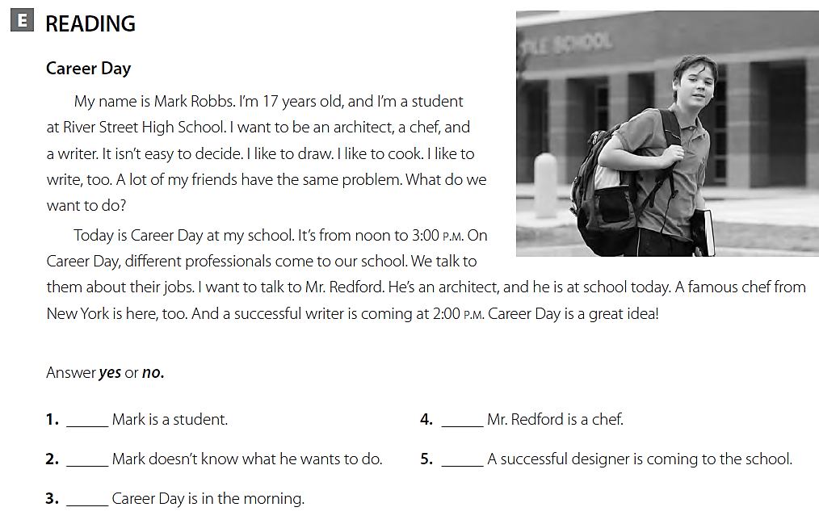
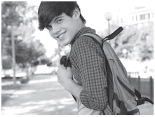
yes
no
yes
no
no

