Slide 1


Listen & Discuss

Slide 2
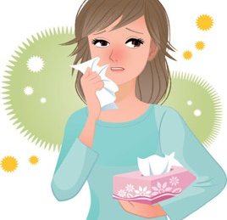
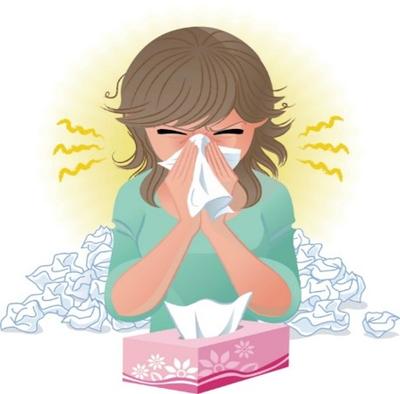
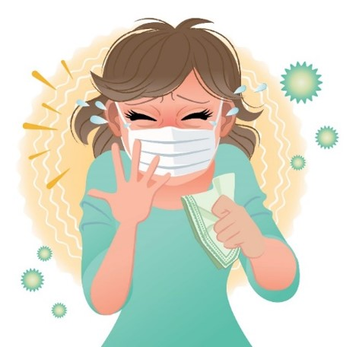
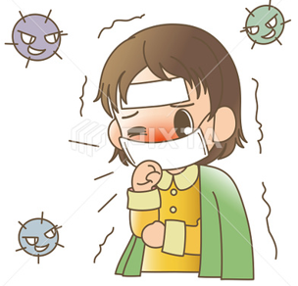

COVID 19
☺ Avoid gathering !
☺ wear a mask before going out
☺ Social distancing is not a choice, it is a must!
☺ Keep a distance of 2 meters to avoid accountability
☺ Wash hands constantly

Slide 3
Day
بسم الله الرحمن الرحيم
Date

Slide 4

LEARNING OBECTIVES
01 List a number of jobs
02 Describe job activity
03 Discuss future jobs using " want "
04 Ask questions about jobs correctly
05 Answer questions about jobs correctly

Slide 5
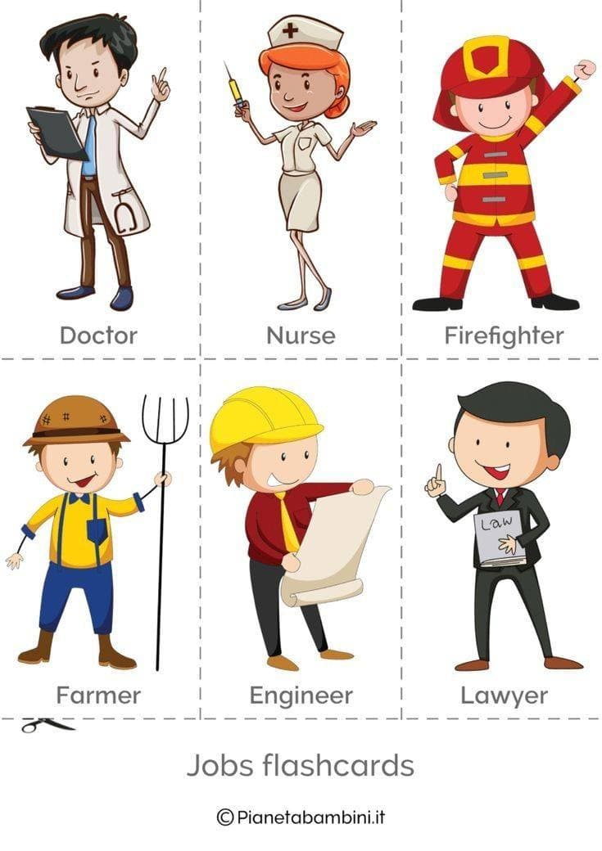
Vocabulary

Slide 6
Vocabulary

Slide 7
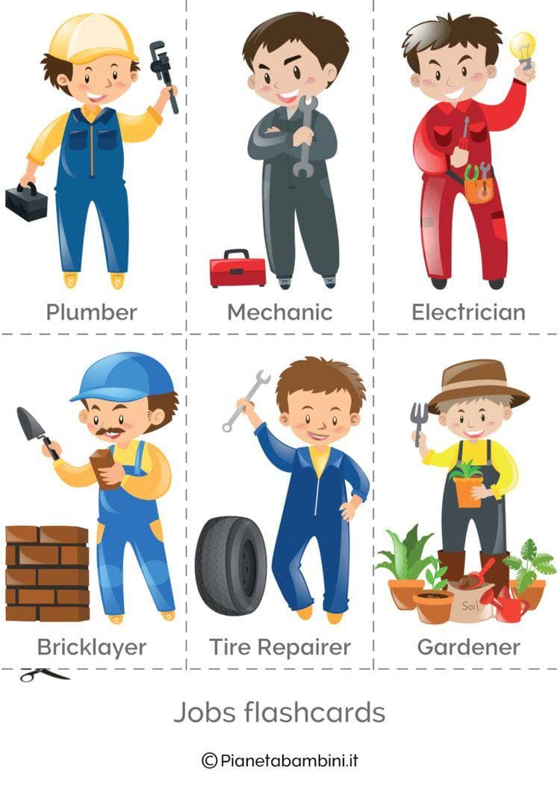

Vocabulary

Slide 8

Vocabulary
Teacher

Slide 9
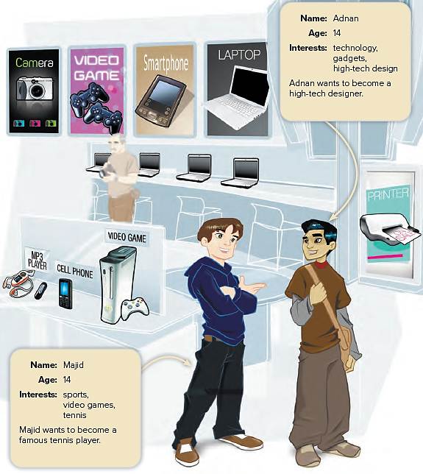

Look at the information about the boys.
What do they want to be?

Slide 10
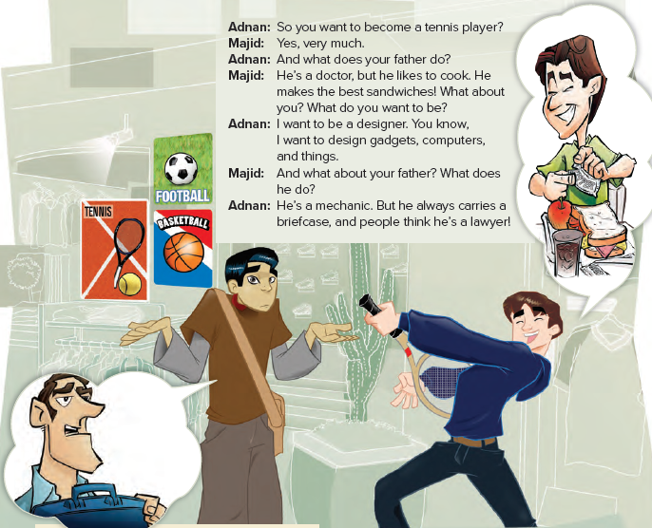

Slide 11

Practice

Slide 12
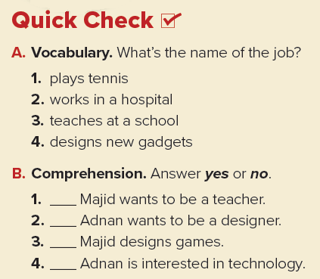
Tennis player
Nurse / Doctor
Teacher
High-tech designer
no
yes
no
yes

Slide 13
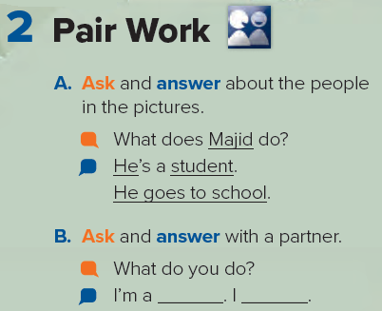

Slide 14
Homework
Page 89

Slide 15
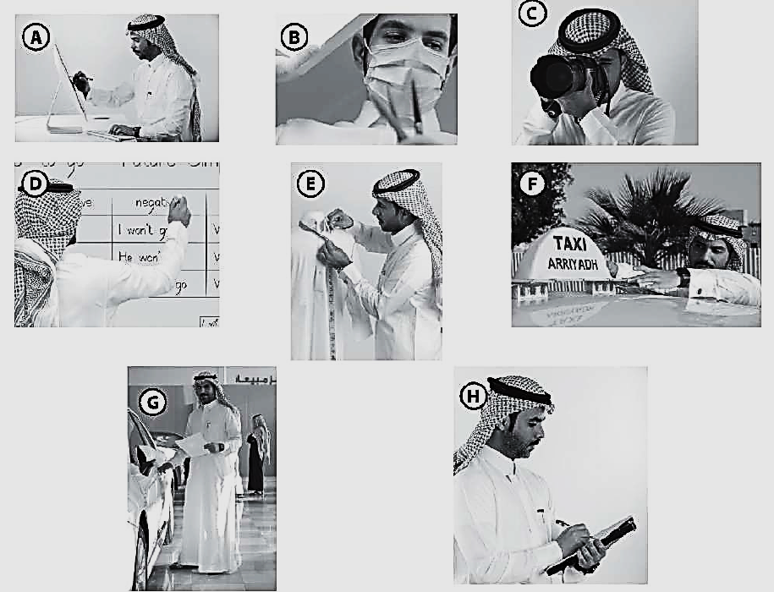

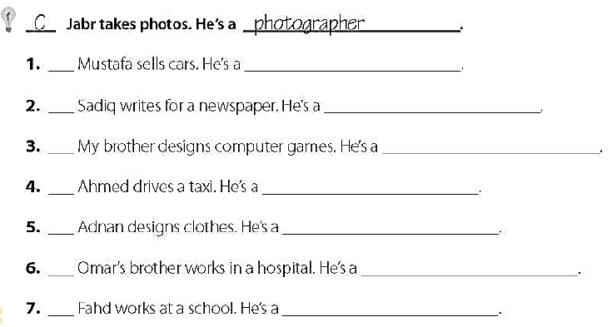
G
salesperson
H
reporter
A
high – tech designer
F
taxi driver
E
fashion designer
B
Nurse - doctor
D
teacher

