Slide 1

What time do you get up?
Form, meaning & Functions

Slide 2
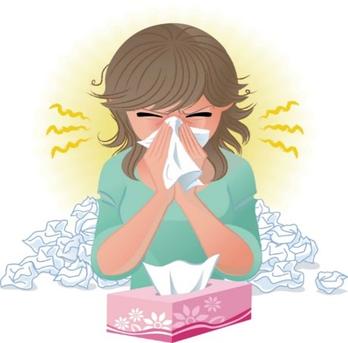
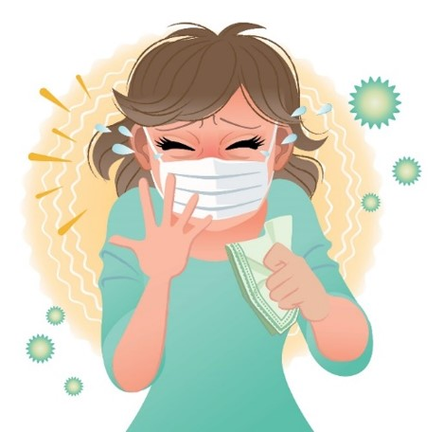
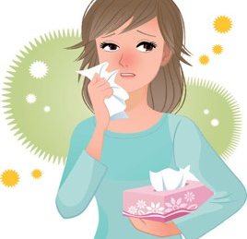
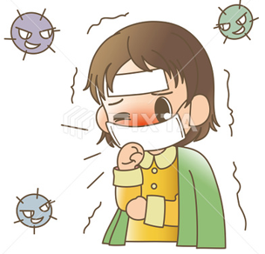

COVID 19
☺ Avoid gathering !
☺ wear a mask before going out
☺ Social distancing is not a choice, it is a must!
☺ Keep a distance of 2 meters to avoid accountability
☺ Wash hands constantly

Slide 3

بسم الله الرحمن الرحيم
Day
Date

Slide 4
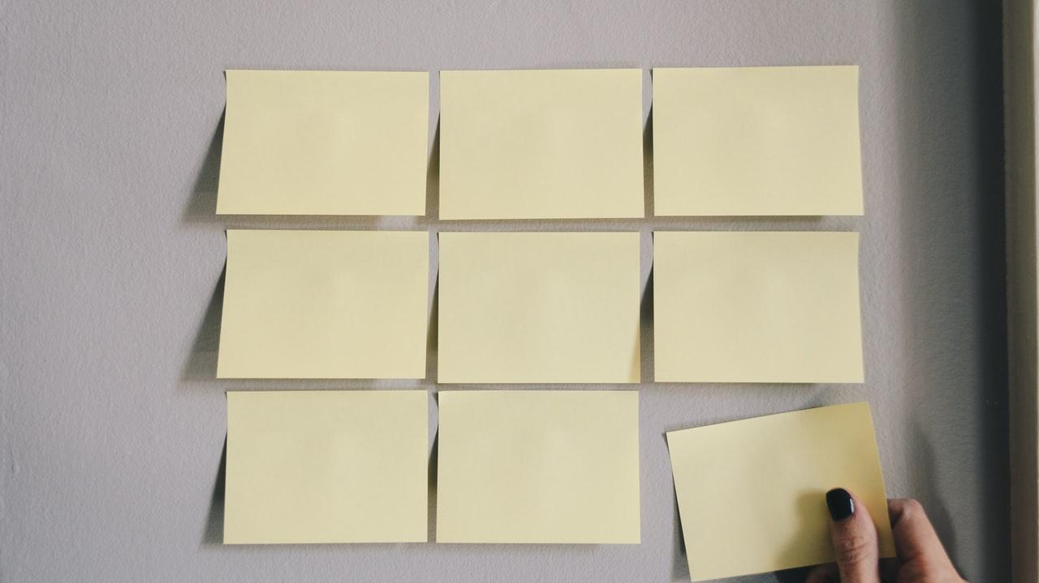
Learning Objectives
Differentiate between simple present & present progressive correctly
Identify stative verbs.
Use the correct form of the verb

Slide 5
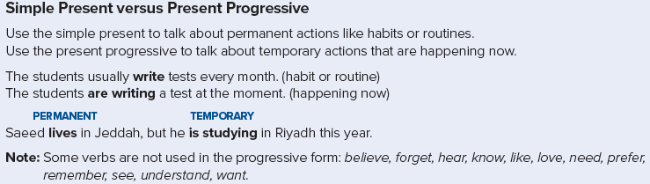

Slide 6
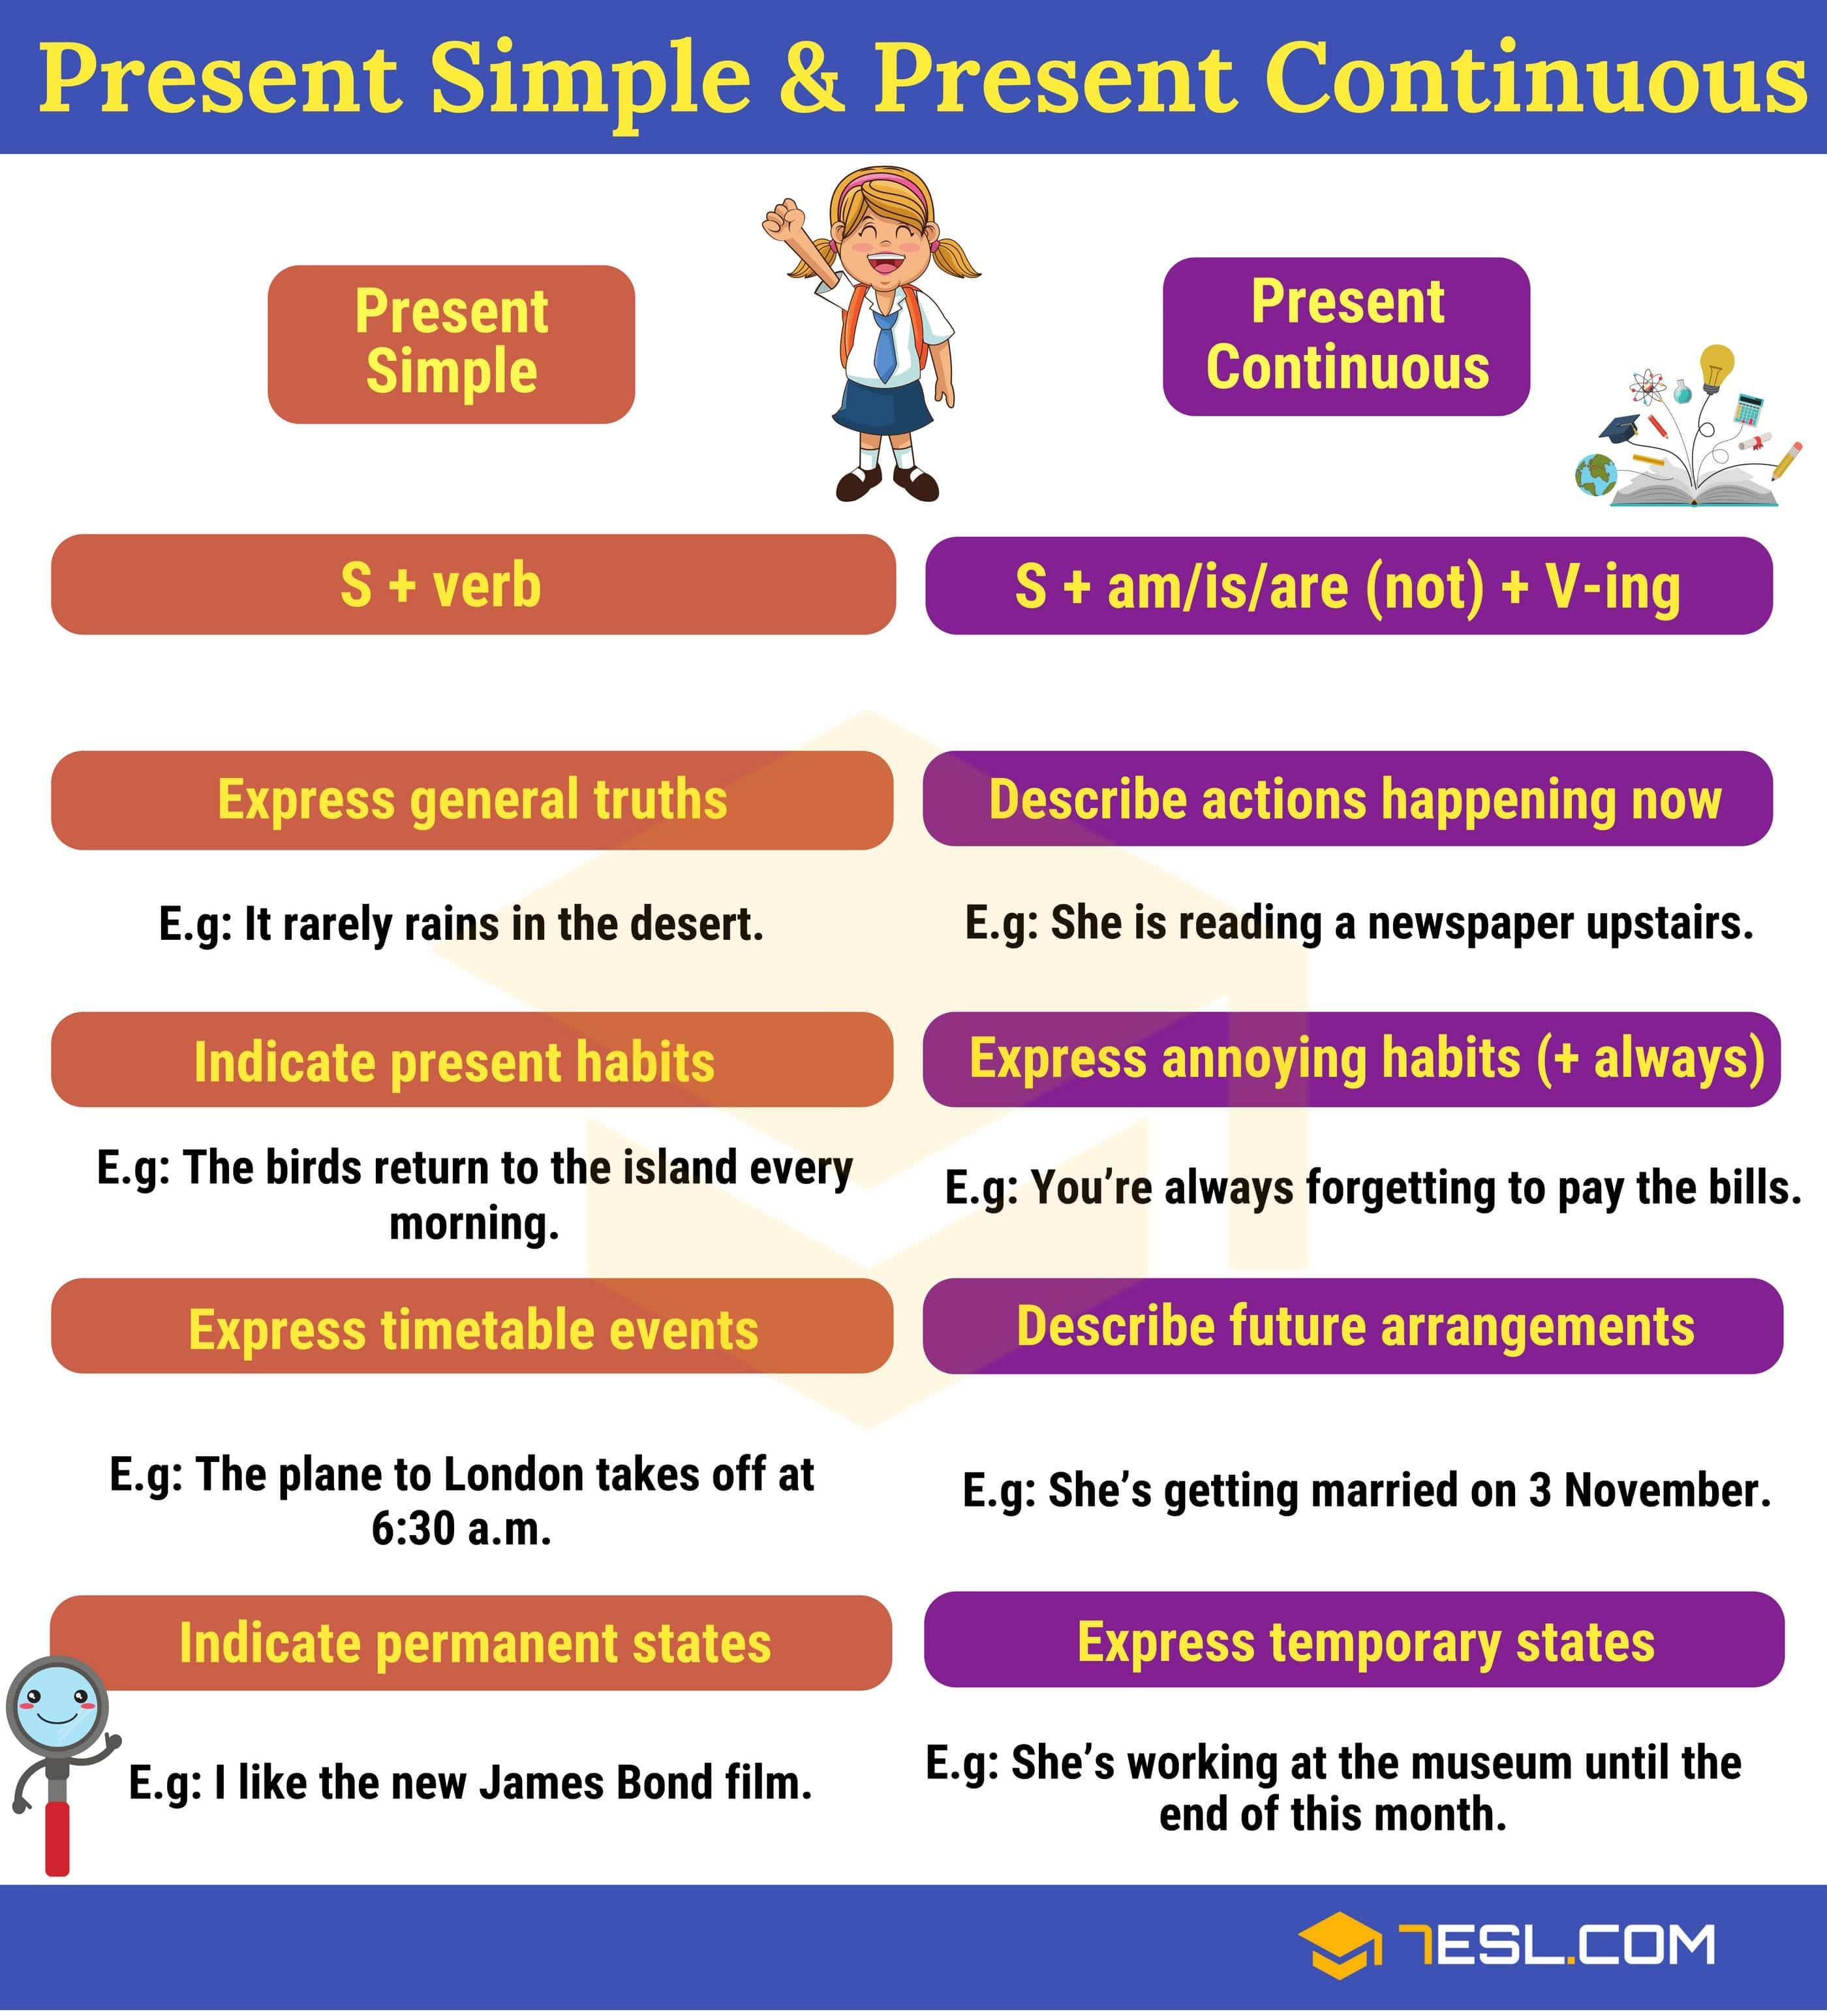

Slide 7
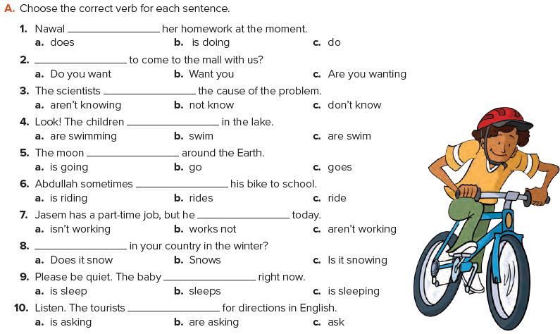

Slide 8
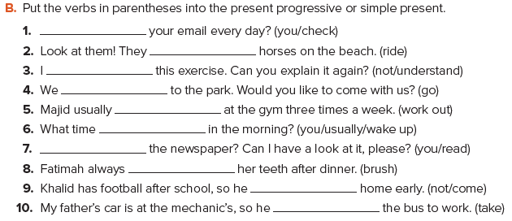
1. Do you check
2. are riding
3. don’t understand
4. are going
5. works out
6. do you usually wake up
7. Are you reading
8. brushes
9. isn’t coming
10. is taking

Slide 9

Practice

Slide 10

Home work
Page 100 G

Slide 11
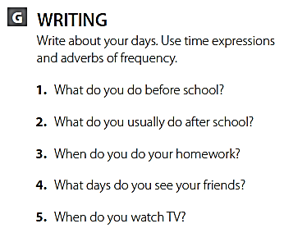
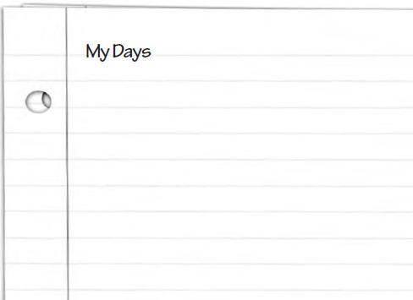
I get up early at 4:30 I take a shower and brush my teeth Then I pray Alfajer prayer.
I always eat breakfast at home. at 6:00 A.M.
Then I go to school. After school, I usually go to the park.
Sometimes I play video games with my friend.
I usually do my homework in the evening. Then I go to bed. I see my friends every day. I watch TV every day, too.

