Slide 1
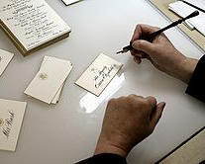
U 6
What was it like?
Reading

Slide 2
Goals:
To read by using pictures strategy.
To answer some questions about Arabic calligraphy

Slide 3
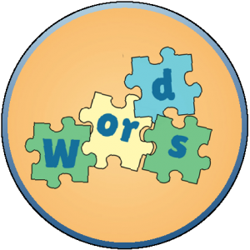
Previous vocab

Slide 4
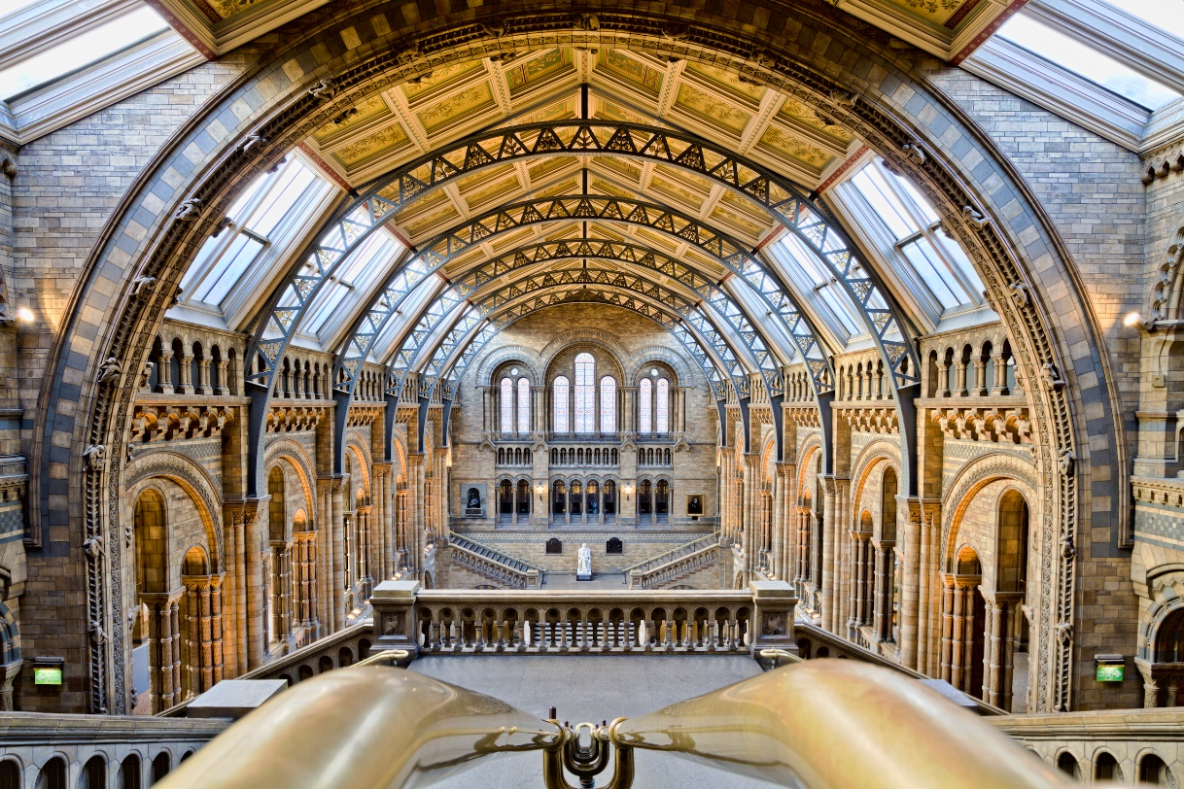
School
Museum
Office

Slide 5
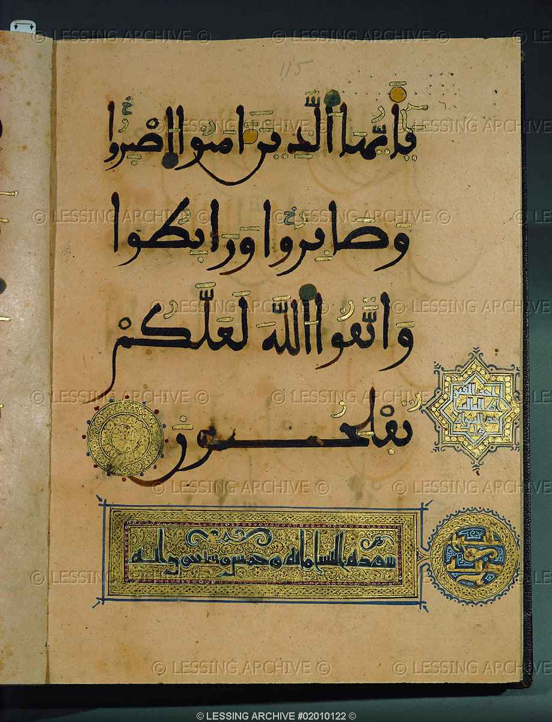
Calligraphy
Exhibit
Museum

Slide 6
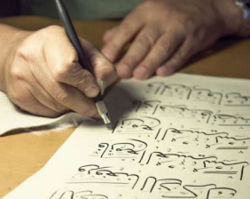
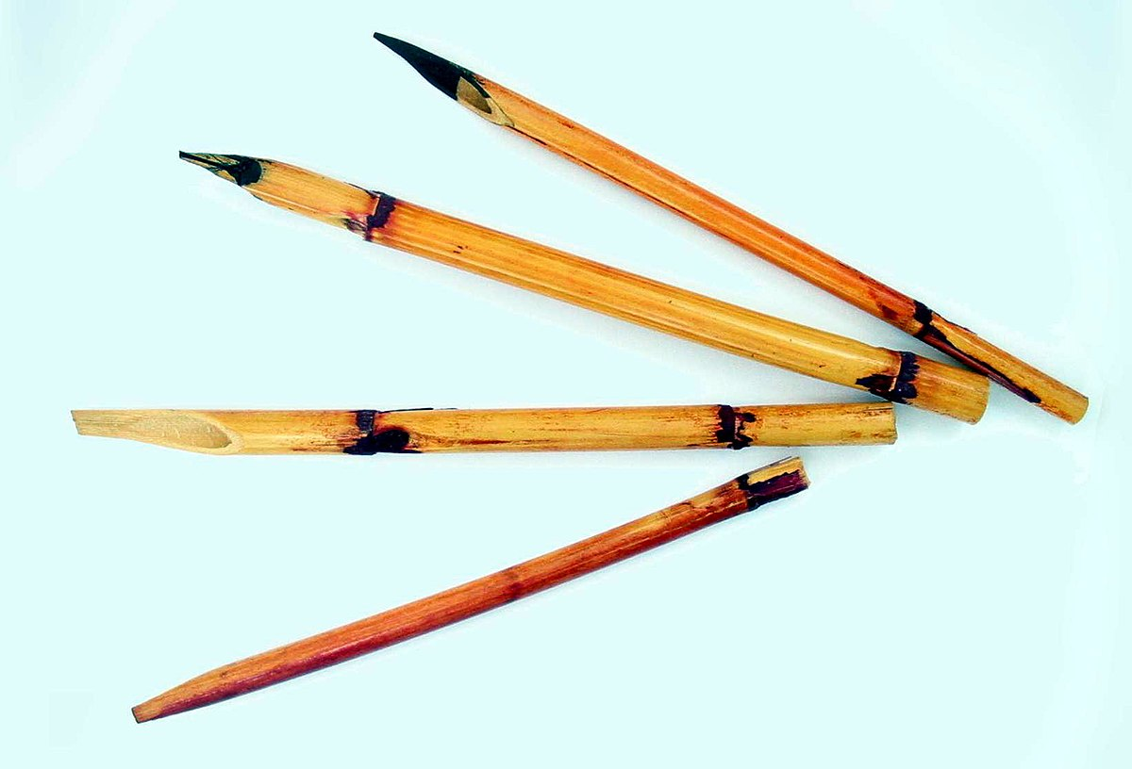
What is the man doing?
He is writing calligraphy.
What is he using to write with?
A qalam, or special reed pen and ink.

Slide 7
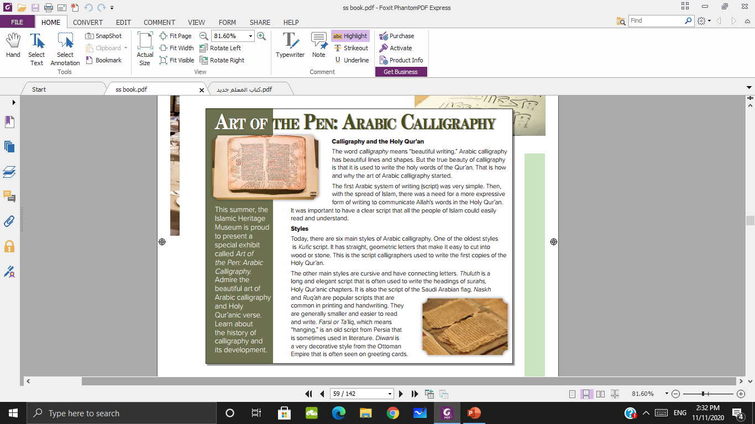
What do you see in the other two pictures?
Pages of the Holy Qur’an, calligraphy

Slide 8
Do they look new or old?
They look old.

Slide 9
Is the writing style the same or different? Why?
It’s different.

Slide 10
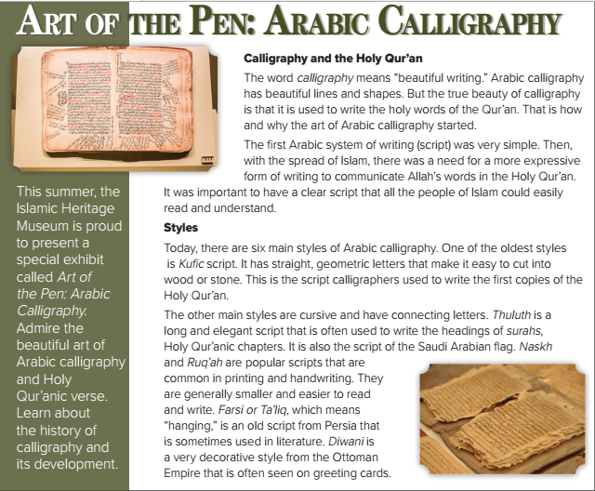
What is the title?
How many headlines are there?

Slide 11

What does calligraphy mean?
What is reason for using calligraphy?
Was the first Arabic system of writing simple??

Slide 12
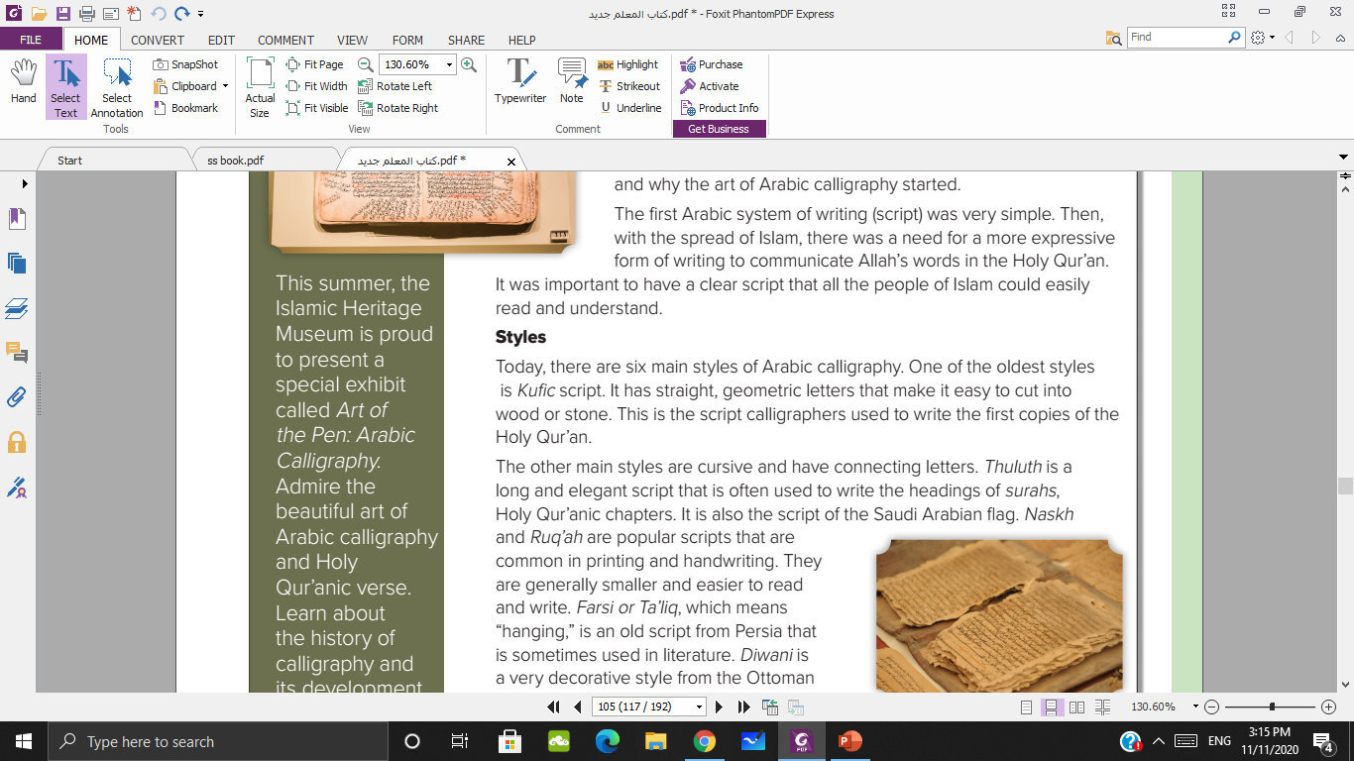
How many styles of Arabic calligraphy?
What is the oldest style of Arabic calligraphy?
Why is this used?

Slide 13
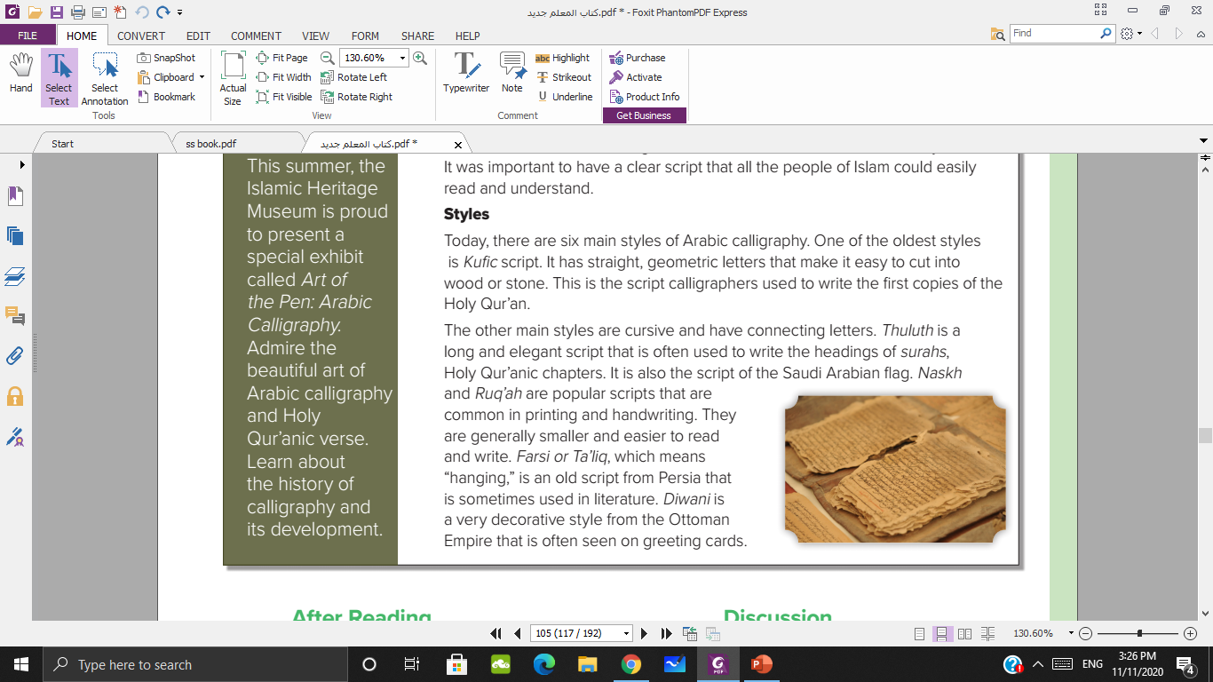
Which style is long and elegant script?
It is used to ………..
Is Thuluth the script of Saudi Arabia flag?

Slide 14

What are the popular scripts that used in printing and handwriting?
What are the other scripts mentioned in the passage?

Slide 15
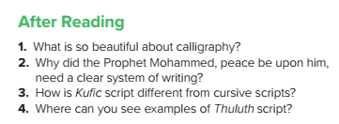

It is used to write the holy words of the Qur’an
It was important to have a clear script that all the people of Islam could easily read and understand.
Kufi script has straight, geometric letters that are not connected.
Thuluth is often used to write the headings of surahs, and it is the script on the Saudi Arabian flag.

Slide 16
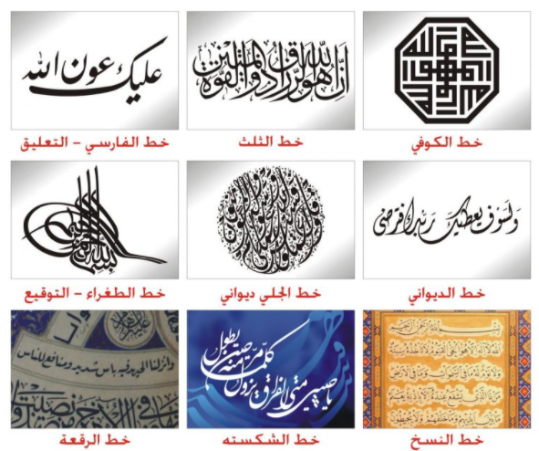

Slide 17


