Slide 1


Slide 2


Slide 3

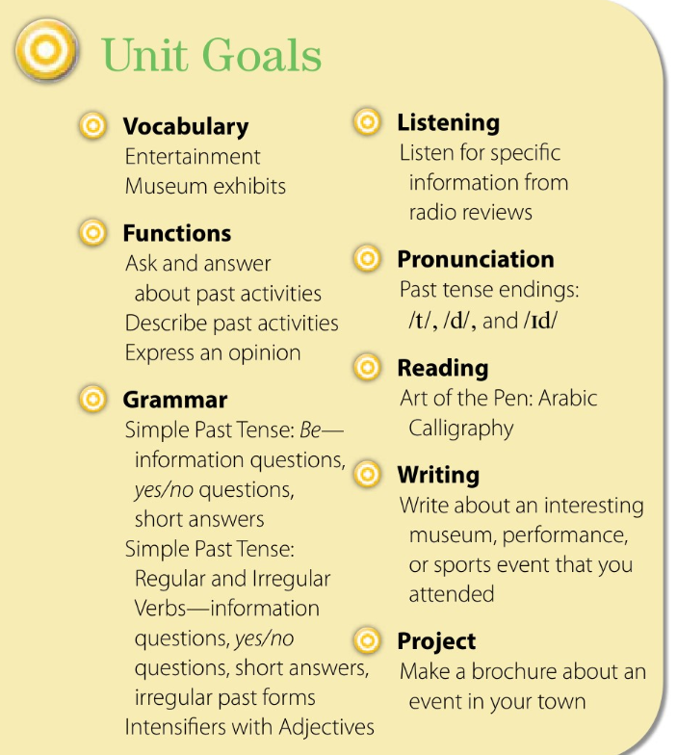

Slide 4



♥
☺
☺
♥

Slide 5
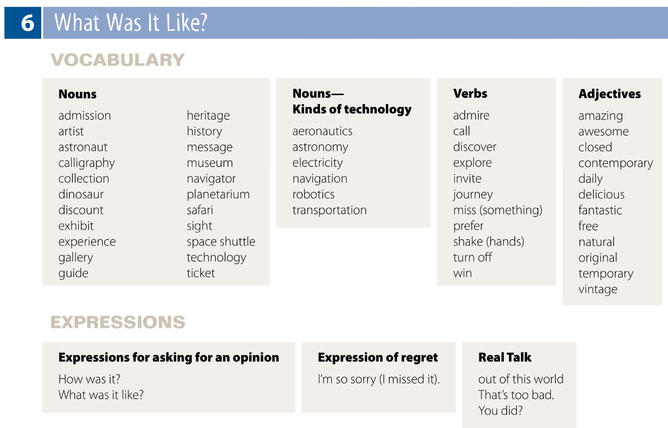

Slide 6

Nouns— Kinds of technology
aeronautics
astronomy
electricity
navigation
robotics
transportation
Nouns
admission
artist
astronaut
calligraphy
collection
dinosaur
discount
exhibit
experience
gallery
guide
Nouns
admission
artist
astronaut
calligraphy
collection
dinosaur
discount
exhibit
experience
gallery
guide
heritage
history
message
museum
navigator
planetarium
safari
sight
space shuttle
technology
ticket
Verbs
admire
call
discover
explore
invite
journey
miss (something)
prefer
shake (hands)
turn off
win
Adjectives
amazing
awesome
closed
contemporary
daily
delicious
fantastic
free
natural
original
temporary
vintage

Slide 7
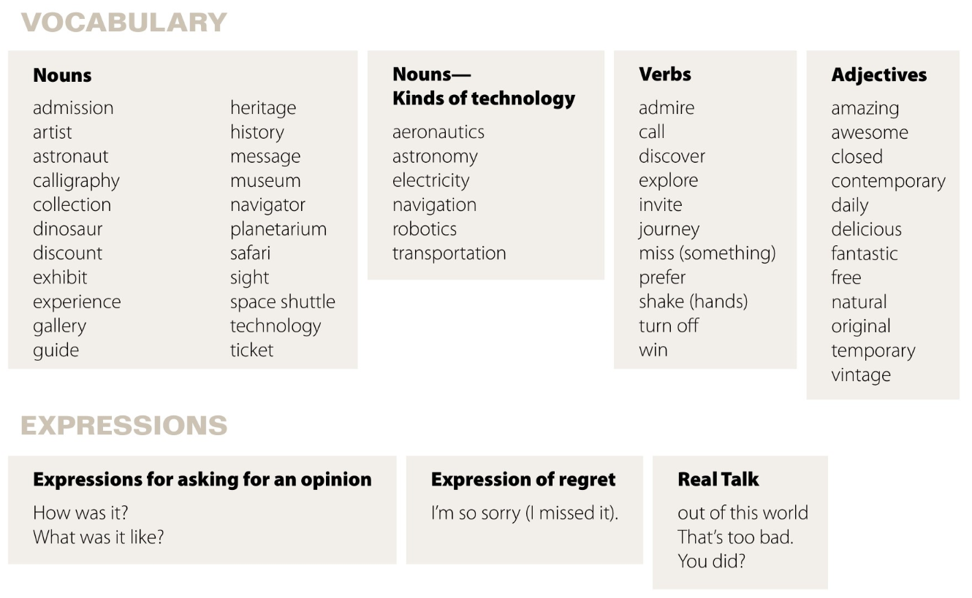

Slide 8
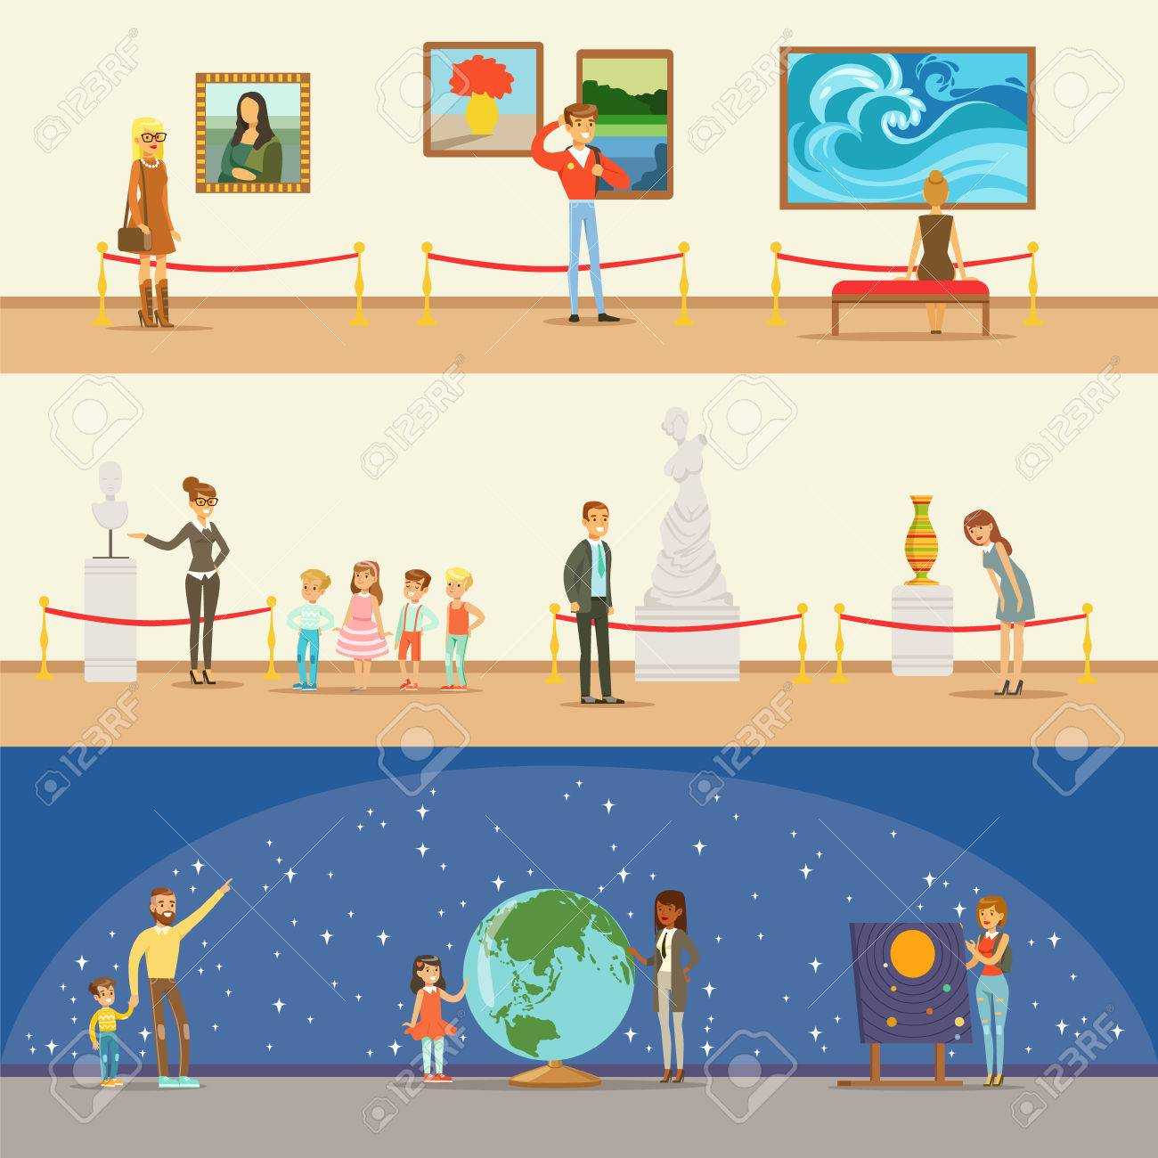
Museum exhibits

Slide 9





Use the verbs in the past tense,
Talk about what you did last weekend.
For example: I went to the mall.
I visited a friend.
I was at a park.
Answer questions about your weekend.
For example:
Did you go to the mall/visit a friend?
Were you at a park?
Yes, I did/No, I didn’t
or Yes, I was/No, I wasn’t.

Slide 10

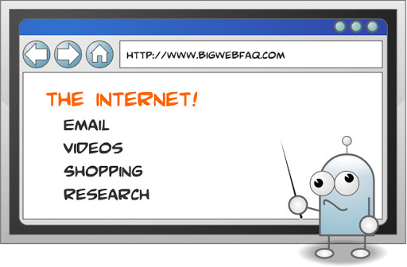

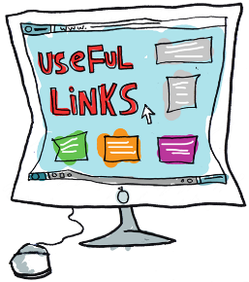
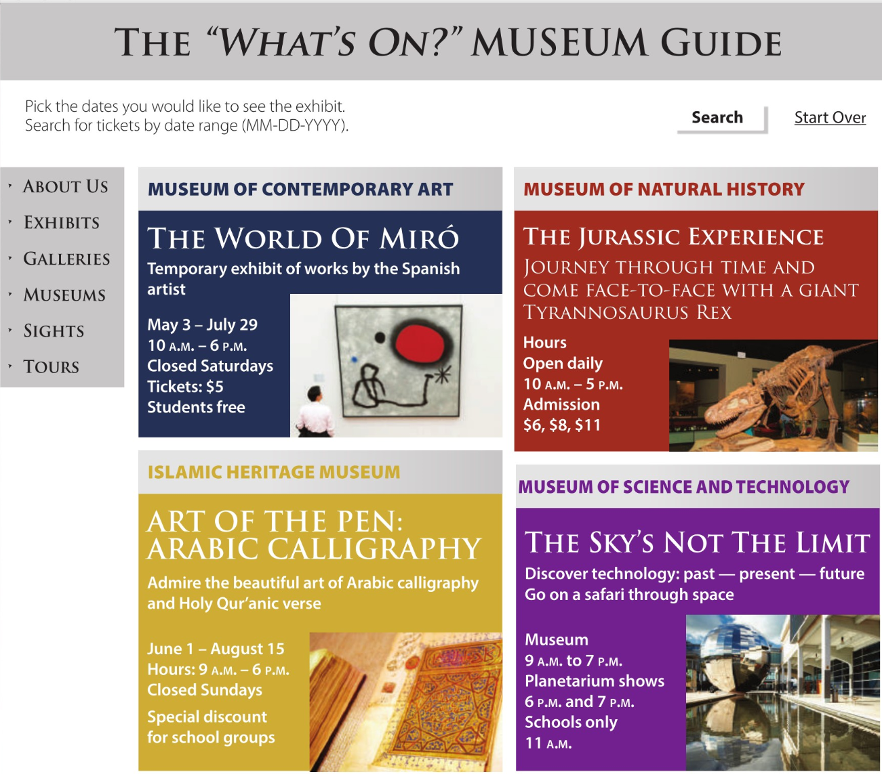
Before listening
Page 48
Open your books to page 48 and look at the web page.
Answer the questions such as the following:
1.What is the subject of the web page?
museum exhibits
2.What’s the name of the web page?
The “What’s On?” Museum Guide
3.What does “What’s on?” mean?
What is happening?
4.What are the four types of museums?
contemporary art, natural history, Islamic heritage, science and technology
5.Where can you see dinosaurs?
Museum of Natural History
6.What country is the artist from?
Spain
7.Where can you see calligraphy?
Islamic Heritage Museum
8.Where can you learn about space?
Museum of Science and Technology
9.Which exhibits are temporary?
The World of Miró, Art of the Pen: Arabic Calligraphy

Slide 11
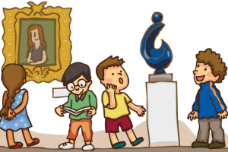
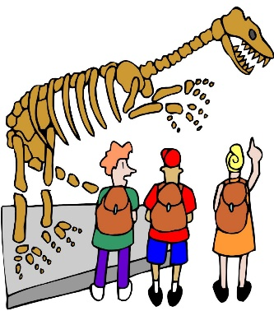
Museum exhibits
A museum is an institution that cares for (conserves) a collection of artifacts and other objects of artistic, cultural, historical, or scientific importance. Many public museums make these items available for public viewing through exhibits that .
A museum is a building in which we see objects of artistic, cultural, historical and scientific interest. These things are kept here for the public. It is a treasure house of great knowledge.
Four reasons to visit a museum
1. Museums make you feel good
a recent study finds that people are happier when they spend money on experiences rather than material purchases. Experiences are shown to create more happiness than material goods
2.Museums make you smarter
The primary role of museums is to engage and educate the community.
3. Museums inspire
Museums provide inspiration through personal connections with visitors. These kinds of personal memories created at museums do not expire.
4.Museums are a great way to spend time with friends and family.
Museums provide a great excuse to spend time with friends and family in a positive way. Personal connections can be made with museums and also with family members during visits.

Slide 12

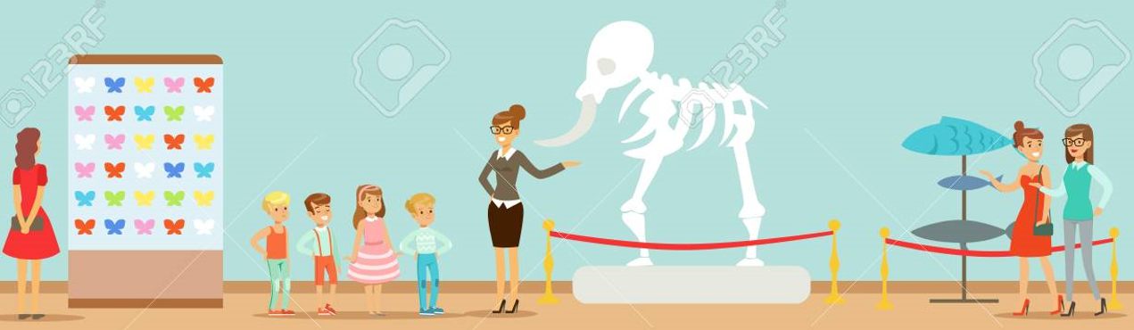
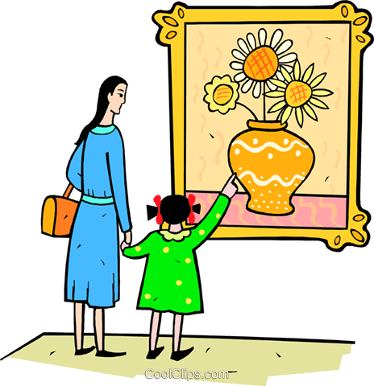
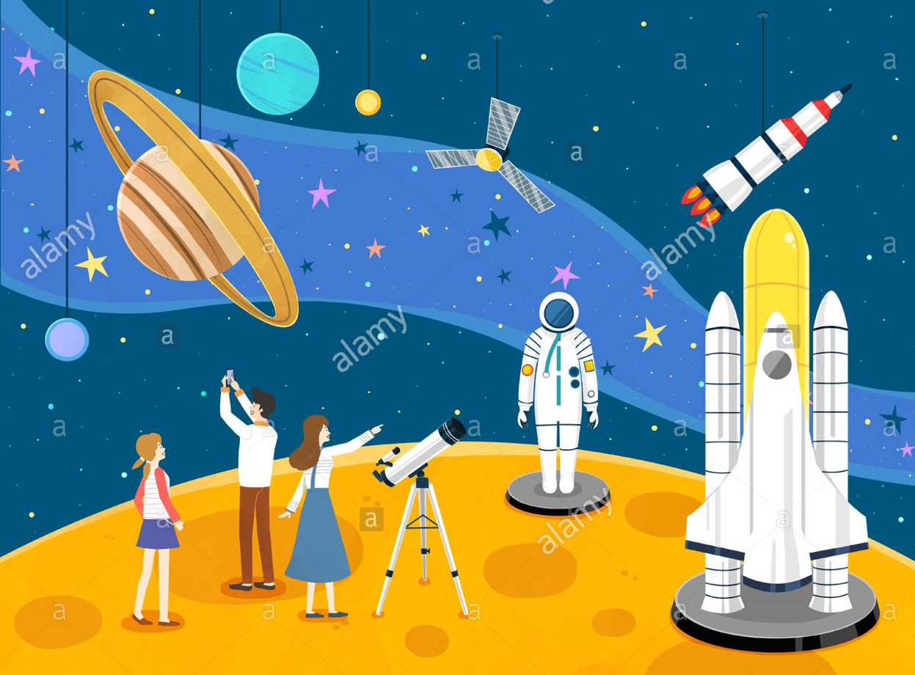
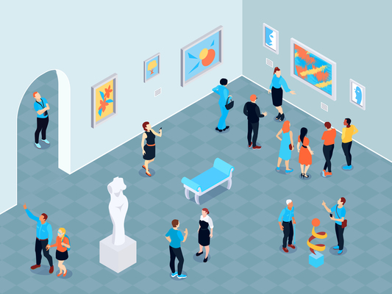

Which museum exhibits are interesting for you? Why
Which exhibits interest you? Why?
Technology Exhibitions
Healthcare Exhibitions
Food Exhibitions
Trade Exhibitions
Consumer Exhibitions

Slide 13




Page 48
Repeat the
phrases chorally and individually.
,nmn

Slide 14
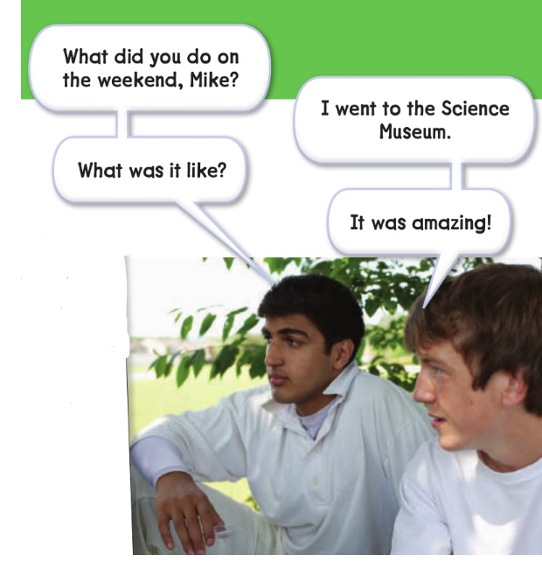
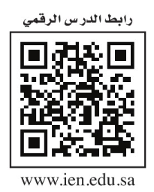
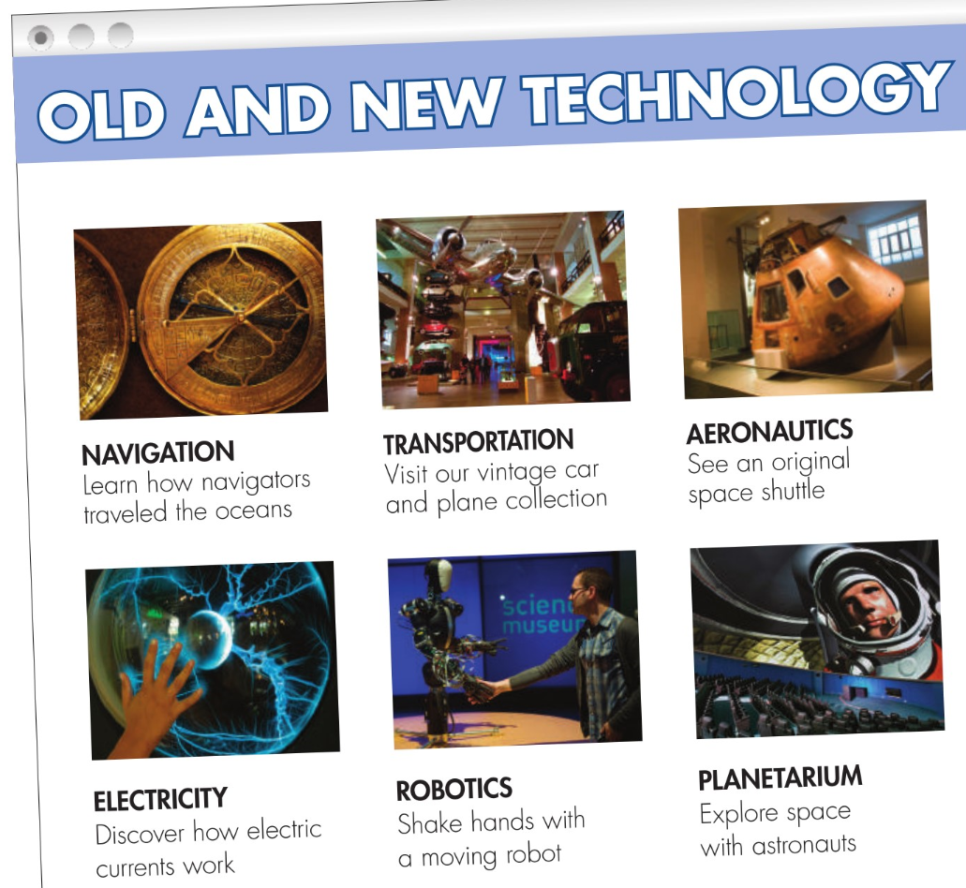
Page 49
,nmn

Slide 15


Page 49
After listening
1.Which museum has no information about prices?
Museum of Science and Technology
Look at the web page on page 49.
Answer the questions the following:
1.What kind of technology exhibits can you see at the Science Museum?
navigation, transportation, aeronautics, electricity, robotics, planetarium
2.Which exhibit has old cars?
Transportation
3.Which exhibits interest you? Why?
4.What are the two people talking about?
5. What did Mike do? Did he like it?

Slide 16
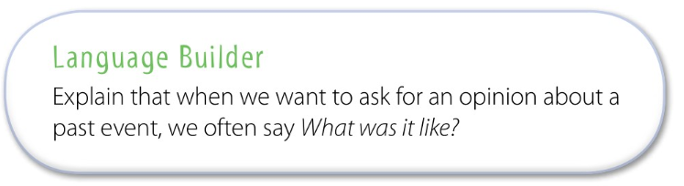

Slide 17

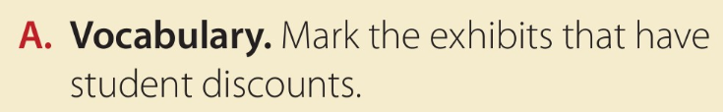

Page 49
Locate where the information about admission prices is in each advertisement.
Then have them look for specific information about student prices.
The World of Miró, Art of the Pen: Arabic Calligraphy, and perhaps
the Natural History Museum

Slide 18

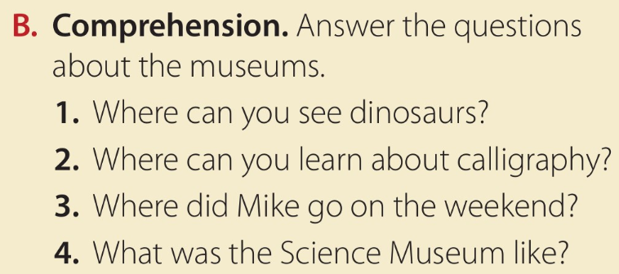
Page 49
1.How many different museums are there?
four
2.What is the name of the boy in the conversation?
Mike
3.What are he and his friend talking about?
what Mike did on the weekend?
Work alone to answer the rest of the questions and check answers with a partner.
1.You can see dinosaurs at the Museum of Natural History.
2.You can learn about calligraphy at the Islamic Heritage Museum.
3.He went to the Science Museum.
4.It was amazing.

Slide 19
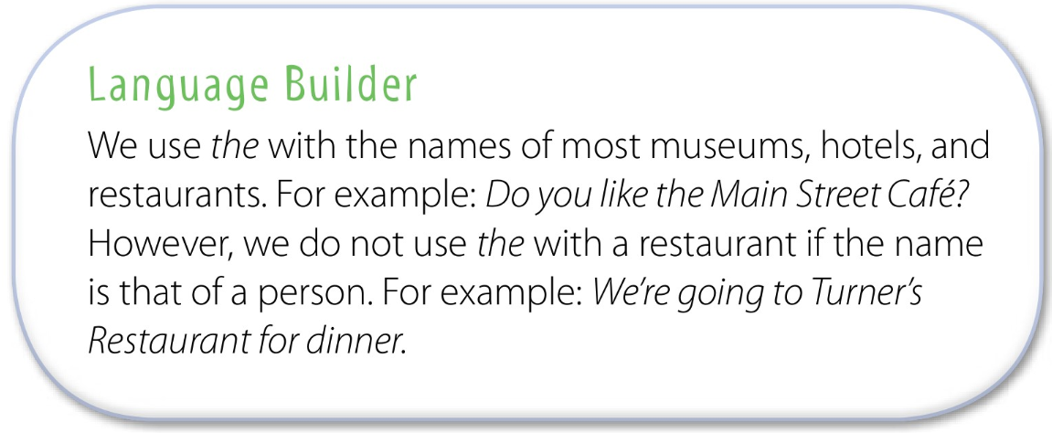

Slide 20



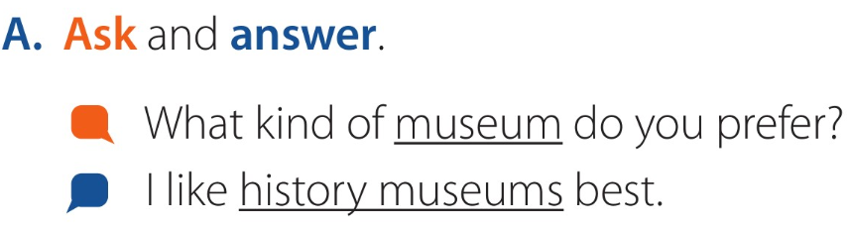
Page 49
Take turns asking and answering the question

Slide 21
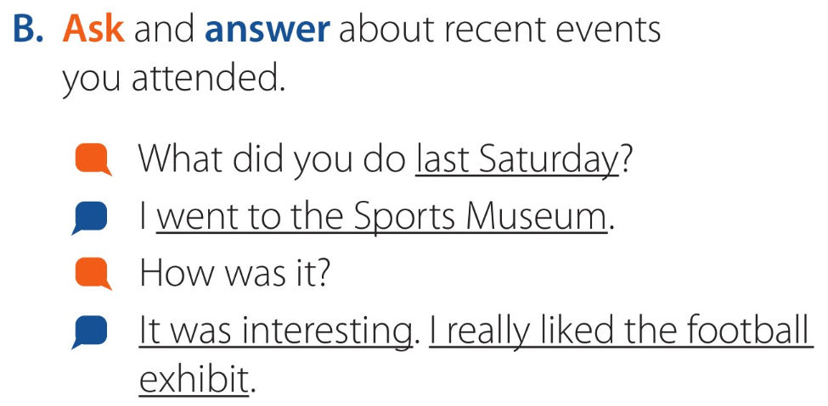
Page 49
Making a substitution for the first question.
For example:
What did you do last Thursday?
☺What’s another way to say How was it?
What was it like?
Practice the conversation in pairs.

Slide 22







Assign page 111 for practice with the vocabulary of
the unit.

Slide 23
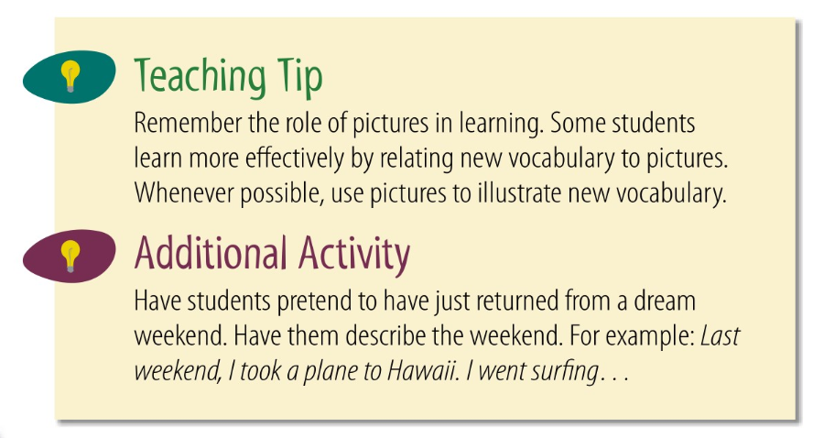
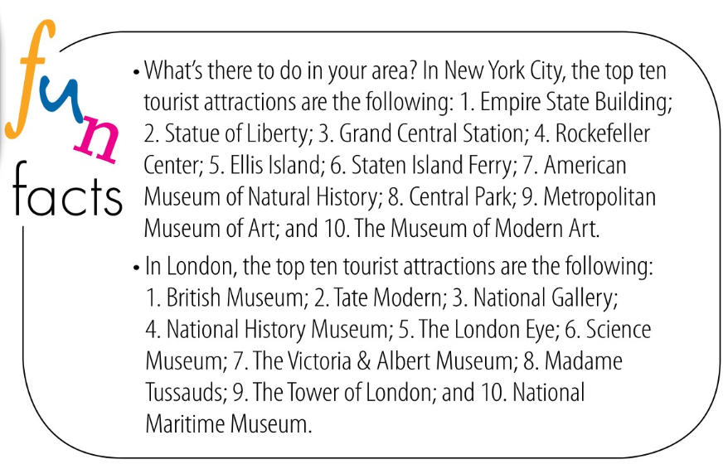

Slide 24

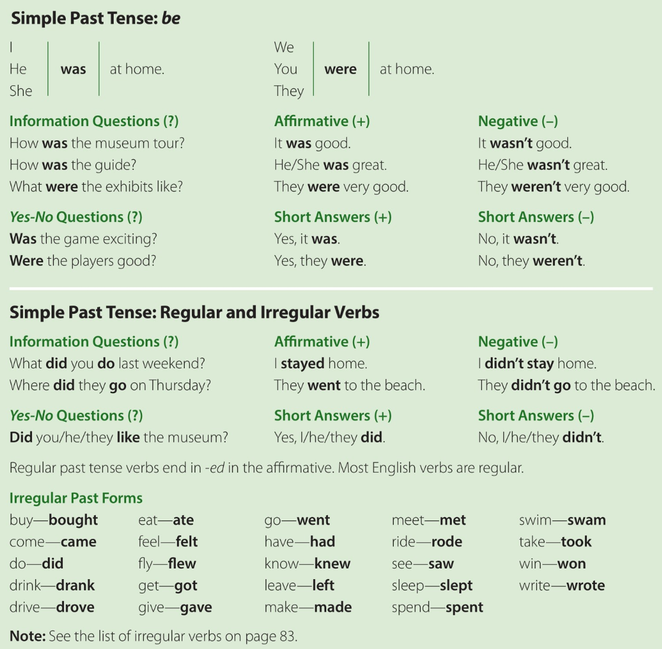
Page 50

Slide 25
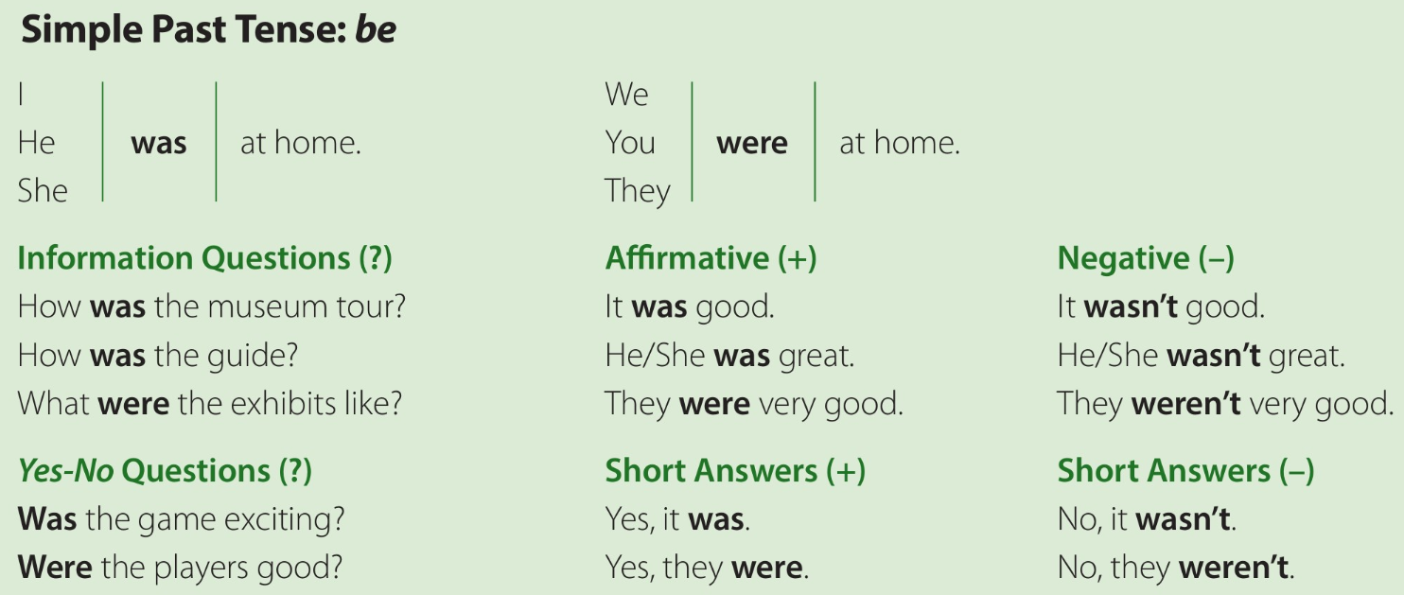
,nmn
Page 50

Slide 26




at the grammar chart in the book
Page 50
Copy the paradigm in your notebooks and complete it.
Fill in the blanks.
(I / He / She / It ͢ was;
You / We / They ͢ were)
_____ _____
_____ was OK yesterday. _____ were OK yesterday.
_____ _____
_____
Read aloud the questions and answers in the first part of the grammar chart.
Use the simple past of be.
Make statements about where you were at certain times yesterday and then
ask the person next to you if that is where you were.
For example:
A: At 9 yesterday morning, I was in bed.
[to B] Were you in bed at 9 yesterday morning?
B: No, I wasn’t. At 9 yesterday morning I was in class.
[to C] Were you in class at 9 yesterday morning?
C: Yes, I was. At noon yesterday, I was in the cafeteria.
[to D] Were you in the cafeteria at noon yesterday?
,nmn

Slide 27
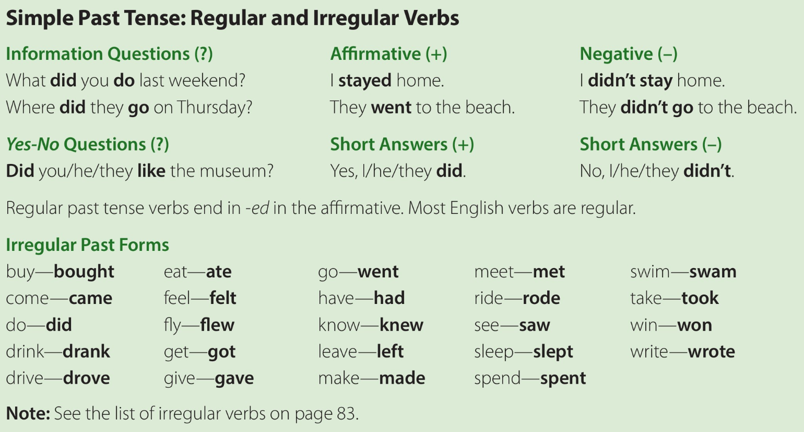
Page 50

Slide 28
Page 50
Read aloud the Wh-questions and answers the chart. We use the simple past
tense to describe things that happened and finished in the past, that is, completed actions. In questions the auxiliary did is used for all persons, singular or plural.
The inverted form of the question (the subject before the verb) follows the same pattern as questions with auxiliary do in the simple present.

Slide 29
simple past questions
Page 50
☺Which are grammatically correct.
For example,
O Did he wanted to go?
O Did he want to go?
O Where did they have dinner?
O Where did they had dinner?
How are questions with be about the past different from questions with other verbs?
We don’t use did with be.
irregular | regular
go/went | watch/watched
drive = | clean =

Slide 30
simple past questions
Page 50
How do we change a regular verb to talk about the past?
(add -ed)
What about verbs like study and cry that end in a consonant and y?
(The y changes to i, and we add -ed.)
☺the simple past form of irregular verbs needs to be memorized.
Use the irregular verbs in sentences about every day.
Say sentences about yesterday.
For example:
A: Ali rides his bike to school every day.
B: He rode his bike to school yesterday.

Slide 31
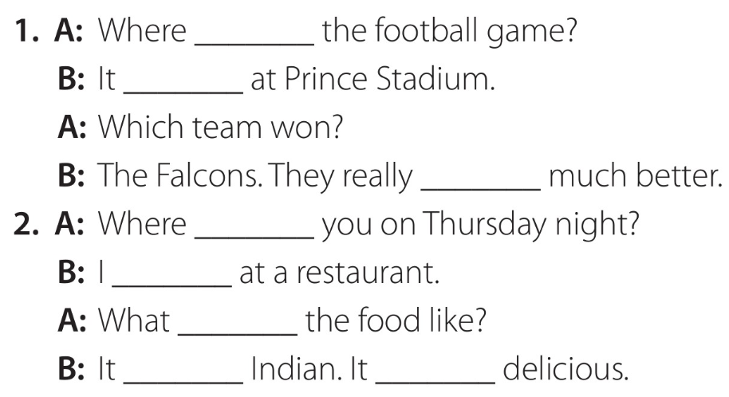
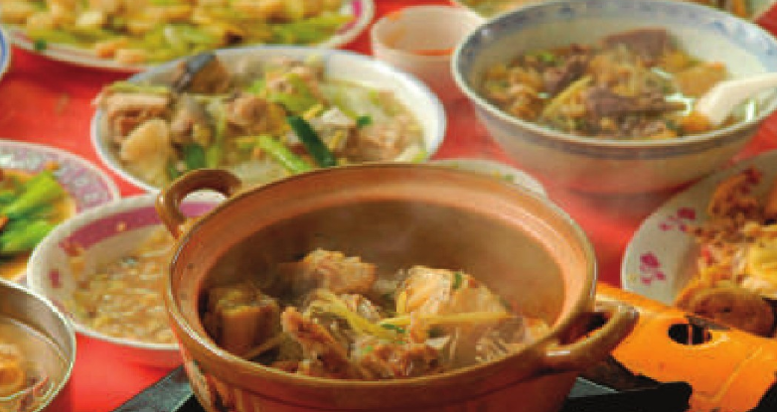
Page 50
Complete the conversations alone.
Then in pairs, students check their answers and practice the conversations.
was
was
were
were
was
was
was
was

Slide 32
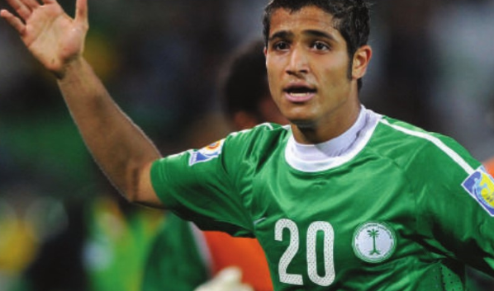
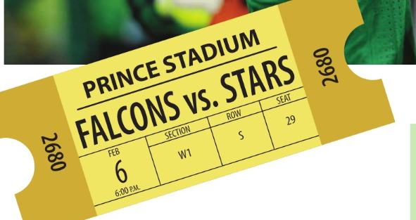

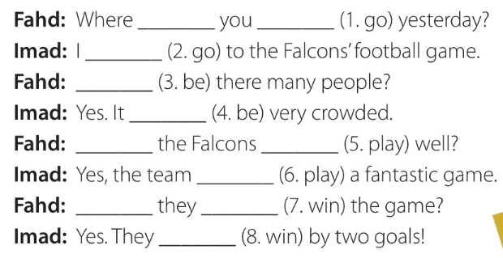
Page 51
complete the conversation. Then in pairs, You check answers and practice the conversation.
did
go
went
Were
was
Did
play
played
Did
win
won

Slide 33

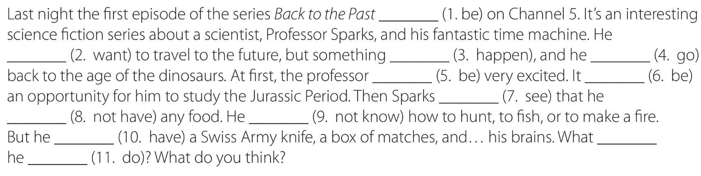
complete the exercise individually.
Page 51
was
wanted
happened
went
was
was
saw
didn’t have
didn’t know
had
did
do

Slide 34



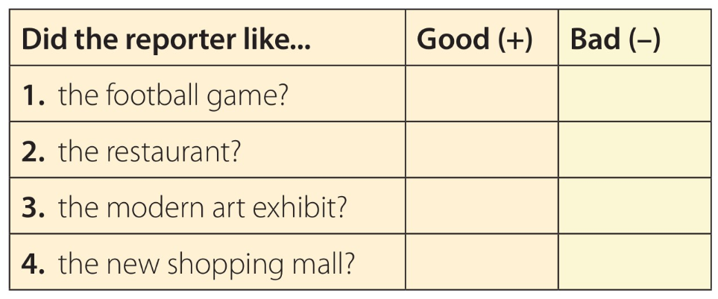
Page 51
listen to reviews of events and decide if the reviews are good or bad. Have
them look at the chart and identify the four events.
bad
bad
bad
good

Slide 35
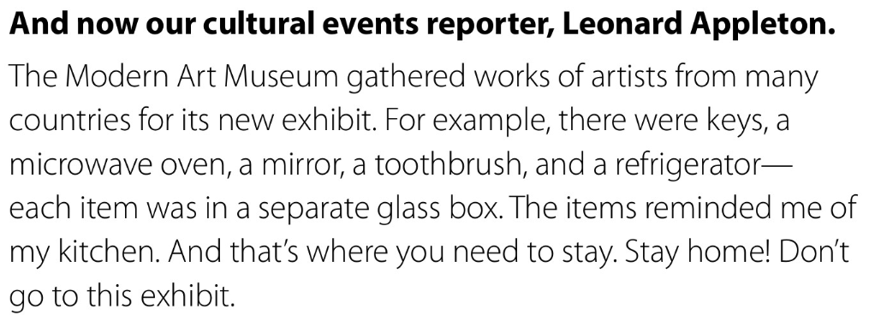

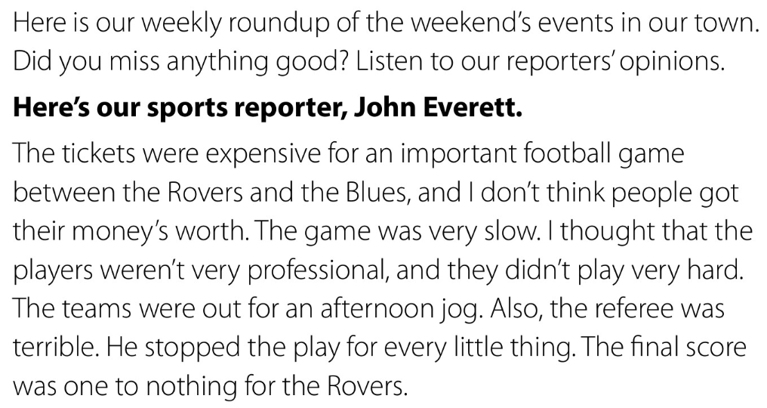
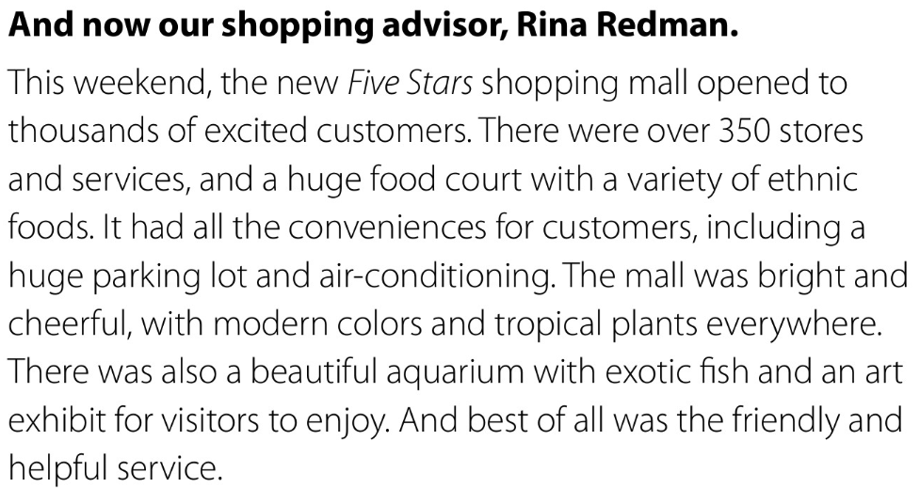
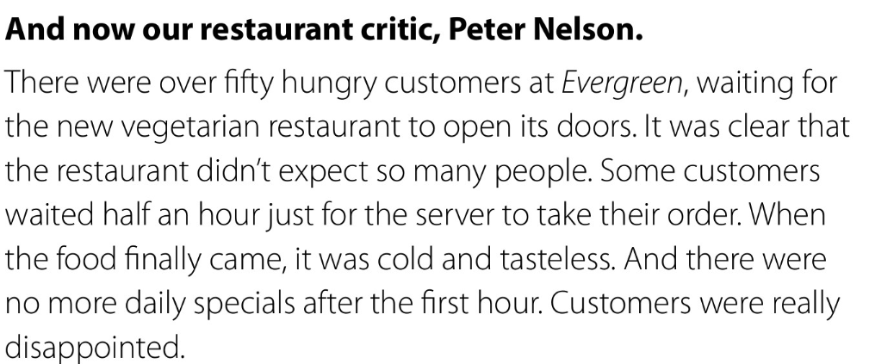

Slide 36




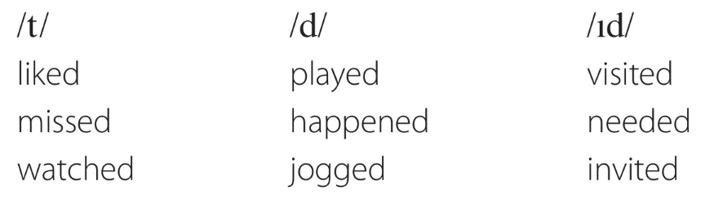
Page 51
listen and repeat.

Slide 37
Assign pages 112–113 for practice with the past tense.

Slide 38
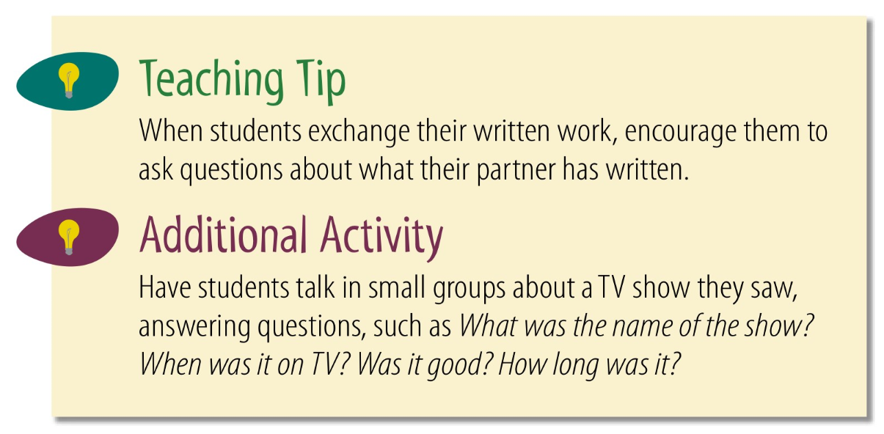

Slide 39


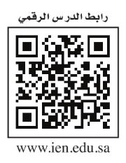
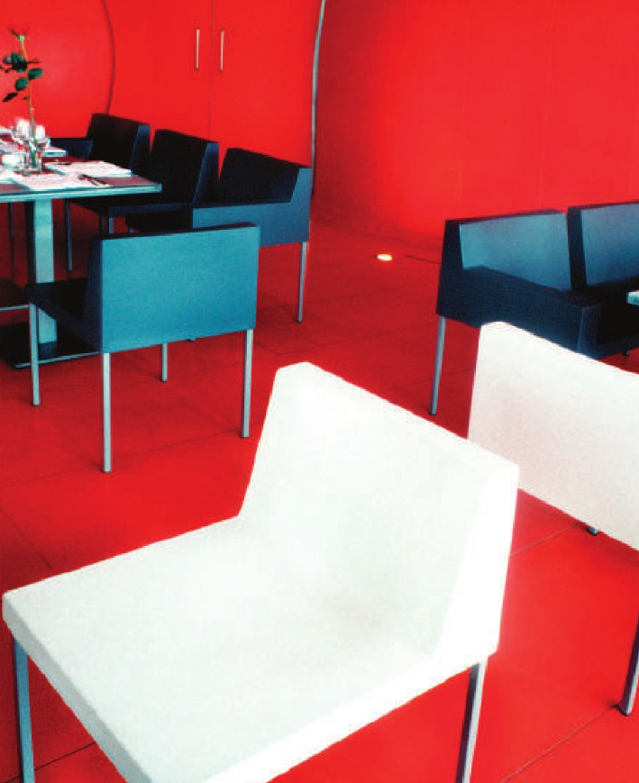
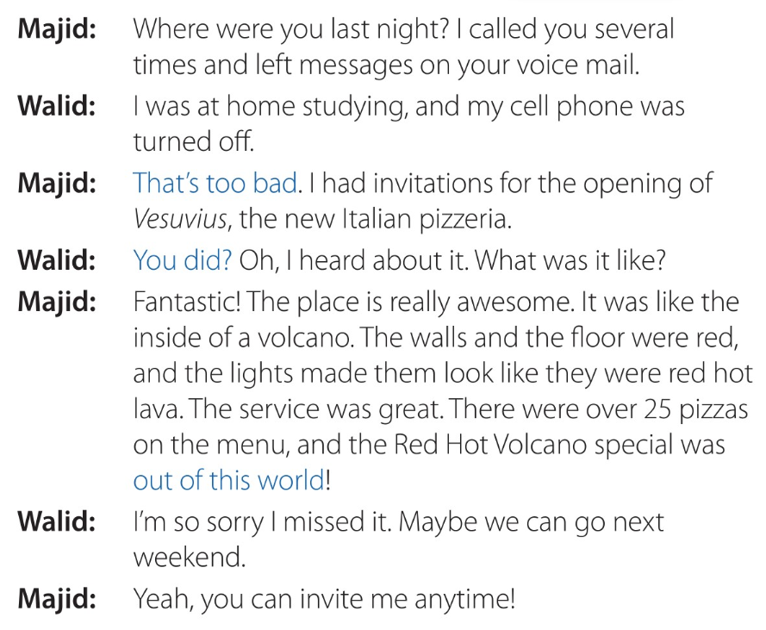
Page 52
☺look at the picture
What is this place?
Would you like to be there? Why or why not?
Read along as you listen.
listen for these words in the conversation.
voice mail,
opening,
awesome,
volcano,
red hot lava,
special invite.

Slide 40

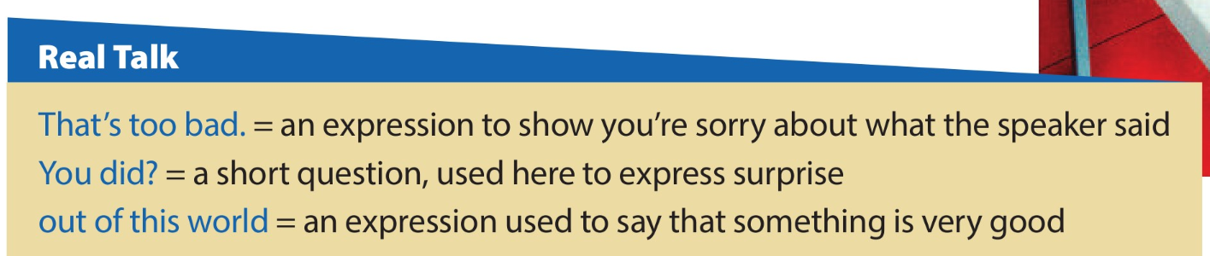
Page 52
1.Who says That’s too bad?
Majid
2.Why does he say it?
He’s sorry he couldn’t talk to Walid.
Say which ones they should respond to with That’s too bad.
1.There aren’t any more tickets for the game. (√)
Our restaurant didn’t get a good review. (√)
My dad bought a new car last week.
I was sick the entire weekend. (√)
I was a good football player in school.

Slide 41
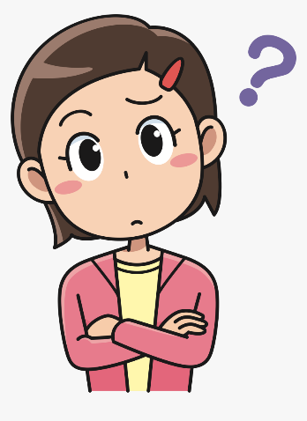
Page 52
Say a variety of surprising statements to elicit You did?
e.g. I went bungee jumping the other day.
3.Who says out of this world?
Majid
4.What is he talking about?
the special pizza
Think of something that you have done, seen, or eaten recently that was out of this world.
For example:
The food I had at Luigi’s the other night was out of this world.
Practice the conversation in pairs, switching roles.

Slide 42
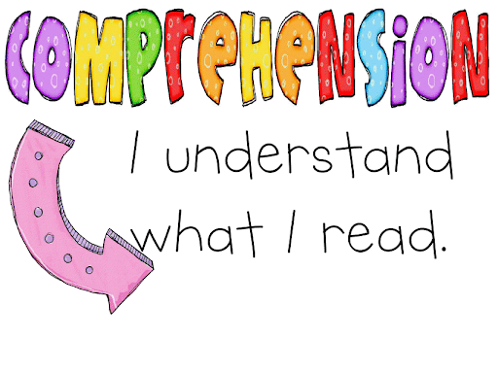

Slide 43



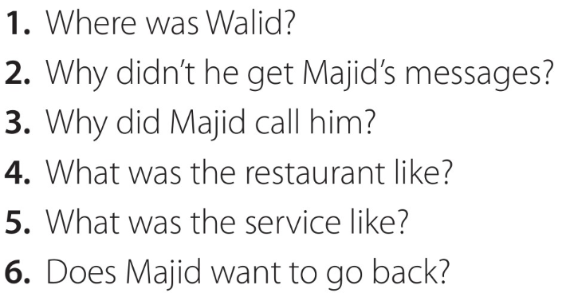
Page 52
Work with a partner, taking turns asking and answering the questions.
,nmn
He was at home studying.
His cell phone was turned off.
He had invitations for the opening of the new pizzeria.
It was fantastic.
It was great.
Yes, he does.

Slide 44


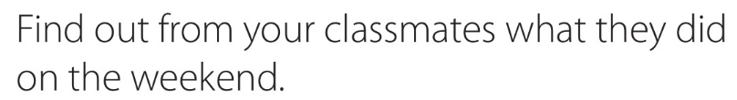
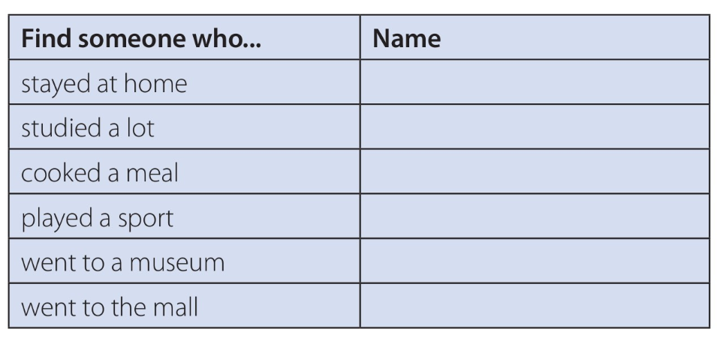


a time limit for the activity or a certain number of classmates to ask.
Page 52
verb phrases
Say the present tense of the verbs in the list.
☺Copy the verb phrases into your books at the bottom of the chart.
☺☺Walk around the room, asking classmates yes/no questions according to the chart
and providing short answers to questions you are asked.
For example:
Did you stay home on the weekend? (Yes, I did./No, I didn’t.)
You should write each student’s name next to the activity on their lists that
she performed.
☺When all of you completed the chart, take a class survey. Ask about one of the activities from the chart.
For example:
Who stayed home?
,nmn
,nmn
,nmn
,nmn
,nmn
,nmn

Slide 45

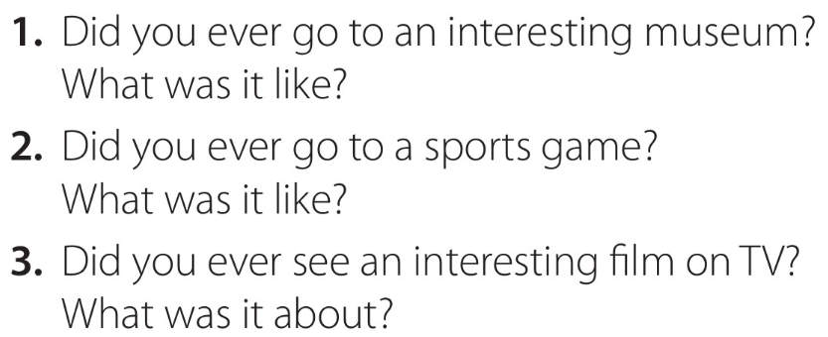

Page 52
Discuss your answers in pairs.
Switch partners and tell your new partners about their first partners.
For example:
Fahd went to an exciting football game.
His team won in extra time.

Slide 46





READING STRATEGY
Using pictures
When pictures accompany a text, the pictures will often tell you a lot about the contents of the reading.
at the pictures.
1.What is the man doing?
writing calligraphy
2.What is he using to write with?
a qalam or special reed pen and ink
3.What do you see in the other two pictures?
pages of the Holy Qur’an, calligraphy
4.Do they look new or old?
Old
5.Is the writing style the same or different?
Different
6.Why?
several possible reasons.

Slide 47






Page 53
Listen and read along

Slide 48


Page 53
Answer the questions individually.
Underline the part of the text that provided
you with the answer.
Go over the answers with your partner.
Answers will vary. Sample answers:
1. It is used to write the holy words of the Qur’an
2.It was important to have a clear script that all the people of
Islam could easily read and understand.
3.Kufjc script has straight, geometric letters that are not connected.
4.Thuluth is often used to write the headings of surahs, and it is
the script on the Saudi Arabian fmag.

Slide 49



Page 53
Say examples of historic calligraphy that you may have read about or seen in museums.
In small groups to discuss what you know about historic calligraphy you have seen or read about.

Slide 50



Slide 51










Marketing event
wedding event
School event
Social media Event
Sport event

Slide 52






Page 54
Marketing event
Recall an event that you attended.
Describe as many sensory details as possible.
to describe her own experience at an event
Complete the chart with details of an event they attended. write as many
details as possible and not to worry if you can’t fill in all of the categories. You will later use
your notes to write about the experience.
,nmn
,nmn
,nmn
,nmn
,nmn
,nmn
,nmn
,nmn
,nmn
,nmn
,nmn
,nmn

Slide 53

Page 54
A good narrative describes events in a way that the reader can share the sensory and
emotional experience of the writer.
☺Go over the information about time words.
Scan the first two lines of the text in B to find time words.
For example:
Before the race…,
While the jockeys…
time words help to clarify the sequence of events in a story.

Slide 54
,nmn
Page 54
☺Read the information about exclamation points.
☺Scan the text in B to find exclamation points.
Examples include:
“That’s the winner!”;
Prince was in front by a neck!;
Prince was the winner by two lengths!
☺How does the writer feel when he makes these statements.
excited
☺Go over the information about quotation marks and scan the text in B to find examples.
“That’s the winner!”;
“They’re off”.
Direct quotes in narratives help the reader to “hear” sounds and speech from the story.

Slide 55





Page 54
Have you ever attended a horse race or seen one on TV?
If so, describe the event.
Go over the meaning of expressions that are specifically related to horse racing such as: stable, jockey, track, binoculars, by a neck, cross the finish line, by a length.
binoculars = a pair of special glasses, that you hold up to your eyes
to look at objects that are a long distance away
jockey = a person whose job is riding horses in races
stable = a building in which horses are kept
track = a piece of ground or a path/ a road, often oval-shaped, that is used for races

Slide 56

Page 54
Read sections of the paragraph. which two words are
usually nouns, but are used metaphorically as verbs.
(paraded, thundered)
☺☺ Focus your attention on the words in the box.
Say definitions (in English) for the words you know.
☺consult a dictionary for any unknown words.
Work individually to complete the paragraph and then compare answers with a partner.
paraded
nervous
crowd
silent
thundered
shook
excited
cheered

Slide 57







Page 54
Write about an event you attended using your notes from the chart.
☺include sensory and emotional details.
☺Exchange papers and vote on which event sounds the most interesting.
sensory =senses of touch, smell, taste, hearing, and sight

Slide 58




Page 54
Check in your local newspaper or on the Web for the week’s events in your town.
☺Organize yourselves in groups and have each group make a brochure
for one of the events.
☺Make sure the brochure is attractive and informative.
☺look in magazines and newspapers to find pictures and words to include in your brochures.
Groups show your brochures to the class.
The class votes on the best one.

Slide 59
Assign page 114 for additional reading and writing
practice.

Slide 60


Page 55

Slide 61

Page 55
Intensifiers are adverbs that emphasize adjectives (and other adverbs).
Read aloud the examples.
Read the following sentence starters on the board and complete with quite
1.It was quite_____. (a difficult test)
2.It was_____. (quite an interesting lesson)
3.He is _____. (quite a tall boy)
The test was quite difficult.
The lesson was quite interesting.
That boy is quite tall.

Slide 62

Page 55
The strong adjectives are adjectives that already have the idea of “very.”
For this reason, very is not used to modify strong adjectives.
For example, it is incorrect to say very fantastic.
But really fantastic and absolutely fantastic are correct.
☺Similarly, intensifiers such as completely, absolutely, or totally
are not used to modify base (or weak) adjectives.
For example, it is incorrect to say absolutely nice.
But very nice and really nice are correct.
☺practice intensifiers with base and strong adjectives,
write the following sentences on the board and have
students complete them with a suitable adverb.
Read the following sentences on the board and complete them with a suitable adverb.
He is _____ certain that he’s going to pass.
The math test was _____ difficult.
The waiters are _____ polite.
The experience was _____ amazing!

Slide 63
Page 55

Slide 64



Slide 65

Page 55
Complete the activity individually.
☺for some answers both words are possible.

Slide 66

Page 55
other possible adjectives for good.
For example: interesting, fantastic, awesome, great, wonderful.
Then the other intensifiers to go with the adjectives.
Write the new sentences on the board.
☺Work individually to complete the sentences.
☺Take turns reading your sentences to a partner.
,nmn
Answers will vary. Sample answers:
The exhibit was extremely interesting. We had a totally awesome time.
The exhibit was quite boring. We had a completely terrible time.
The food was absolutely awful, and the service was quite slow.
The pizza was really delicious, and the service was extremely friendly.
That’s a really great idea. It’s absolutely brilliant.

Slide 67
The end
Noureyah Alghamdi

Slide 68

Role play is the act of imitating the character and
behaviour of someone who is different from yourself,
Benefits of Role-Play
☺Build confidence:
☺Develop listening skills:
☺Creative problem-solving:
☺Develops communication and language skills:
☺Allows students to act out and make sense of real-life situations:
☺Develops social skills as children, collaborate with others:
☺Encourages children to express their ideas and feelings in a relaxed environment:
☺Sparks creativity and imagination:

Slide 69



Page 83

Slide 70


