Slide 1
Form, meaning and function
Tr. Nora Khalid

Slide 2
Goals:
01
02
03
04
To recognize the difference between because and so
To recognize the difference between so and neither
To use so and because correctly
To use so and neither correctly

Slide 3

Because
So

Slide 4

Refers to cause.
I study hard because I want to pass the exam.

Slide 5

Refers to effect.
I want to pass the exam so, I study hard

Slide 6
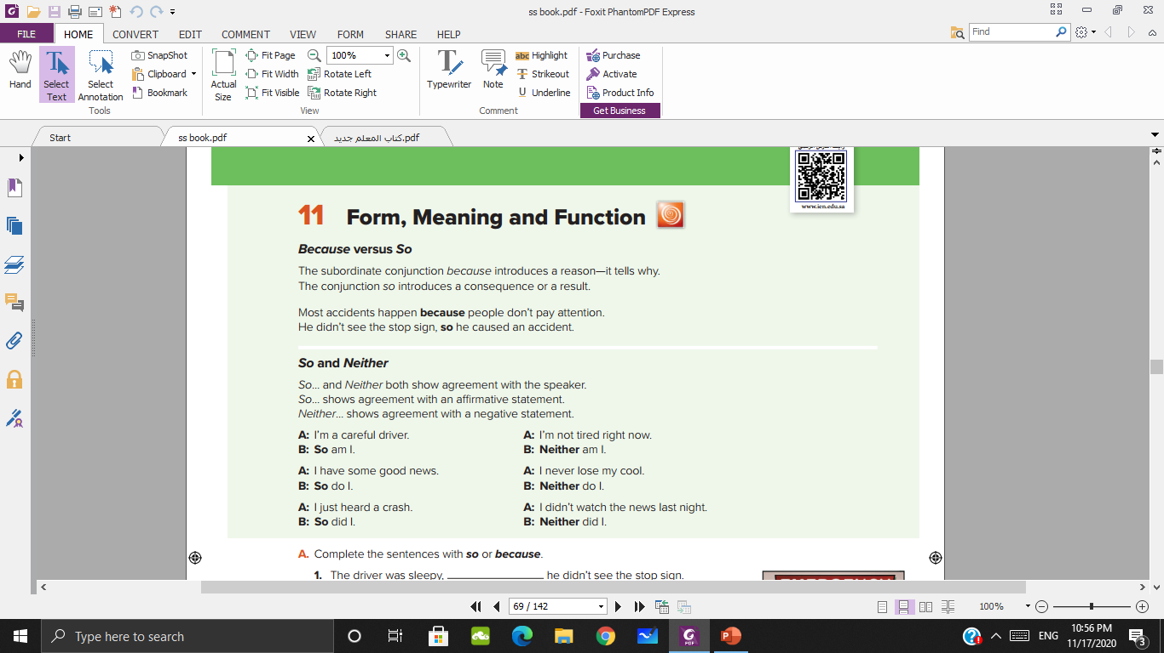

Slide 7
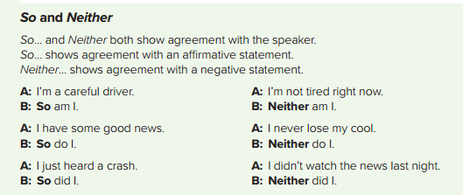

Slide 8
CONCEPTS
Which shows affirmative agreement….
Which shows negative agreement….
So
Neither

Slide 9
Use: so / neither
I don’t speak Spanish
I’m hungry
I cleaned my room yesterday
I didn’t eat breakfast

Slide 10
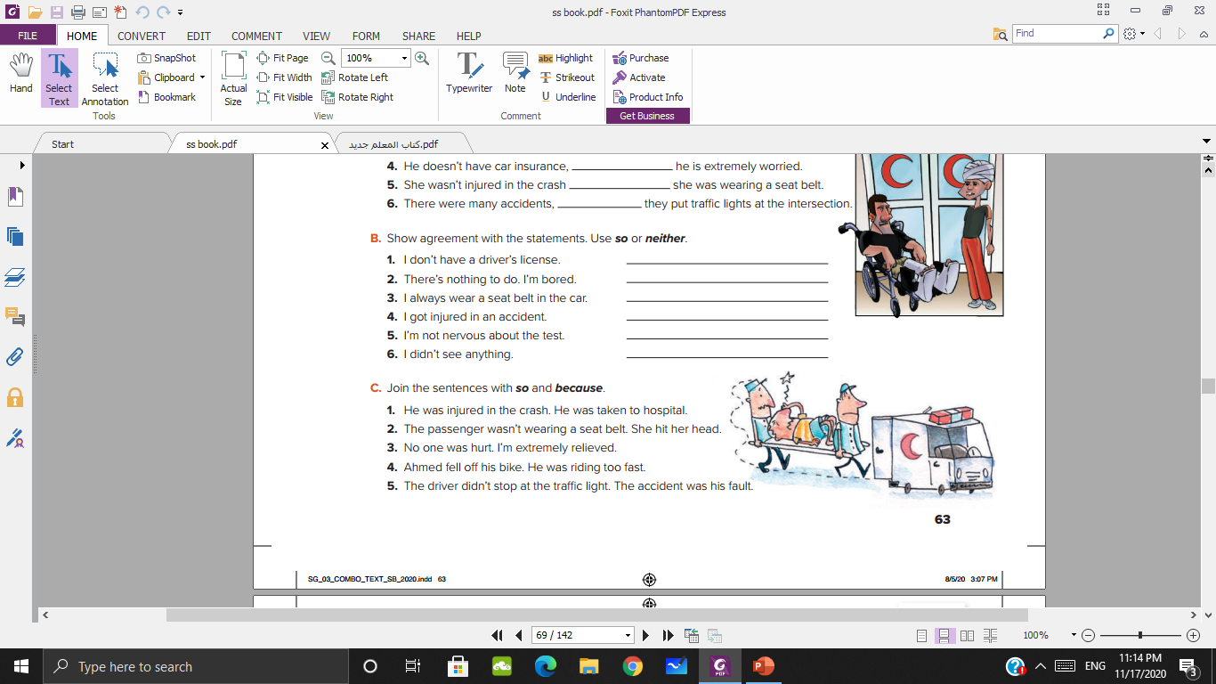
He was injured in the crash, so he was taken to hospital.
The passenger wasn’t wearing a seat belt, so she hit her head.
No one was hurt, so I’m extremely relieved.
Ahmad fell off his bike because he was riding too fast.
The driver didn’t stop at the traffic light, so the accident was his fault.

Slide 11

https://learningapps.org/view15224257

Slide 12
Thank you

