Slide 1

FORM, MEANING
AND
FUNCTION
63

Slide 2
1
SO
&
BECAUSE

Slide 3
Because
The subordinate conjunction because
introduces a reason..
it tells why
Most accidents happen.
because people don’t pay attention

Slide 4
SO
The conjunction so introduces a result.
He didn’t see the stop sign,
So he caused an accident.

Slide 5
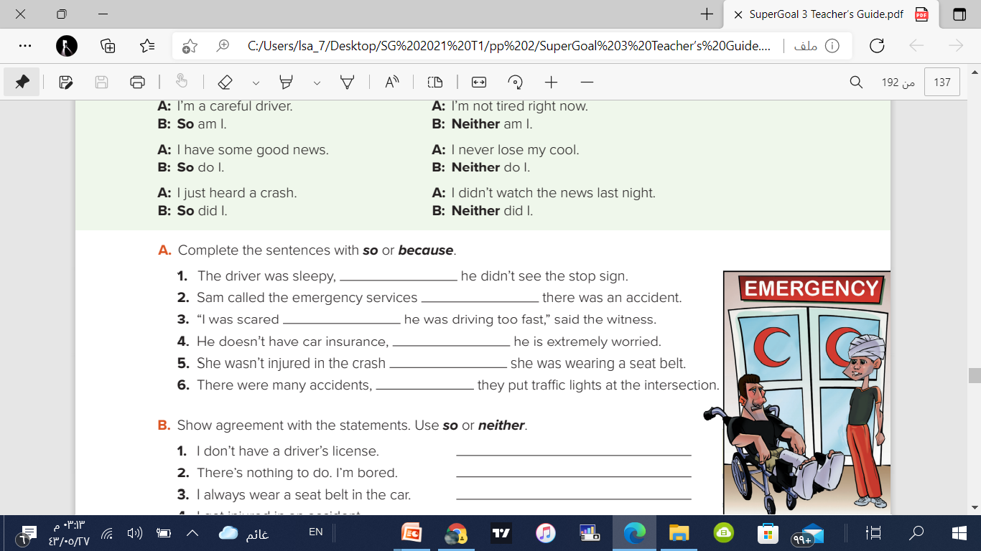
Complete the sentences with so or because
6 | 5 | 4 | 3 | 2 | 1
so
because
because
so
because
so

Slide 6
2
SO
&
Neither

Slide 7
So and Neither
So… and Neither
Both show agreement with the speaker.

Slide 8
So
So… shows agreement with an affirmative statement.
I have some good news.
So do I
🔨
I just heard a crash.
So did I.

Slide 9
Neither
Neither… shows agreement with a negative statement.
I’m not tired right now.
Neither am I.
I didn’t watch the news last night
Neither did I.

Slide 10
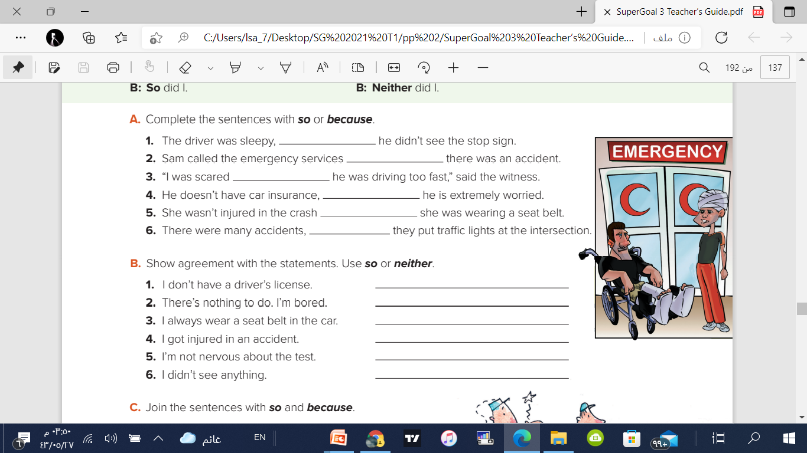
Show agreement with the statements.
Use so or neither.
Neither do I. | 1
So am I | 2
So do I. | 3
So did I. | 4
Neither am I | 5
Neither did I. | 6

Slide 11
Summary
Because
it tells why.
So
Introduces a result
B
s
shows agreement with an negative statement.
Neither
shows agreement with an affirmative statement.
So
N
S

Slide 12
U7 WHAT HAPPENED?
The Sene of the Accident
There was / were
Someone / no one
Nothing / Anything
What ? Who?
Where ?How?
Why ?
3
5
1
2
4
6
Feelings
Reading
So you
Want to be Cool
So / Niether

Slide 13
Thanks!
Any questions?

Slide 14
Any questions?
You can find me at:
Telegram @T_RAED
Twitter @RAE_D_1
THE END

