Slide 1


Slide 2
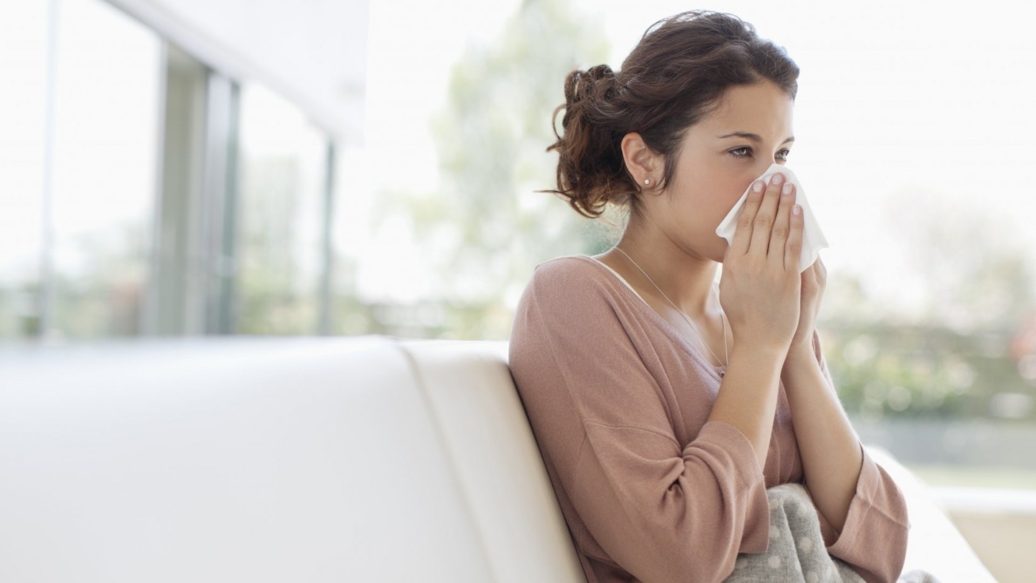

What’s wrong?
Two blessings that many people are deceived by are health and freetime

Slide 3


Slide 4

U 8
Writing
Day:
Date:

Slide 5

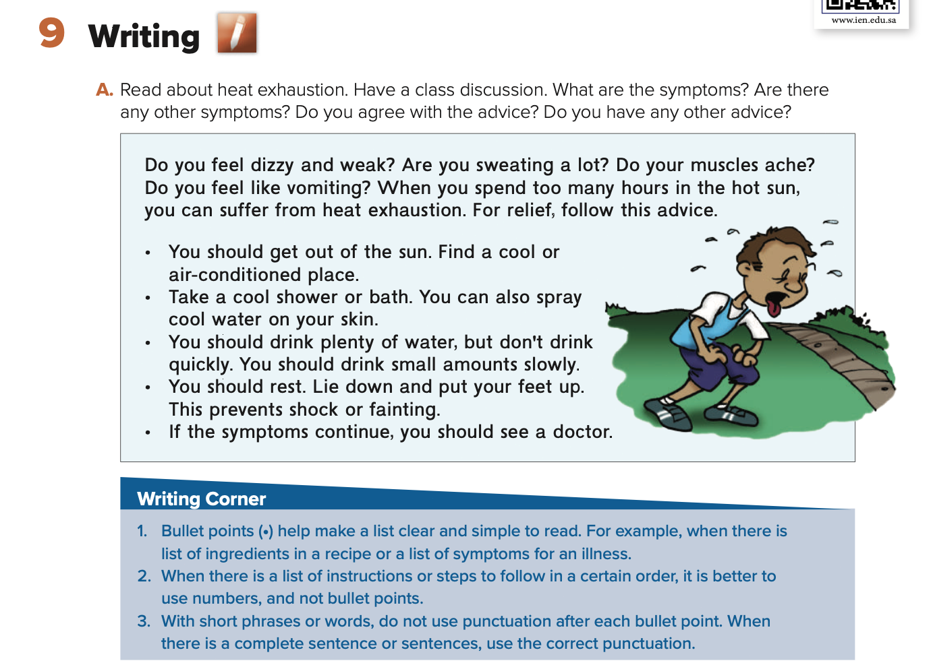
Use subject pronouns
find illnesses
Find symptoms and make advice

Slide 6
Symptoms: dizzy, weak, sweating, muscles ache, vomiting

Slide 7

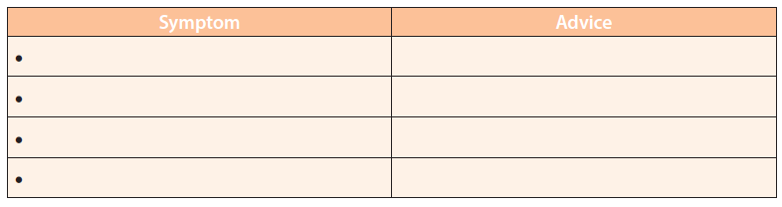

Slide 8
a headache
you should Take some aspirin
a stomachache
You shouldn't eat anything right now
a sore throat
You should drink warm liquids.

Slide 9




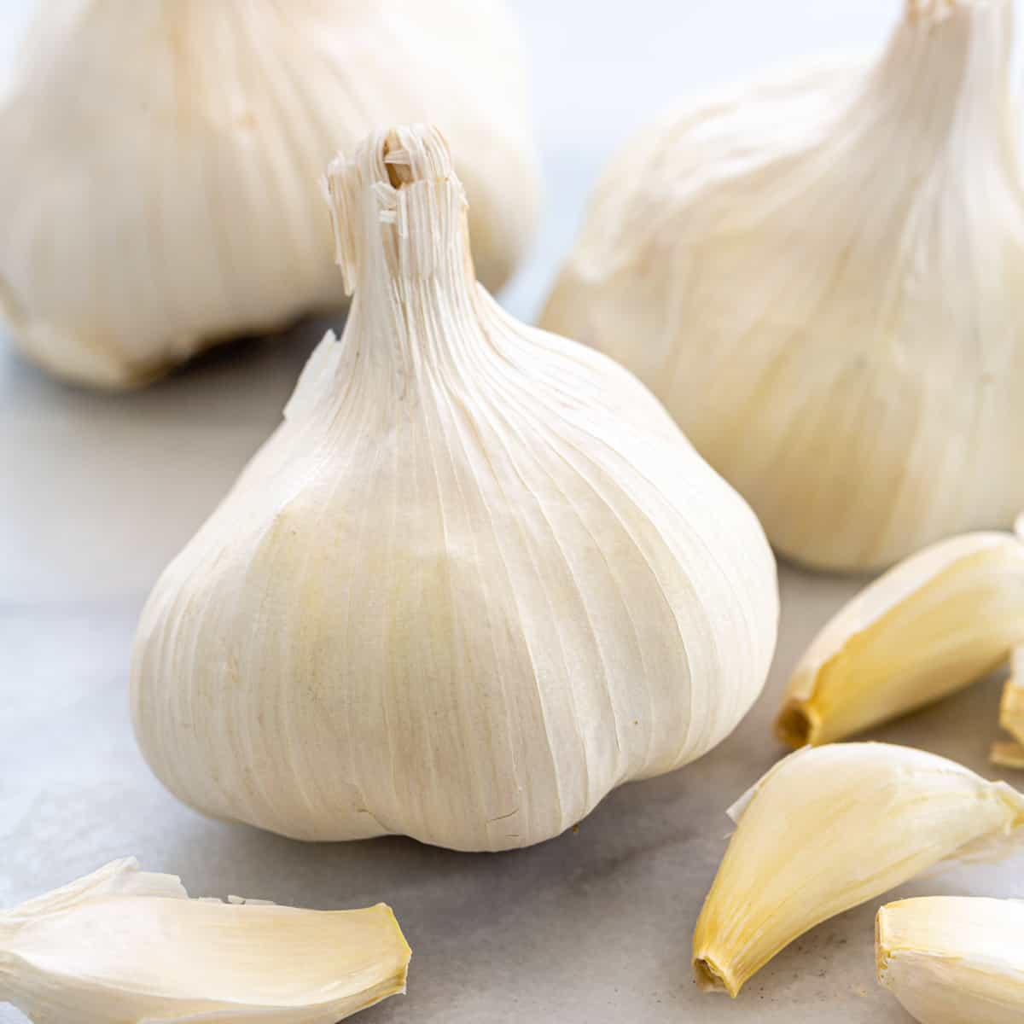
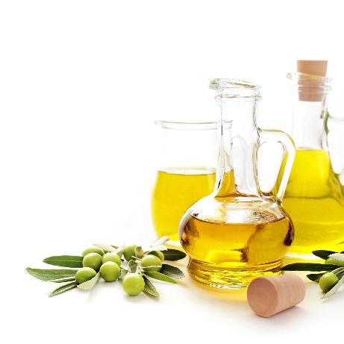
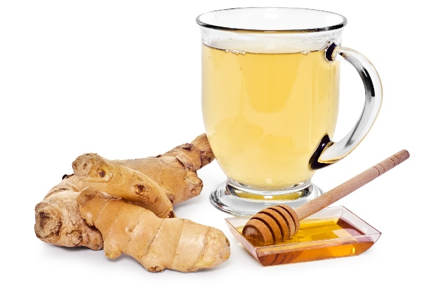
illnesses
lemon
garlic
ginger drink
honey
olive oil

Slide 10
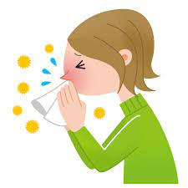
U8\Composition
*Write a paragraph about Feeling Sick . Give your opinion about it.
When was the last time you were sick?
What did you feel?
What do you do when you have a fever?
What do you do to feel better when you are sick?
What are some foods that help you feel better?
How can you protect yourself from the flu? Why?
I was sick last week. I don't feel well. Because I have a fever. I have a runny nose and a cough .I take some medicine and stay home and rest. I eat well and drink ginger and tea. I feel better in a few days. I think flu viruses spread so quickly by people when they cough or sneeze. We should wash our hands and avoid being around sick people.

Slide 11
DON’T FORGET YOUR HOMEWORK
AT MADRASATI PLATFORM

Slide 12
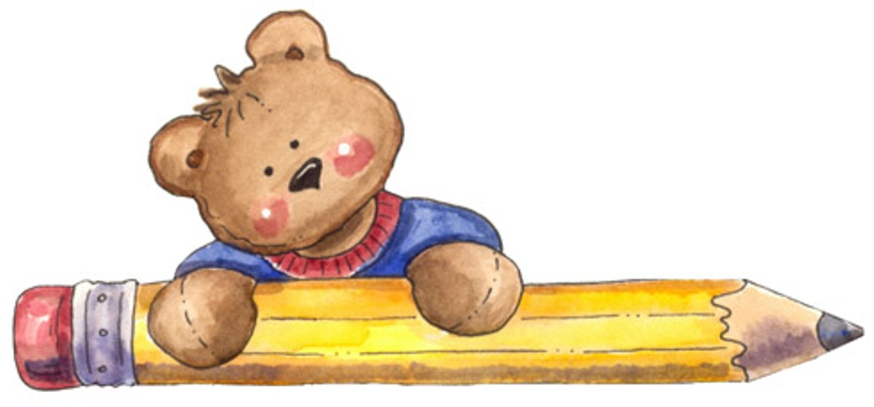
Have a nice day
Thank you
Your teacher\ safa Salman AlHerz

