Slide 1


Slide 2


Slide 3


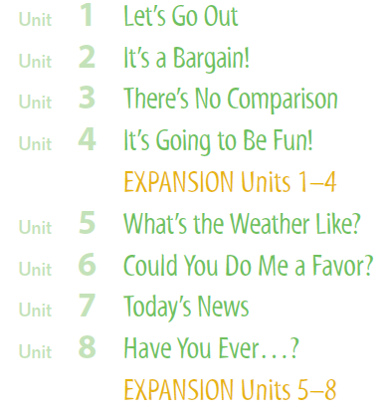

Slide 4

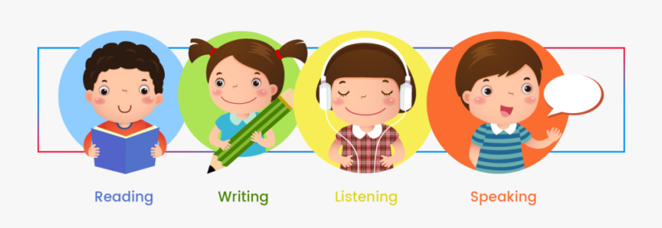

Slide 5
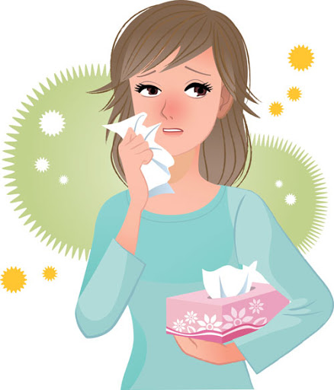
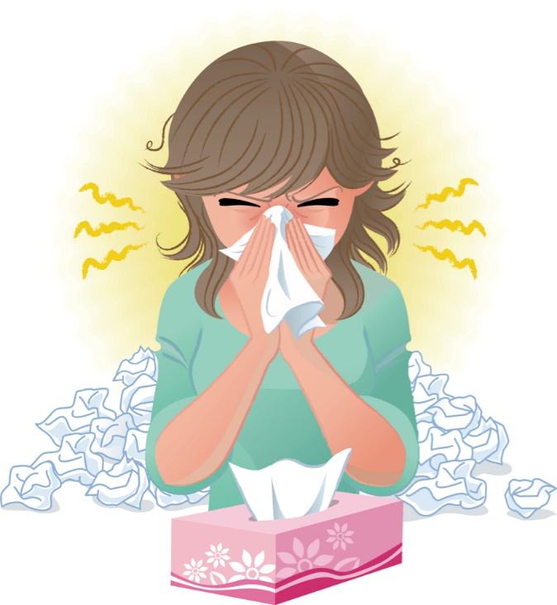
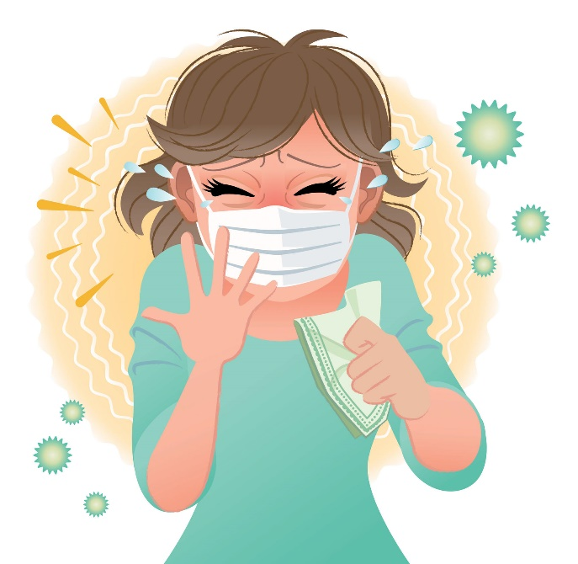
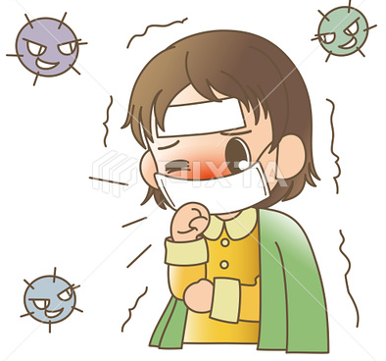
Covid 19
☺Avoid gathering !
☺We must wear a mask before
going out.
☺Social distancing is not a
choice, it is a must!
☺Keep a distance of 2 meters
to avoid accountability
☺wash hands constantly.

Slide 6
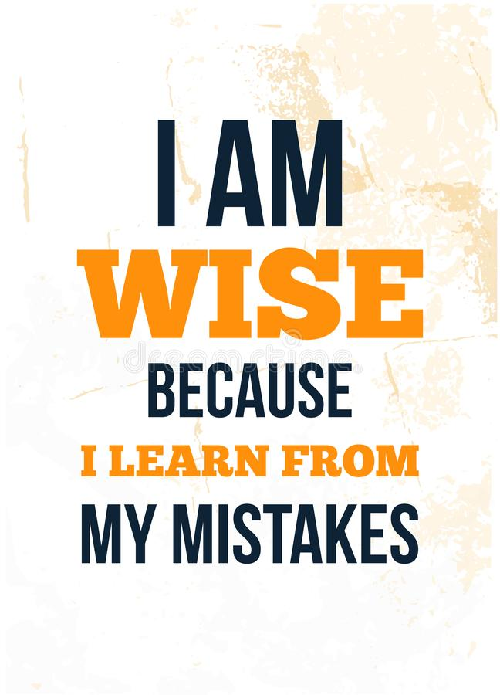

Slide 7
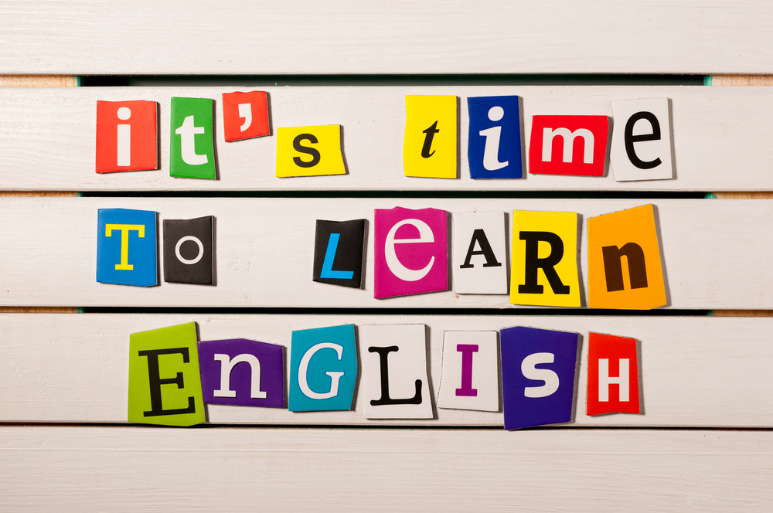

Slide 8




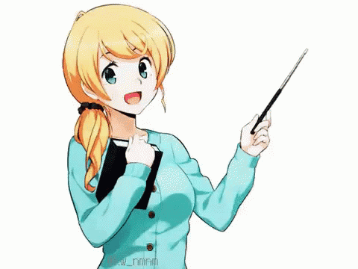
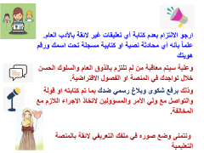
Today: Tuesday
Date:
9-4-1442 H
November 24th \ 2020
everyone,
How is everything going?

Slide 9




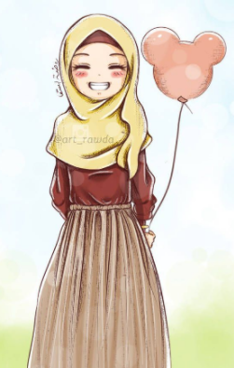
ارجو الالتزام بعدم كتابة أي تعليقات غير لائقة بالأدب العام. علماً بأنه أي محادثة نصية او كتابية مسجلة تحت اسمك ورقم هويتك
وعلية سيتم معاقبة من لم تلتزم بالذوق العام والسلوك الحسن خلال تواجدك في المنصة او الفصول الافتراضية.
وذلك برفع شكوى وبلاغ رسمي ضدك بما تم كتابته او قولة والتواصل مع ولي الأمر والمسؤولين لاتخاذ الاجراء اللازم مع المخالفة.
ونتمنى وضع صوره في ملفك التعريفي لائقة بالمنصة التعليمية

Slide 10
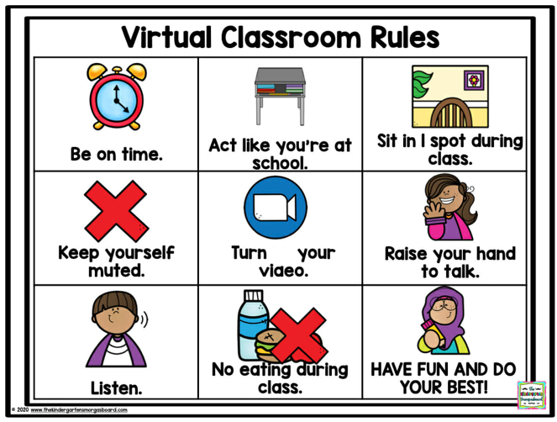
off

Slide 11




☺
♥
Listen to the reduction of have + to.
Express obligation.
Answer questions from conversation about making excuses
Practice conversation about making excuses

Slide 12





Page 5
Even though we pronounce the reduction, we still write the full form, have to.

Slide 13
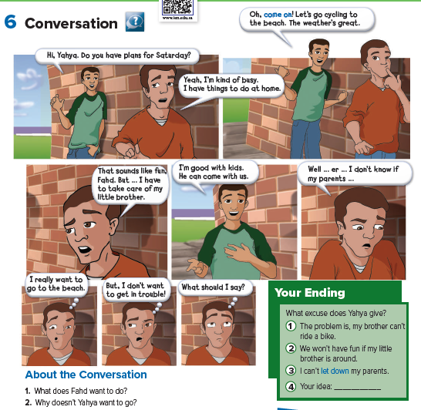


Page 6
Who is in the cartoon?
What do you think this
conversation is about?
Choose the
ending you like best,
You may reject all three endings, but you must come up with one of your own.

Slide 14


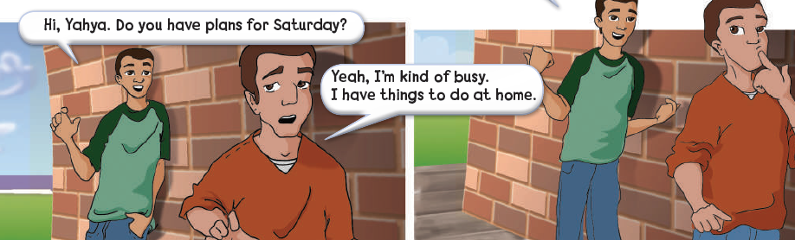
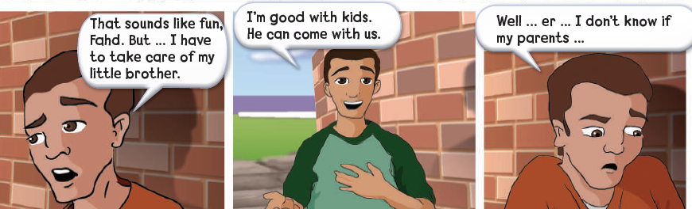
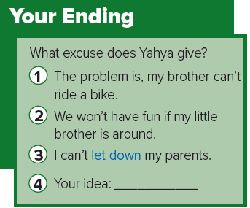
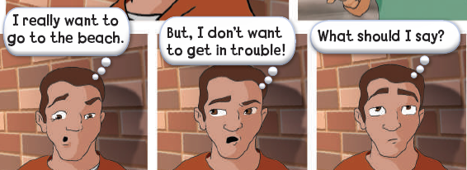
Page 6
Choose the
ending you like best,
You may reject all three endings, but you must come up with one of your own.

Slide 15
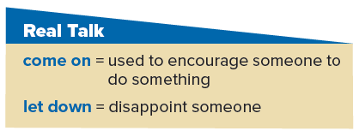
Page 6
Who says come on? (Fahd)
Why does he say it? (He wants to convince Yahya to do something.)
a teen to a parent (maybe the teen wants to go out on a school night);
a sister to her older sister (maybe she wants to borrow some clothes).
a situation where someone let you down.
For example: My brother promised to help me paint the kitchen last week.
But then he called and said he was busy. He really let me down.
The meaning of let me down (disappointed me).
Tell about situations where someone let you down.

Slide 16
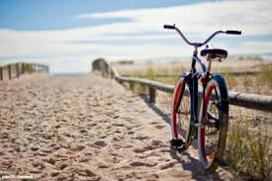

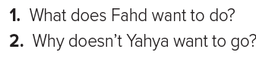
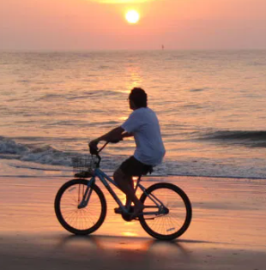
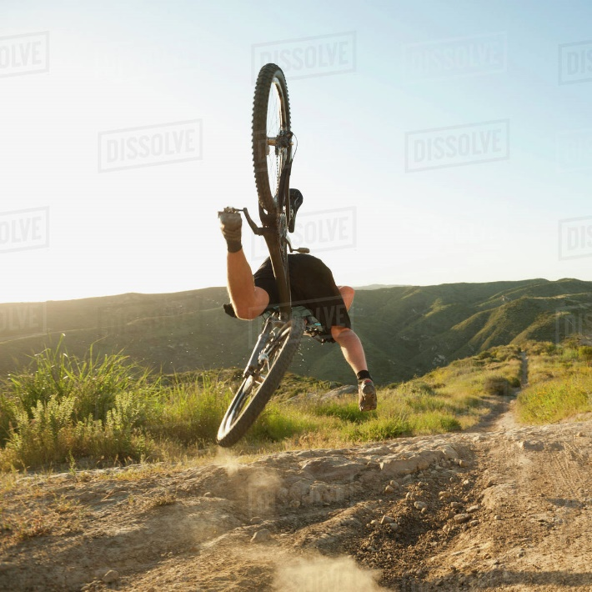
Page 6
1. Fahd wants to go cycling to the beach.
2. Yahya doesn’t want to go because he might get in trouble.

Slide 17
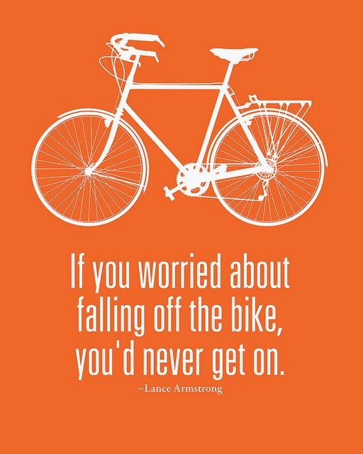

Slide 18

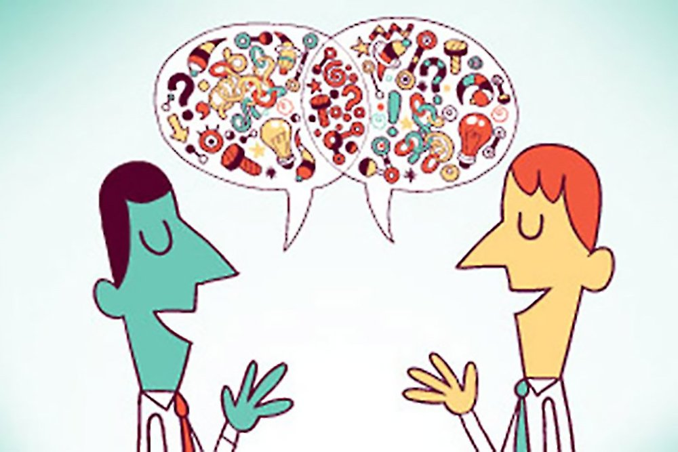

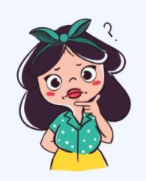


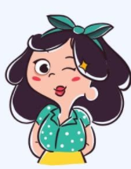
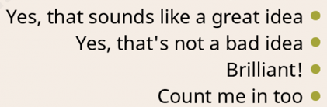
Page 6
for example, should, Let’s, Why don’t we…
●What should we do on Friday?

Slide 19


Slide 20
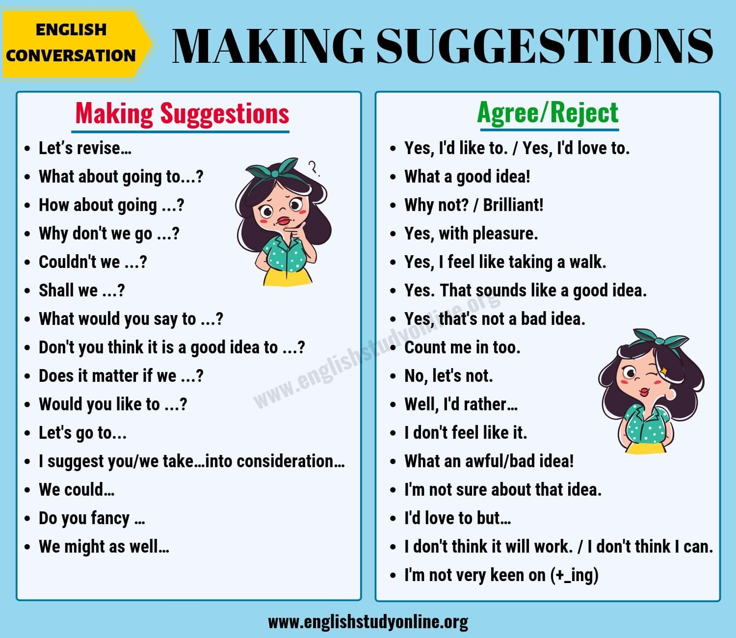

Slide 21


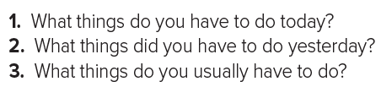

Page 6
1.I have to go swimming.
2.I had to wash the dishes.
3. I have to brush my teeth everyday.

Slide 22


أتمنى الاهتمام بمتابعة الدروس في قتوات عين الرسمية من وزارة التعليم
T.Noureyah Alghamdi
The end

Slide 23
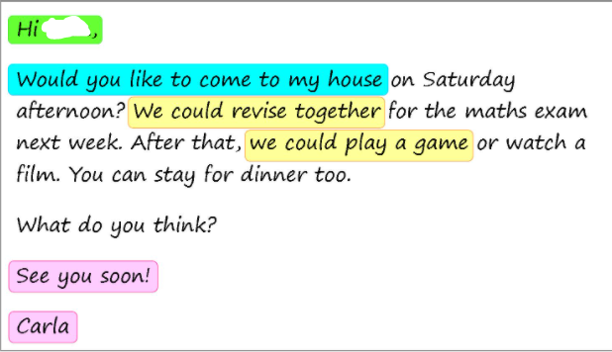

Slide 24

