Slide 1


Slide 2
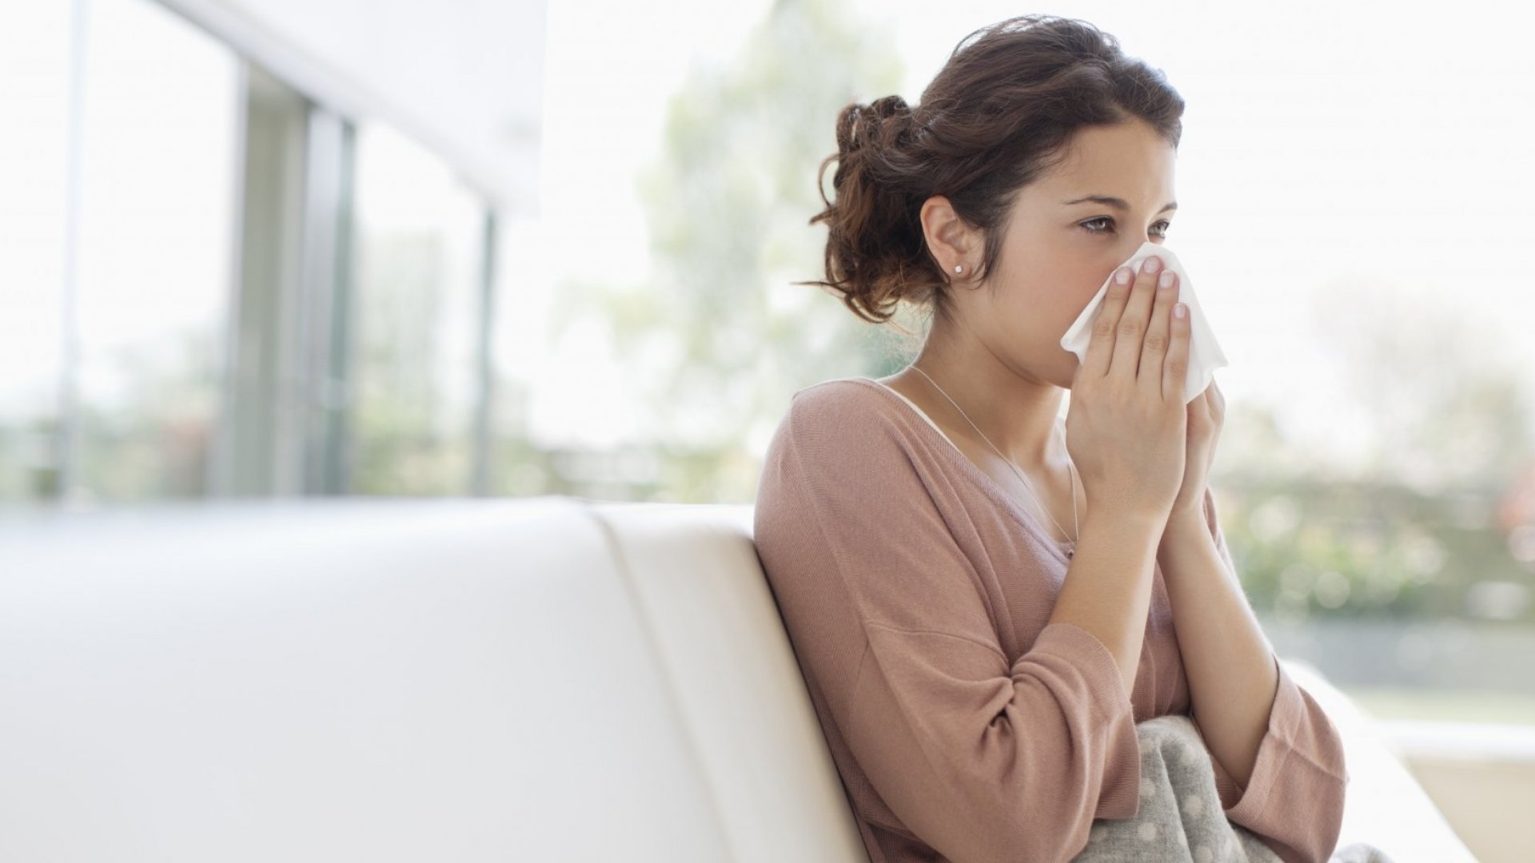

What’s wrong?
Two blessings that many people are deceived by are health and freetime

Slide 3


Slide 4

U 8
Form , Meaning and function
Day:
Date:

Slide 5

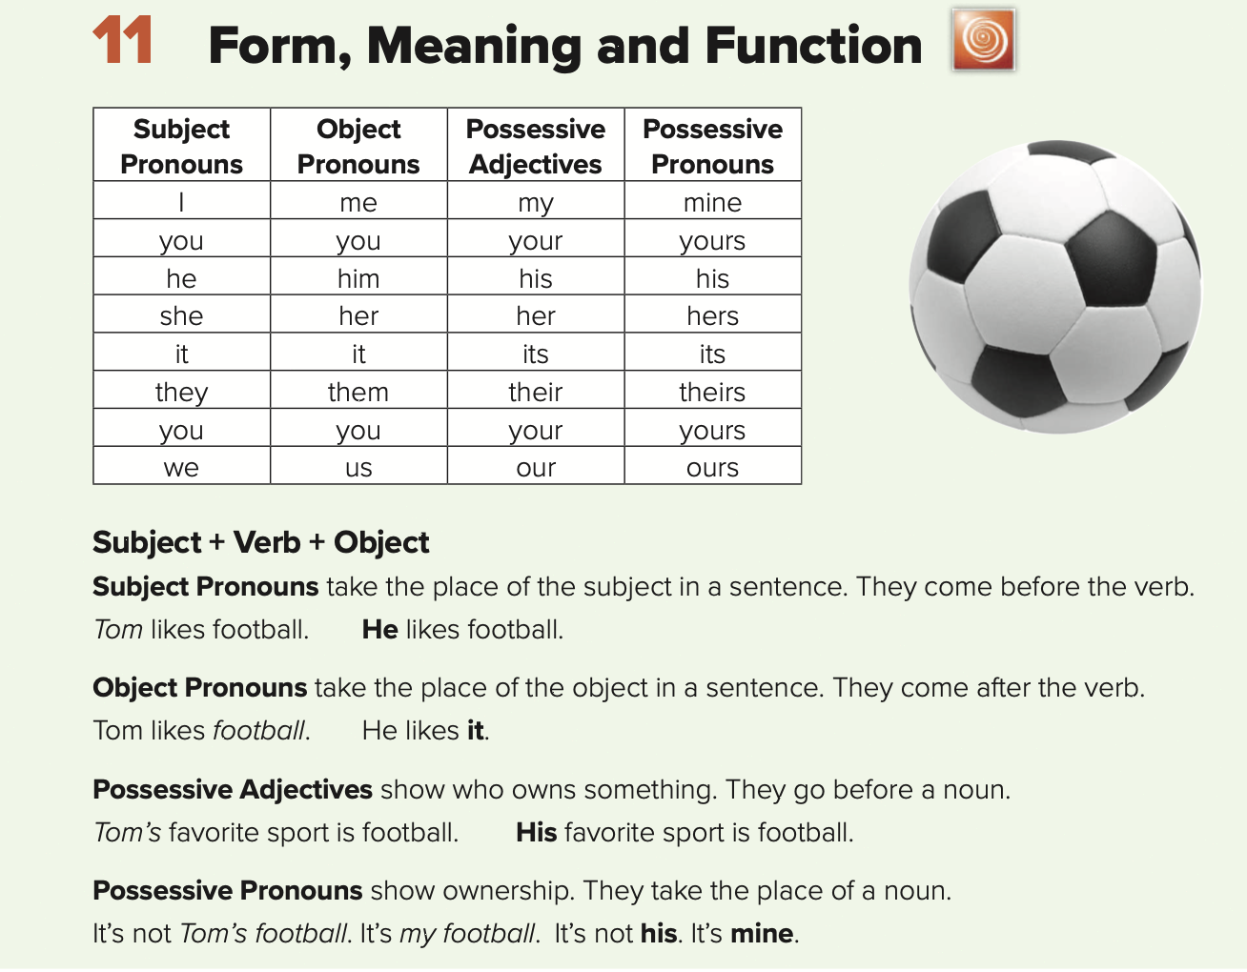
Use subject pronouns
Use subject pronouns
Use object pronouns
Use possessive adjectives and pronouns

Slide 6


Slide 7
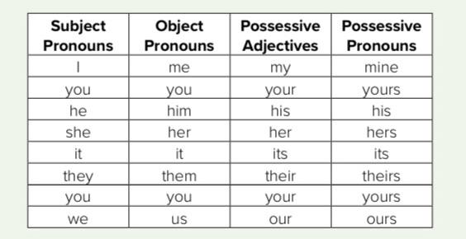

Slide 8
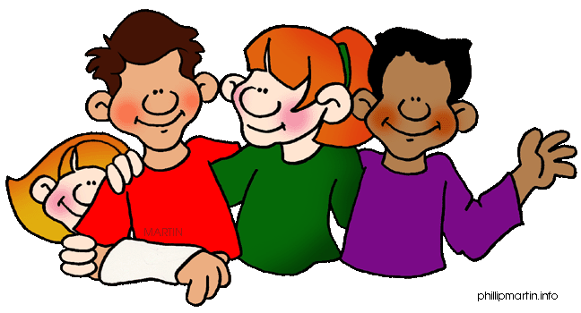
Personal or subject
Pronouns

Slide 9
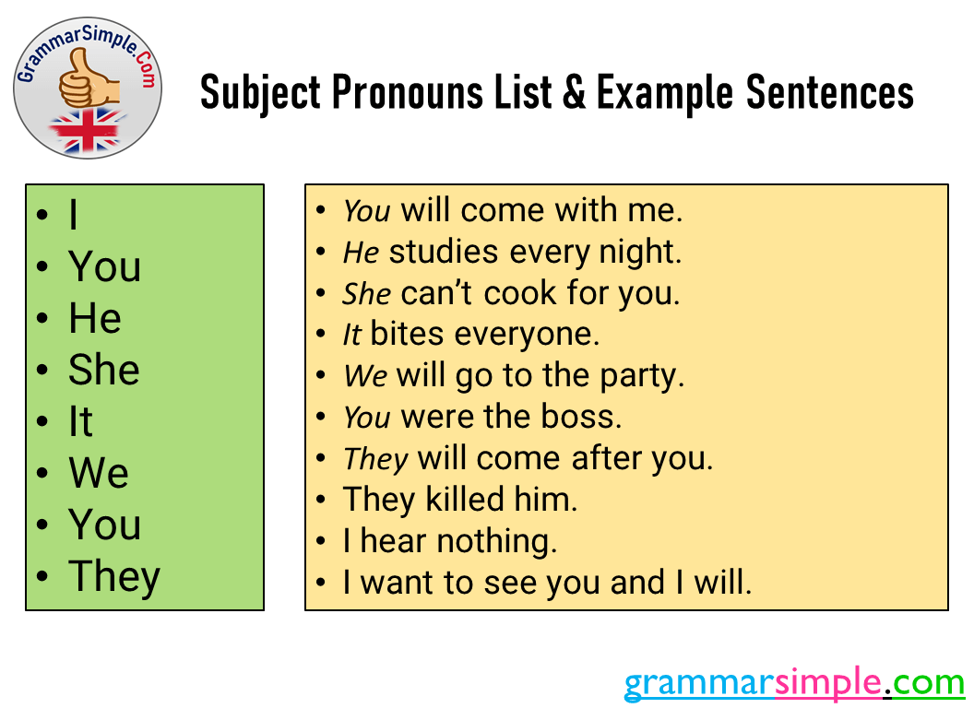

Slide 10



He
This is my friend Tom. ____ is from Britain.
He
Him

Slide 11

His mother is a doctor.
____ works in that hospital.
She
She
Her

Slide 12
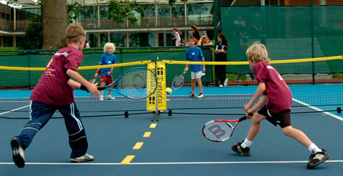
Bob and I usually play tennis together. ____ are good at it.
We
We
Us

Slide 13

objective
pronoun

Slide 14


Slide 15
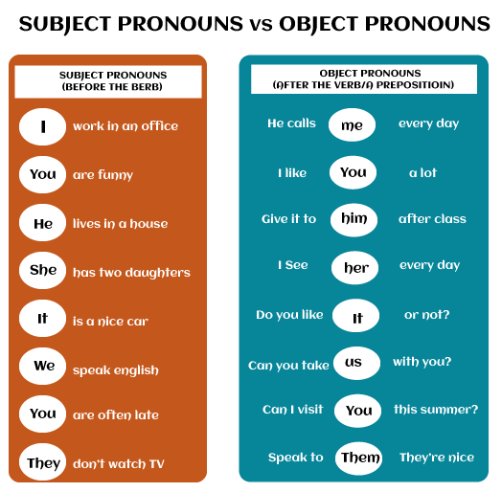

Slide 16
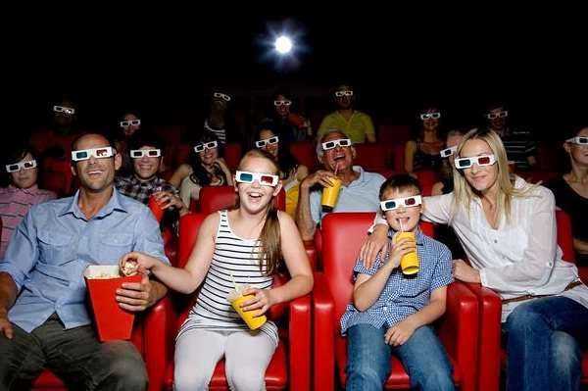
5/10
My parents like watching films.
I often go to the cinema with _____ .
them
they
them

Slide 17
We won the match.
So they gave ___ a trophy.
us
we
us

Slide 18
Possessive
pronoun

Slide 19
Personal pronouns
Possessive adjectives
I
My
You
Your
He
His
She
Her
It
Its
We
Our
You
Your
They
Their

Slide 20
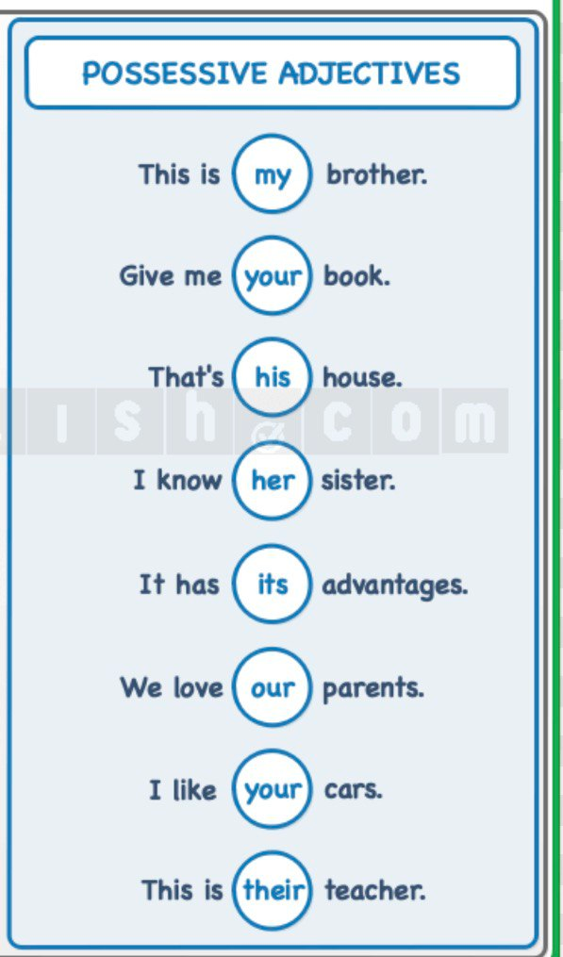
*Show who owns something
*they go before a noun

Slide 21
Possessive
pronoun

Slide 22
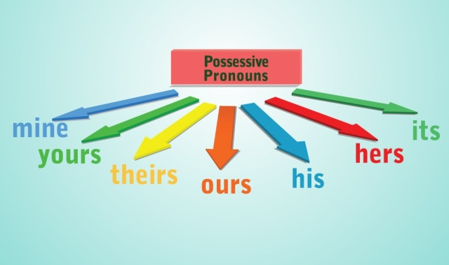
show ownership
They take the place of a noun

Slide 23
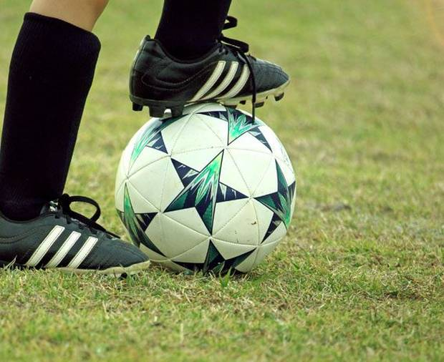
It is not Tom’s foorball. It is my football.
Ex.: It is not his. It is mine
Possessive pronouns

Slide 24
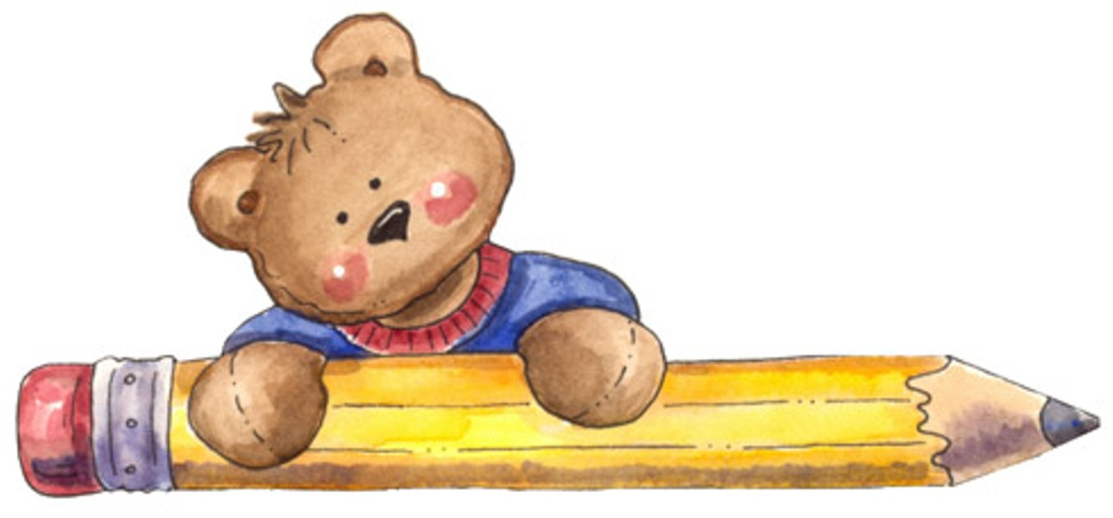
Let's practice

Slide 25

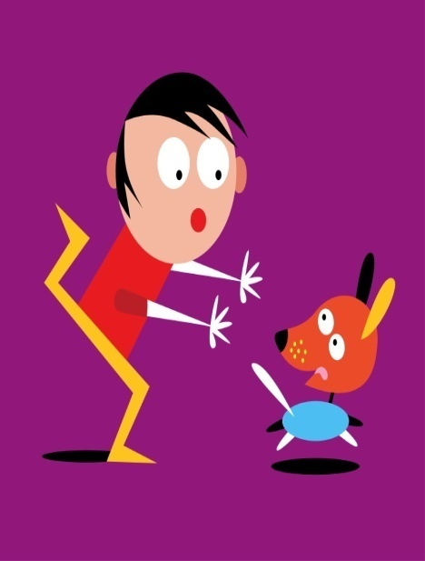
Complete with the correct personal pronoun and possessive adjective
This is _________ friend, Sally. _______ is a student and _________ is 11 years old. This is __________ house.
my
She
she
her
This is Joe. __________ ´s from the UK. __________is 10 years old. This is ___________ dog. __________ name is Rex.
He
He
his
its

Slide 26
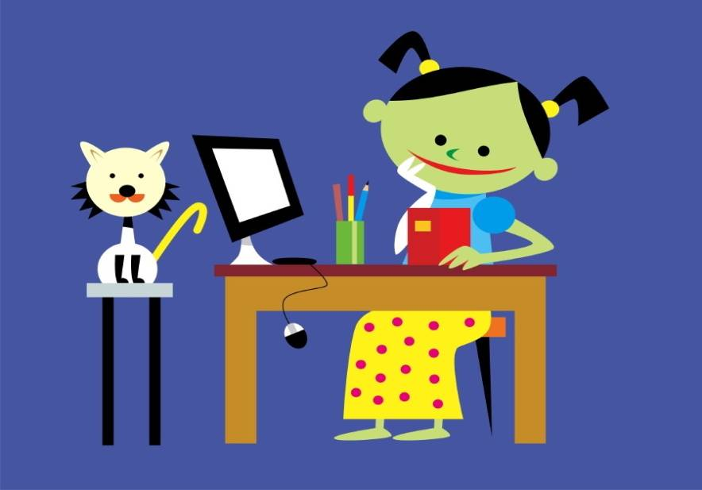
I
Hello! __________ ´m Carla. _______´m from Italy. _________ favourite colour is blue. This is ________ cat. _________ is white.
I
My
my
It

Slide 27
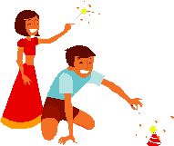
These children are from India. ___________ names are Ken and Mia. ___________ are twins. __________ ´re 12 years old. __________ favourite colour is red.
Their
They
they
Their

Slide 28

Hello, everyone! ________ are all friends. __________ ´re in the same school. __________ school is fantastic. This is ________ school bus. _______´s yellow.
We
We
Our
our
It

Slide 29
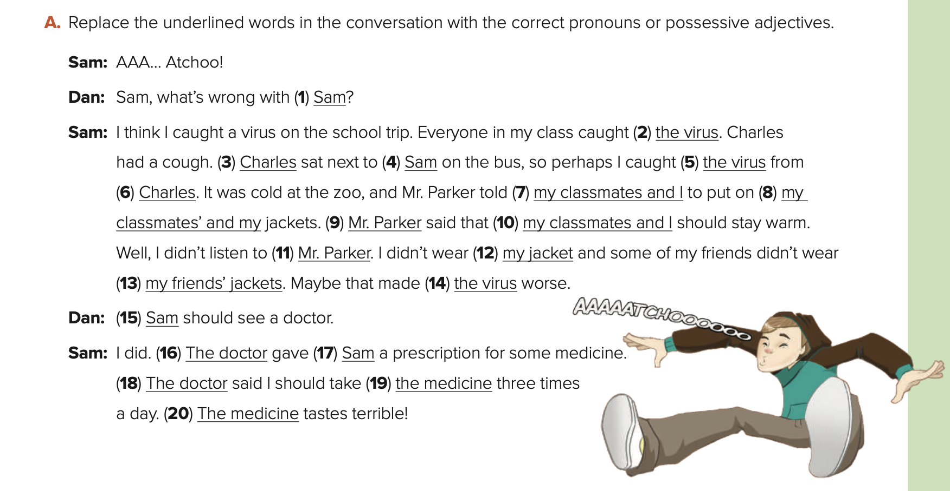
you
it
He
me
it
him
us
our
He
We
him
mine
theirs
it
You
He
me
He
it
it
73

Slide 30
DON’T FORGET YOUR HOMEWORK
AT MADRASATI PLATFORM

Slide 31
Have a nice day
Thank you
Your teacher\ safa Salman AlHerz

