Slide 1
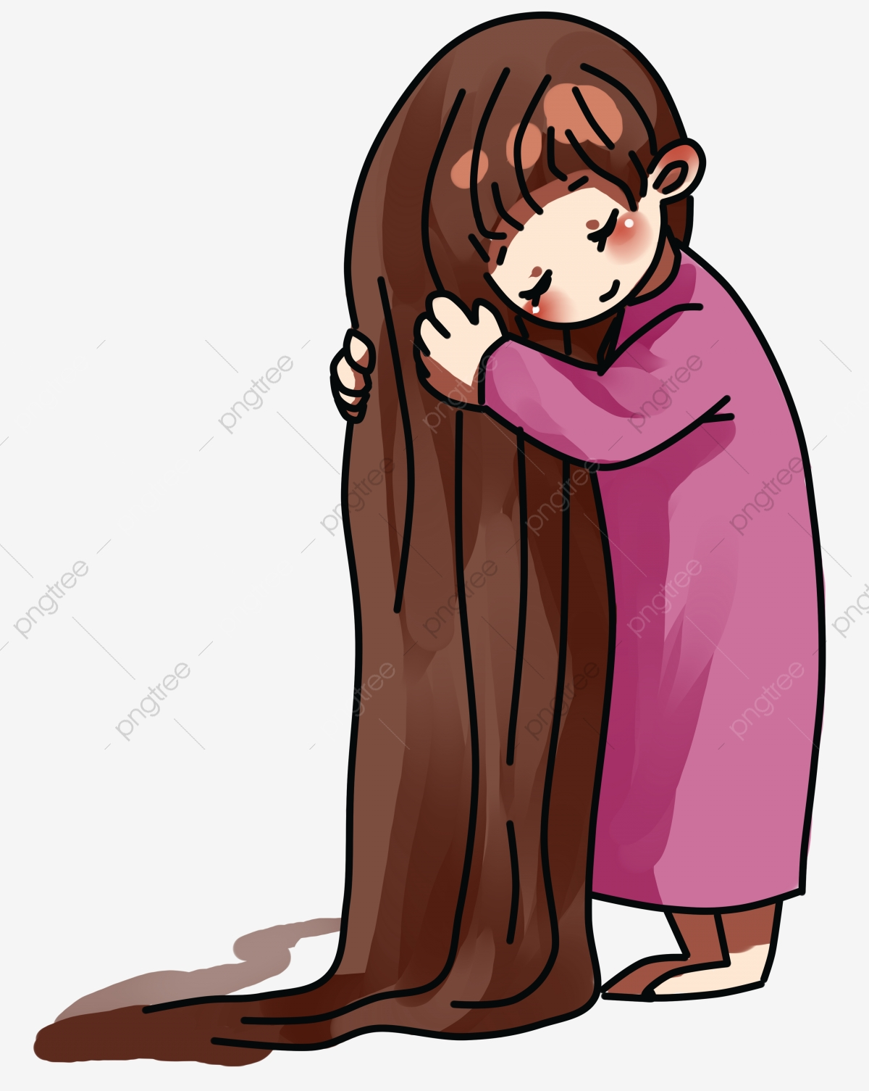
Choose:
1)This hair is ( to – too – two )long
2)(Who – Whose ) dress is this ?
3) It is Amal`s dress. It`s (her – hers).
4)(My – Mine )mother is a teacher.
5)Which bag do you want?
The leather ( one – ones ) please.
6)Which rings do you want ?
The silver ( one – ones )

Slide 2
Unit 2
It`s a Bargain !
Conversation
&
Form , meaning and function

Slide 3




It`s a Bargain !
Low price
inexpensive
ridiculous prices
fractions of the price
free
Discount
Offer

Slide 5
The objectives of the lesson :
Form a conversation about shopping habits
Practice a conversation responses
Use can, could , may and might correctly .

Slide 6
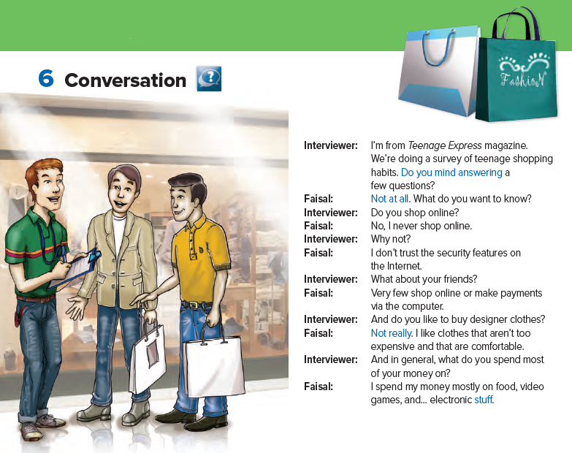


Slide 7
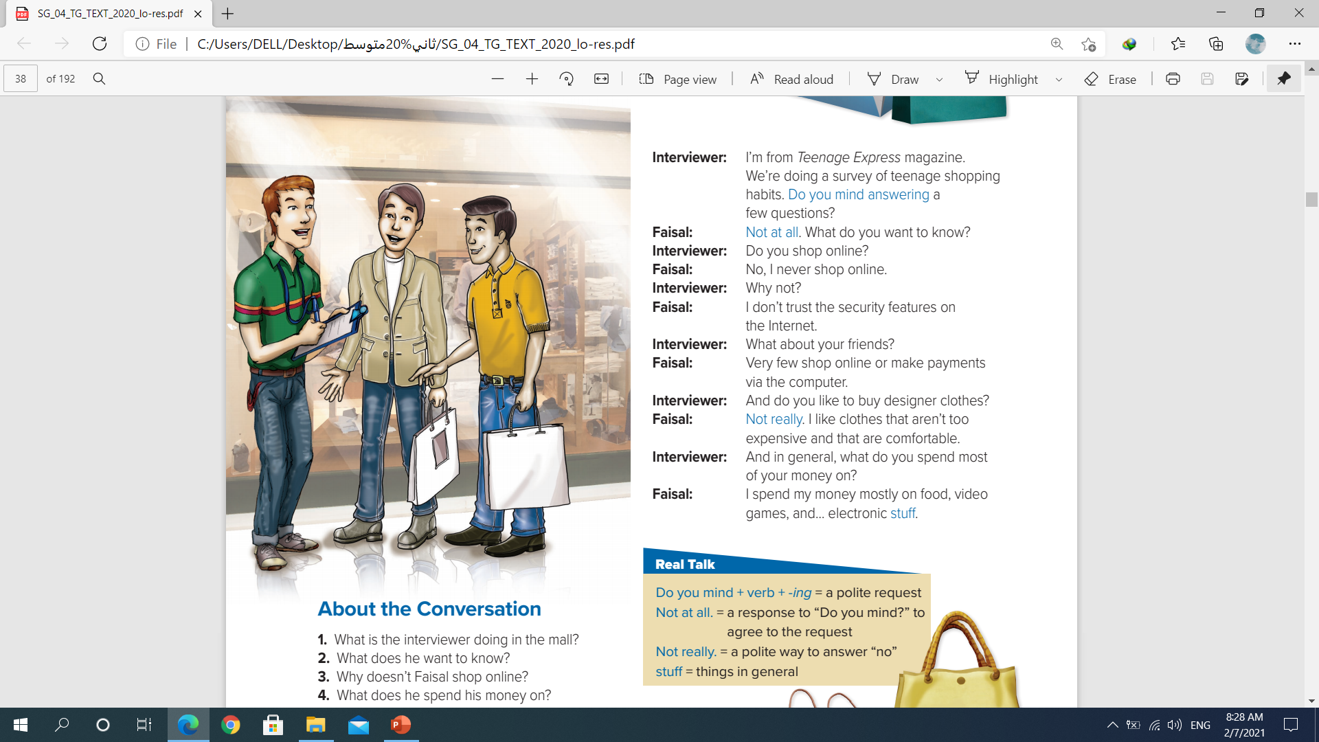

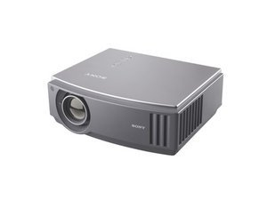
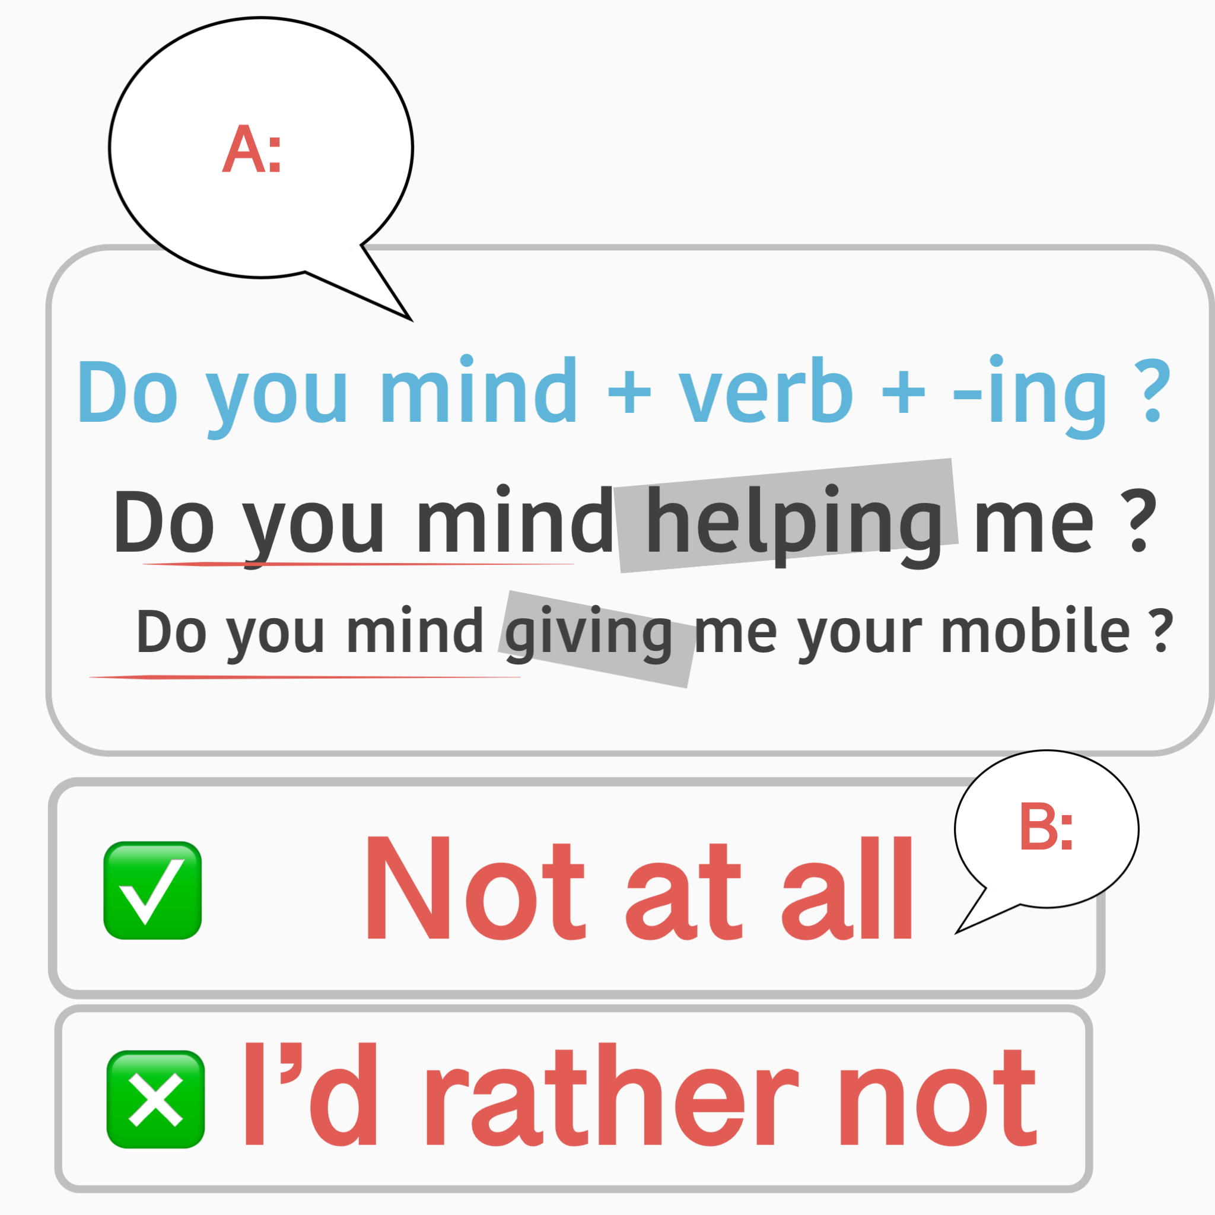
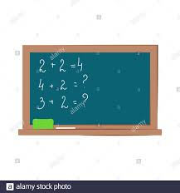
Close the door
Turn on the projector
Clean the board

Slide 8
Do you like to …………………..……?
play football .
clean the class.
eat chines food.
Not really

Slide 9
things
Bring me this stuff .
Take this stuff out.
Help me to carry this stuff.

Slide 10
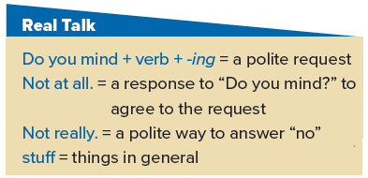

Slide 11
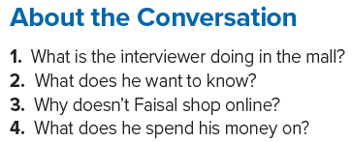
1)
1
2)
3)
4)

Slide 12
can
could
may
might
Show possibility or uncertainty | Make offer | Make request | Refuse | Give permission | Ask for permission
can..?
can
can`t
can
could..?
could
may..?
may
may
may not
might

Slide 14
can – could - may
can – could
can – could - may
can`t
can – could - may
can – could
may - might
may - might
can – could
can – could

