Slide 1
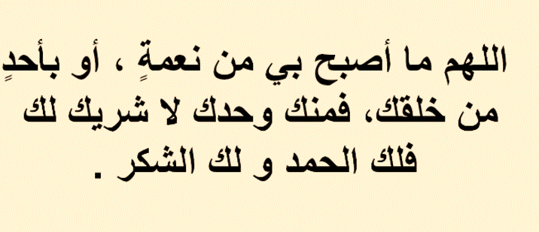

Slide 2


Slide 3
Unit-1-
Did You Hurt Yourself
Done by Hissah Alotaibi

Slide 4
4-Language context
5-Listening
6-Pronunciation
7 About You

Slide 5
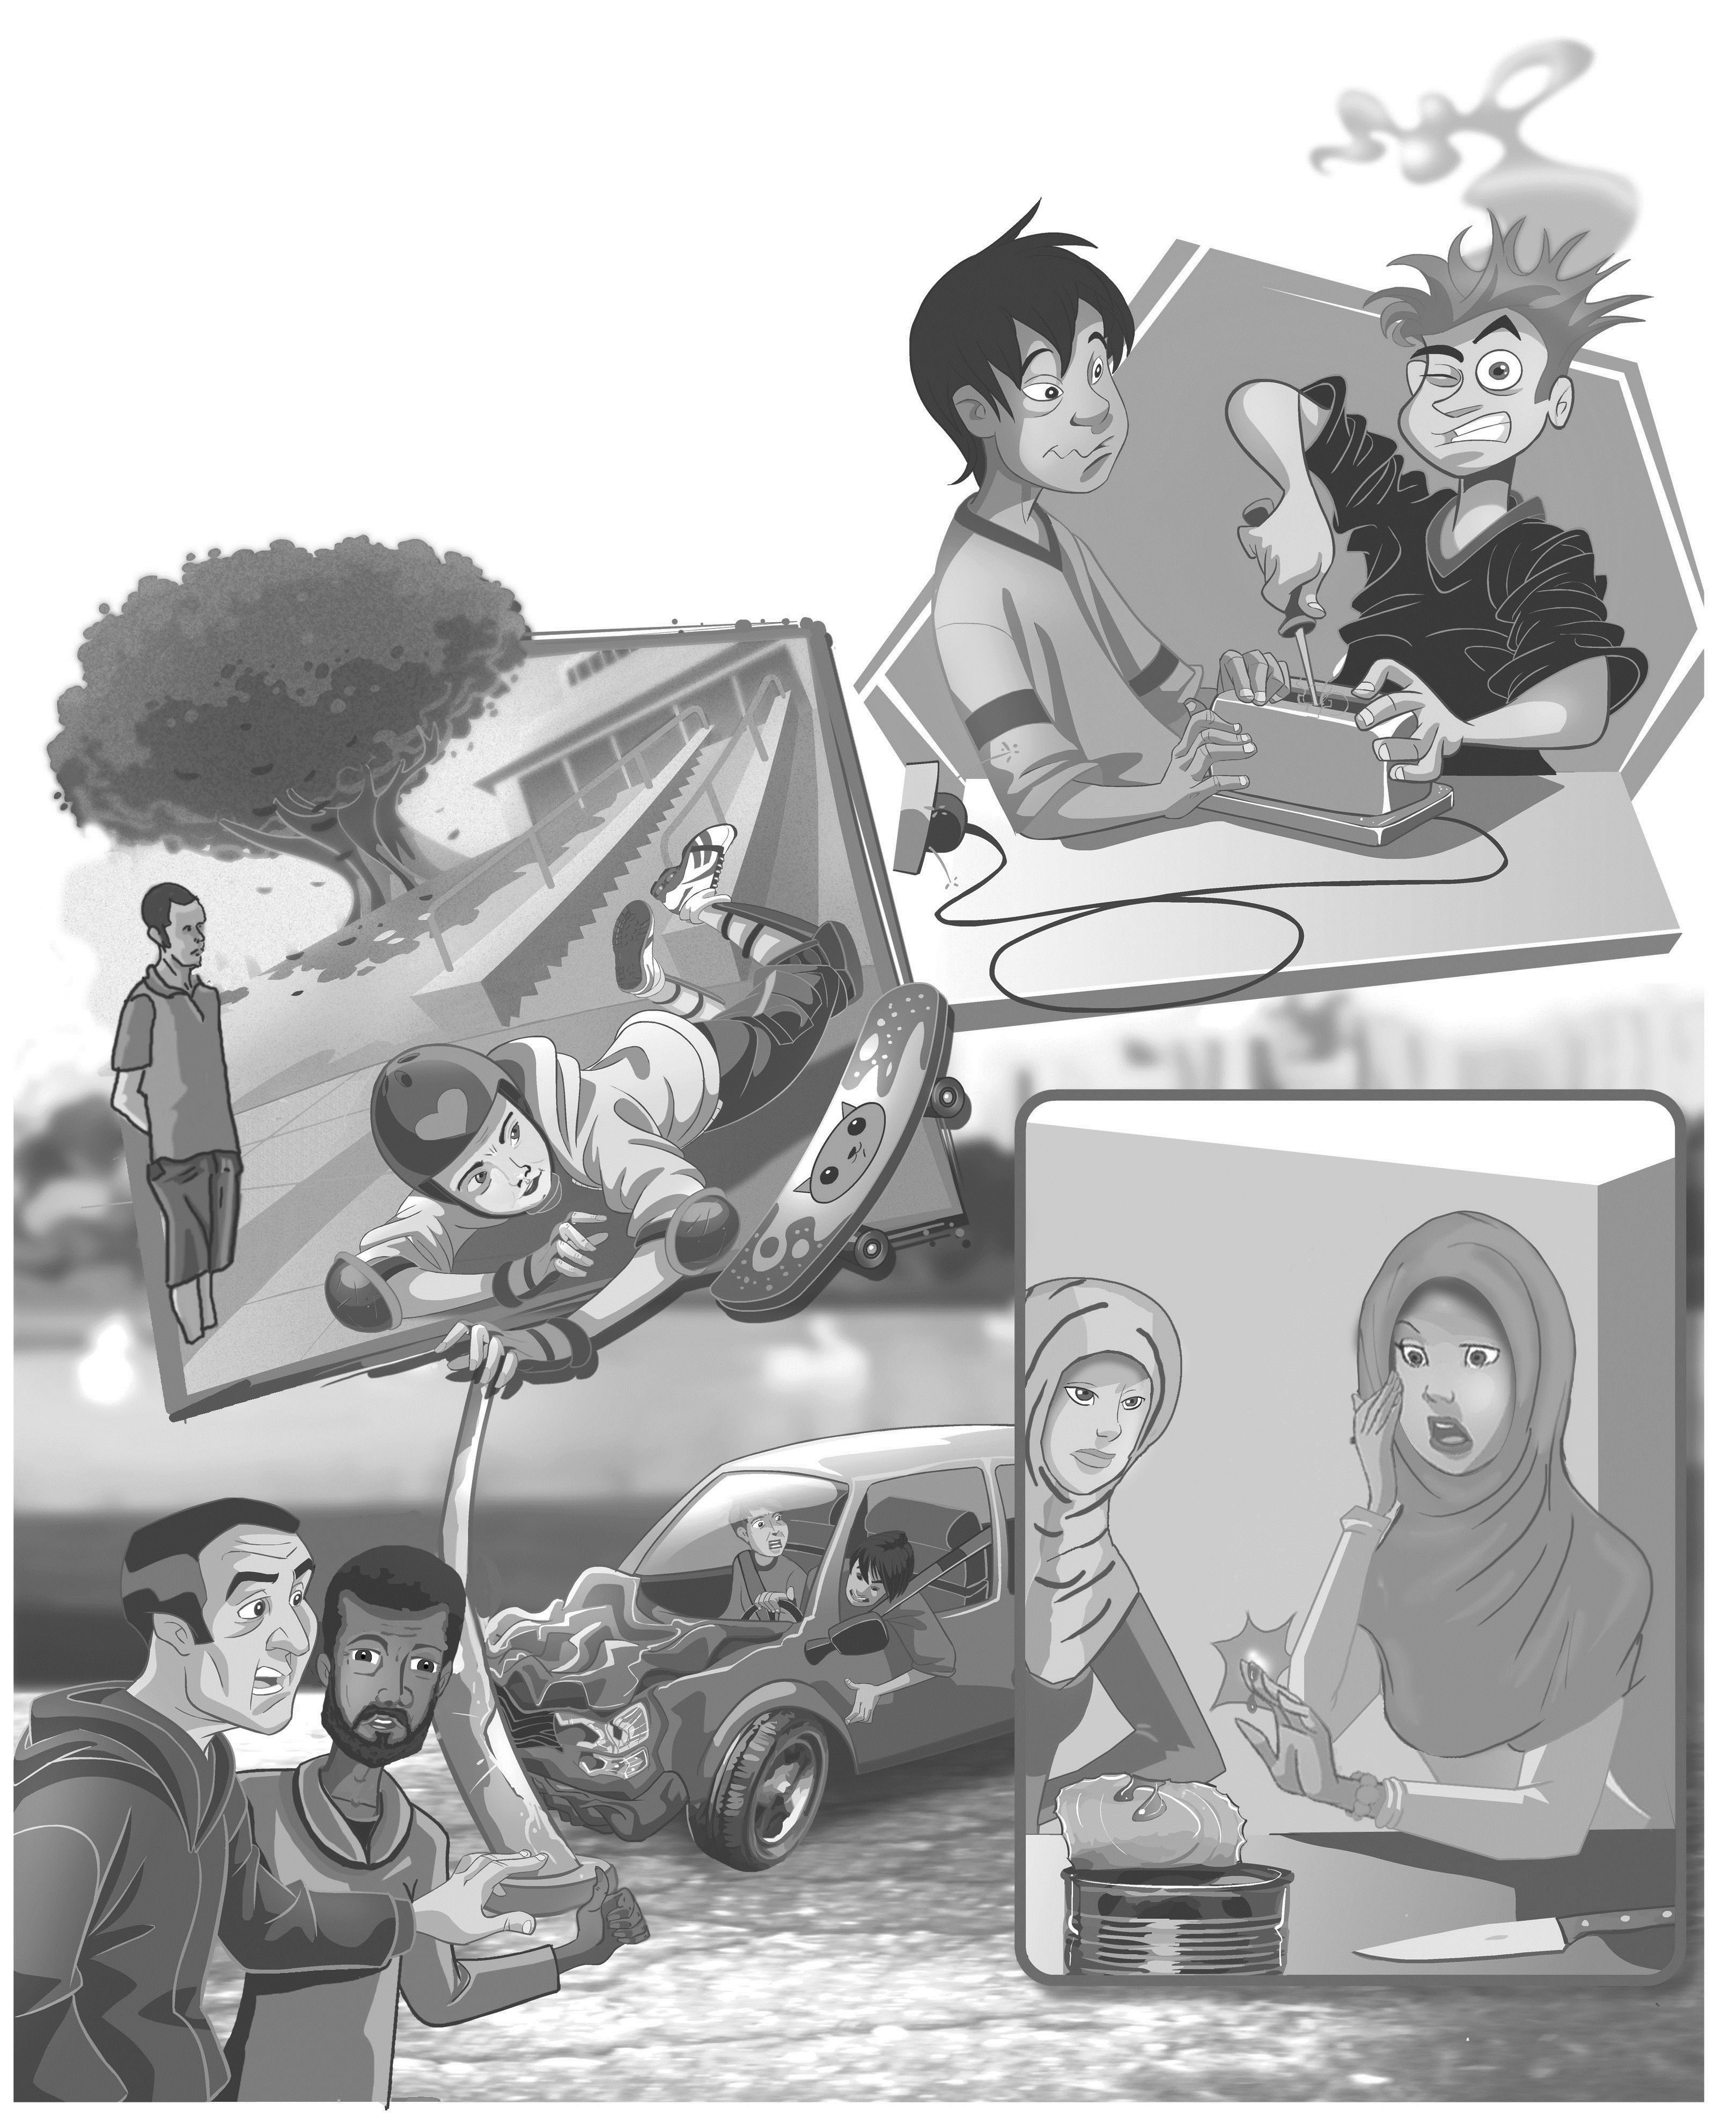

Objectives
1
Listen to the audio
2
Complete sentences according to the audio
3
Find the consonant cluster
4
Share positively in pair work

Slide 6
4 Language context

Slide 7
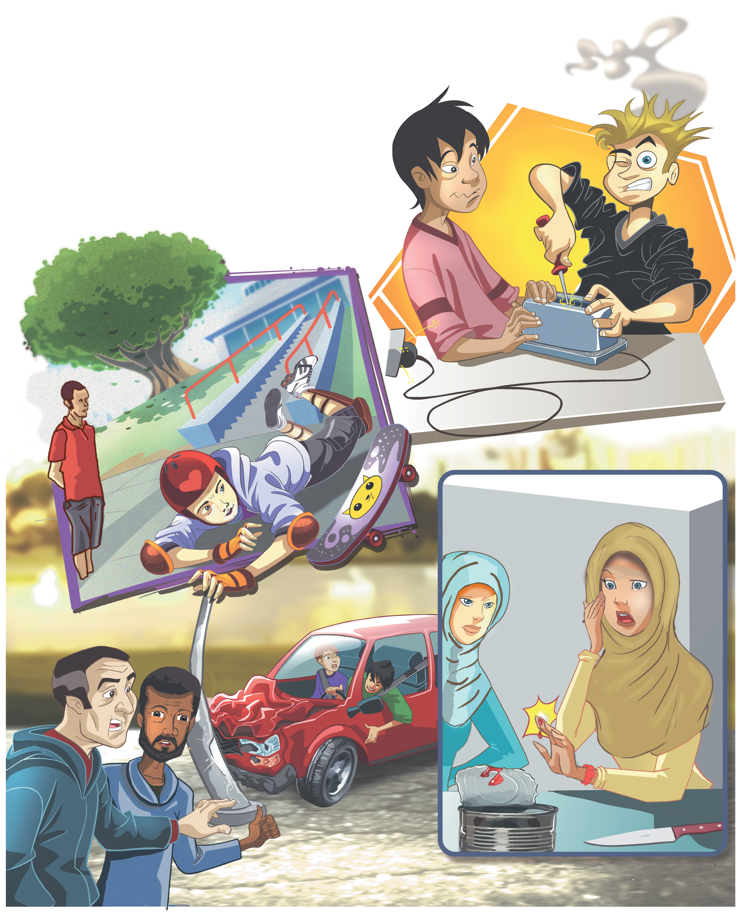
Warm Up
How did they hurt themselves?
Did they hurt themselves?

Slide 8

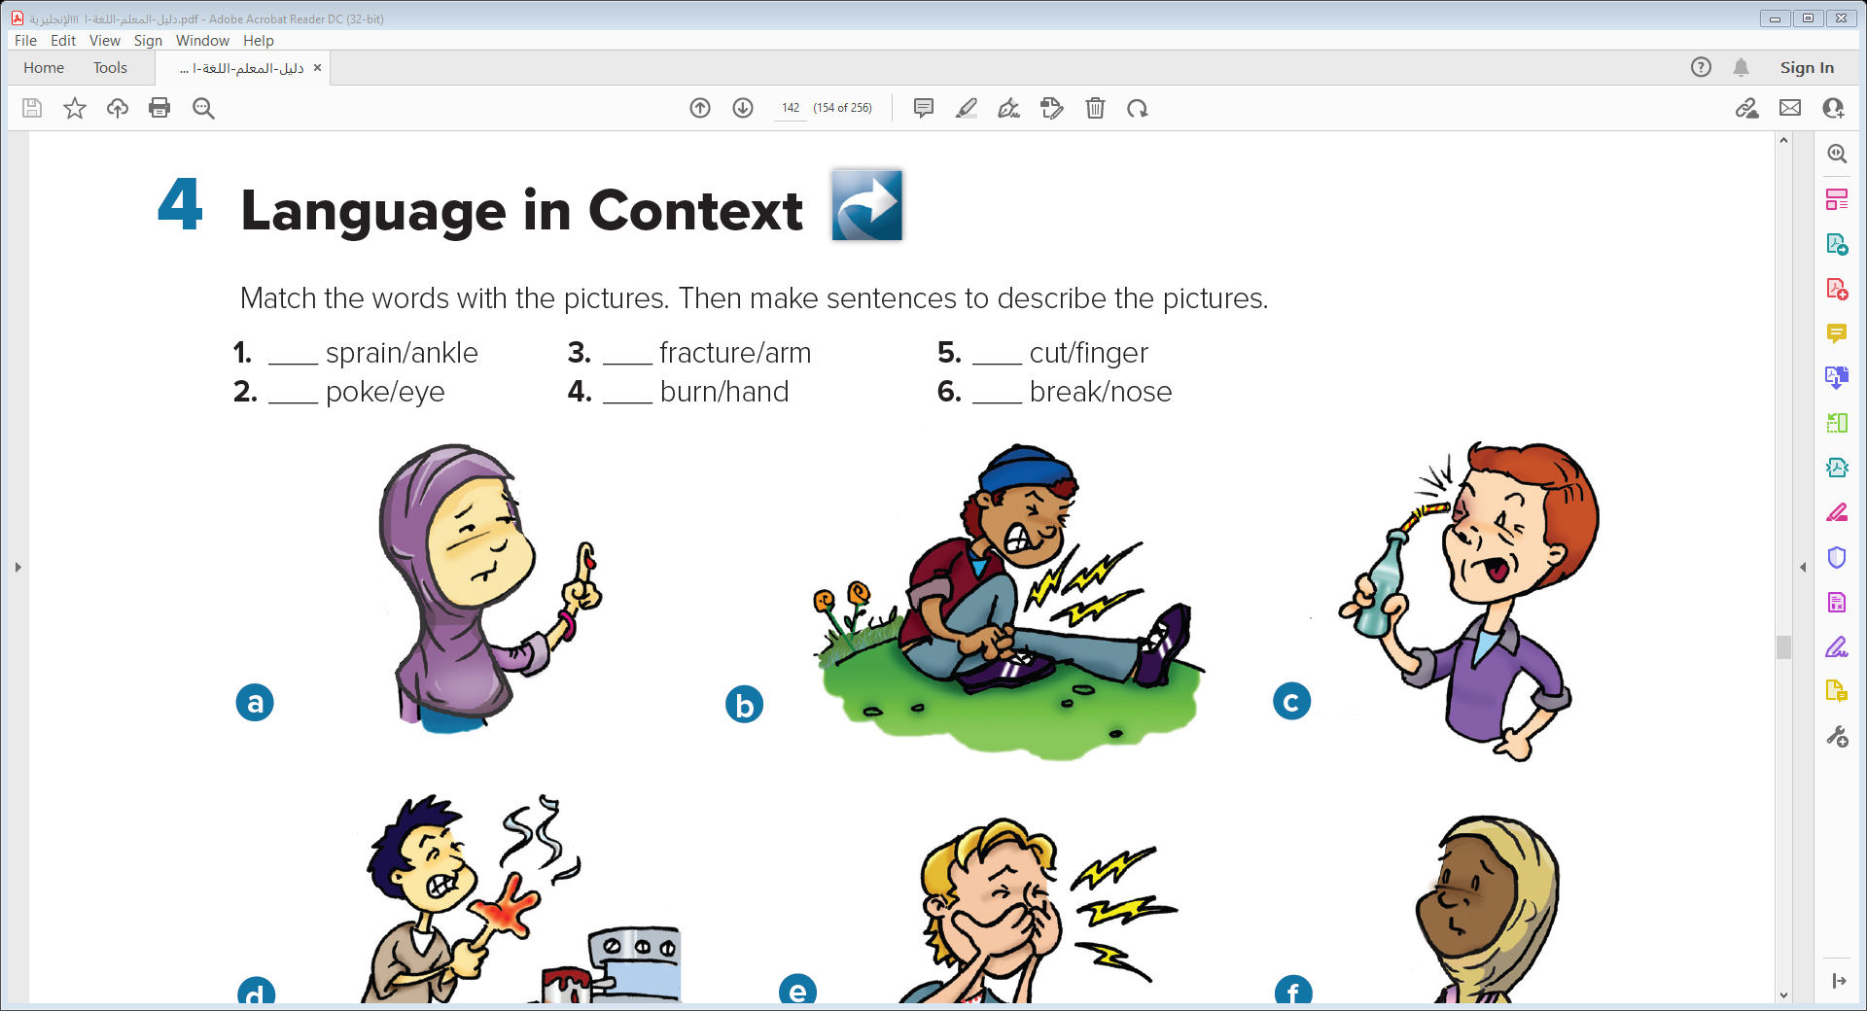
Match the words with the pictures. Then make sentences to describe the pictures.
a
b
c
5. a She cut her finger.
1. b He sprained his ankle.
2. c He poked himself in the eye.
4. d He burned his hand
6. e He broke his nose.
3. f She fractured her arm.
f
d
e

Slide 9
5 Listening

Slide 10



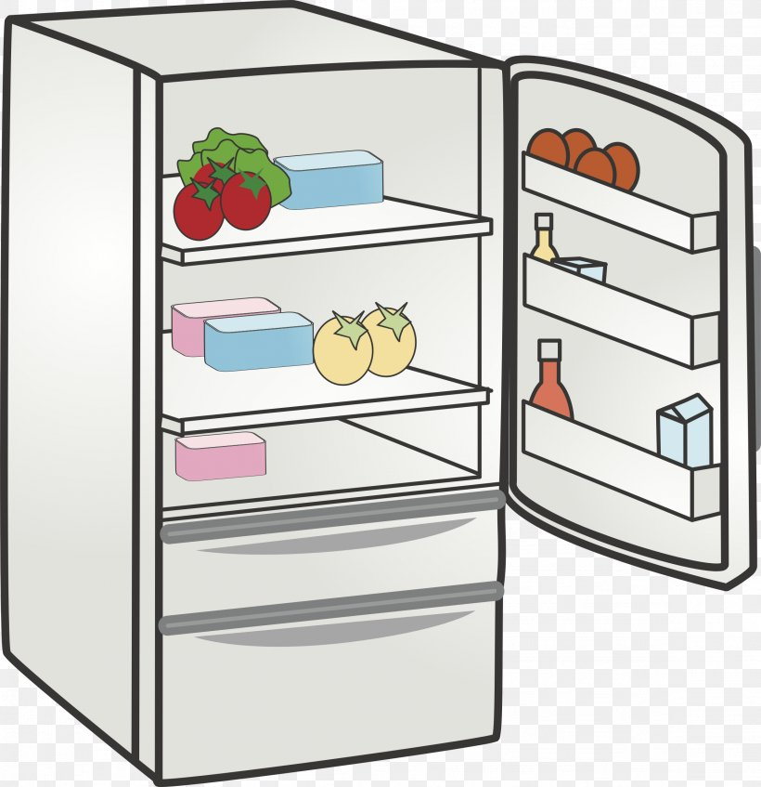

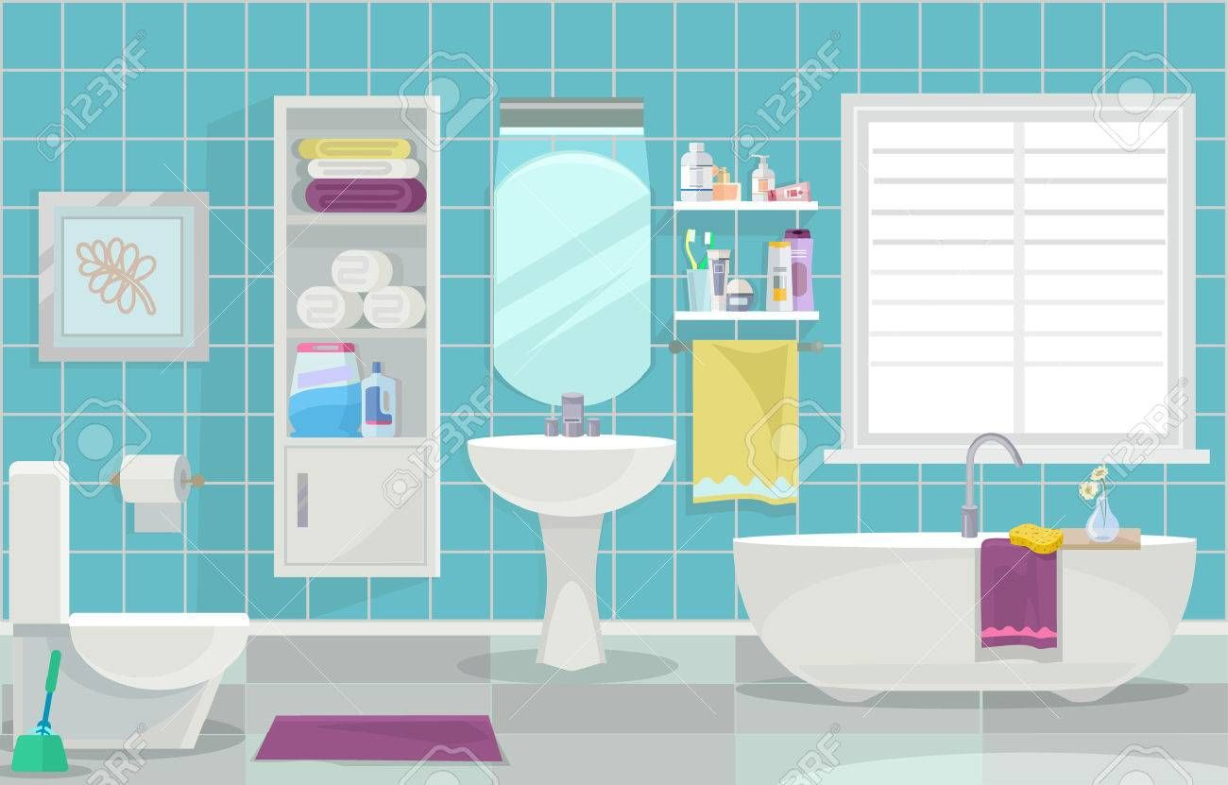
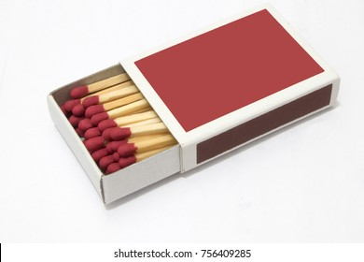
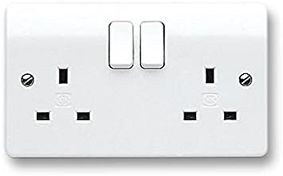
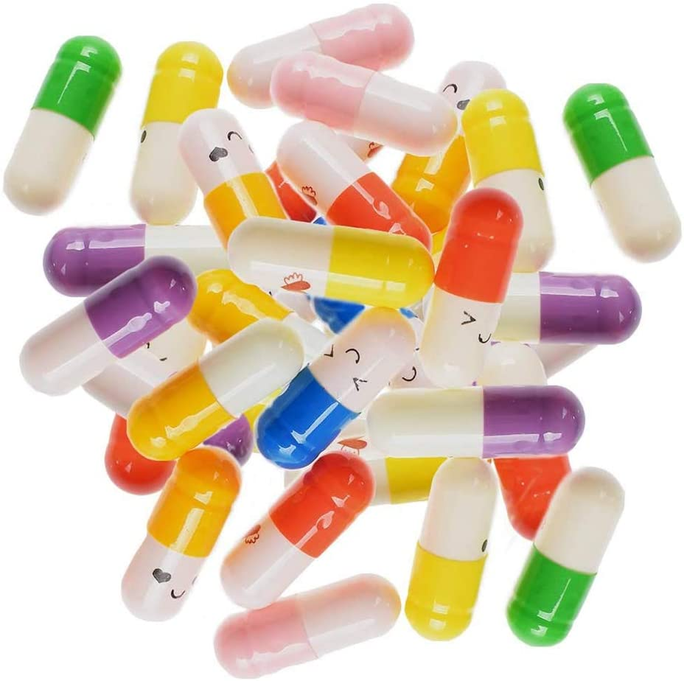
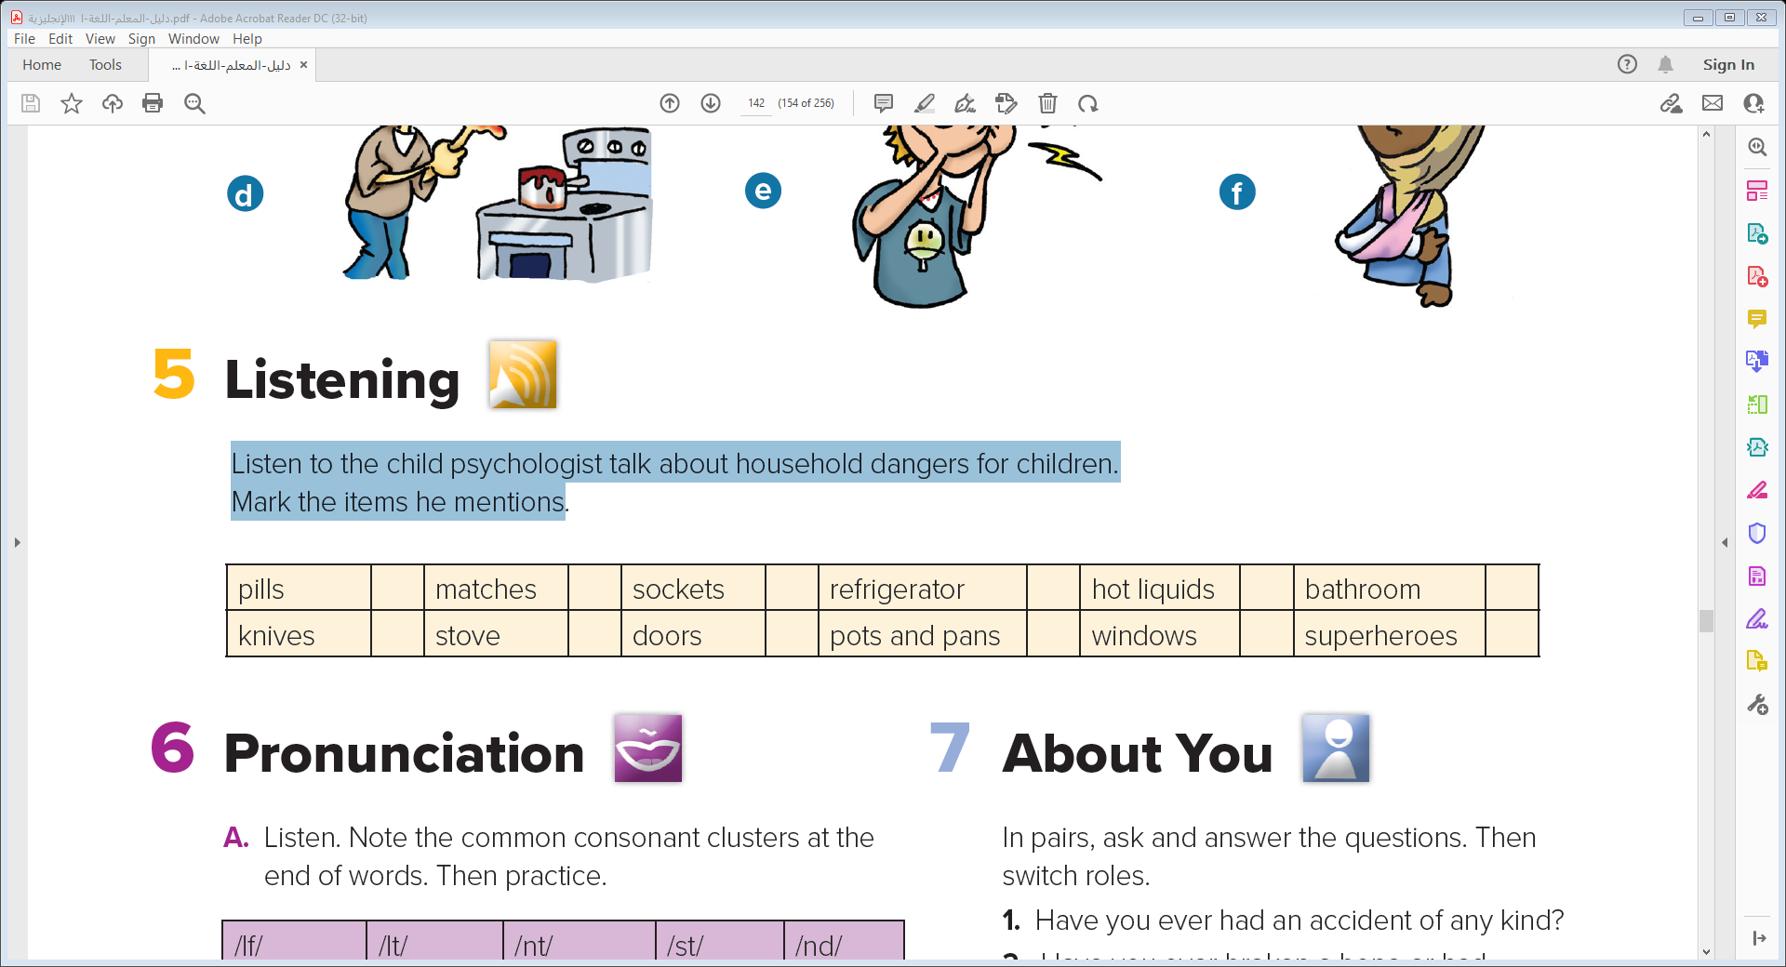
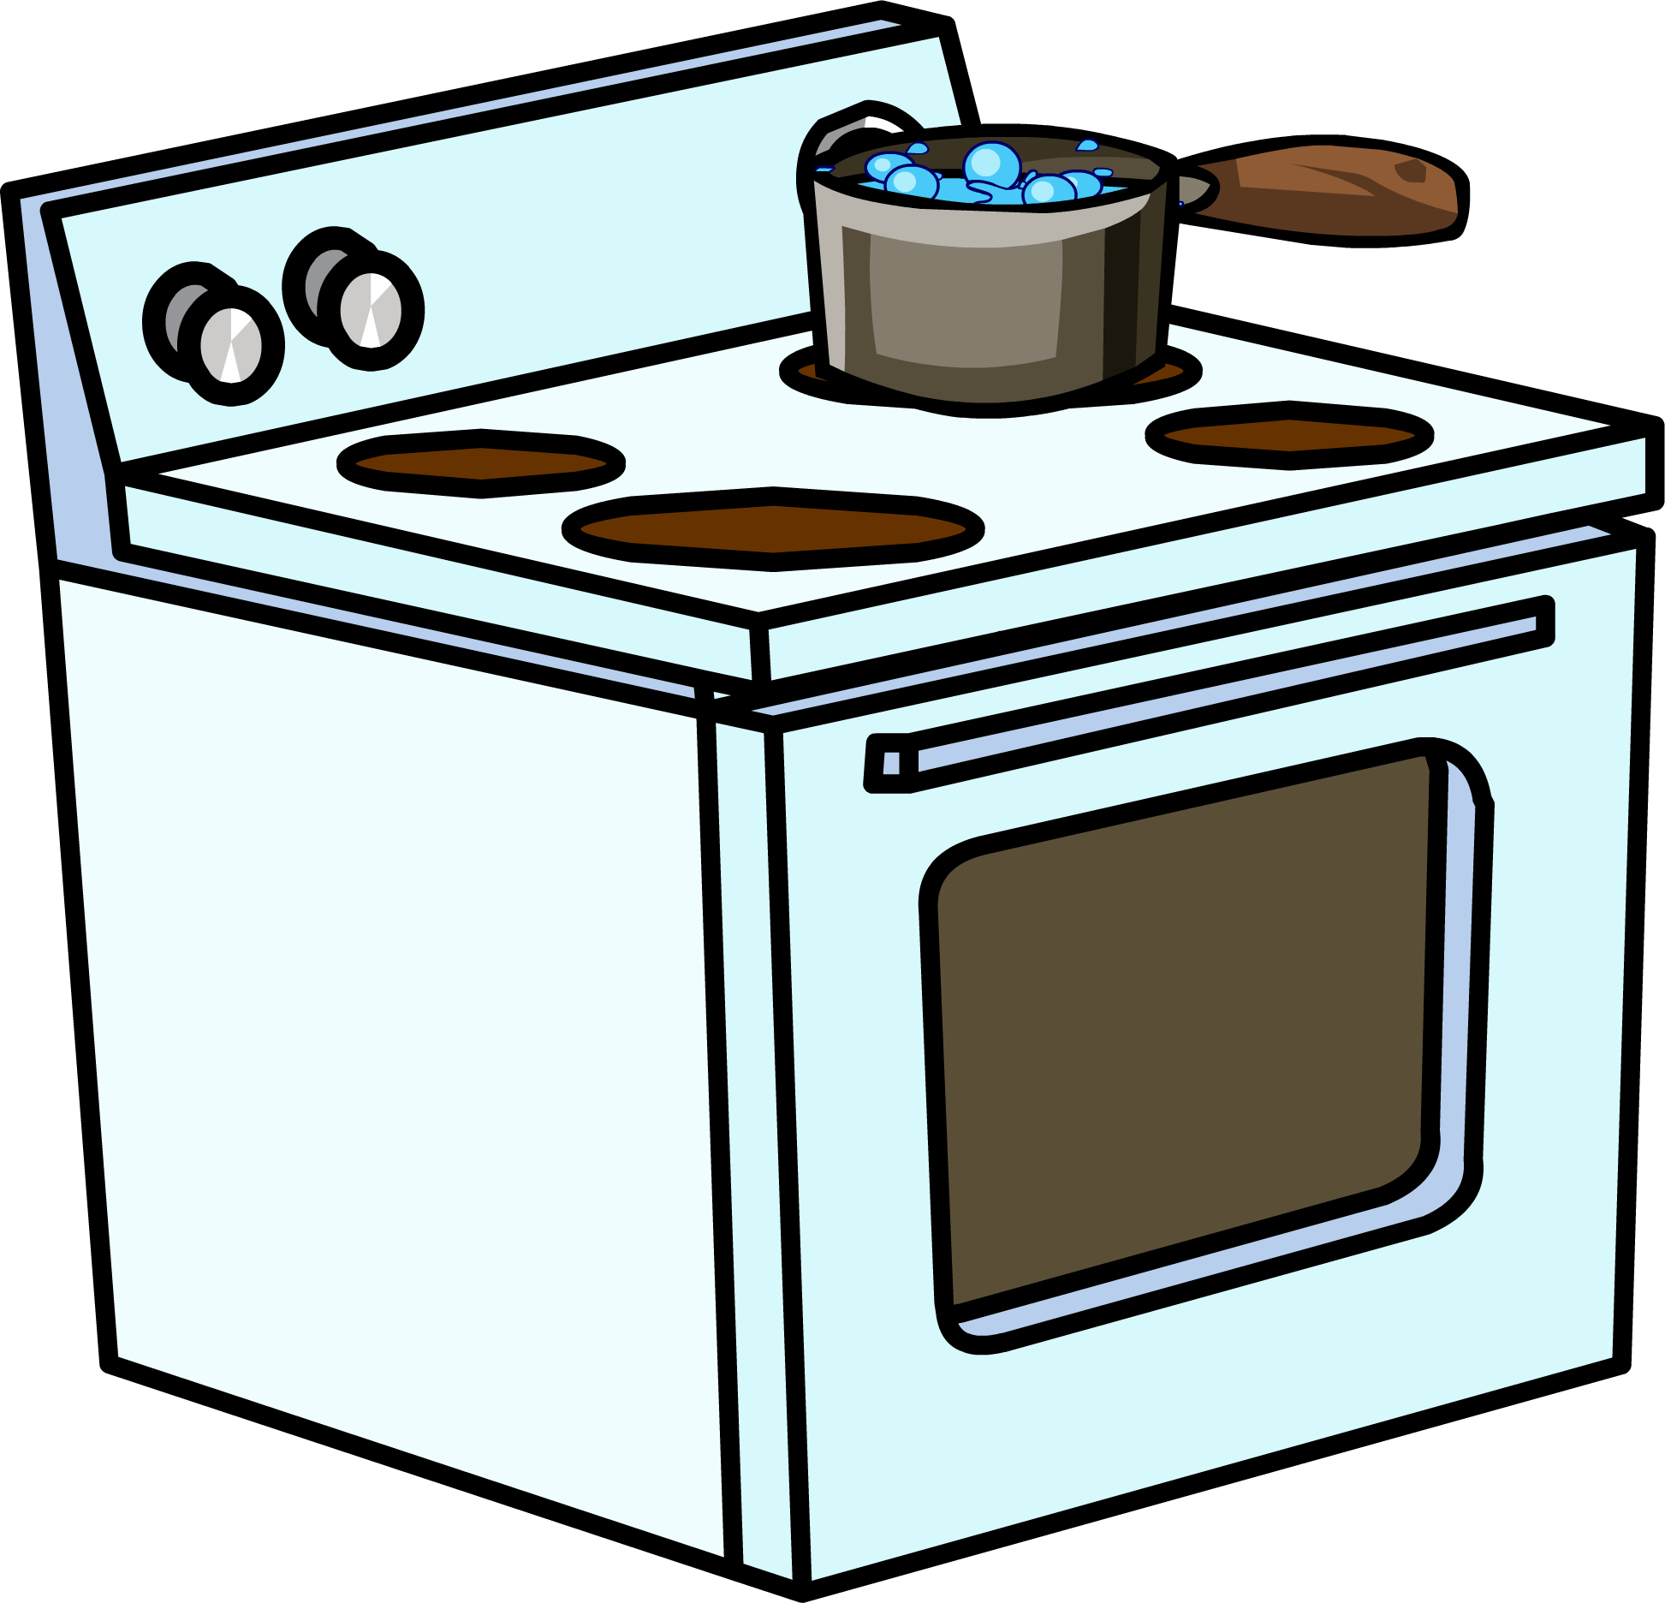
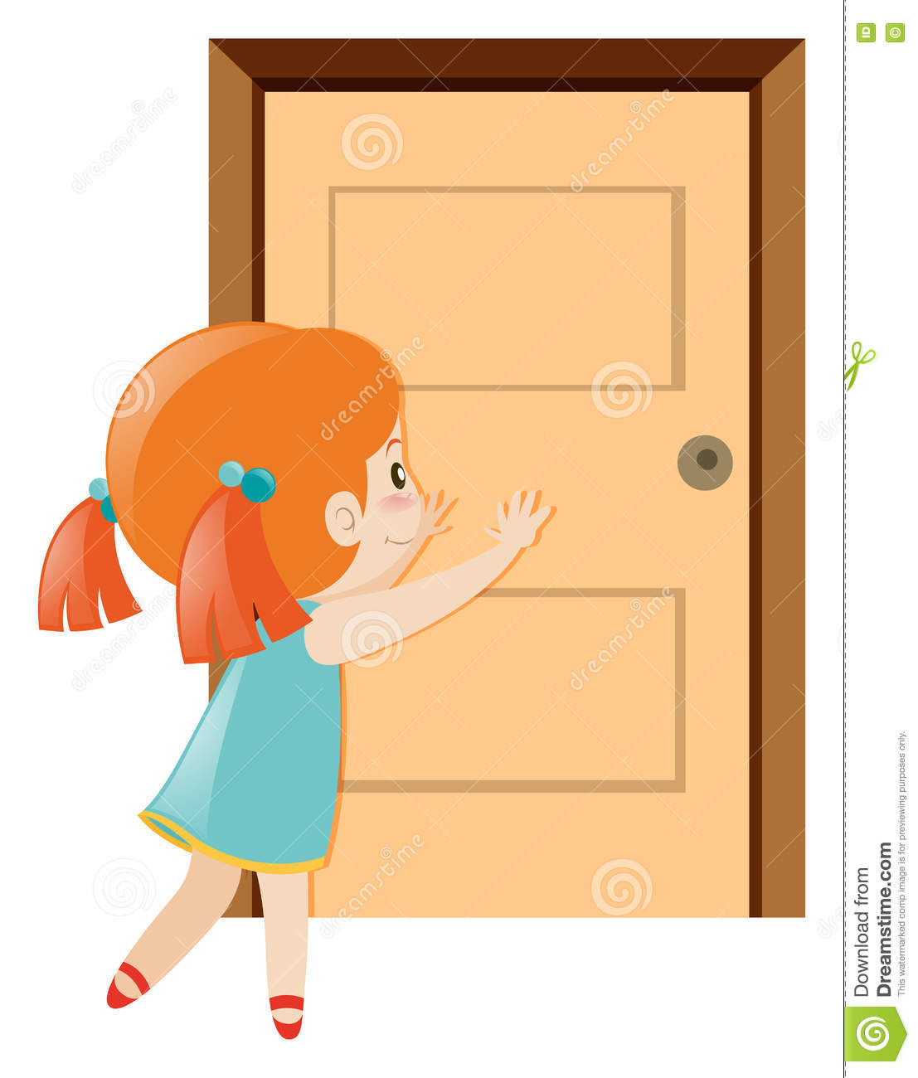

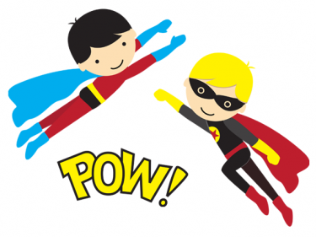
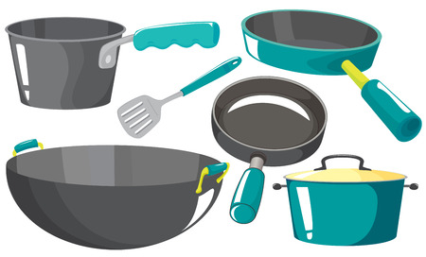
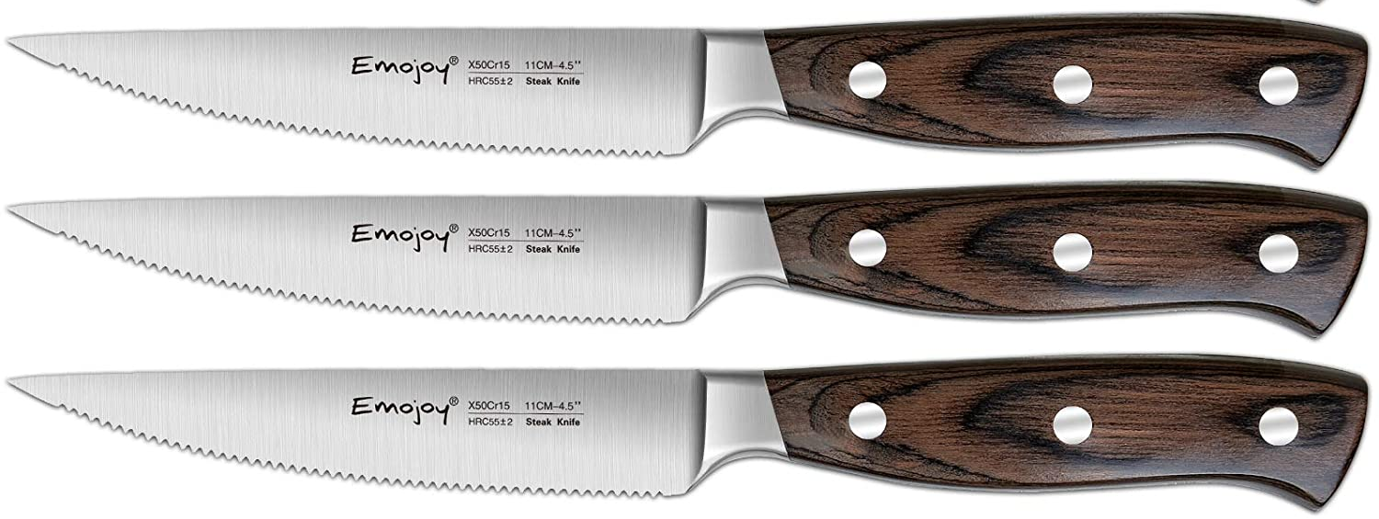

Listen to the child psychologist talk about household dangers for children. Mark the items he mentions
Who is he ?
child psychologist

Slide 11

Listen to the child psychologist talk about household dangers for children. Mark the items he mentions

Slide 12
6 Pronunciation

Slide 13
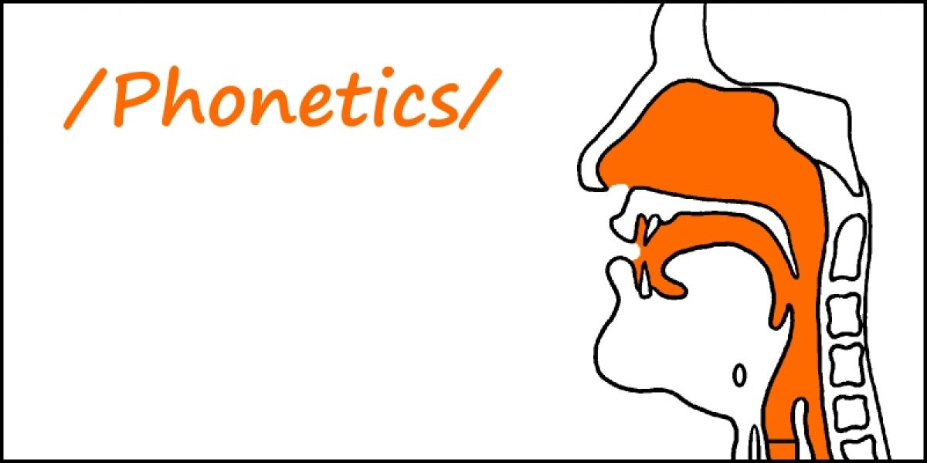
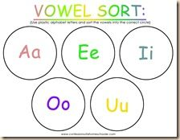
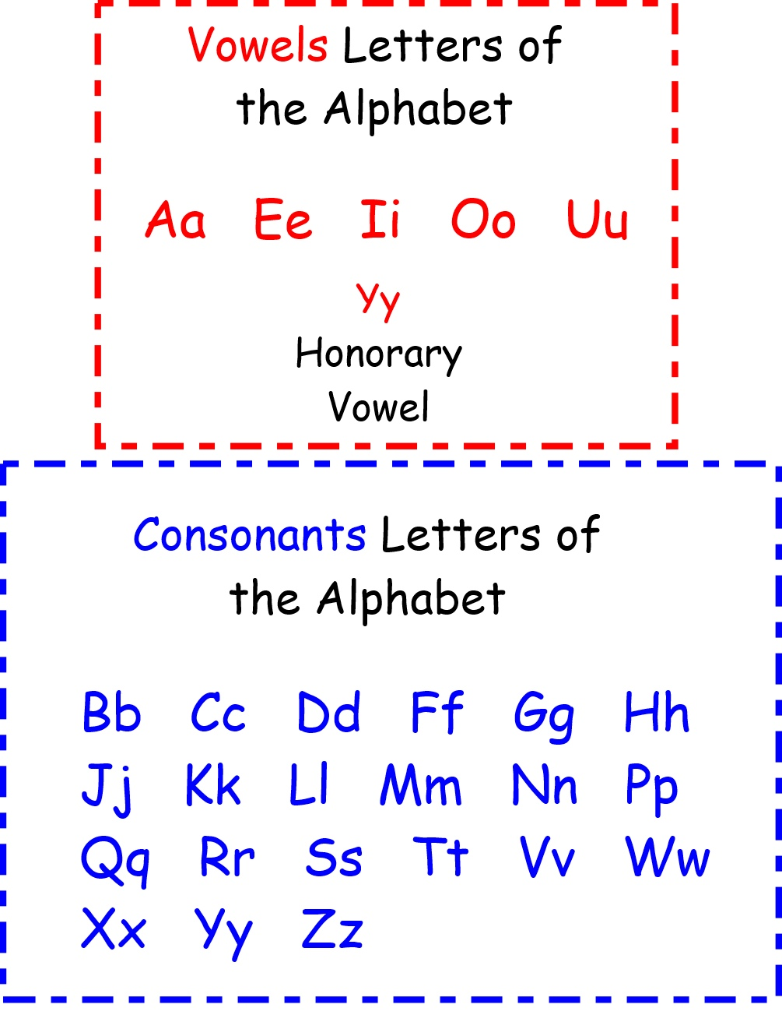
English
letters
Vowels
Consonant
drowsy
CC
Consonant Cluster

Slide 14
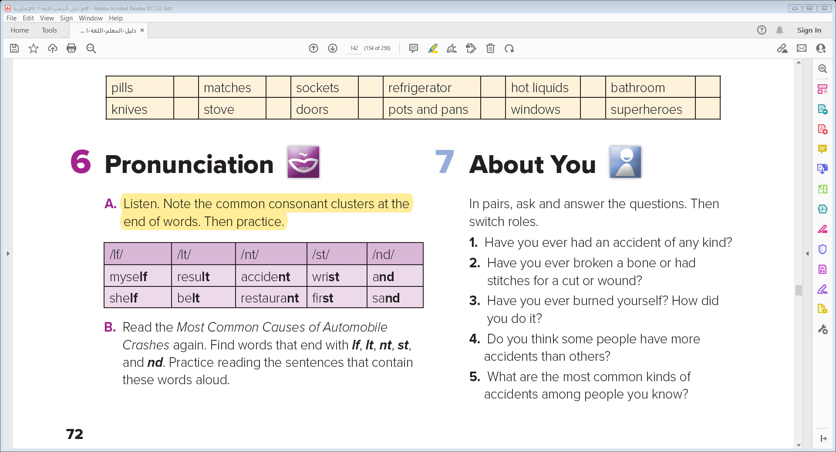

Slide 15

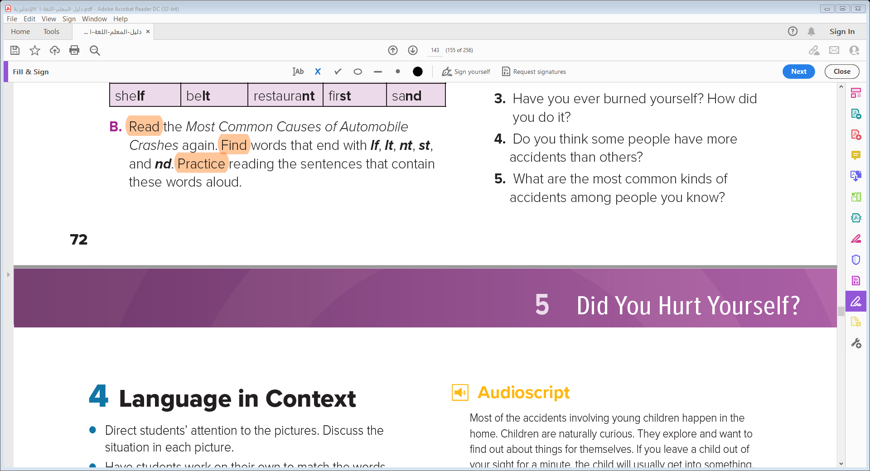

Slide 16
7 About You

Slide 17

In pairs, ask and answer the questions. Then switch roles.
Have you ever had an accident of any kind?
2. Have you ever broken a bone or had stitches for a cut or wound?
3. Have you ever burned yourself? How did you do it?
4. Do you think some people have more accidents than others?
5. What are the most common kinds of accidents among people you know?

Slide 18

Exit Ticket
1- Mention 3 things that you have learned today?

Slide 19
