Slide 1


Slide 2
GOOD MORNING

Slide 3
Unit-2-
Take My Advice
3-Grammar

Slide 4
Modal Auxiliaries:
Had Better
Two-Word- and Three-Word Verbs

Slide 5
Objectives:
1 – Use ( should , ought to , might , could ) to give advice .
2 – use “ had better “ to make very strong advice .
3 – Build a correct two- and three-word verb .
4-Share positively in pair work

Slide 6
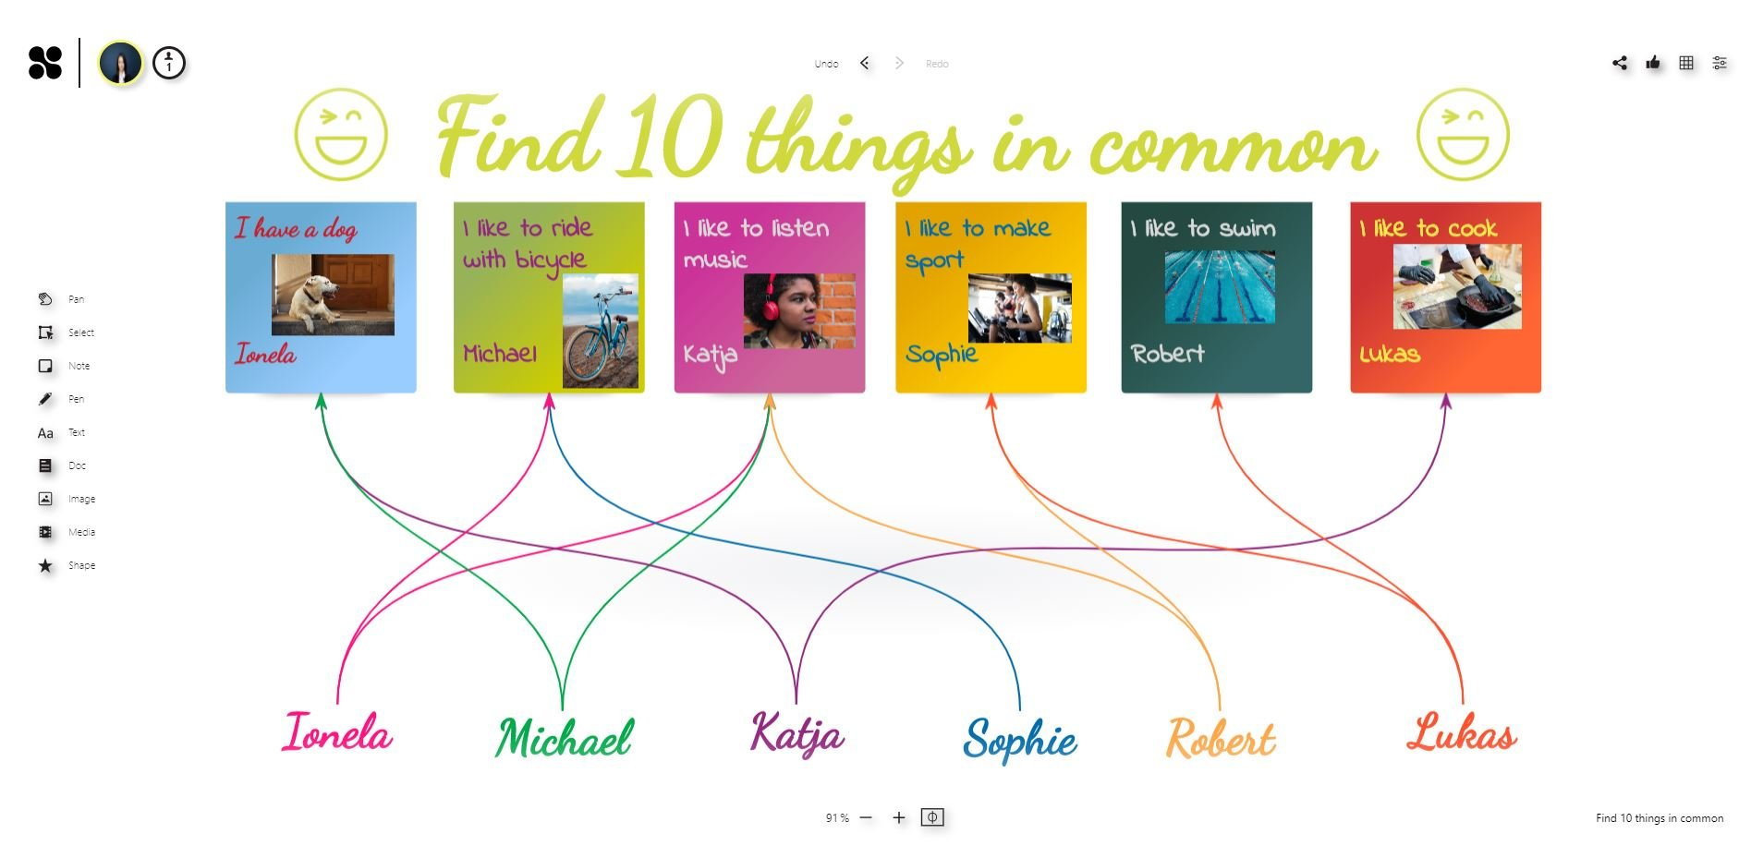

Slide 7
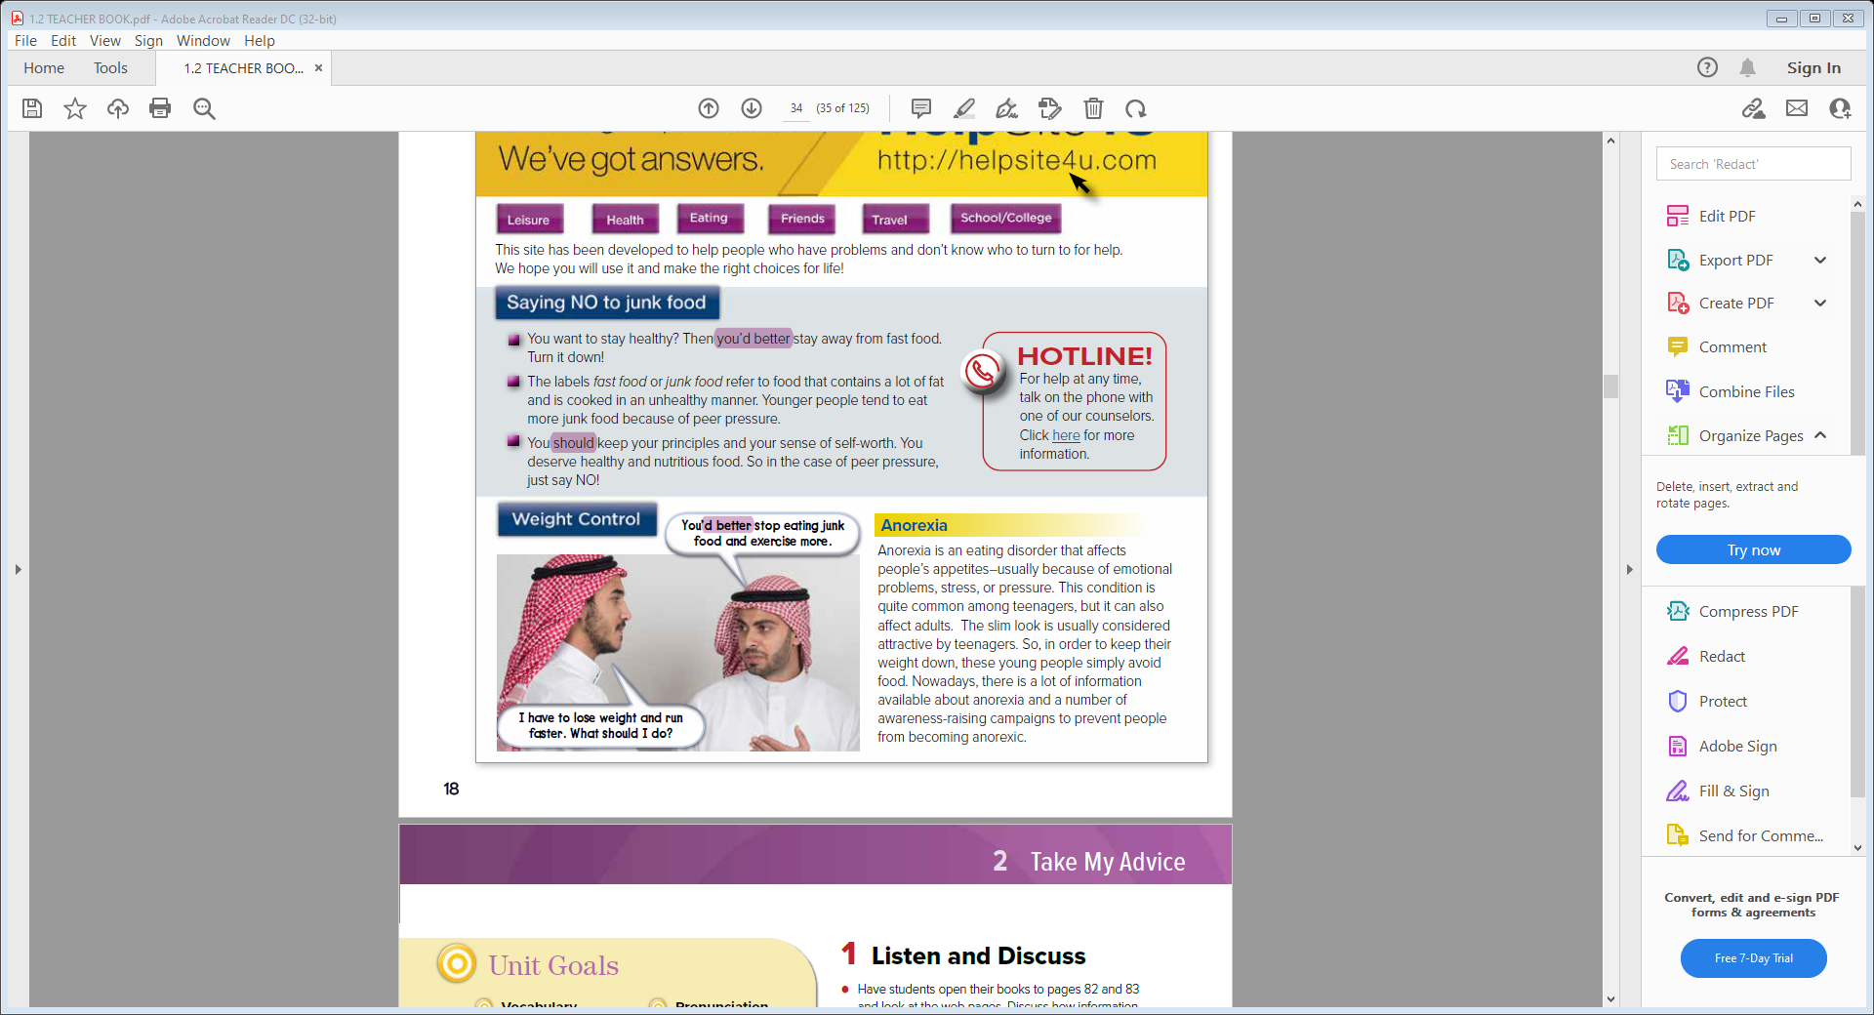
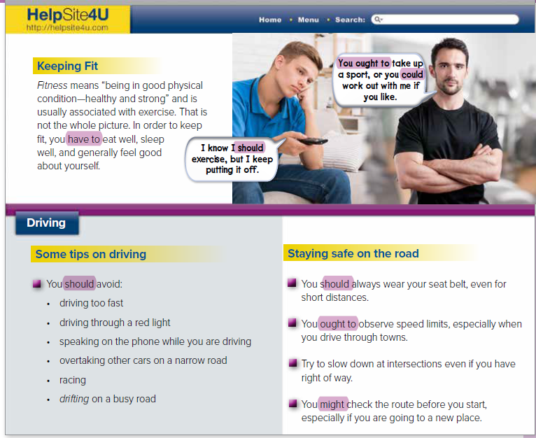
Students Book –p18-19
Underline the expressions of advice on the site.

Slide 8
Modal Auxiliaries:
Had Better

Slide 9
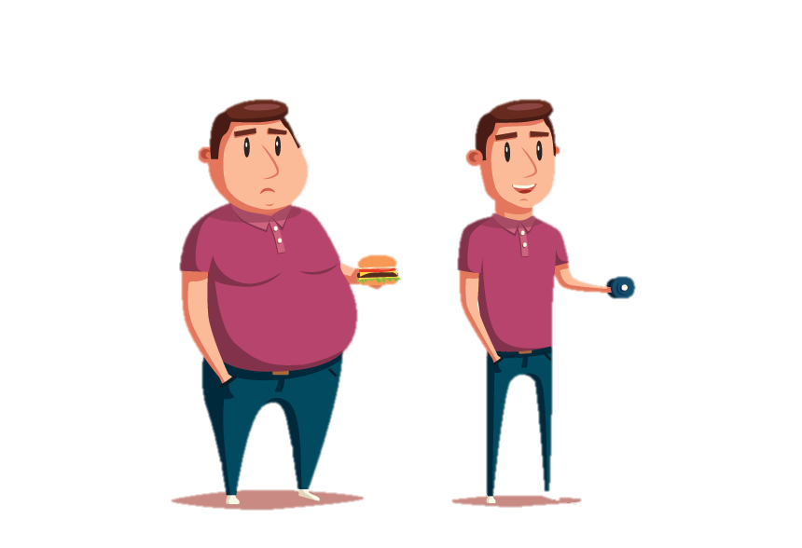
Modal Auxiliaries
Should, Ought To, Might, Could
Should he lose weight?
He shouldn’t lose weight
He should lose weight
He ought to lose weight
He ought not to lose weight

Slide 10
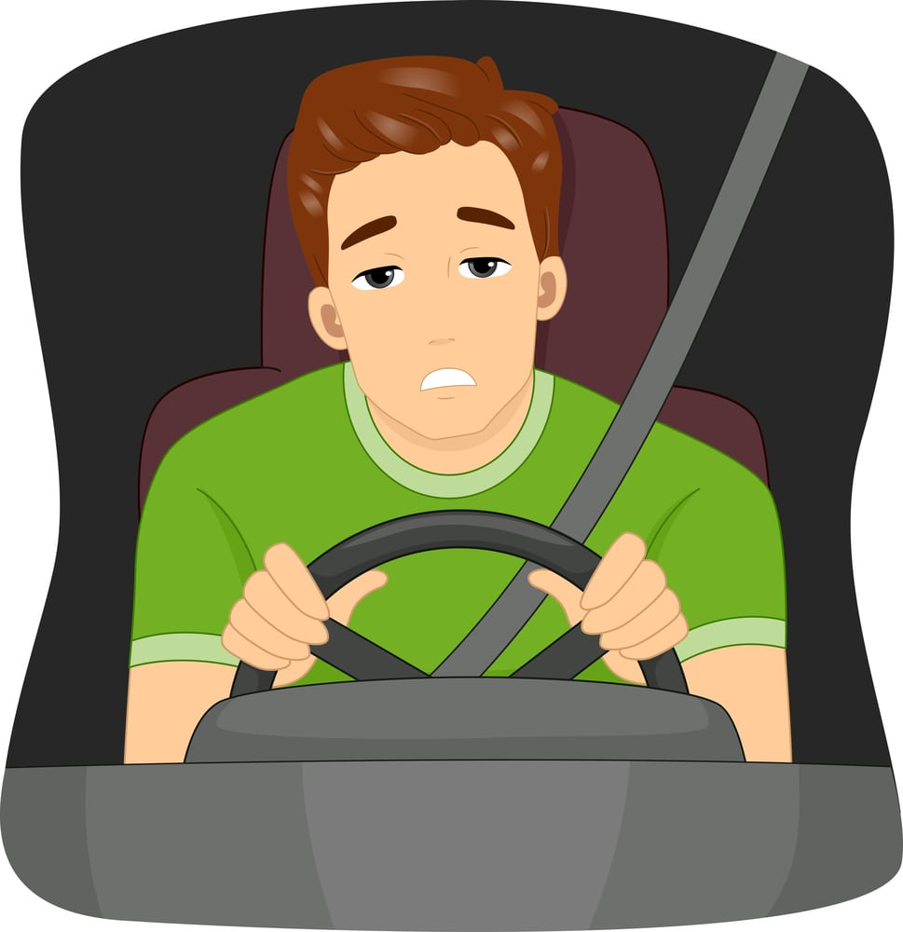

Should drive his car?
He might drive his car.
He could drive his car.
11 p.m
Use should, ought to, might, and could to give advice.
Ought to is stronger than should. Might and could are less strong.

Slide 11
Had Better
Should he lose weight?
He ‘d better lose weight
He ‘d better not lose weight
Had better is used to give advice. It’s stronger than should and ought to.
Note: had can be contracted to ‘d..

Slide 12
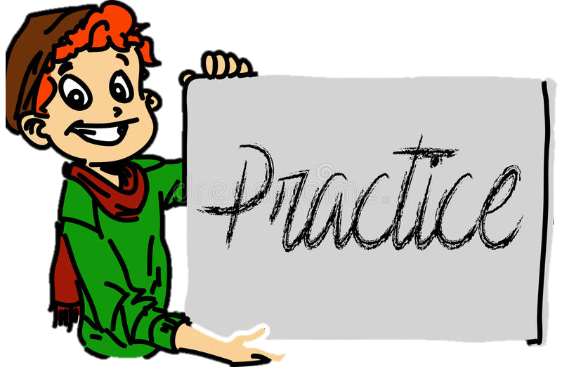
Time

Slide 13

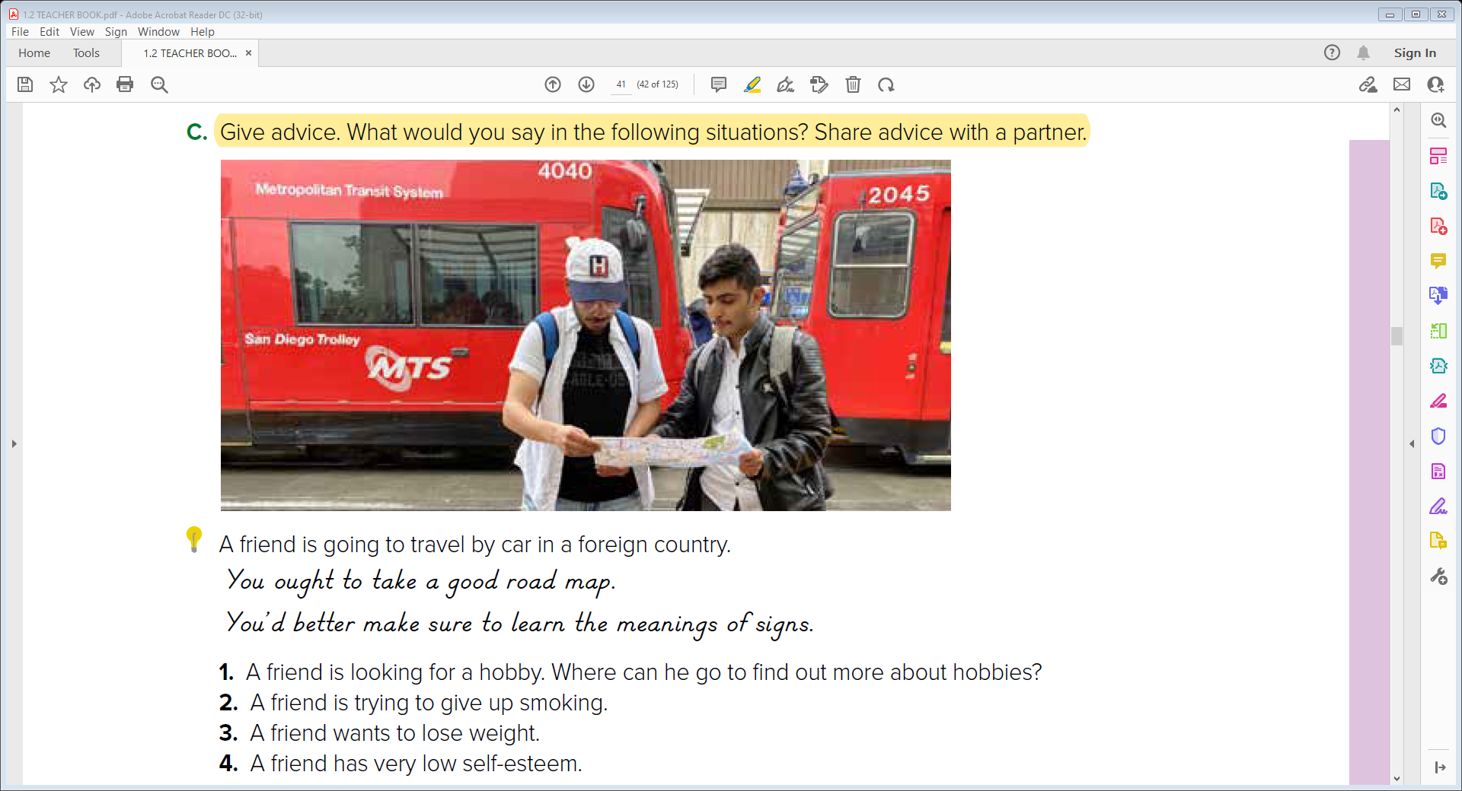
1 - You could go to a sport’s club.
2- You ought to get a nicotine patch.
3- You’d better give up sweets. You ought to eat more vegetables.
4- You should have more confidence in yourself.
5- You should go out and have fun. You might volunteer
to help others.

Slide 14
D. Write sentences using had better.
Laura has been sick for a couple of days.
It’s time she saw a doctor. She Had better see a doctor
1. It’s getting late.
It’s time you went home. ____________________________________
2. I haven’t had a vacation for a long time.
It’s time I took one. ____________________________________
3. The kids have been playing all day.
It’s time they went to bed. ____________________________________
4. Our car is really falling apart.
It’s time we bought a new one. ____________________________________
You’d better go home .
I’d better take a vacation .
They’d better go to bed .
We’d better buy a new car .

Slide 15
Two-Word- and Three-Word Verbs

Slide 16
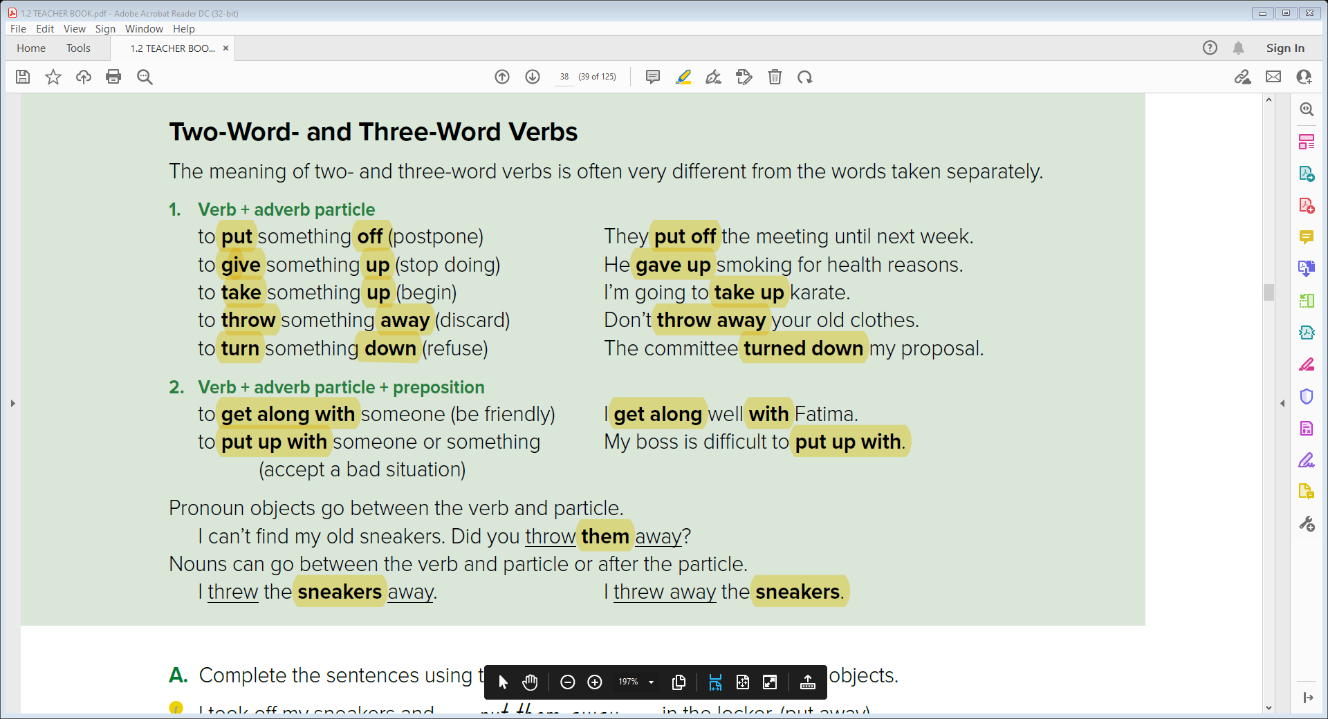
Two-Word- and
Three-Word Verbs
The meaning of two- and three-word verbs is often very different from the words taken separately
1. Verb + adverb particle
11

Slide 17
2. Verb + adverb particle + preposition
11
11
11
11
11
11

Slide 18
Time

Slide 19
A-Complete the sentences using the verbs in parentheses with pronoun objects.
I took off my sneakers and put them away in the locker. (put away)
When I received the form, I __________________. (fill out)
2. I finished reading the book and __________________ to the library. (take back)
3. His hair was too long, so he __________________ for his passport photo. (cut off)
4. The magazines were old. That’s why I __________________. (throw away)
5. When you finish using the computer, please __________________. (turn off)
filled it out
took it back
cut it off
threw them away
turn it off

Slide 20
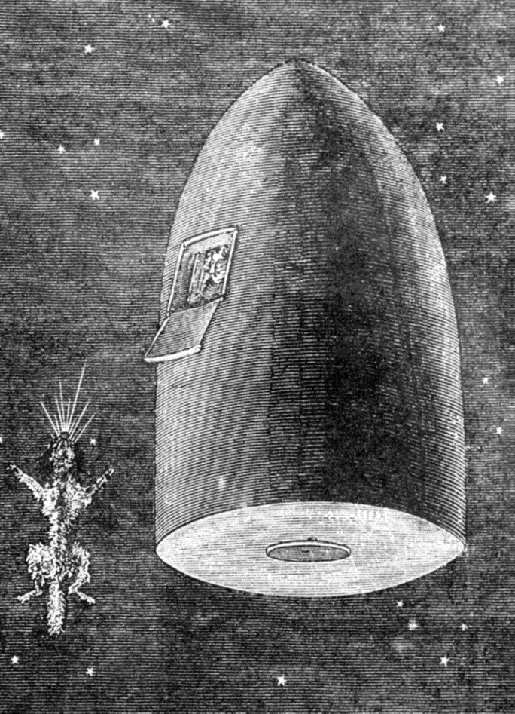
B. Substitute the words in parentheses with two-word and three-word verbs.
Thank you for your offer, but I’m going to have to turn down (refuse) your help.
1. I need to clean my closet and ____________ (discard) a lot of old clothes.
2. We have to ____________ (tolerate) our neighbors’ loud voices every night.
3. I have to finish my big report. Can we ____________ (postpone) our meeting for tonight?
4. Samuel wants to lose weight. He ought to ____________ (begin) a sport like jogging.
He should also ____________ (stop) eating sweets.
5. I have a new person who shares my apartment. Unfortunately we ______________ (not have a good
relationship). I have to ____________ (accept) his messy ways.
throw away
put up with
Put off
take up
give up
don’t get along
Put up with
Notes:
ايه انا

Slide 21
قال تعالى
(وَلَا يَنفَعُكُمْ نُصْحِي إِنْ أَرَدتُّ أَنْ أَنصَحَ لَكُمْ إِن كَانَ اللَّهُ يُرِيدُ أَن يُغْوِيَكُمْ ۚ هُوَ رَبُّكُمْ وَإِلَيْهِ تُرْجَعُونَ)

Slide 22

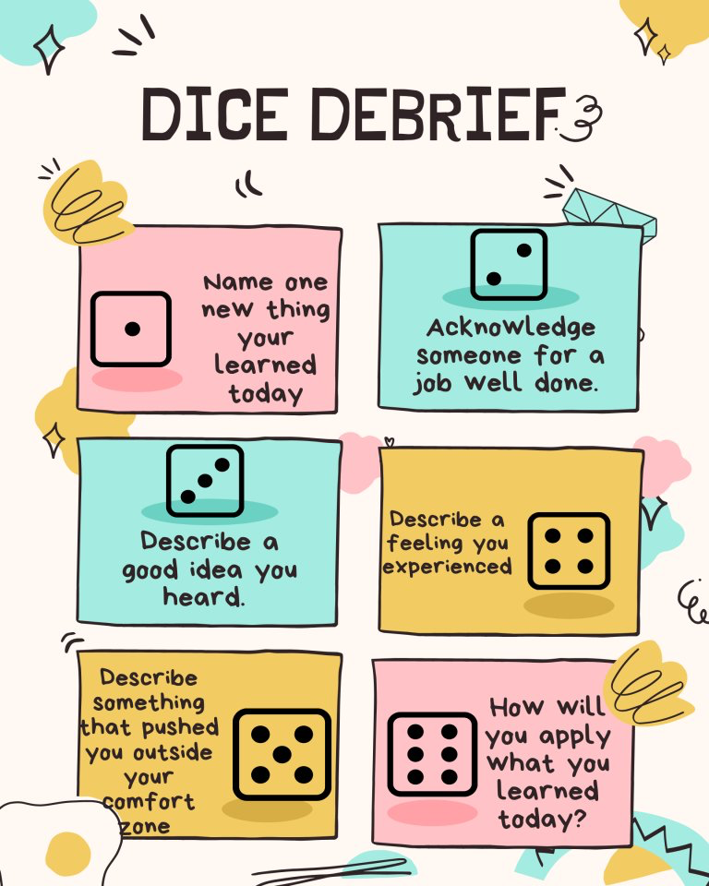
Dice Debrief

Slide 23


