Slide 1
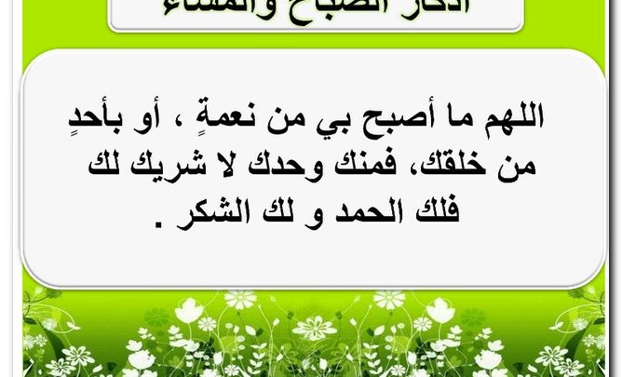

Slide 2


Slide 3
Unit-2
Take My Advice
L-10- Writing

Slide 4

Objectives
Students will be able to
Ask friends about their problems .
Write notes about a letter .
Find a problem in a text.
Find advice and solution in a text .
Share positively in pair work

Slide 5





Revision
1- I don’t have __________ apples .
Choose
a – a little b- many c- a lot of
2- She doesn’t spend __________ time .
A- lots of b – much c- many
3- He drinks __________ coffee at the café.
a – a little b- a few c- much
4- Ali bought __________ carrots yesterday.
a – much b- a little c- a few

Slide 6
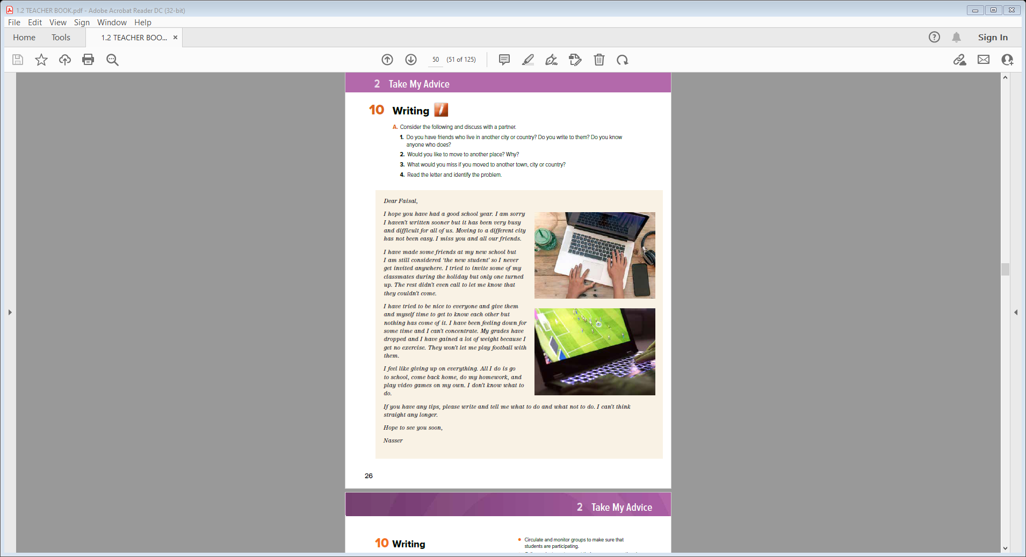
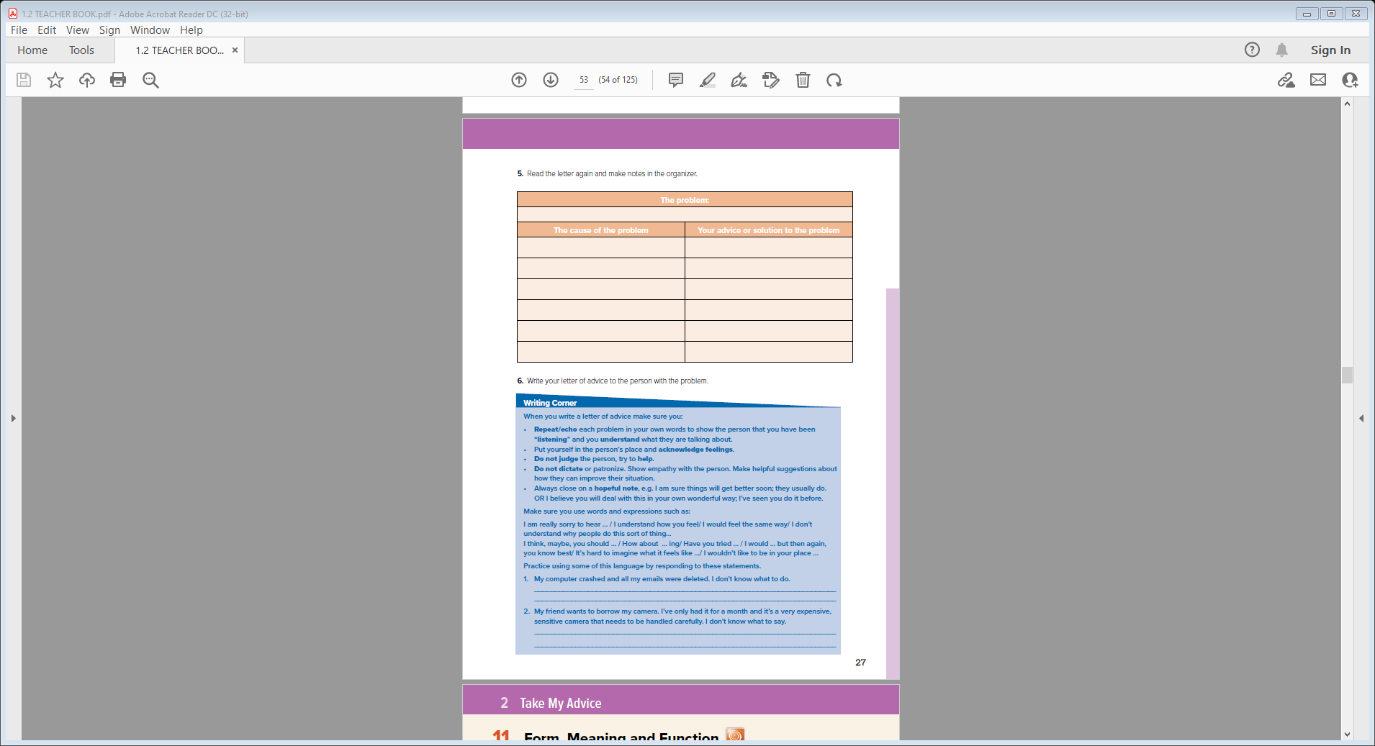
Students Book
P.26-27

Slide 7

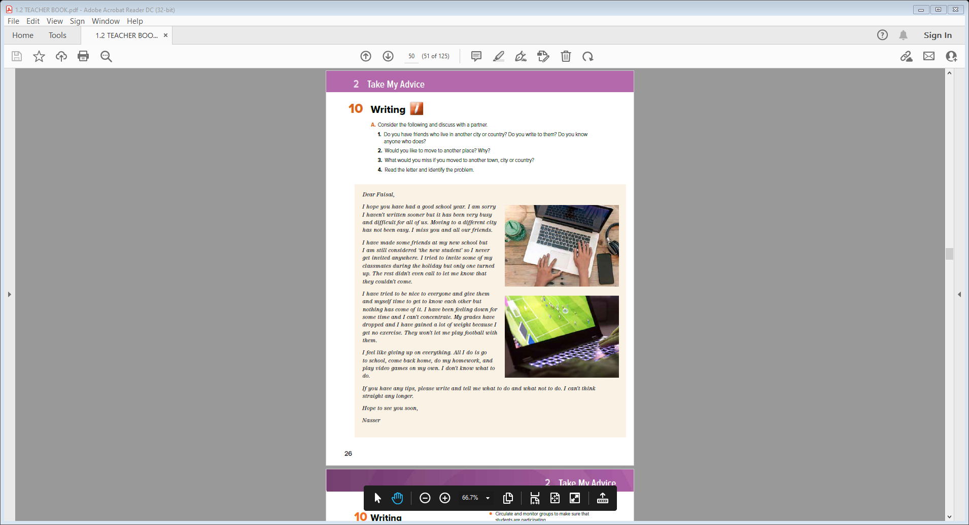

Who is the person?
Where is he?
How is he feeling?

Slide 8


Do you have friends who live in another city or country? Do you write to them? Do you know
anyone who does?
Would you like to move to another place? Why?
What would you miss if you moved to another town, city or country?

Slide 9

Read the letter and identify the problem
Notes:
He misses all his friends.
He is considered “the new student” and is excluded
from the group.
He is not invited anywhere.
When he invited classmates over to his house, only
one turned up the rest ignored him.
They won’t let him participate on the football team.
He feels isolated. He is very unhappy and bored.
He can’t concentrate not think straight.
He can’t function well at school.

Slide 10
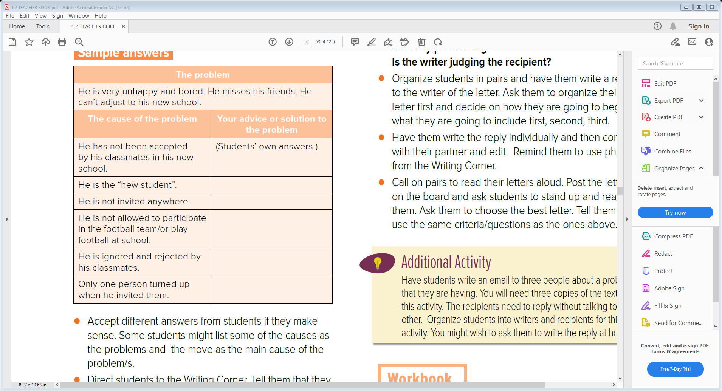
5. Read the letter again and make notes in the organizer.
Notes:
How would you feel if you were in this position?
What would you do to get people to accept you?
Why do you think he has gained weight?
What do you think he should do?
What do you think he means when he says “I feel
like giving up on everything.”?

Slide 11
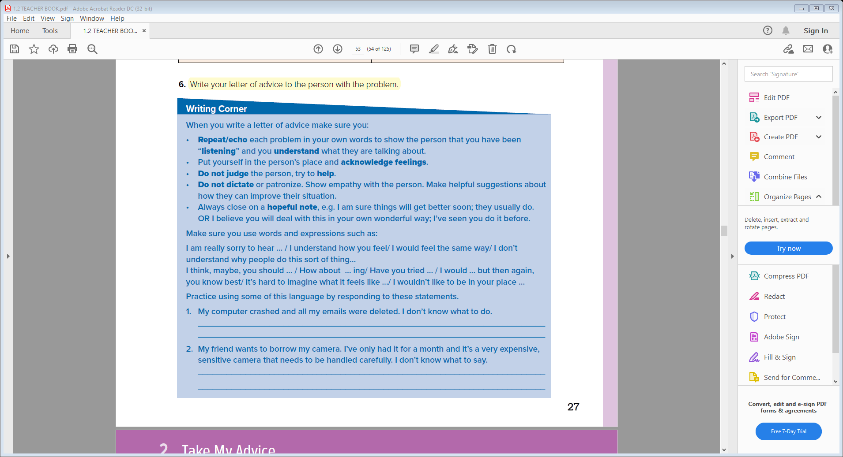

Slide 12



Slide 13
Dear Nasser,
I hope you have had a good school year. I am really sorry to hear that you are very unhappy and bored , misses his friends and can’t adjust to his new school.
You have not been accepted by your classmates in your new school and they considered you as “new student”………………………………………………………………………………………………………………………………………………
They did not invite you anywhere …………………………………………………………………………………………………………..
You are not allowed to participate in the football team. ………………………………………………….
I believe you will deal with this in your own wonderful way; I’ve seen you do it before

Slide 14


