Slide 1


Slide 2
GOOD MORNING

Slide 3
Unit-2-
Take My Advice
1 Listen & Discuss
2 Pair Work

Slide 4
1 Listen & Discuss

Slide 5
Objectives:
1-Name a helping website .
2-Listen for some advice from HelpSite4U .
3-Discuss each advice .
4-Recognize expressions of advice .
5-Answer some questions .

Slide 6
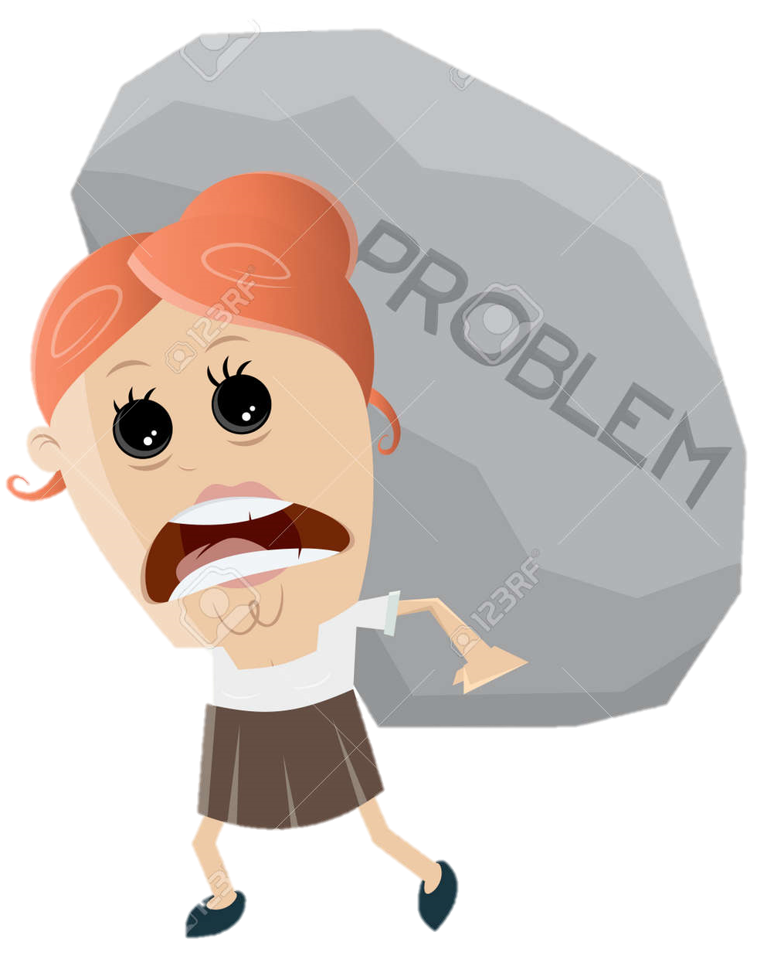
Warm Up
What do you do when you have problems?
Who do you go to?
What kinds of problems do people your
age often have?
PROBLEM
Do you go online to get advice?
What common problems do some of
your friends have?

Slide 7

Students Book
P. 18 -19

Slide 8
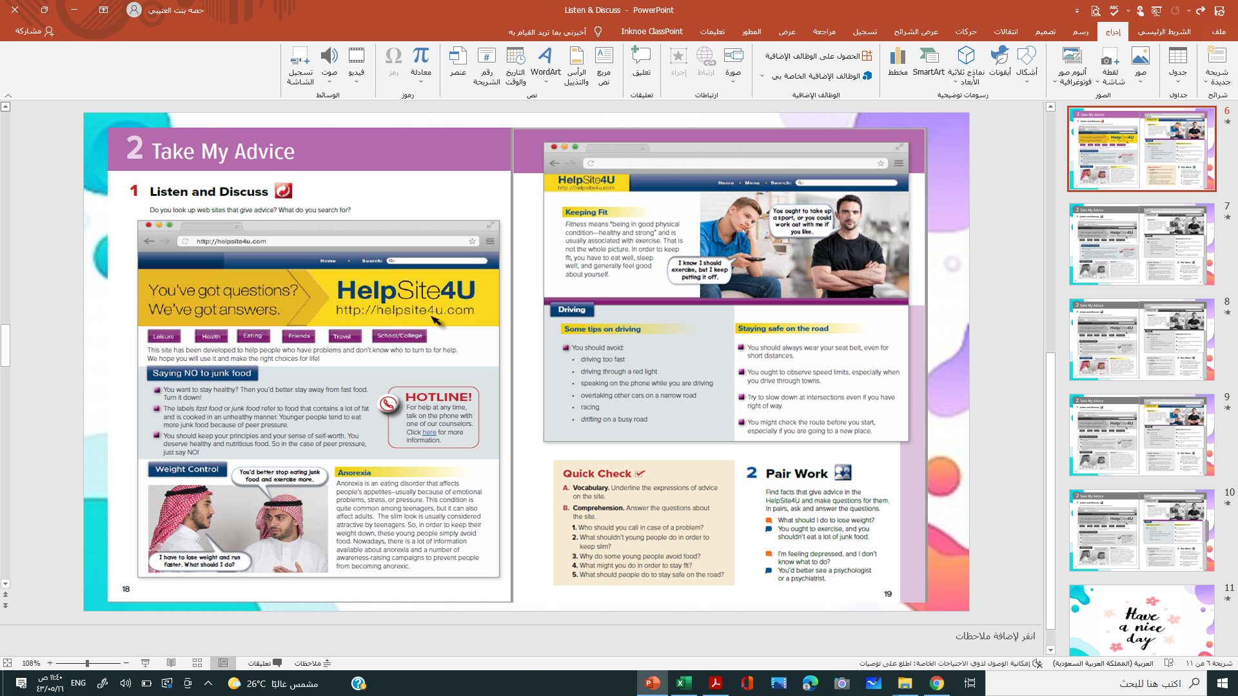
Skimming
What is the title of the website?
What are the subheadings ?
Why has this site been developed ?
Notes:
Language Builder
Remind students that the prefix il- means not. For example,
illegal means not legal; illegible means difficult or impossible
to read; illiterate means not able to read or write.

Slide 9

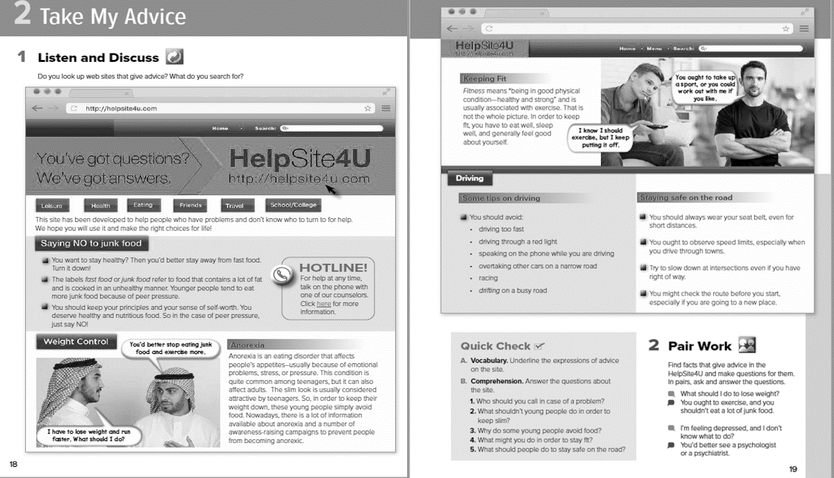
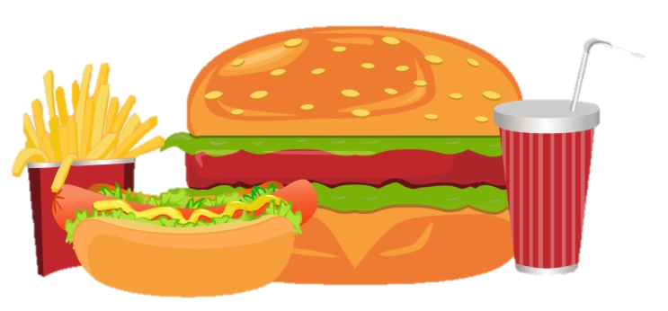
Turn to
Turn down
What is junk food ?

Slide 10
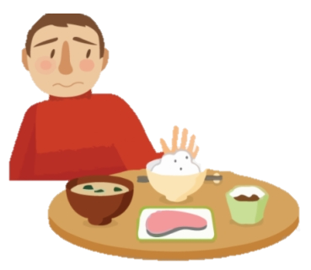
What is anorexia ?
Keep down

Slide 11
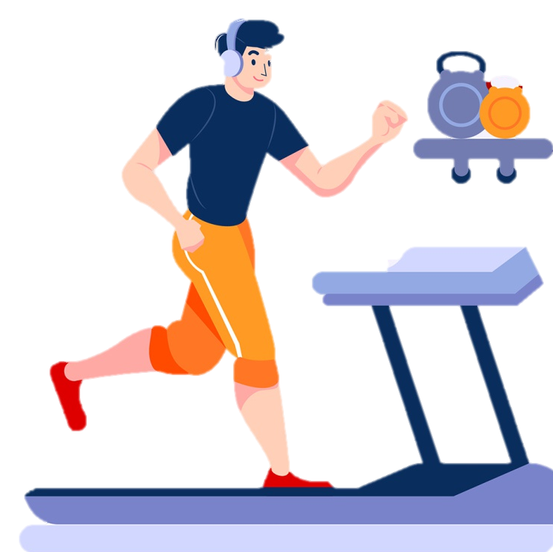
Take up
Put off
What does fitness mean ?

Slide 12

What are the verbs used to give advice ?

Slide 13
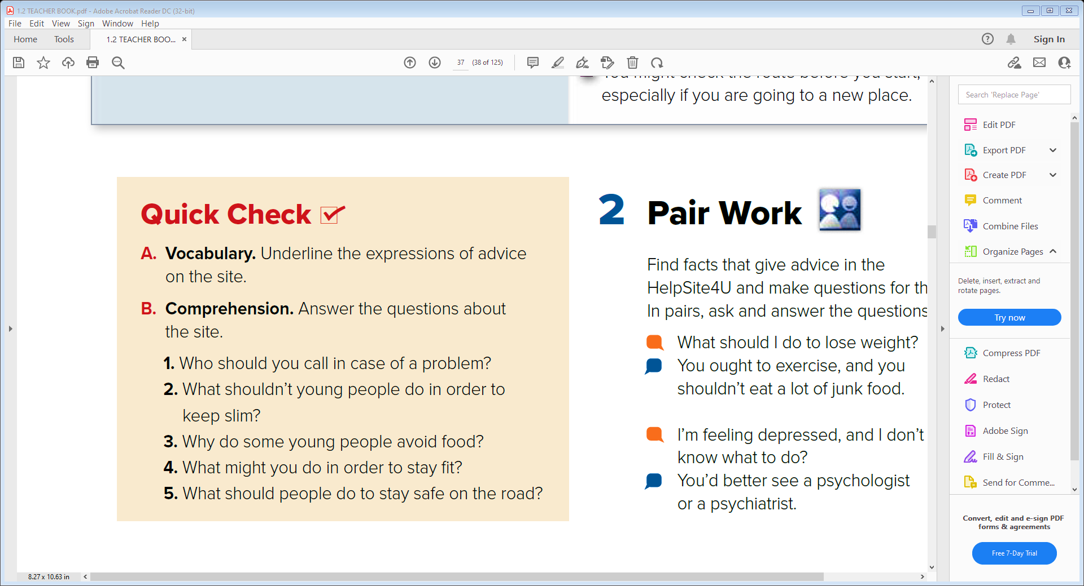
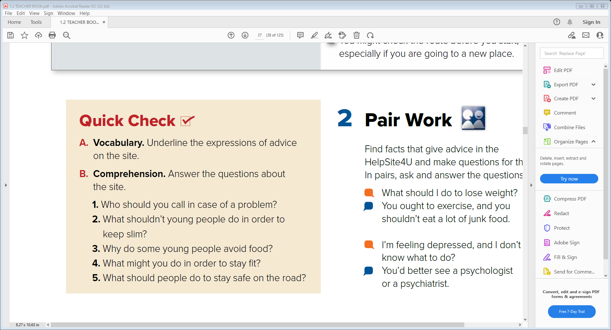
1. You should call the counselors on the website.
2. They shouldn’t avoid food.
3. Some young people avoid food to look attractive.
4. You might take up a sport or work out.
5. They should wear their seat belt. They should slow down on intersections.

Slide 14
2 Pair Work

Slide 15

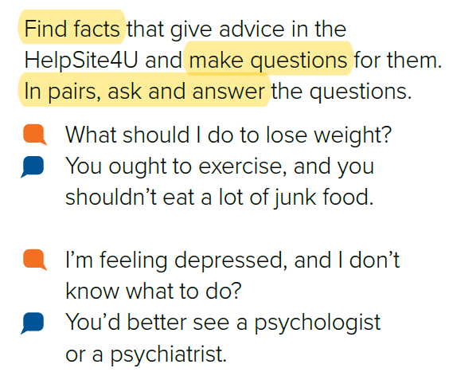

Slide 16


Slide 17


