Slide 1
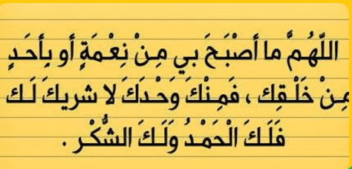

Slide 2
GOOD MORNING

Slide 3
Unit-2-
Take My Advice
4-Language Context
5-Listening
6-Pronunciation
7-About you

Slide 4

Objectives:
Write advice based on information .
Listen for specific information .
Recognize the stress in two and three-word verb ..
Share positively in pair work.

Slide 5
4-Language Context

Slide 6
Student Book
P.22
Read about Ali’s lifestyle.
Give advice to deal with his stress using
should, ought to, or had better.
Works 10 hours a day in the office
• Takes work to do at home on the weekend
• Drinks a lot of coffee
• Spends an hour and a half in traffic on
his commute
• Doesn’t have time to exercise
• Rarely goes out with friends
• Hasn’t had a vacation in two years

Slide 7


Works 10 hours a day in the office
• Takes work to do at home on the weekend
• Drinks a lot of coffee
• Spends an hour and a half in traffic on
his commute
• Doesn’t have time to exercise
• Rarely goes out with friends
• Hasn’t had a vacation in two years
1- He ought to work less .
2- He shouldn’t work on weekends .
3- He ought not to drink a lot of coffee .
4- He should move closer to work .
5- He’d better start to exercise .
6- He should go out with friends more .
7- He’d better take a vacation .

Slide 8
5-Listening

Slide 9



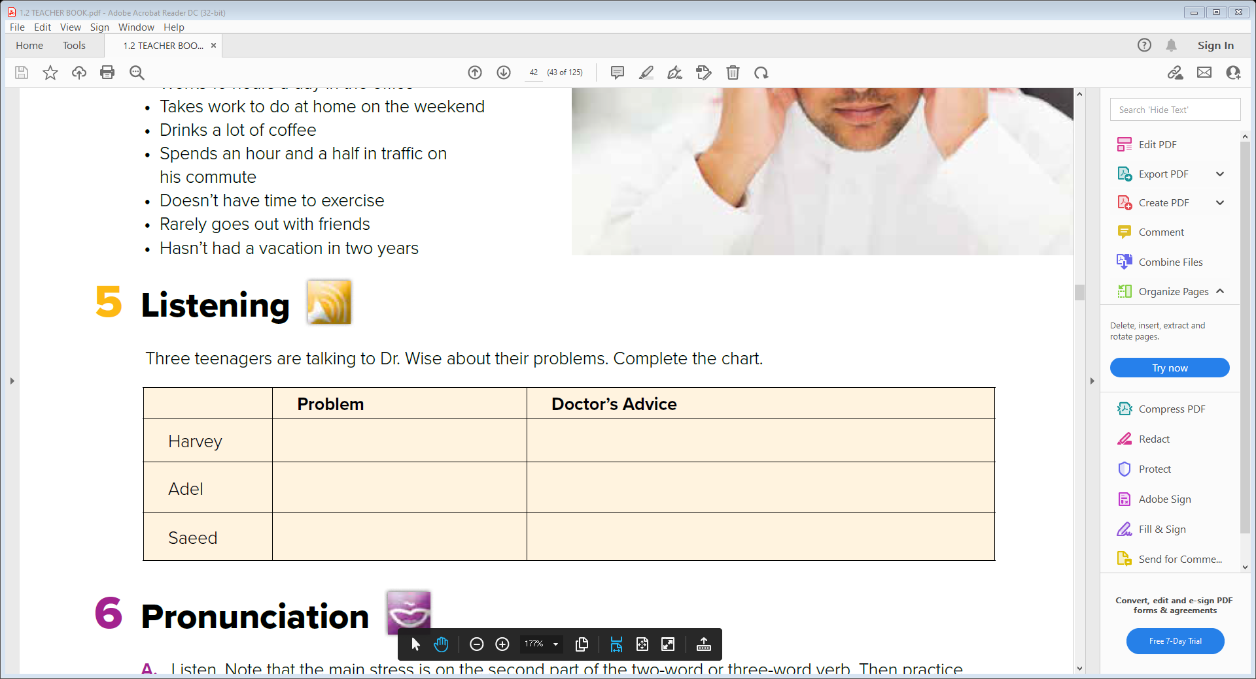
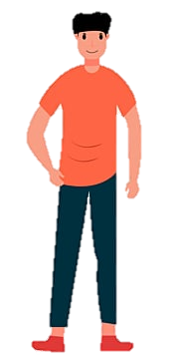
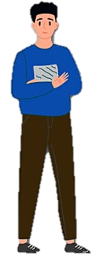
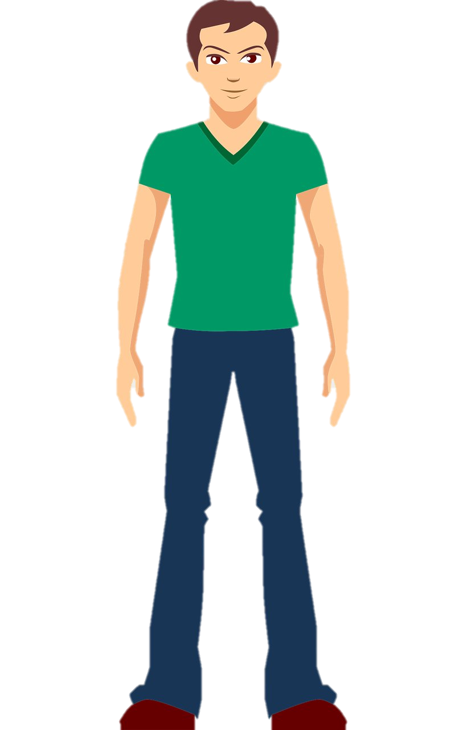
Three teenagers are talking to Dr. Wise about their problems. Complete the chart.
He’s gaining weight
He should change his diet and take up sport or do some other physical activity
He has a problem with his skin
He should stop eating nuts
He feels weak every time he exercises
He should start having salt in his food again

Slide 10
6-Pronunciation

Slide 11
A. Listen. Note that the main stress is on the second part of the two-word or three-word verb. Then practice.
put off I put off my new diet.
turn down I don’t want to turn down a friend who asks for help.
put up with Ahmed has put up with the noise for a long time. Now he has had enough.
put off I put off my new diet.
turn down I don’t want to turn down a friend who asks for help.
put up with Ahmed has put up with the noise for a long time. Now he has had enough.
B . Read the advice website again. Find two-word and three-word verbs. Practice reading them aloud, putting the main stress on the second part.

Slide 12
7- About You

Slide 13


In pairs, ask and answer the questions. Then switch roles.
1. What are the most common problems for the people you know?
2. Do you know people that are either easy or difficult to get along with? Why is that so?
3. Do you know anyone who eats too much junk food? How can you help?
4. Do you know anyone who suffers from anorexia? How can you help?
5. Are you weight conscious? Explain.
6. Are you concerned about your health and fitness? Explain.

Slide 14


