Slide 1


Slide 2
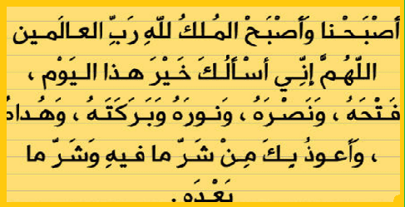

Slide 3
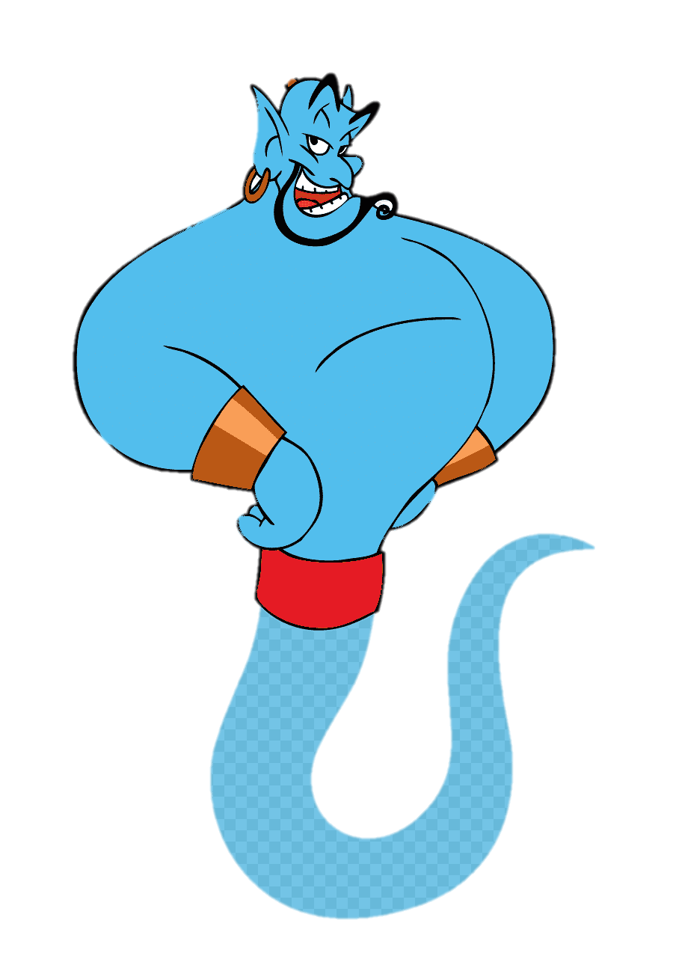
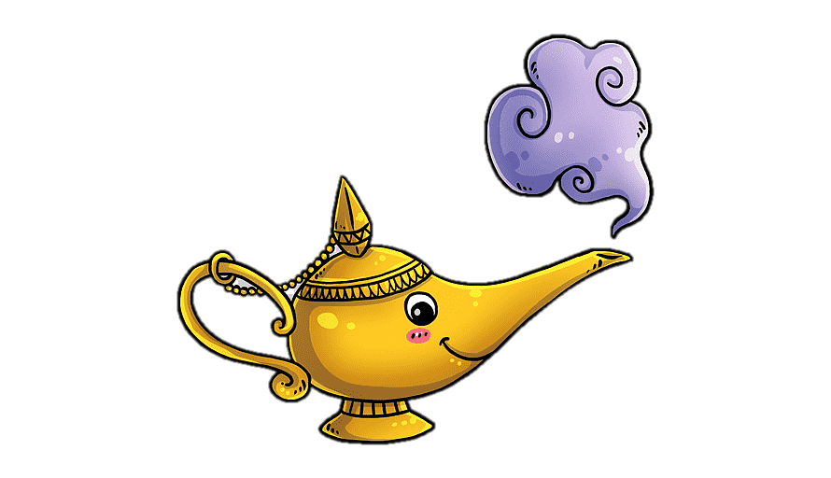
Unit-4
Wishful Thinking

Slide 4
1 Listen and Discuss
2- Pair Work

Slide 5
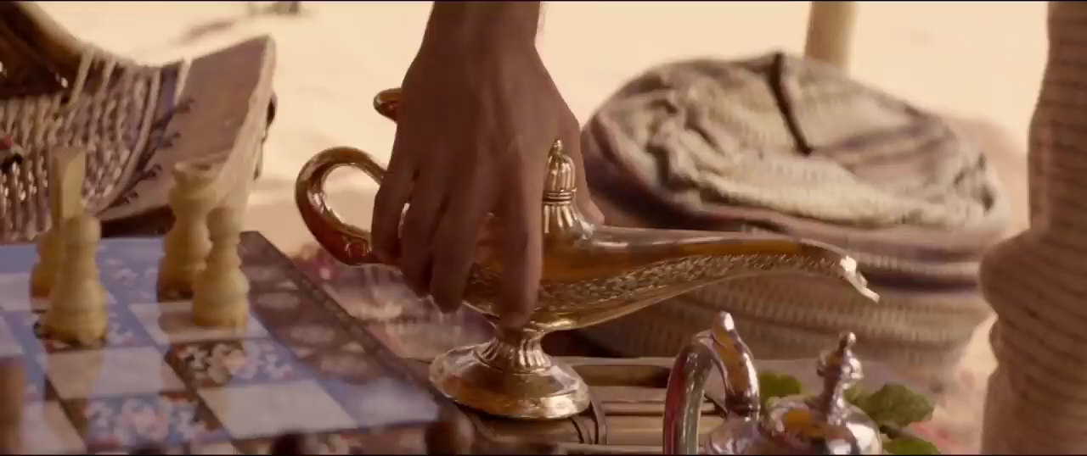

Slide 6
Objectives
The students will be able to :
understand person’s wish .
use new expressions .
recognize the correct / false sentences .
answer the questions about the article .
use wishes to form questions .
ask and answer questions about wishes .

Slide 7

Student Book P-45.46
1 Listen and Discuss

Slide 8
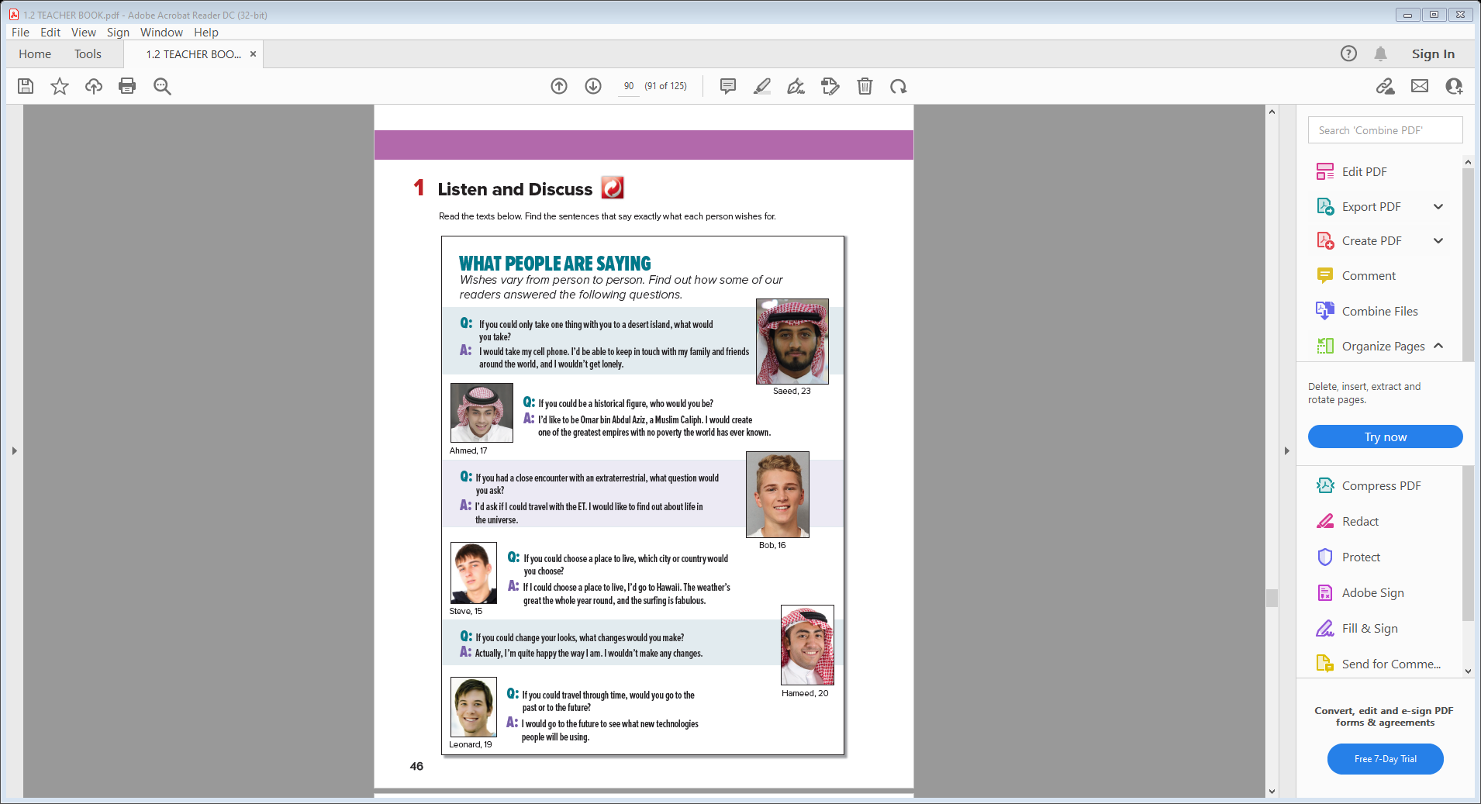
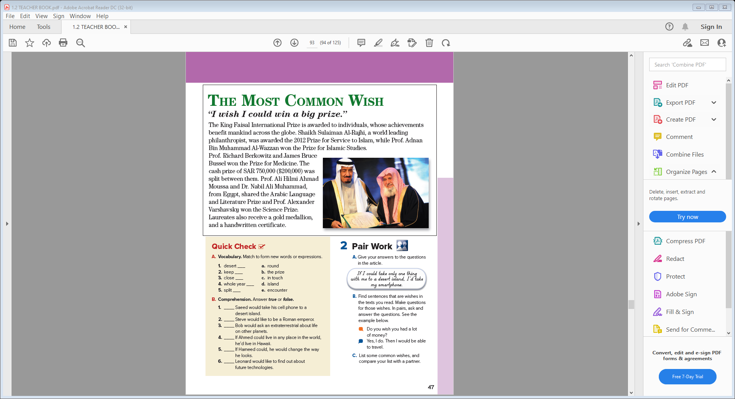
Student Book P-45.46
How old is Saeed?
What does Saeed choose ?

Slide 9

How old is Saeed?
What does Saeed choose ?
How old is Ahmed?
What does Ahmad want to be ?

Slide 10
How old is Ahmed?
What does Ahmad want to be ?
How old is Bob?
What would Bob like to find if he could travel with ET ?

Slide 11
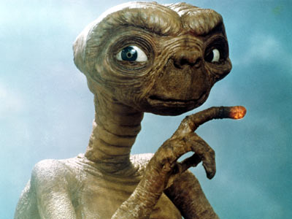
How old is Bob?
What would Bob like to find if he could travel with ET ?
extraterrestrial,
How old is Steve?
Why would he go to Hawaii

Slide 12
How old is Steve?
Why would he go to Hawaii
How old is Hameed?
Would Hameed like to change in himself ?

Slide 13
How old is Hameed?
Would Hameed like to change in himself ?
How old is Leonard?
Why did Leonard choose the future ?

Slide 14
How old is Leonard?
Why did Leonard choose the future ?

Slide 15
Which prize did Shaikh Sulaiman Al-Rajhi win?
Who won the Arabic Language and Literature
Prize?
What kind of achievements are required for one to
qualify?
Which prize did Prof. Alexander Varshavsky win?
Notes:
How much is the cash prize Prof. Richard Berkowitz
and James Bruce Bussel have won?
How many prizes are given?

Slide 16

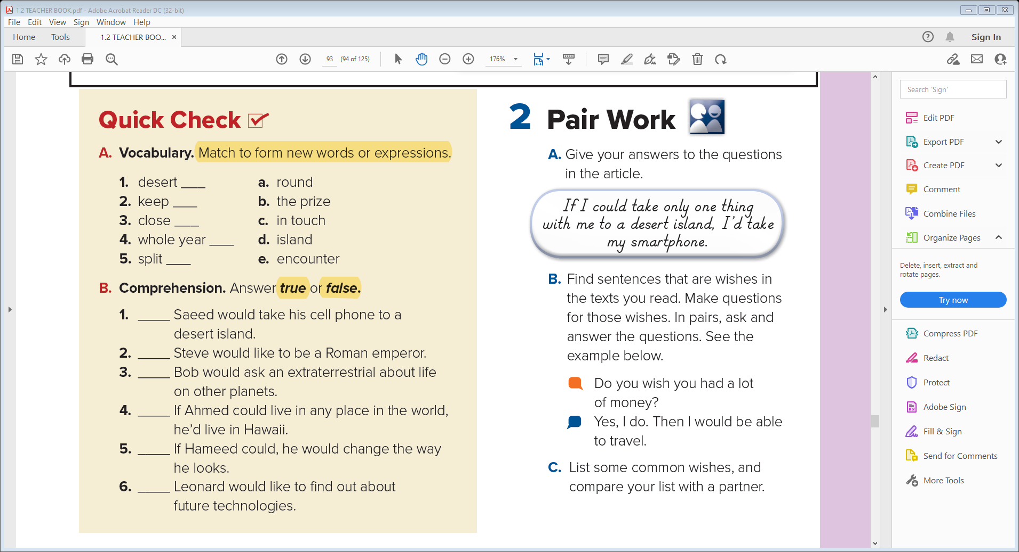
d
c
e
a
b
true
false
true
false
false
true

Slide 17
2- Pair Work

Slide 18

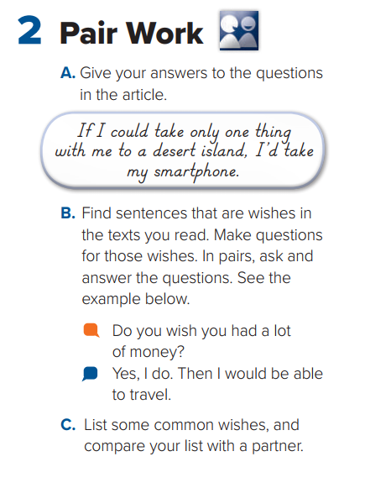

Slide 19


Quick Check

Slide 20


Slide 21


