Slide 1


Slide 2
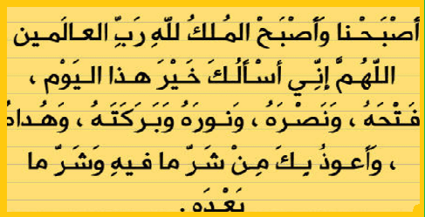

Slide 3
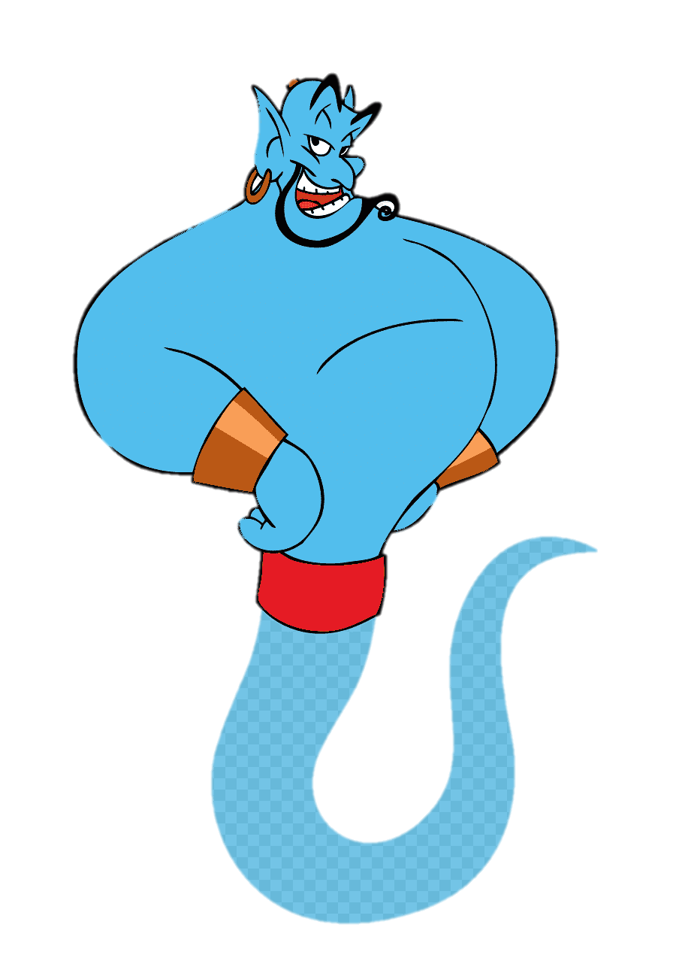
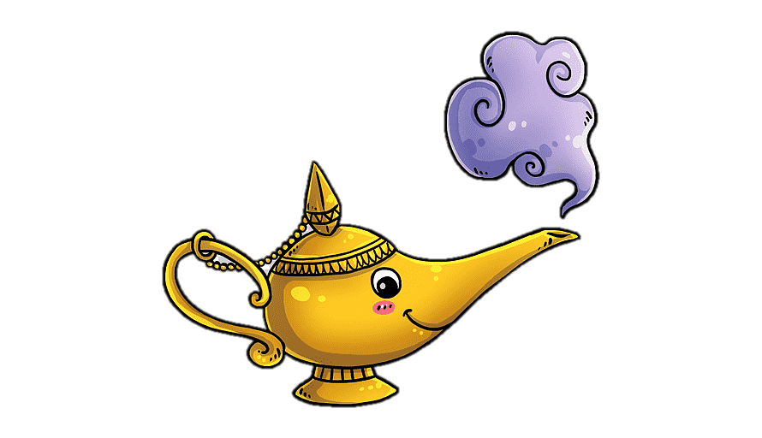
Unit-4
Wishful Thinking

Slide 4

8 Conversation

Slide 5
Revision
Read the sentences
If you had a lot of money, you would buy a new big house.
You would donate to charities if you had a lot of money.

Slide 6

4-Language in Context
Objectives
The students will be able to :
Scan the text
Skim the text
use the "real talk" expressions in short conversation .
Answer comprehension questions about the conversation
Share positively in pair work.

Slide 7

Warm Up
Student Book
p.51
Notes:
what do you know about game shows?
Name some of your favorites ones

Slide 8

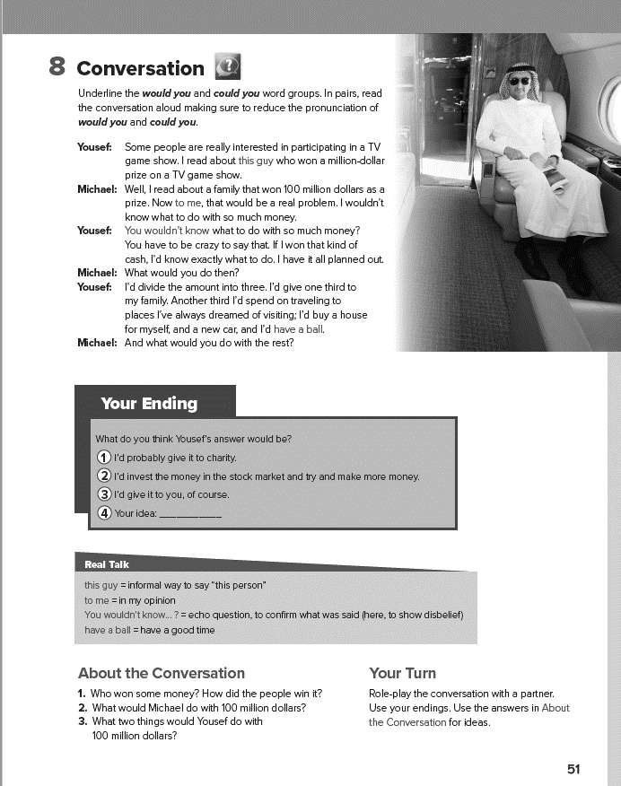
How many persons do we have ?
What are their names ?
What is the conversation about ?
Student Book
p.51

Slide 9

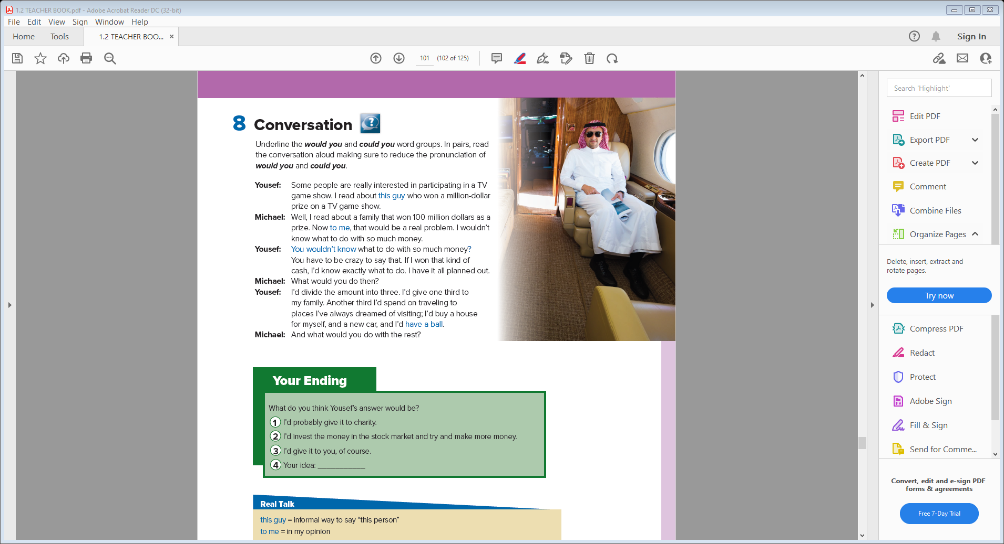
Skimming
How many persons do we have ?
What are their names ?
What is the conversation about ?

Slide 10

underline the
would you and could you,
Book Closed & Listen
underline the
expressions that are
unfamiliar.

Slide 11
Scan
underline the
would you and could you,
underline the
expressions that are
unfamiliar.
Notes:
Write on the board: Some people really
have all the luck. Have students use the context to tell
you what this expression means

Slide 12
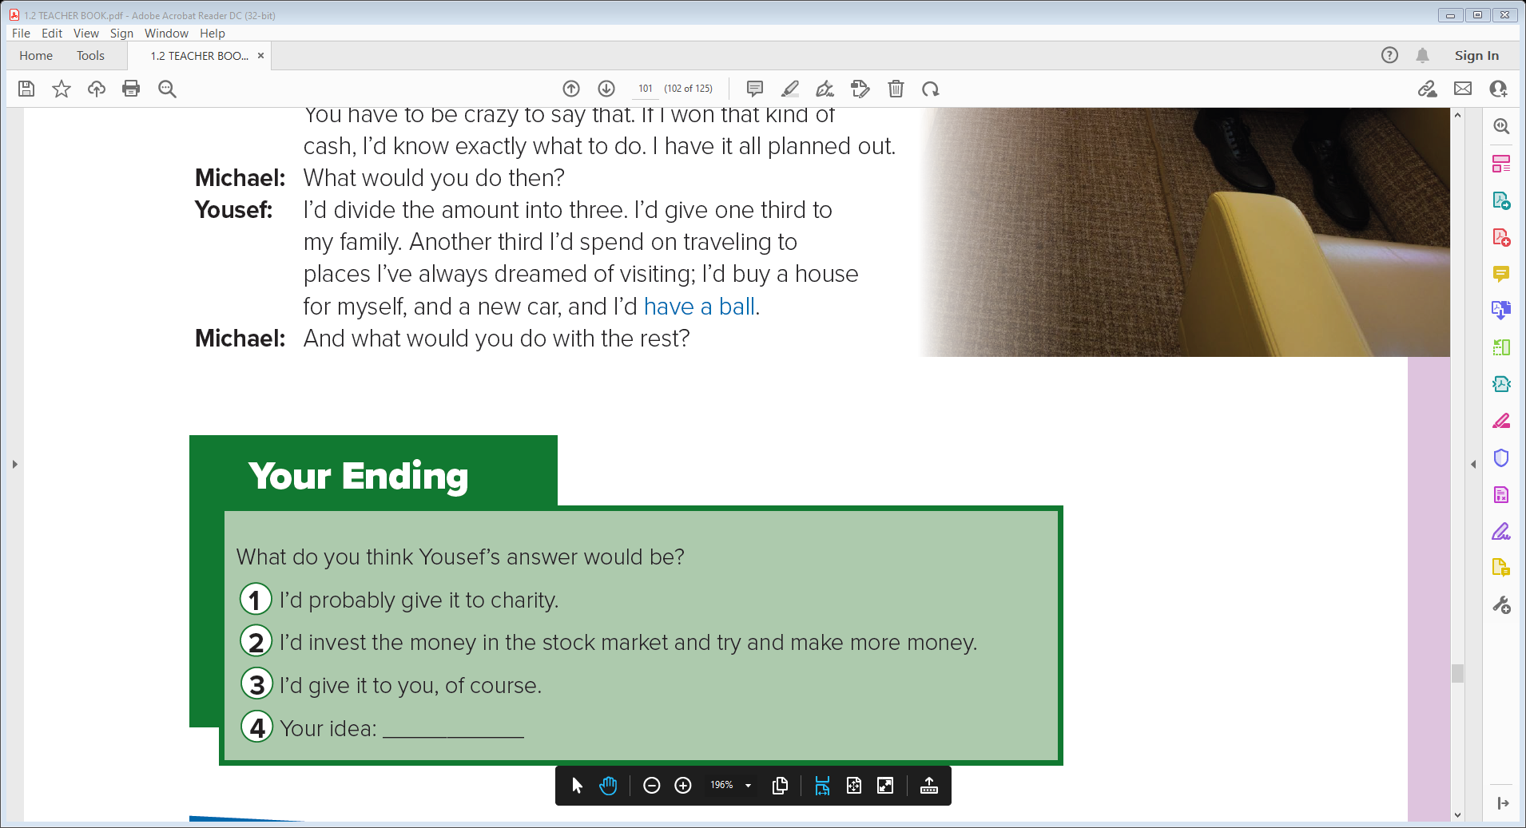
Listen & Read along

Slide 13
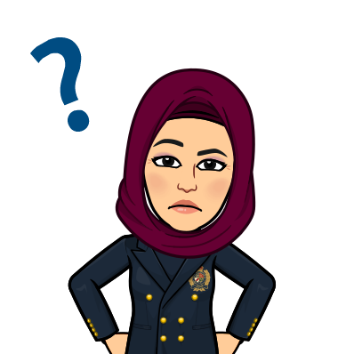
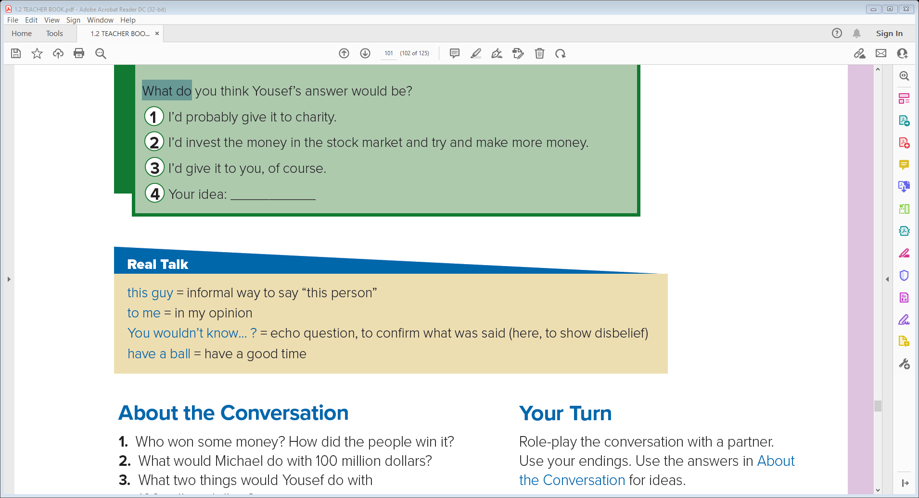


Slide 14
Who is this guy is in the conversation?
Who says to me?
Michael
Who says You wouldn’t know…?
Yousef
Who says I’d have a ball.
Yousef
Notes:
1-(Explain that
Yousef doesn’t really know, or it isn’t important.)
2-Explain that for me
would have the same meaning.
3-Explain
that it’s common to make this type of question to show
Disbelief
4-Ask students
what other expressions they use or have heard that
mean have a good time.

Slide 15

Your Turn
About the Conversation
1. Who won some money? How did the people win it?
2. What would Michael do with 100 million dollars?
3. What two things would Yousef do with 100 million dollars?
1- A guy won a million-dollar prize on a TV game show . A family won $100 million as a prize .
2- Michael says that he wouldn’t know what to do with so much money .
3- Yousef would give one third of the money to his family on the condition that they wouldn’t ask for money ever again. Ηe would spend one third on traveling to places he’s always dreamed of visiting .

Slide 16
Quick Check
Your Turn
Role-play the conversation with a partner.
Use your endings. Use the answers in About
the Conversation for ideas.

Slide 17
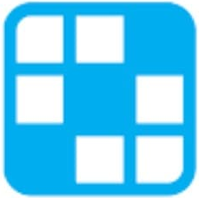

Quick Check

Slide 18
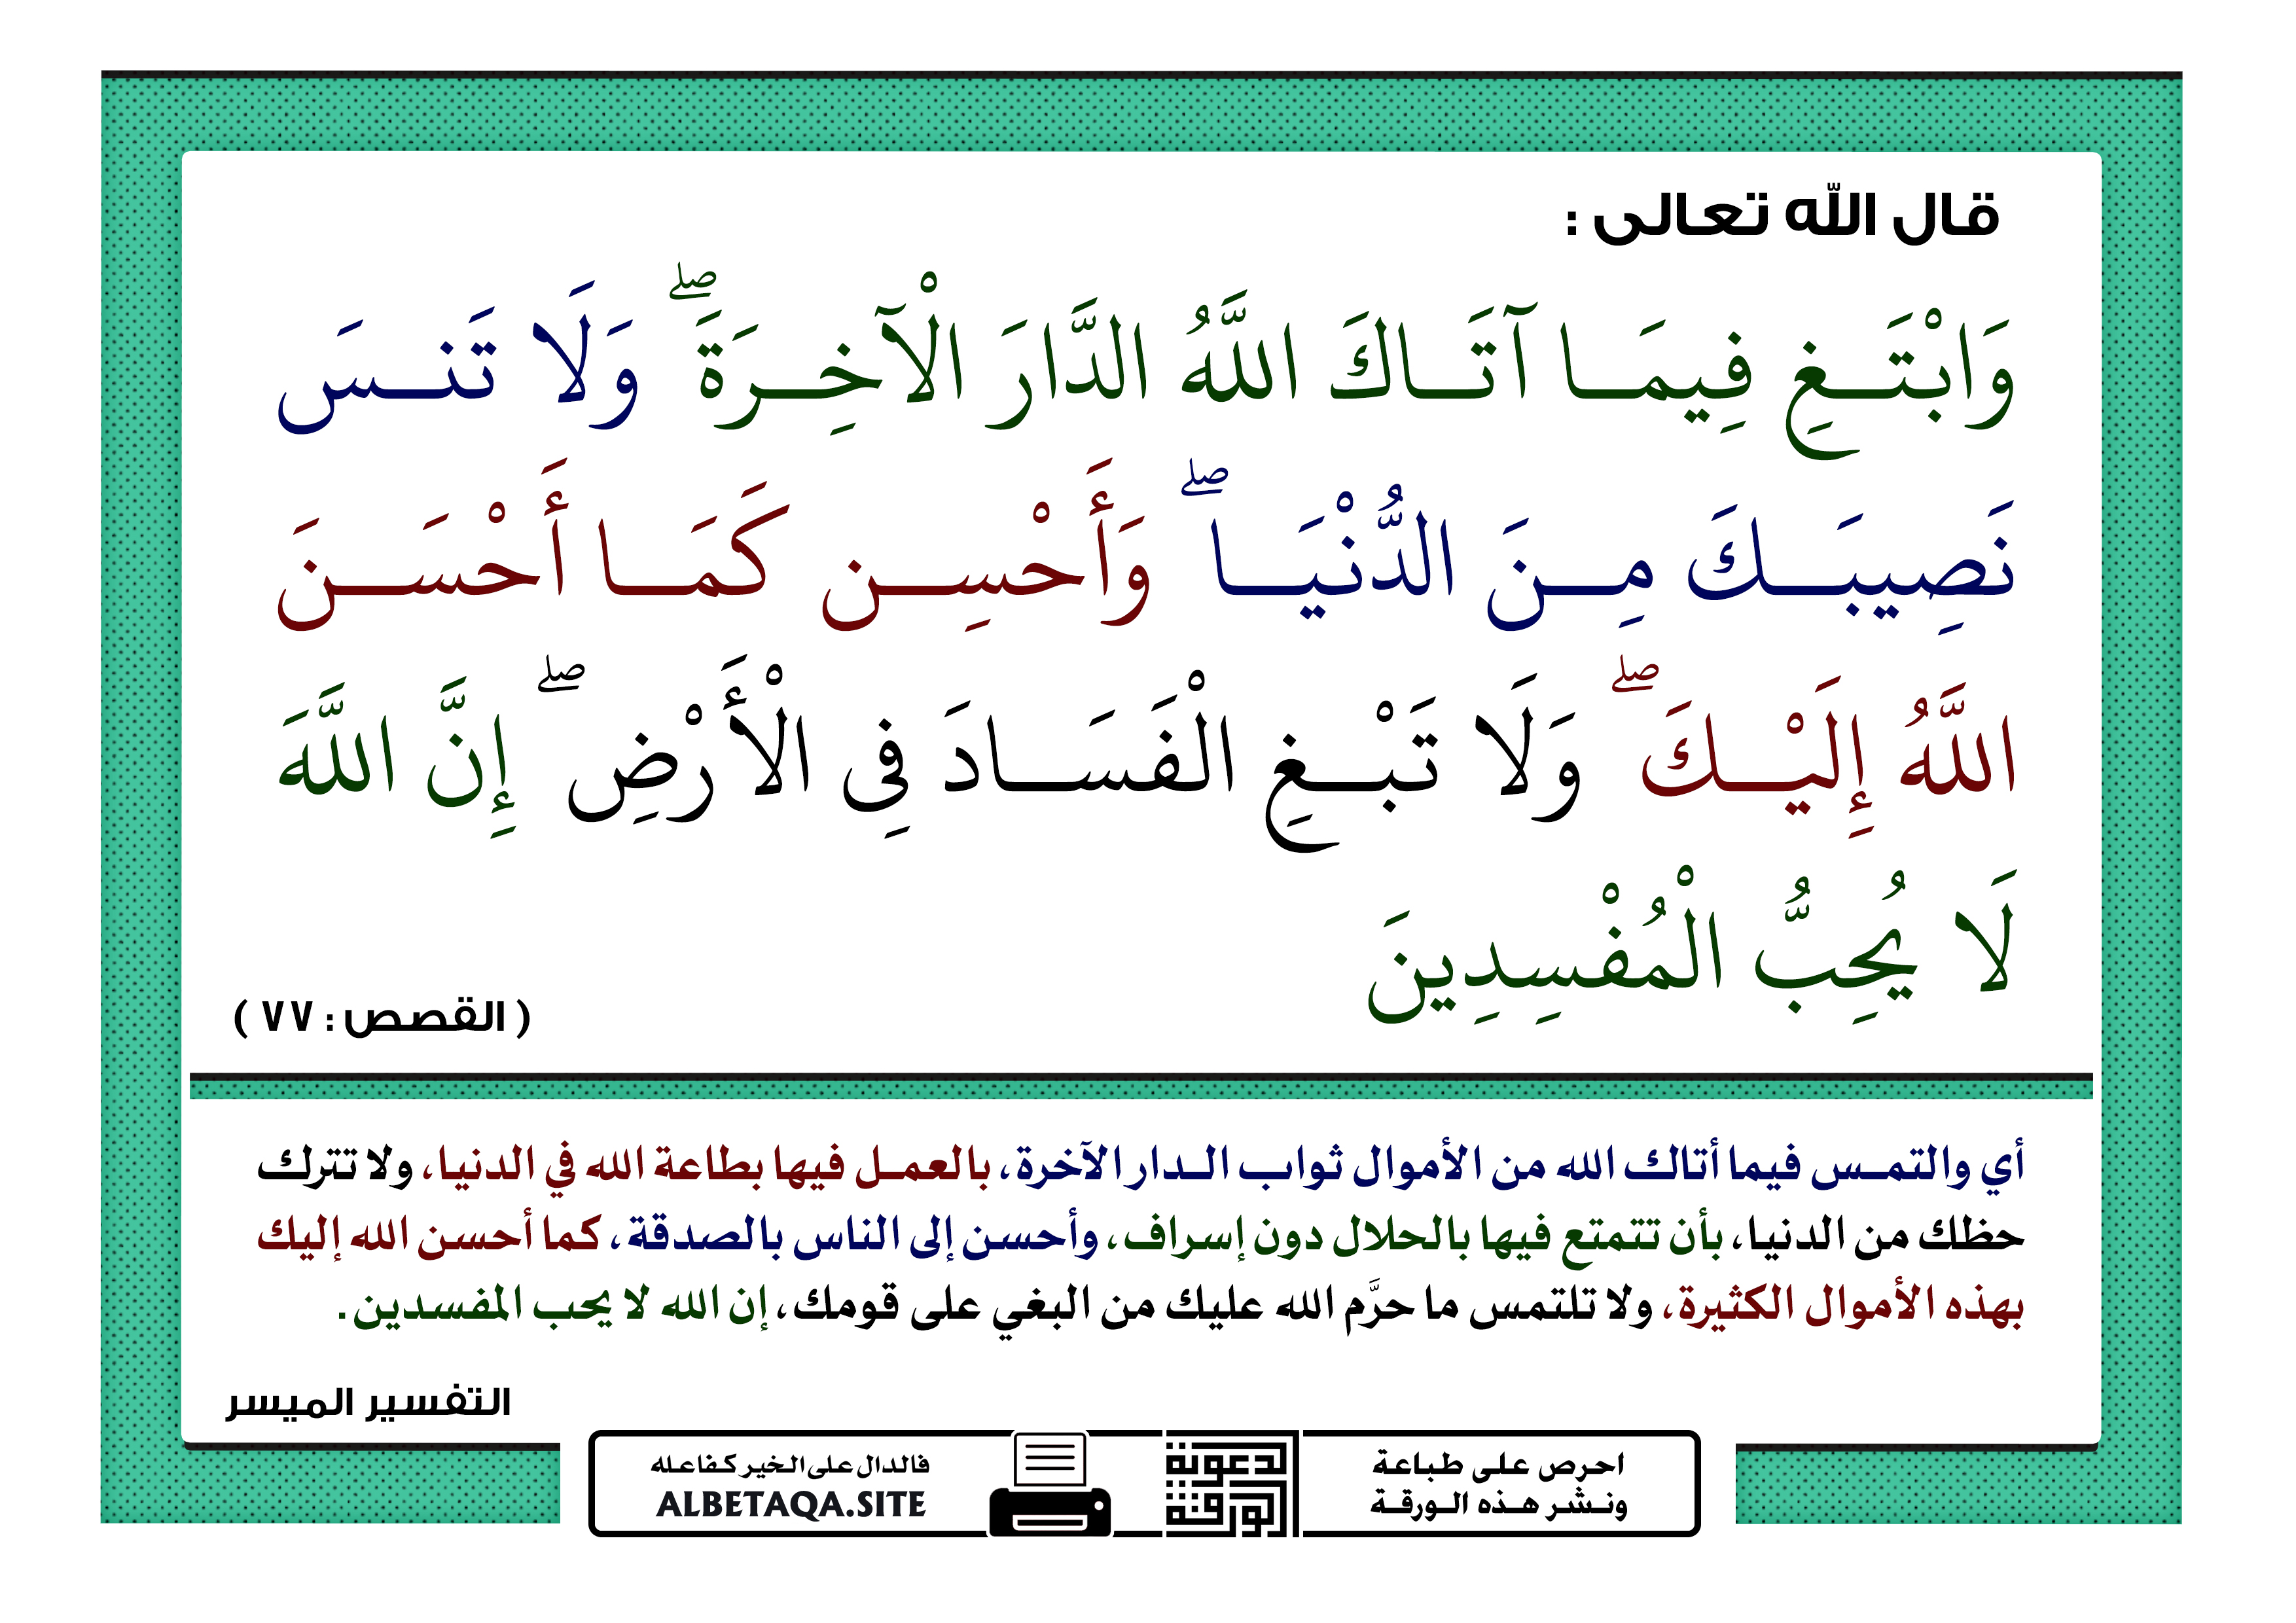

Slide 19


