Slide 1


Slide 2
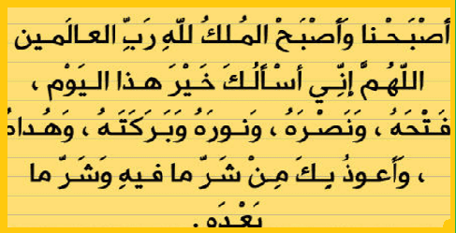

Slide 3
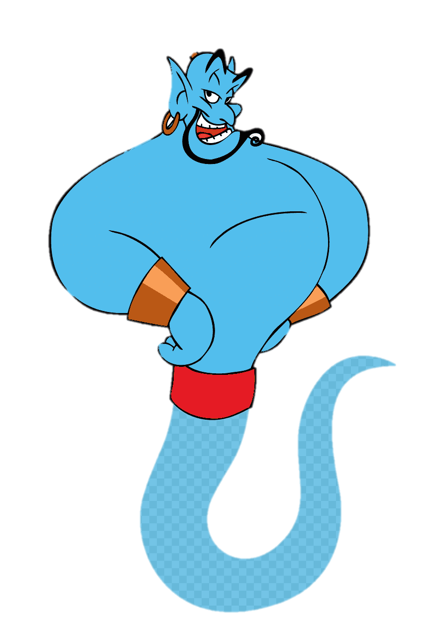
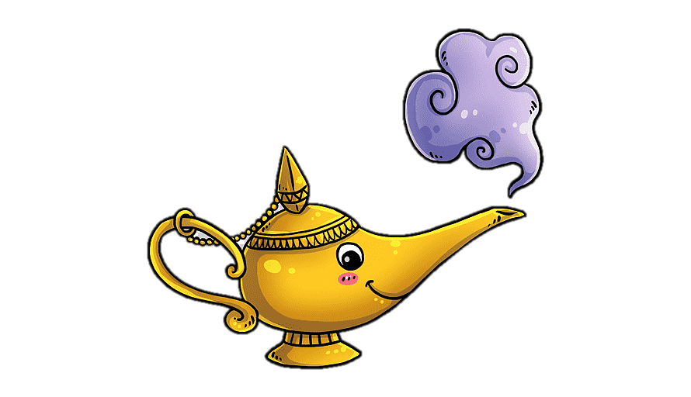
Unit-4
Wishful Thinking

Slide 4

4-Language in Context
5-Listening
6-Pronunciation
7- About You

Slide 5

Revision
Find the fib
If I had a lot of money, I would buy a new big house.
I would donate to charities if I had a lot of money.
If I were rich, I will make more charitable donations.

Slide 6

4-Language in Context
Objectives
The students will be able to :
compare wishes with a classmate.
find out wishes on an audio.
practice reducing the pronunciation of (could-would) .
ask about hypothetical situations .
Share positively in pair work.

Slide 7

A rich businessman offers to pay for three things you want because you
received the highest grades in the
school district. What would you ask for?
4-Language in Context

Slide 8


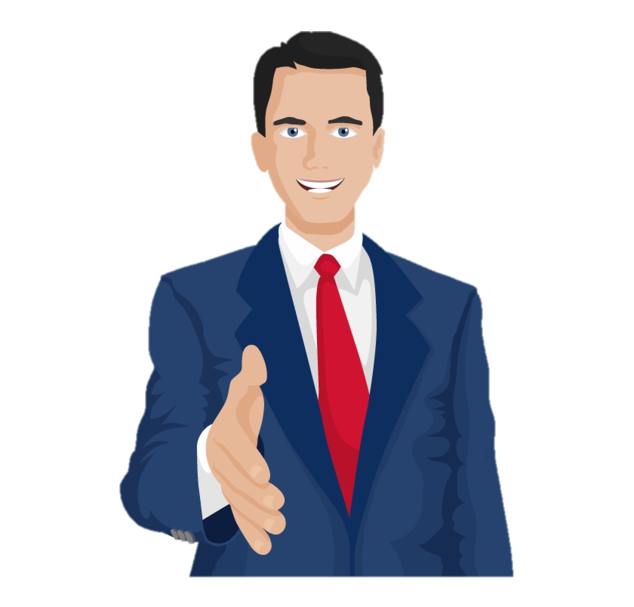

2. Compare your wants with members of the class and select the funniest one?
A rich businessman offers to pay for three things you want because you
received the highest grades in the
school district. What would you ask for?
I wish………

Slide 9
5-Listening
2. Compare your wants with members of the class and select the funniest one?

Slide 10

5-Listening

Slide 11


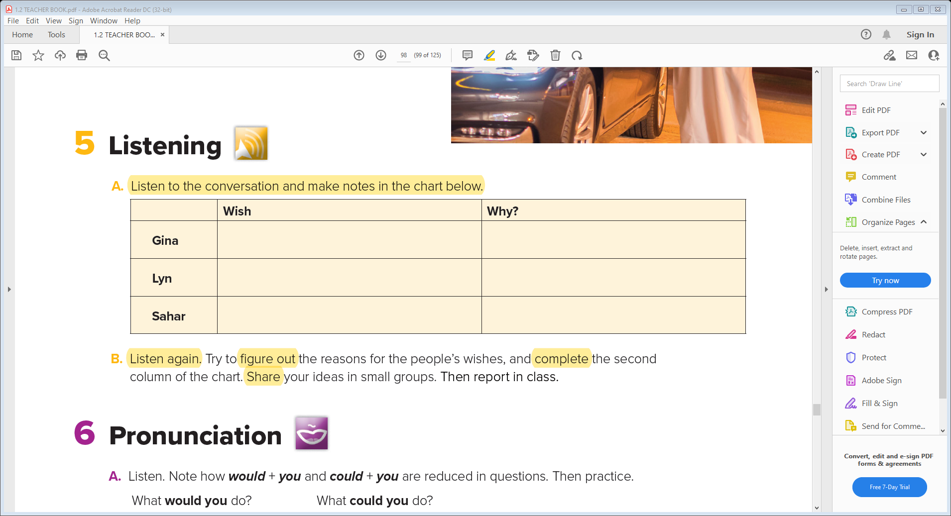
6-Pronunciation
She wishes she were so clever .
She wishes she were a talented writer .
She wishes she had the right kind of materials.
to think of new ideas
She wishes she could do something
to help
She wishes they had money
so they wouldn’t have to ask any more
j

Slide 12
6-Pronunciation

Slide 13
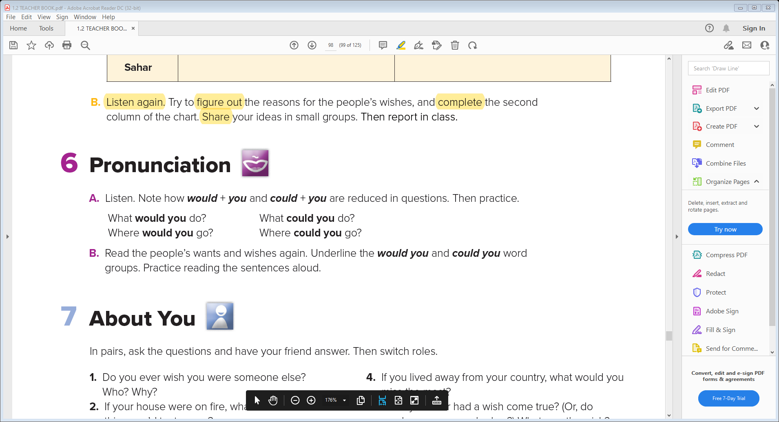
7- About You

Slide 14
7- About You

Slide 15

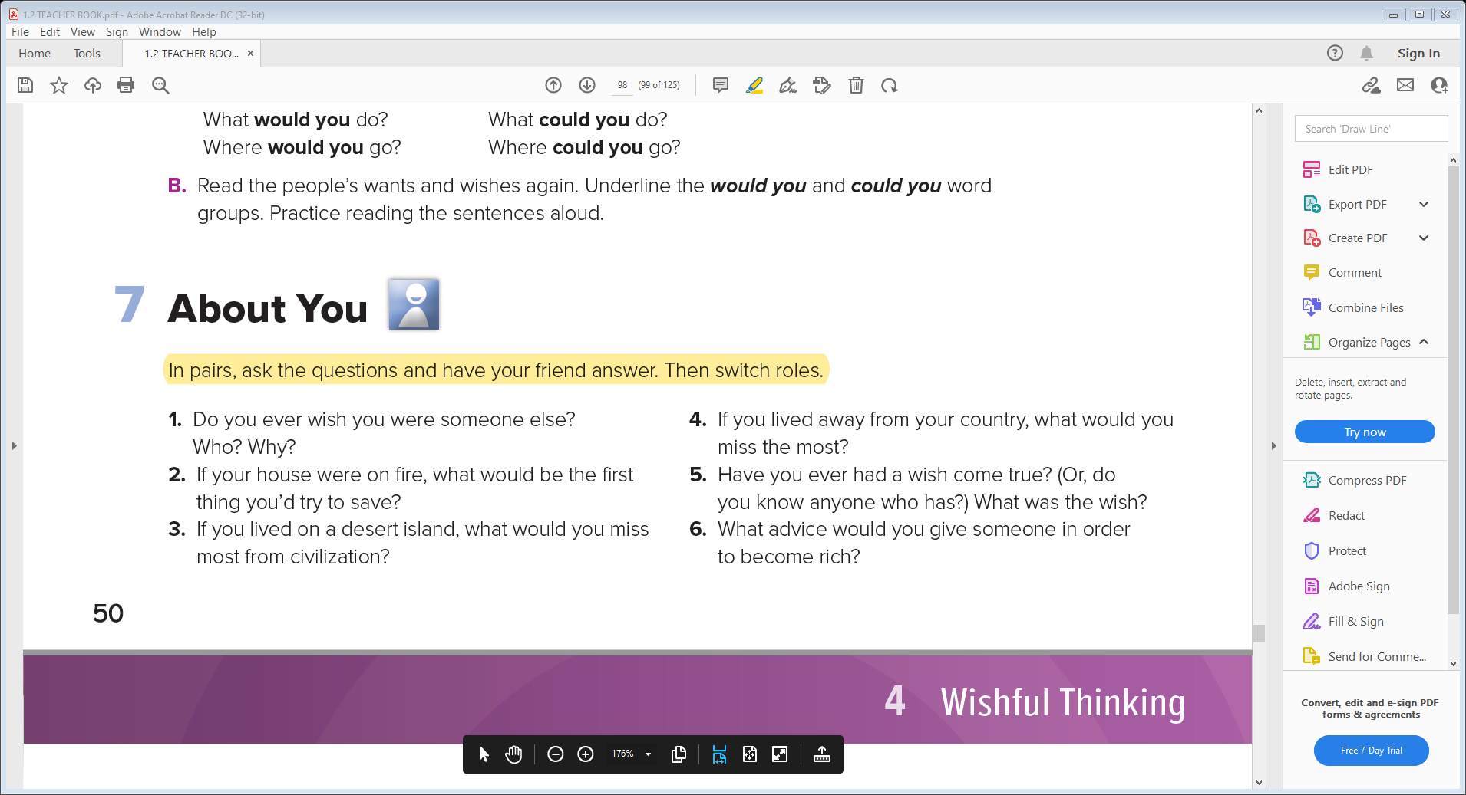

Slide 16


