Slide 1


Slide 2


Slide 3
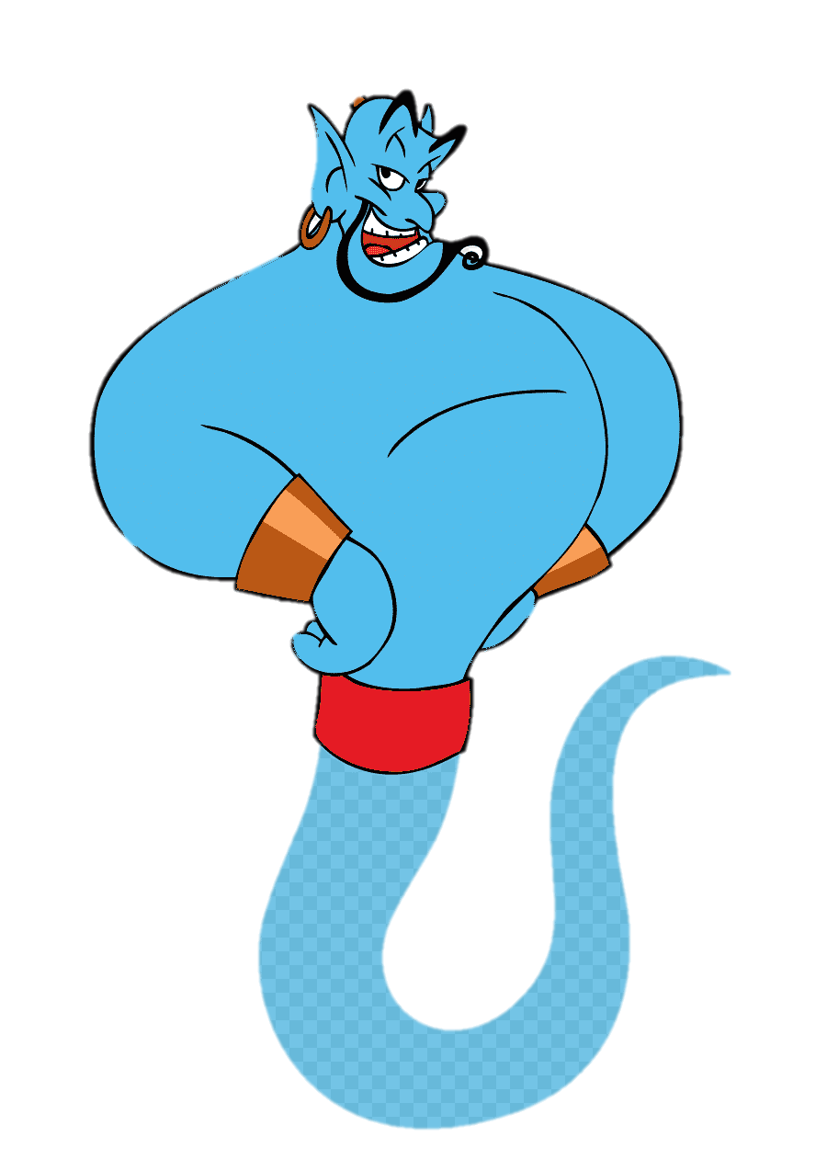
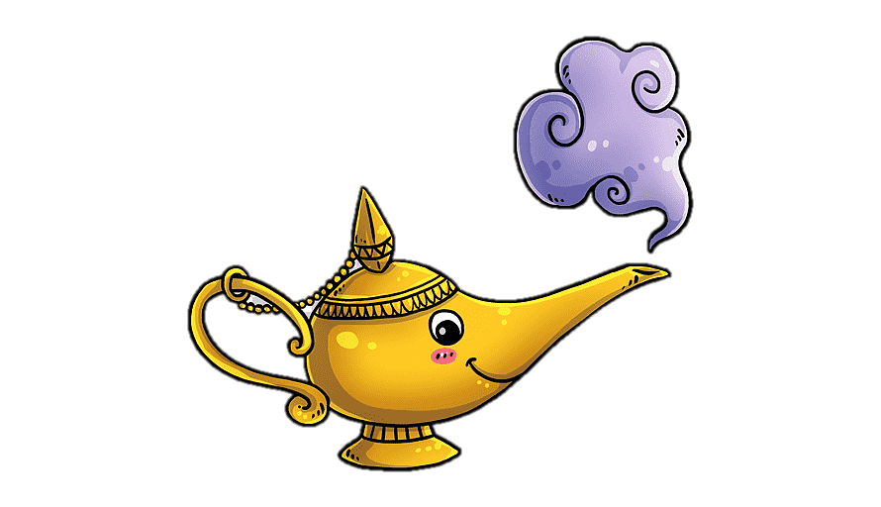
Unit-4
Wishful Thinking

Slide 4
10-Writing

Slide 5

Warm Up
Objectives
The students will be able to :
Complete the dialogue by matching the quiz questions to the right answers .
Write a description of a day in your life as a game show winner.
Analyze a text to its main events .
Write the positive/negative aspects of a celebrity lifestyle .

Slide 6







Where do you think he
is? Why?
What does he do? How do you know?
Who do you think the
person in the picture is?
Are there
any clues in the picture that helped you guess?
Revision

Slide 7

Warm Up
Have you ever watched a quiz show on television? What did
you think of it?
Where do you think he
is? Why?
What does he do? How do you know?
Who do you think the
person in the picture is?
Are there
any clues in the picture that helped you guess?

Slide 8
Have you ever watched a quiz show on television? What did
you think of it?
2. Would you ever participate in a quiz show? Why? Why not?

Slide 9

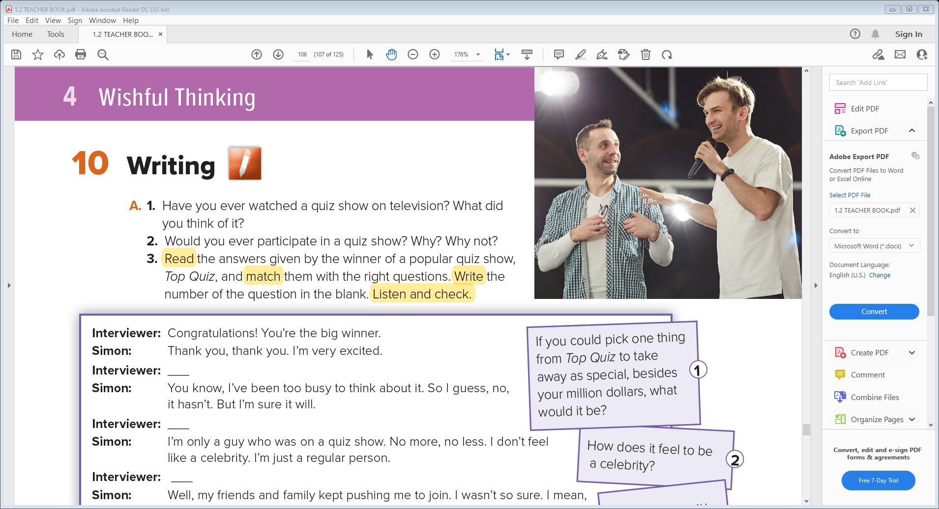
2. Would you ever participate in a quiz show? Why? Why not?

Slide 11
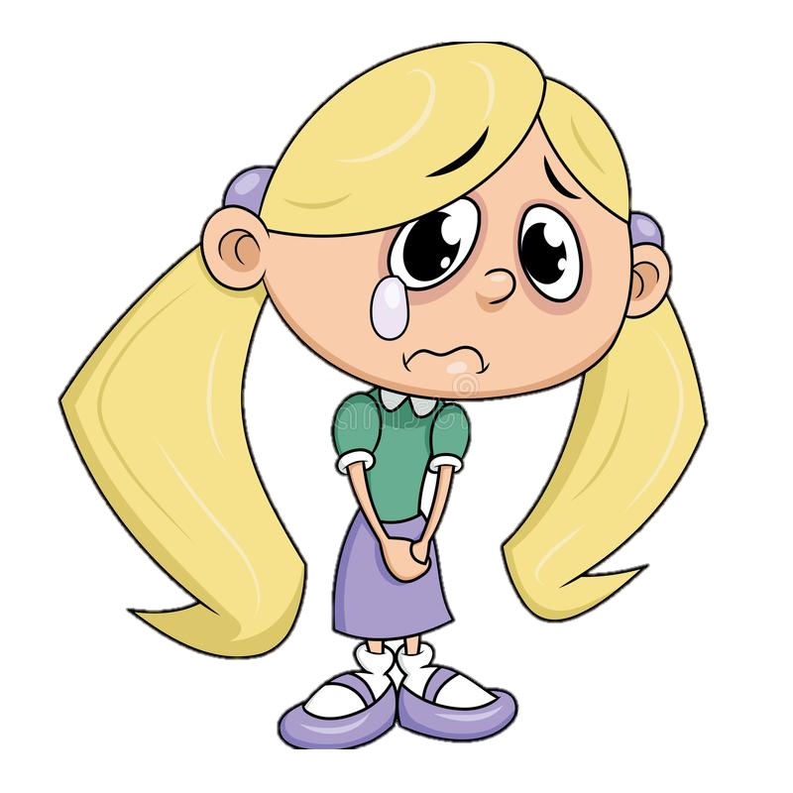
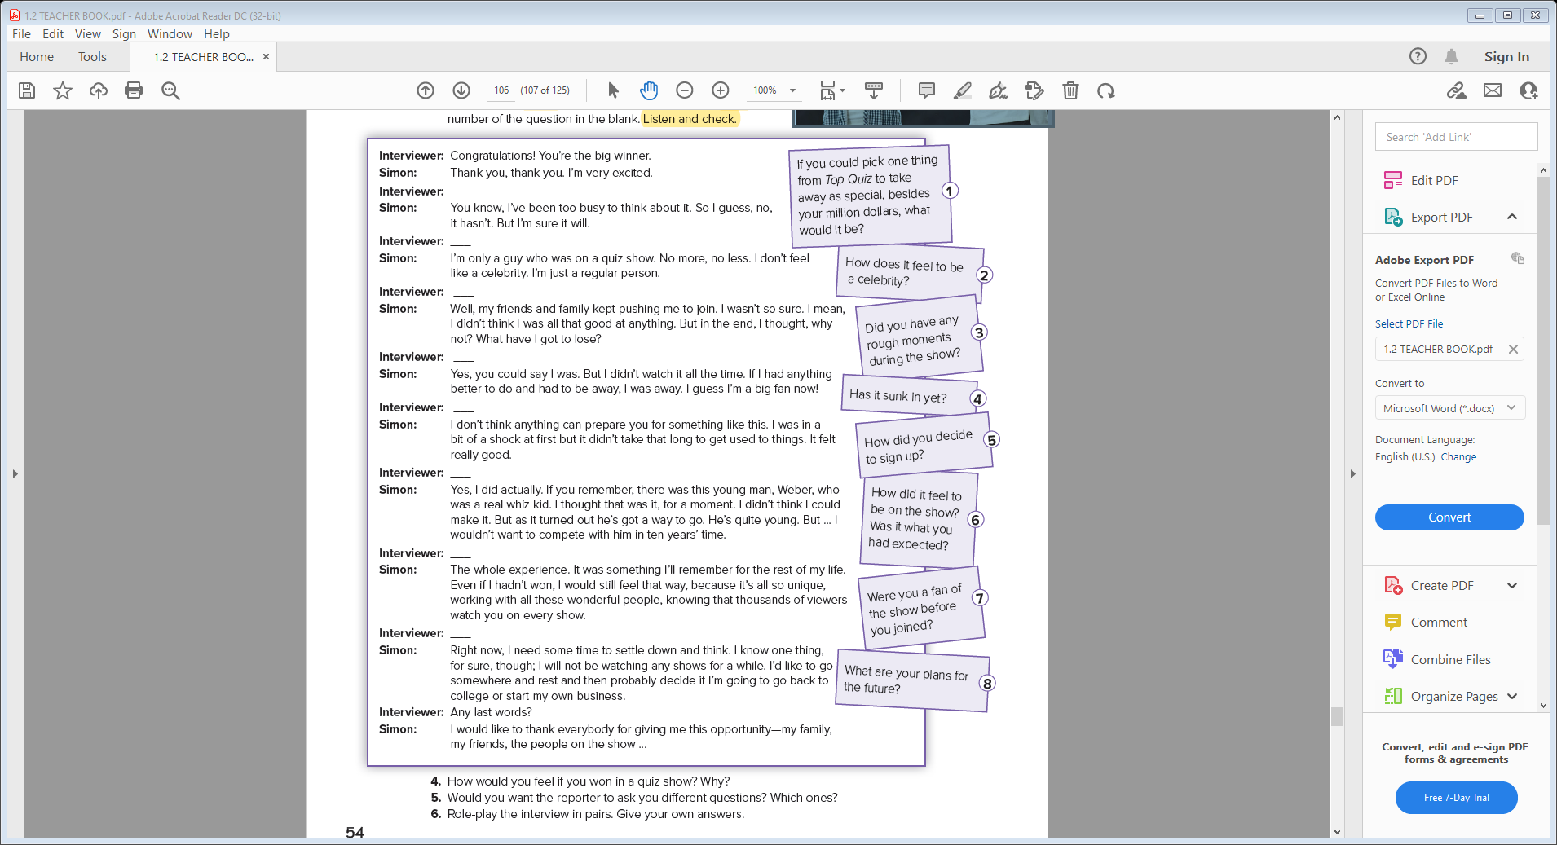

4
2
4. How would you feel if you won in a quiz show? Why?
5
7
6
3
1
8

Slide 12
5. Would you want the reporter to ask you different questions? Which ones?
4. How would you feel if you won in a quiz show? Why?

Slide 13
5.Would you want the reporter to ask you different questions? Which ones?

Slide 14
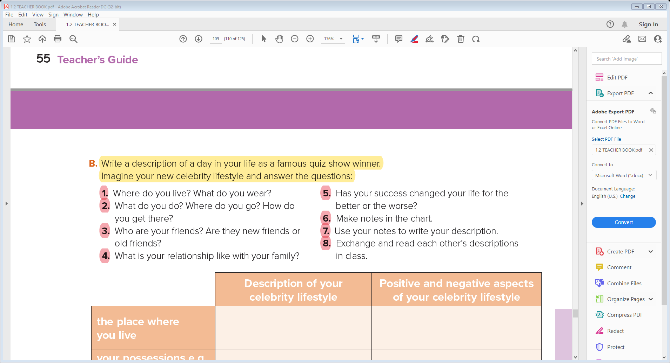
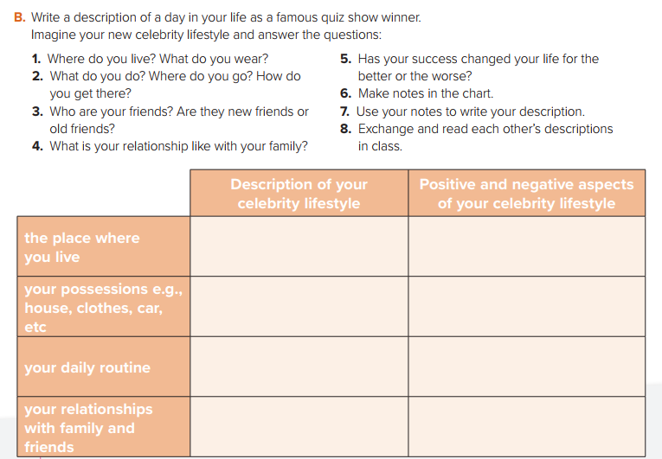

Slide 15
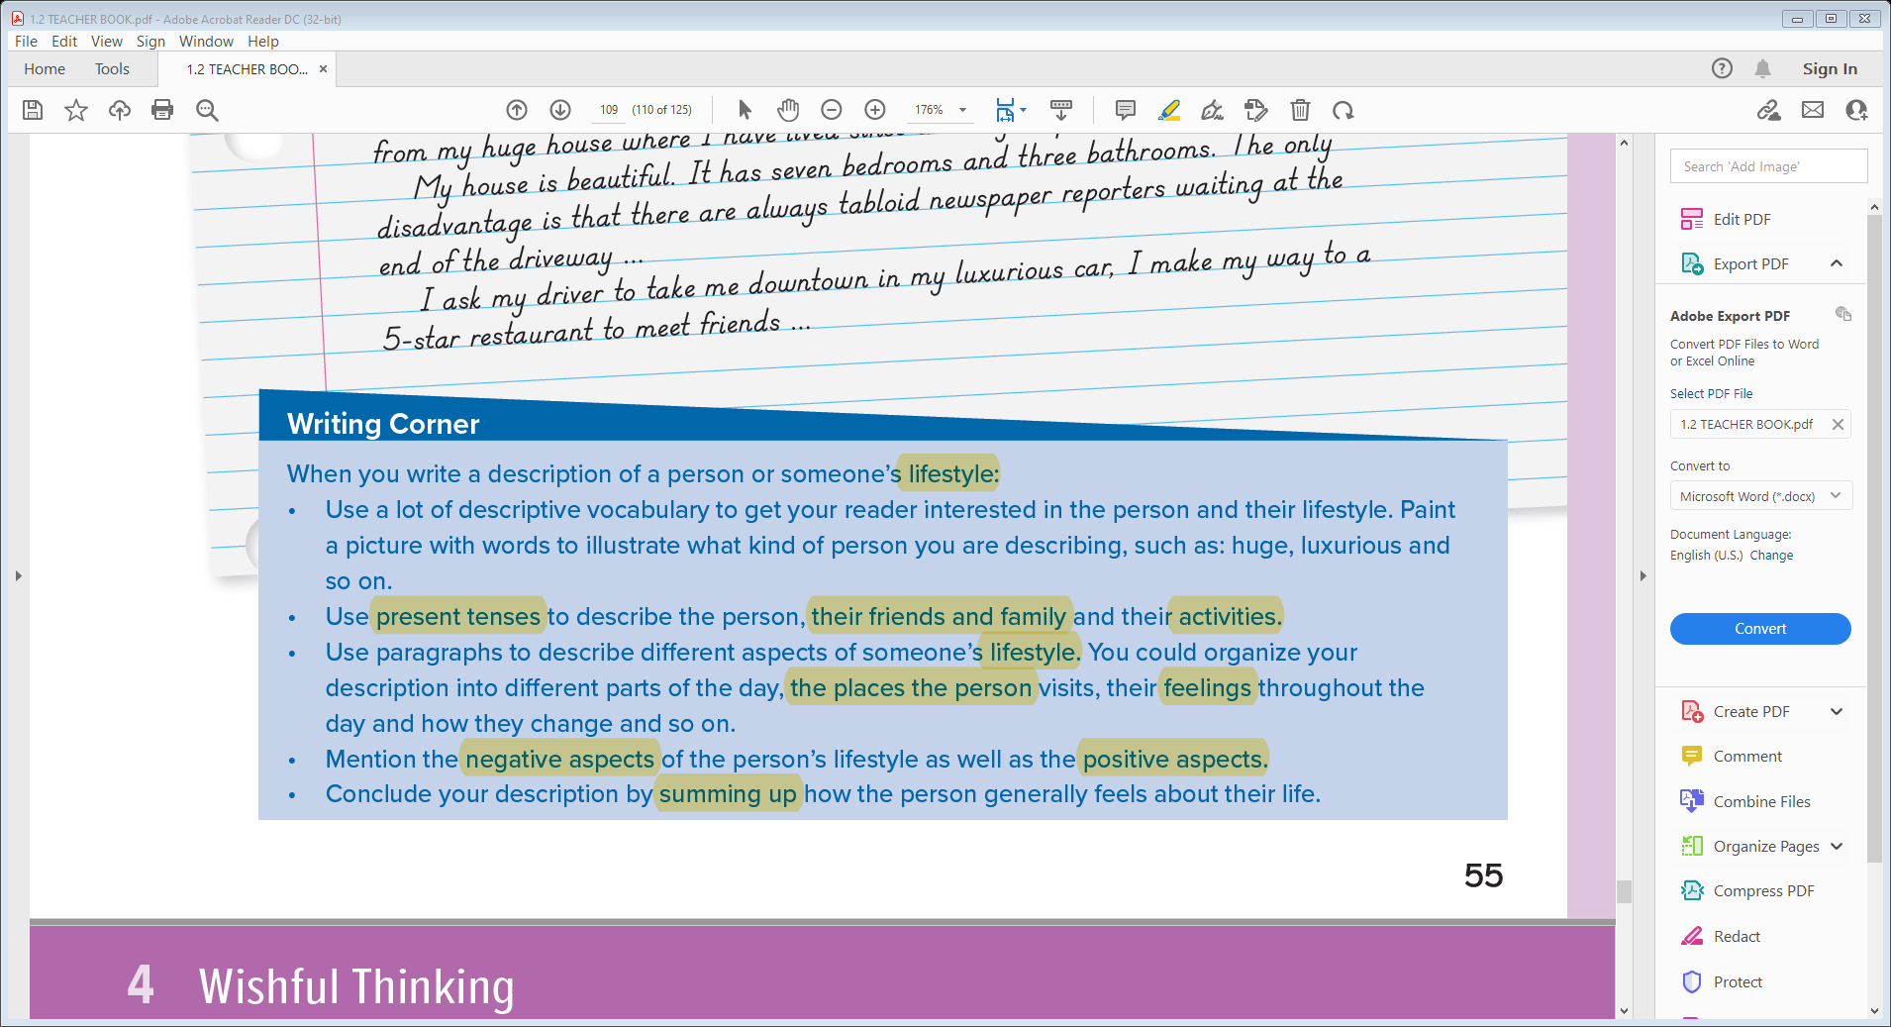
far away from the city
a villa near the sea
huge house / brand watches / fancy cars
many interviews
fancy gifts
Gym / play golf
healthy style
hang out with friends
spend time with family
powerful relationships
fake friends

Slide 17
-------------------------------------------------------------------------------------------------------------------------------------------------------------------------------------------------------------------------------------------------------------------------------------------------------------------------------------------------------------------------------------------------------------------------------------------------------------------------------------------------------------------------------------------------------------------------------------------------------------------------------------------------------------------------------------------------------------------------------------------------------------------------------------------------------------------------------------------------------------------------------------------------------------------------------------------------------------------------------------------------------------------------------------------------------------------------------------------------------------------------------------------------------------------------------------------------------------------------------------------------------------------------------------------------------------------------------------------------------------------------------------------------------------------------------------------------------------------------------------------------------------------------------------------------------------------------------------------------------------------------------------------------------------------------------------------------------------------------------------------------------------------------------------------------------------------------------------------------------------------------------------------------------------------------------------------------------------------------------------------------
Introduction
Body
The person’s character
activities
Friends & family
Conclusion

Slide 18


