Slide 1
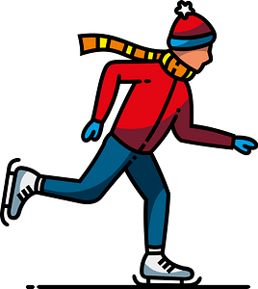
Unit 2
Sporting Life
Reading
Done by: Entisar Al-Obaidallah

Slide 2




Goals of Lesson
Mention
Name
01
02
Read
Talk
03
04
Some information about Norway.
Some winter sports in Norway
for specific information
about popular sports in Saudi Arabia

Slide 3

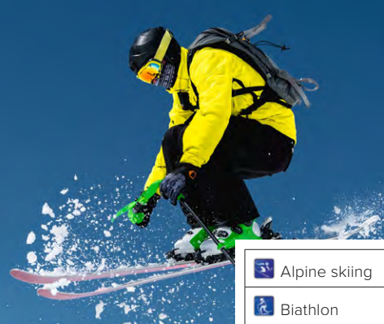

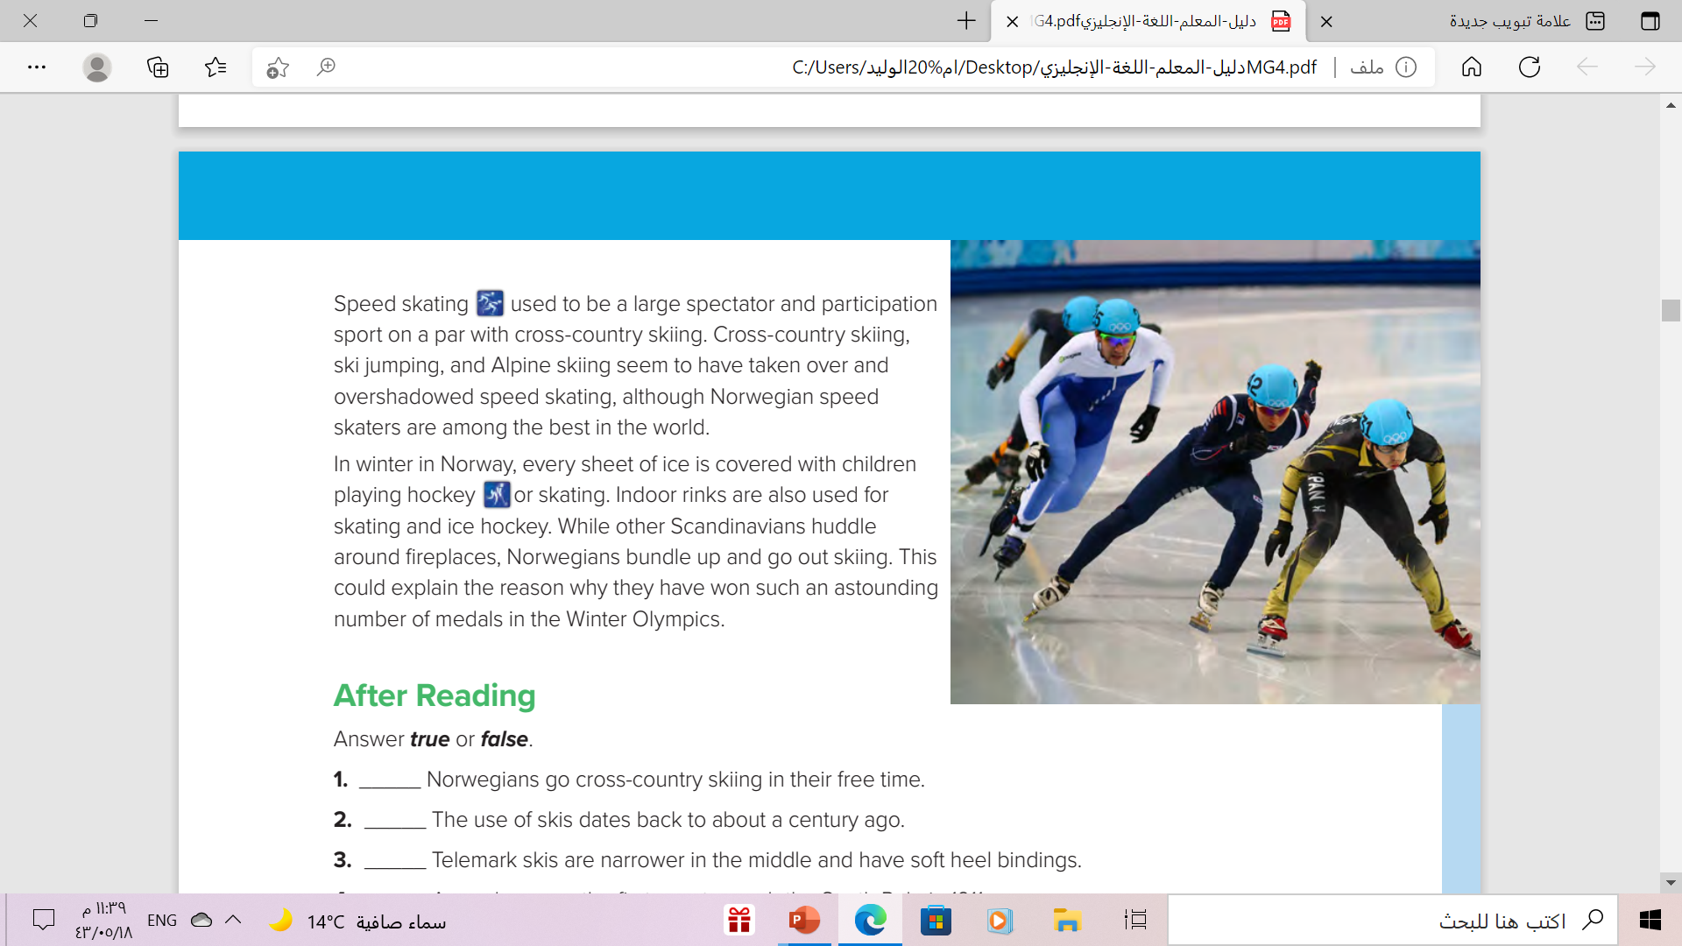
Warm up
What are the people doing in each picture?
The 1st one is ski – jumping
The 2nd one is speed skating

Slide 4

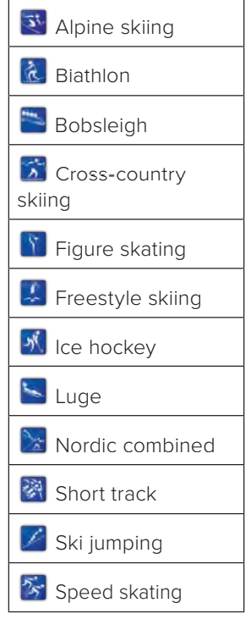



Warm up
What are these
The most popular winter sports in Norway

Slide 5
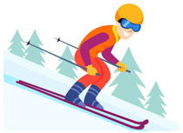
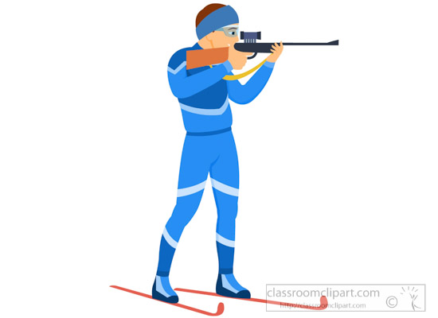
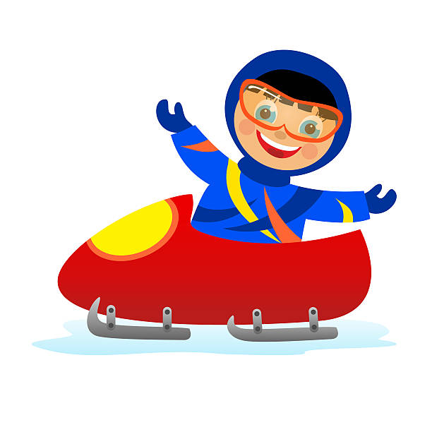
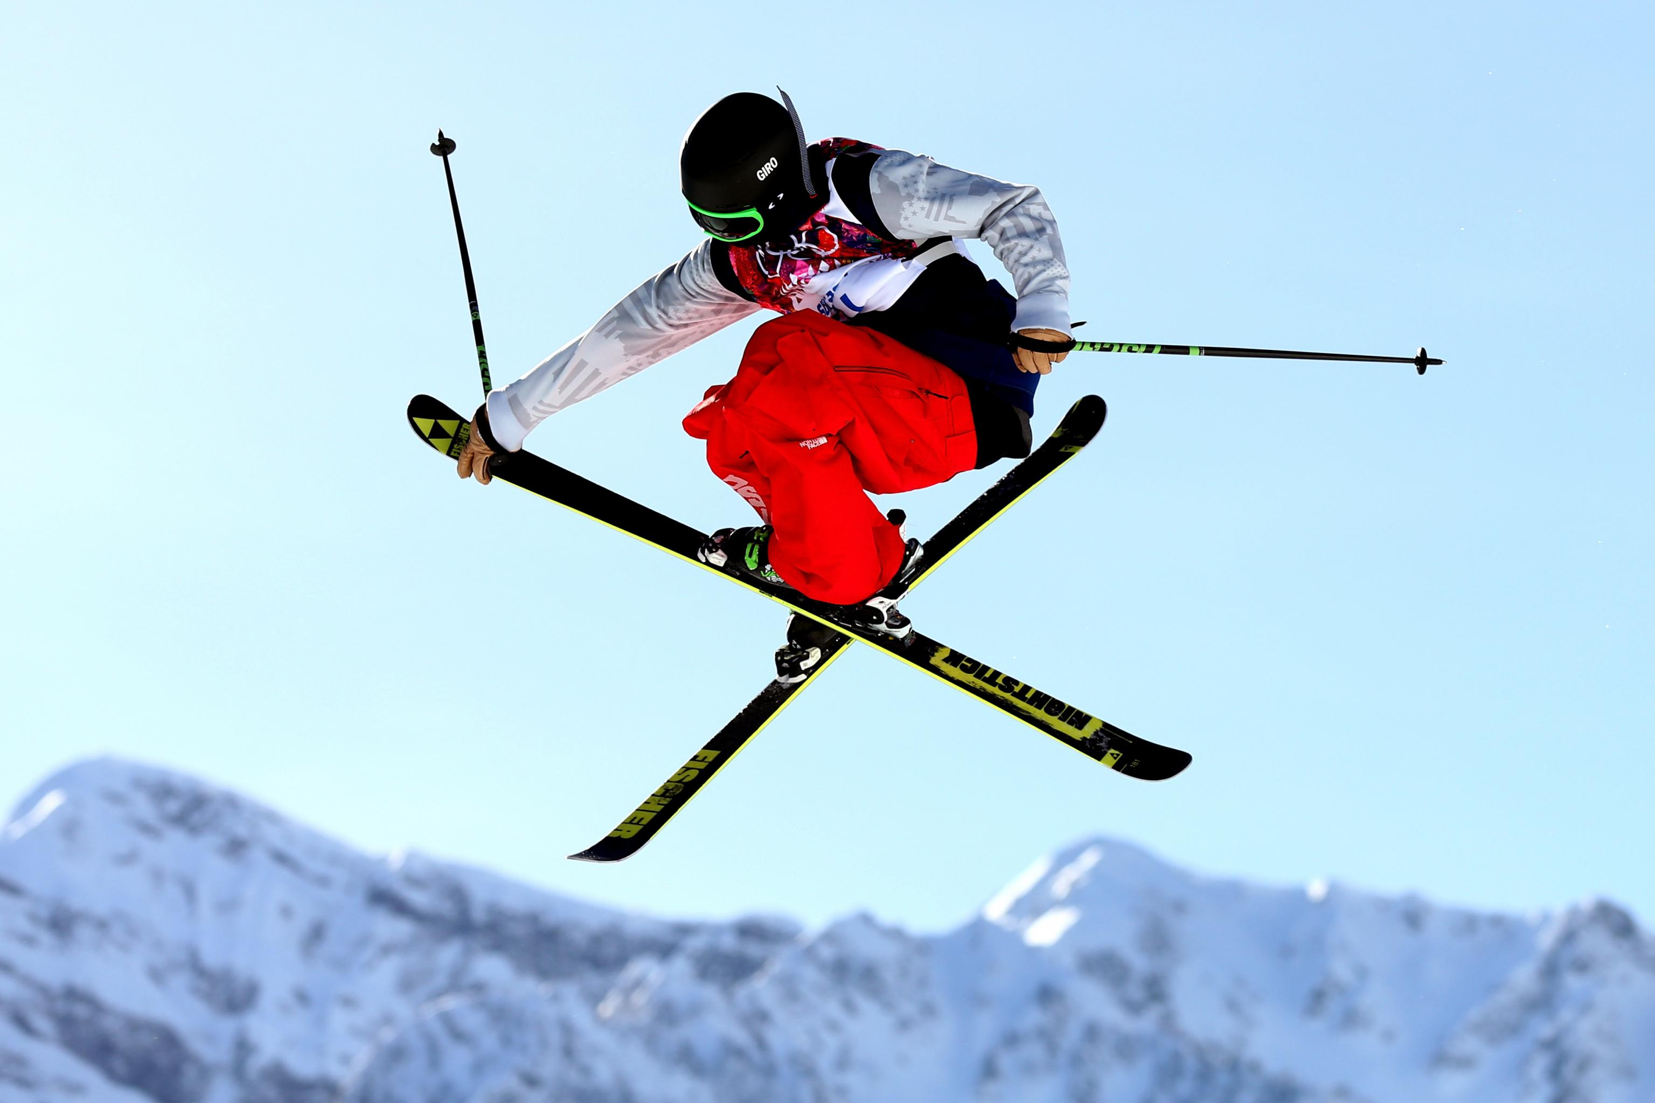
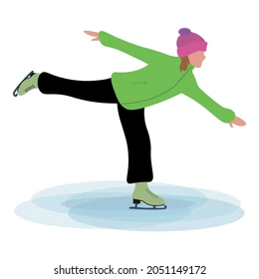
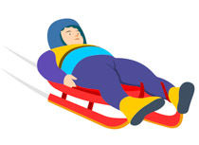
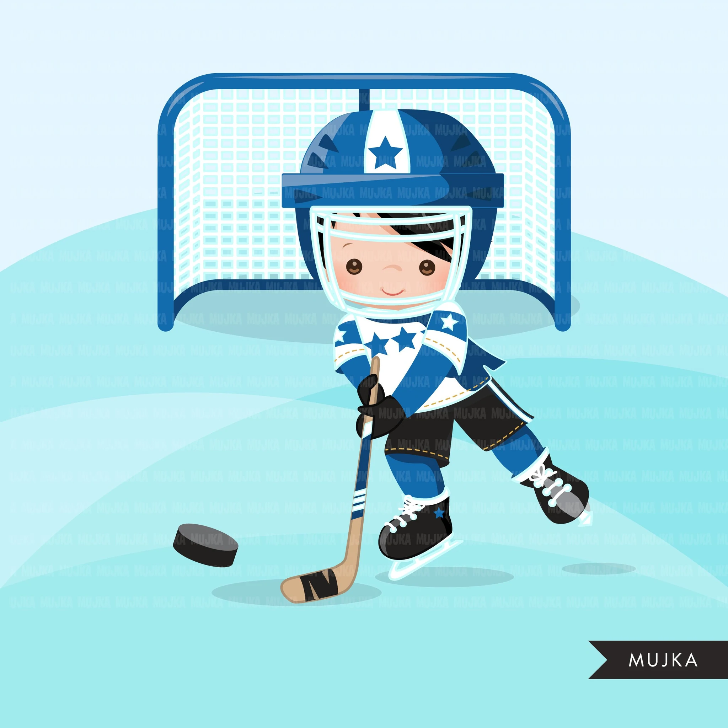
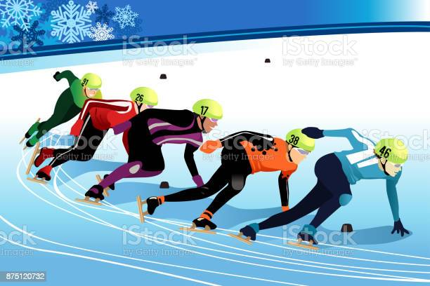
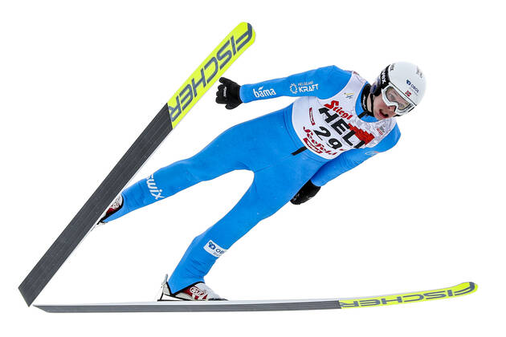
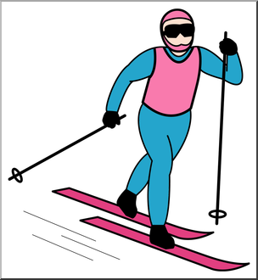
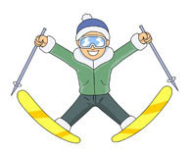
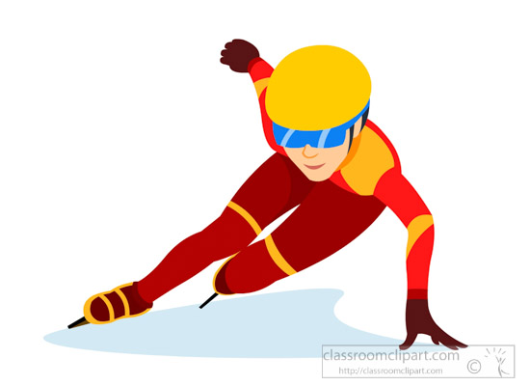

Winter sports
Bobsleigh
Biathlon
Alpine skiing
Freestyle skiing
Luge
Ice hockey
Figure skating
Speed skating
Short track
Nordic combined
Cross-country skiing
Ski jumping

Slide 6

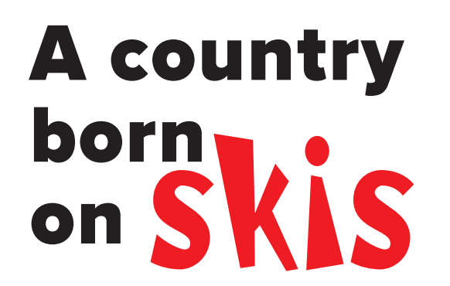
Warm up!
what do you think “a country born on skis” mean ?
It means that most Norwegians learn to ski from a very young age and therefore it becomes as natural as cycling or running.

Slide 7
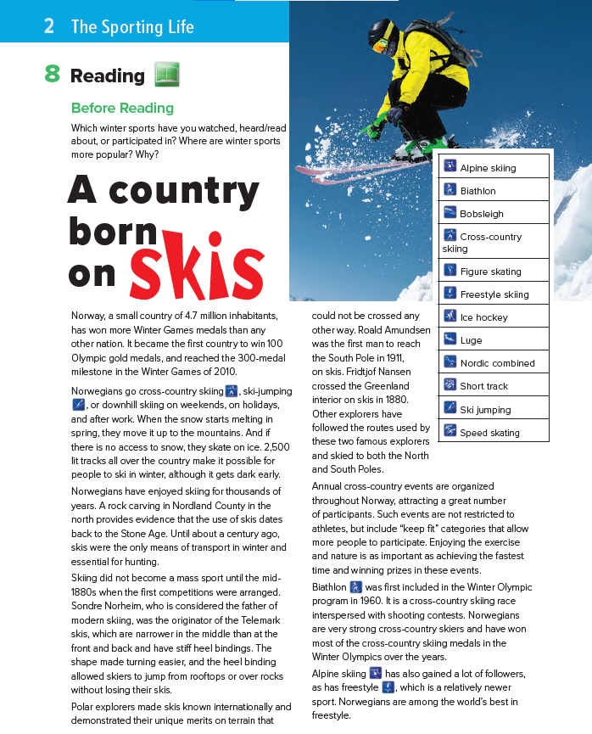

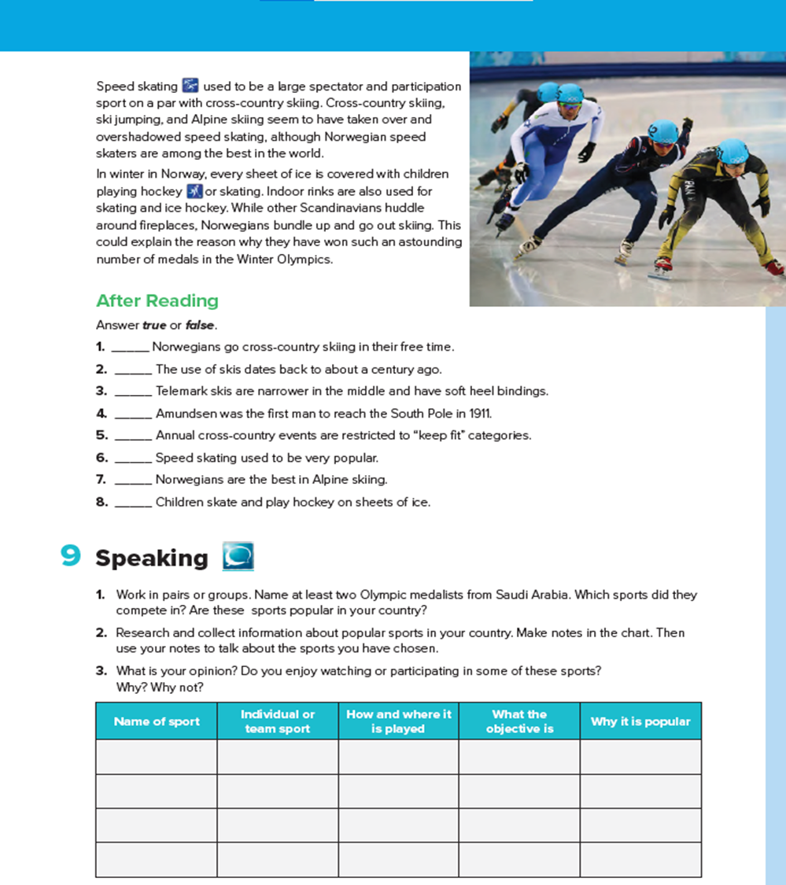

Book Open
pages.(26- 27)

Slide 8
8
9
What is the title of the text?
1
A country born on skis
2
5
How many paragraphs are there
3
6
9 paragraphs
7
4

Slide 9
Reading Strategy
Timed reading

Slide 10

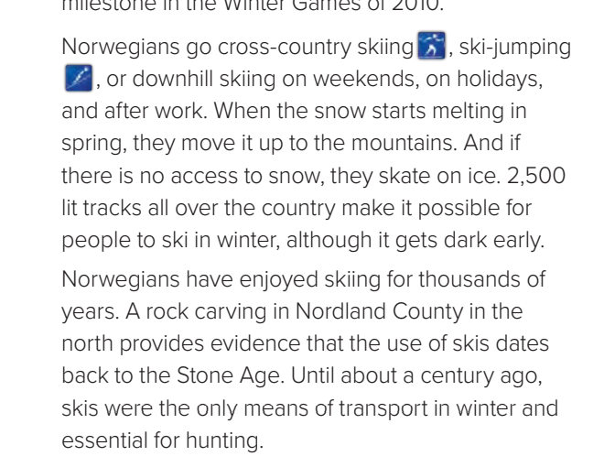
READING STRATEGY Timed Reading
When do Norwegians go cross-country skiing?
What do they do if there is no access to snow?
Is it possible for people to ski in winter in the dark?
How important were skis a century ago?

Slide 11
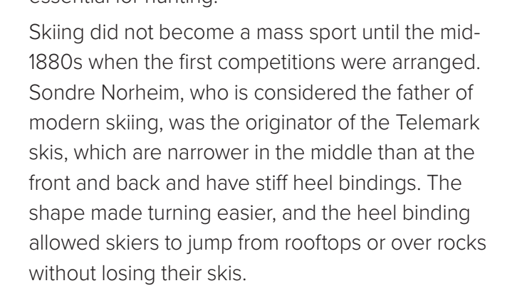
READING STRATEGY Timed Reading
Who is considered to be the father of modern skiing?
What was important about the Telemark skis?

Slide 12

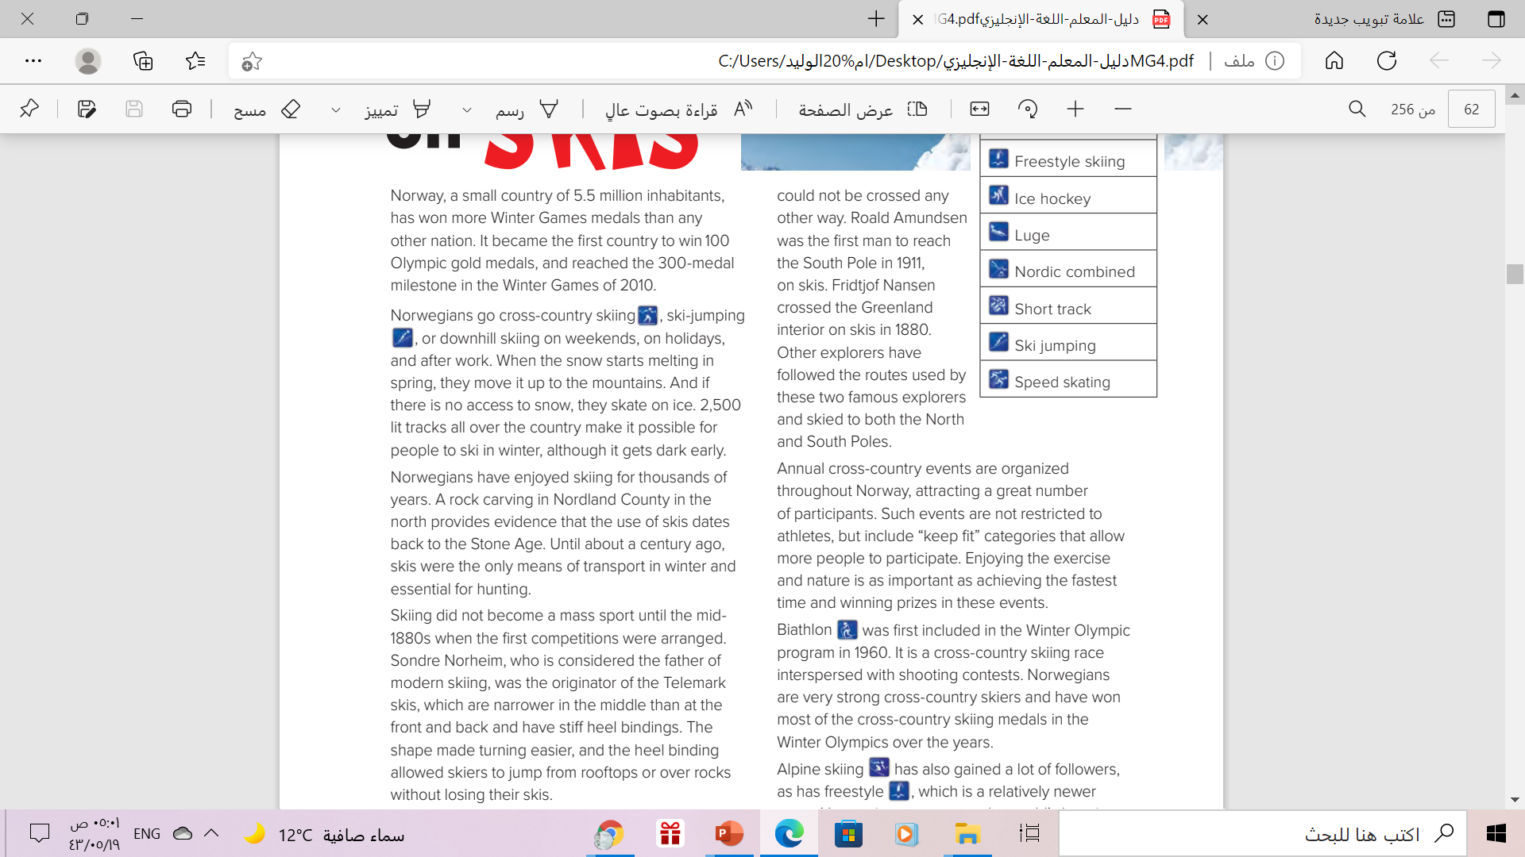
READING STRATEGY Timed Reading
Who was the first man to reach the South Pole?
Is Biathlon an Olympic sport?
Which country has won most of the Olympic medals in cross-country skiing?
Norway

Slide 13
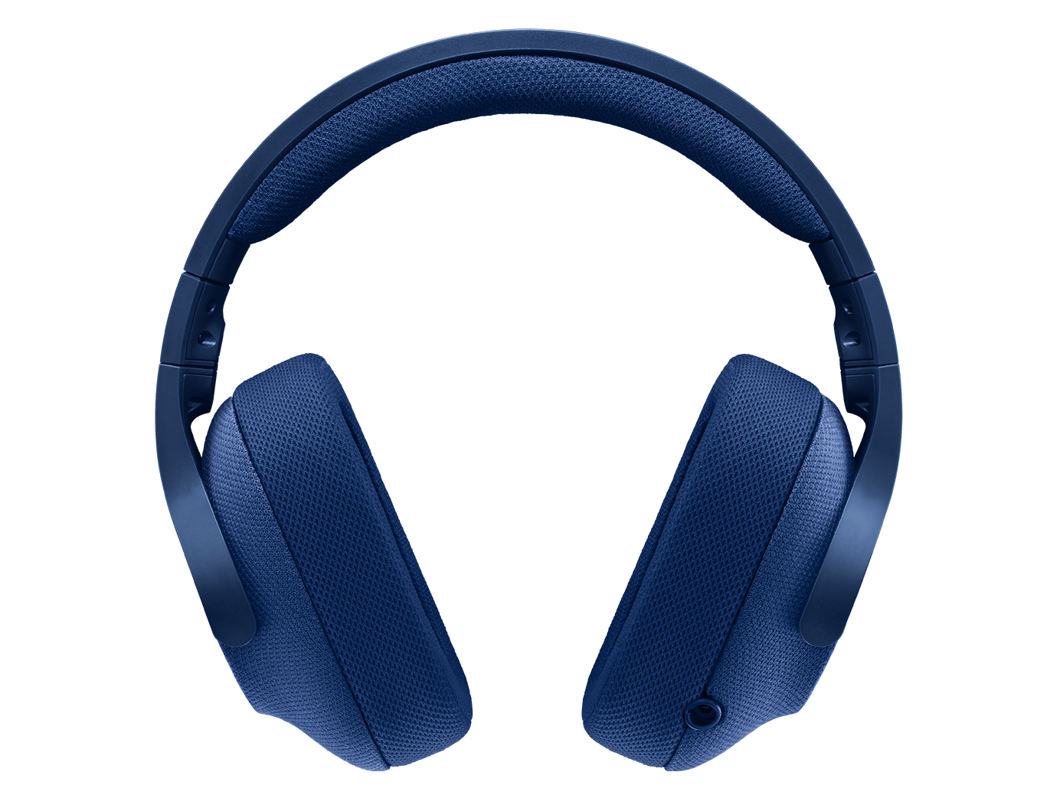

Read along as you listen
pages.(26- 27)

Slide 14




Slide 15
Awesome words
Look at the words in Vocabulary Building on page 25. Find and underline the words in the reading.

Slide 16
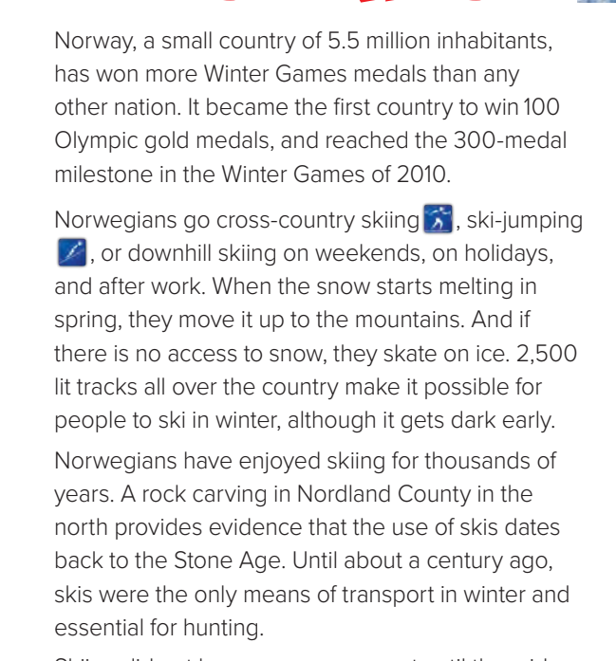
Book Open

Slide 17
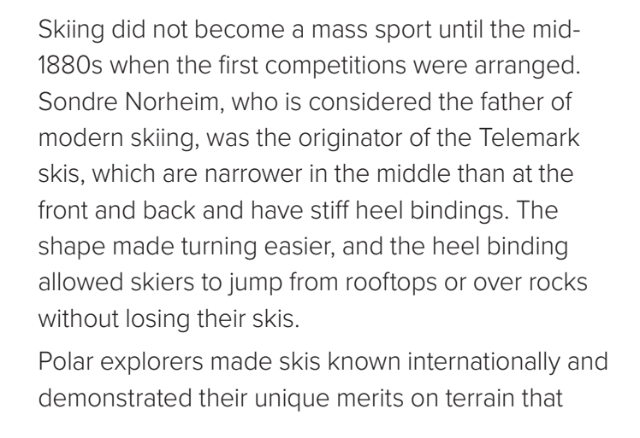
Book Open

Slide 18
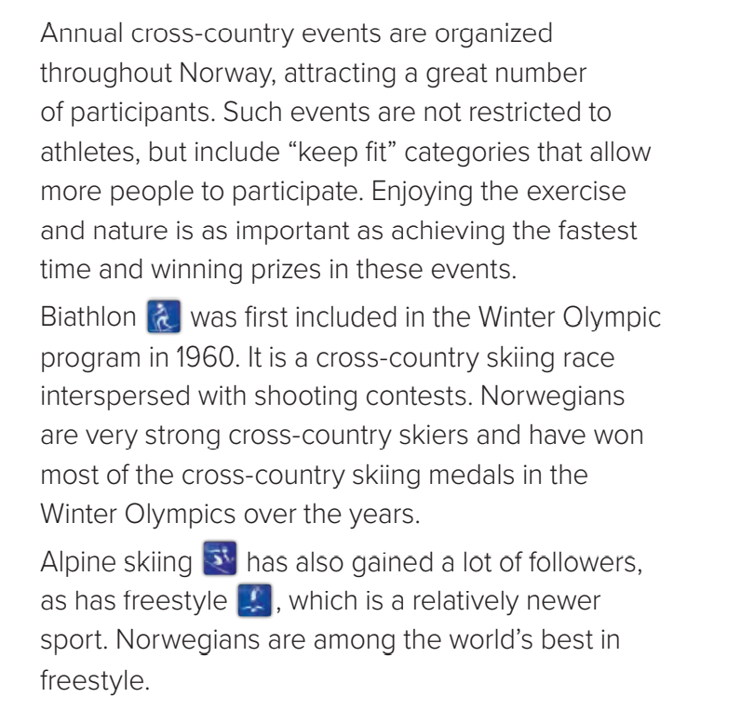
Book Open

Slide 19
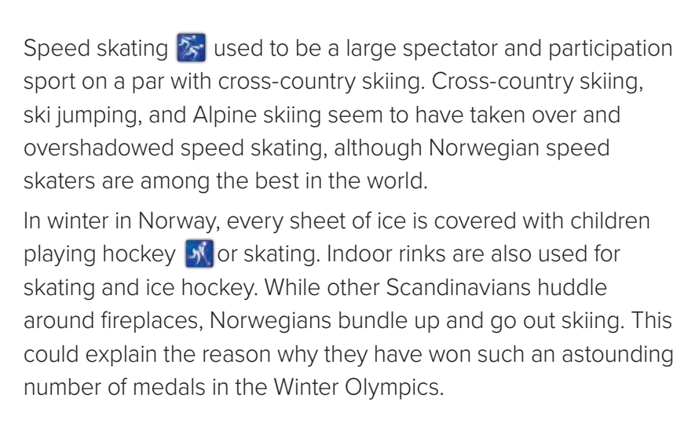
Book Open

Slide 20


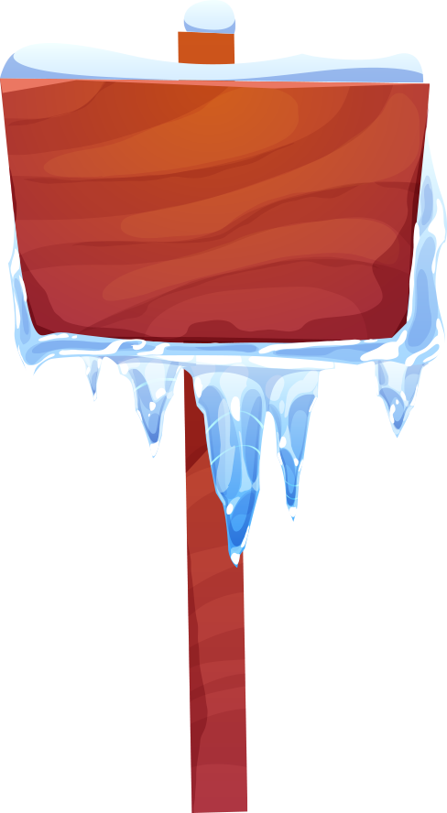
Book Open
Page ( 27 )

Slide 21
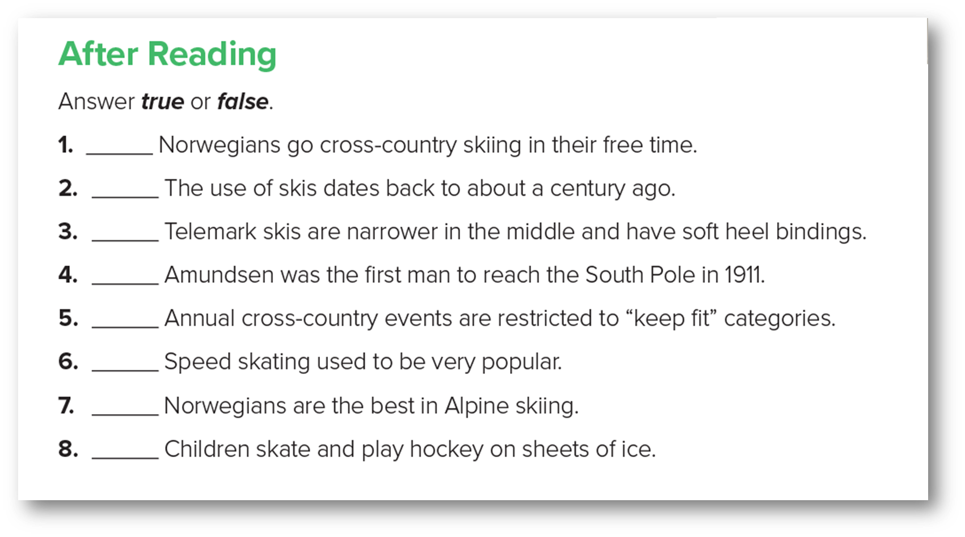

After Reading
True
False
False
True
False
True
False
True

Slide 22
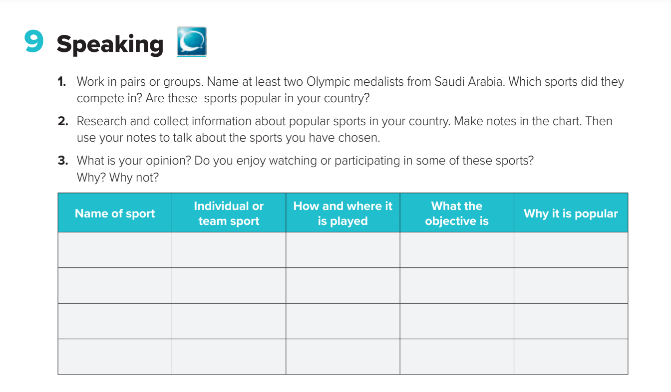

Slide 23

Remember

Slide 24
Home work
Workbook
Page ( 15 ) , exercise
( I )

Slide 25

Thanks!

