Slide 1
Unit 1
There is No Place Like Home
Reading
Mega Goal 4
Done by: Entisar Al-Obaidallah

Slide 2
Lesson Goals
01
02
03
Discuss
Read
Answer
04
05
06
Match
Complete
Talk
the topic of Vision 2030 Kingdom of Saudi Arabia
the text for specific information
Some comprehension questions correctly
the words with their meanings correctly
Chart about an imaginary family in your city/town in 2030.
about the advantages of
2030 vision

Slide 3
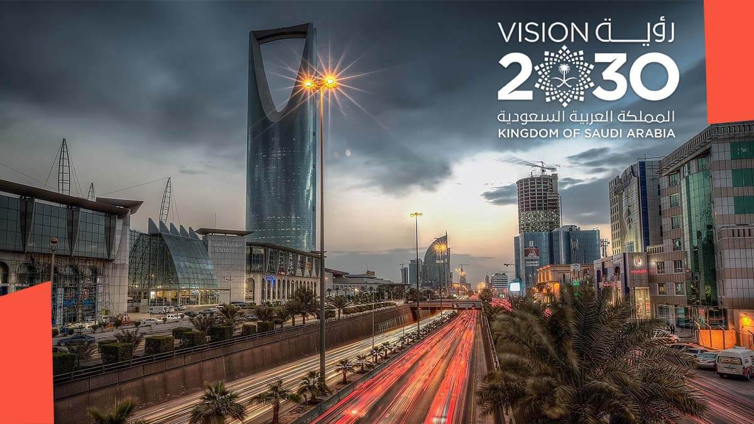

Whose idea is Saudi vision 2030?
Crown Prince Muhammad Bin Salman
What are the three bases of the vision?
Society , people & Economy
When will the vision be achieved?
By 2030

Slide 4


Book Open
page.(10)

Slide 5
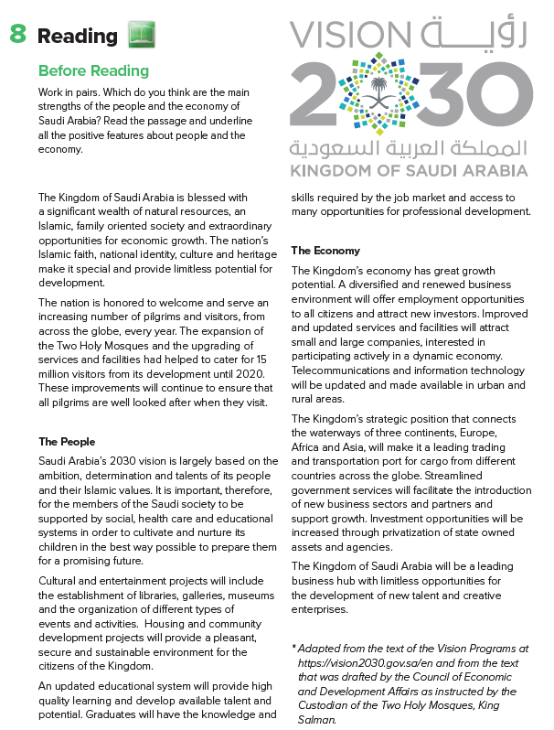
1
How many subtitles are there ?
Two titles
2
6
What are they?
7
The people and The Economy
3
How many paragraphs re there ?
8
4
8 paragraphs
5

Slide 6
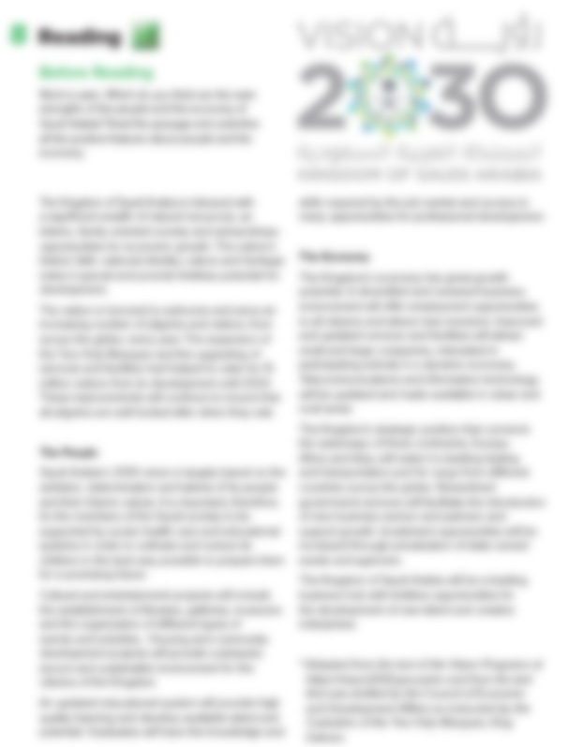


Read along as you Listen

Slide 7
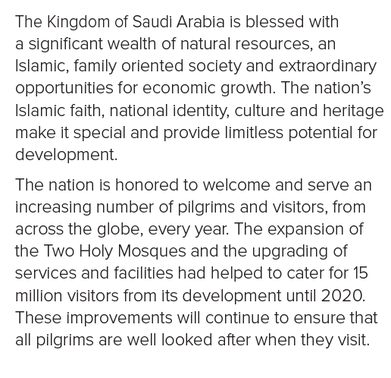

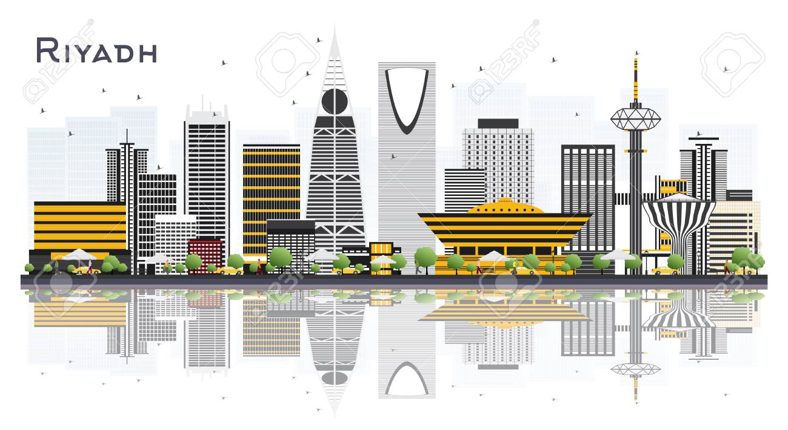
1
Which factors make the Kingdom of Saudi Arabia special?
2
How many visitors did the expansion of Two Holy Mosques provide with in 2020?

Slide 8
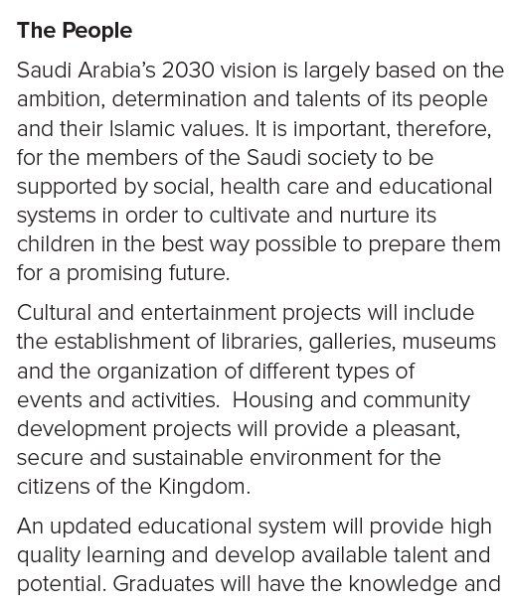







3
What is Saudi Arabia’s 2030 vision based on?
4
What will cultural and entertainment projects include?
5

Slide 9
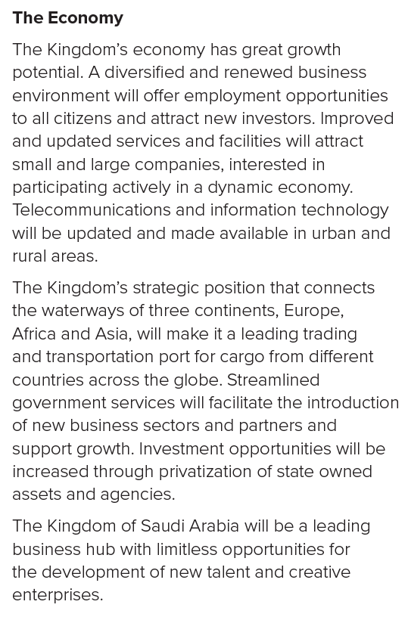



6
How will the renewed business environment benefit the Economy?
7
How will streamlined government services benefit business?
8

Slide 10



Slide 11
A word means
very important
What is significant in the text?
words means
non-ending ability
What kind of potential is it?
A word means
provide with

Slide 12
Wat does
“cultivate and nurture its children” mean?
STRENGTHS
(devote time, thought and attention to developing the right attitudes and values)
A word means
to be maintained for a long period of time

Slide 13


A word means
different; various
A word means
properties of certain value

Slide 14
Book Open
page.(11)

Slide 15
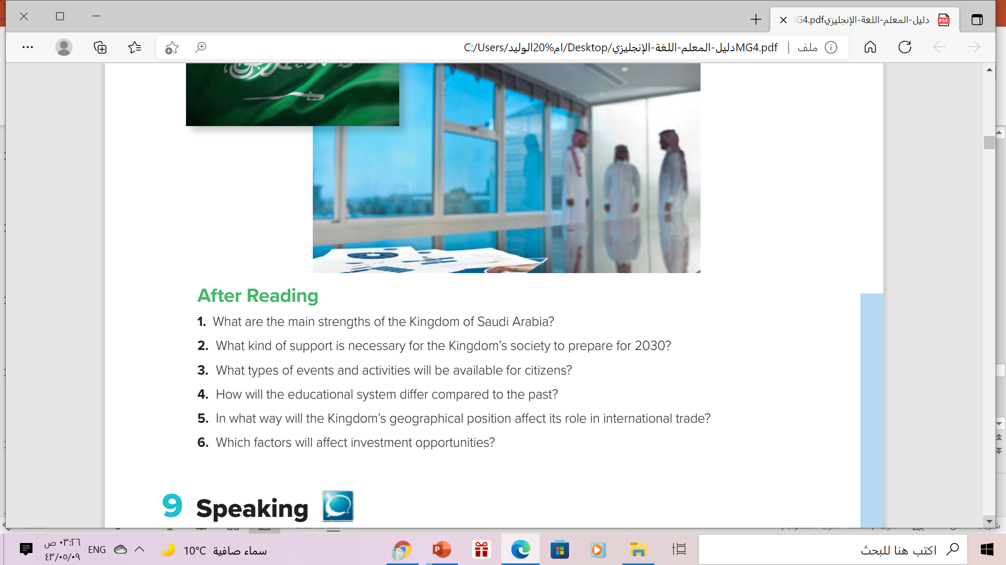
1
wealth of natural resources, its Islamic, family oriented society, its strategic position and opportunities for economic growth.
4
It will be updated to provide high quality learning and develop available talent and potential. It will provide the knowledge and skills required by the job market.
2
social, health care and educational systems that will help it raise its children in the best way possible to prepare them for the future.
5
5. The Kingdom’s position connects the waterways of three continents, Europe, Africa and Asia. This give it a unique advantage as a trading and transport hub.
6
a)streamlined government services
b) the privatization of state owned assets and agencies.
3
Cultural and entertainment events, libraries, galleries, museums, community projects.

Slide 16
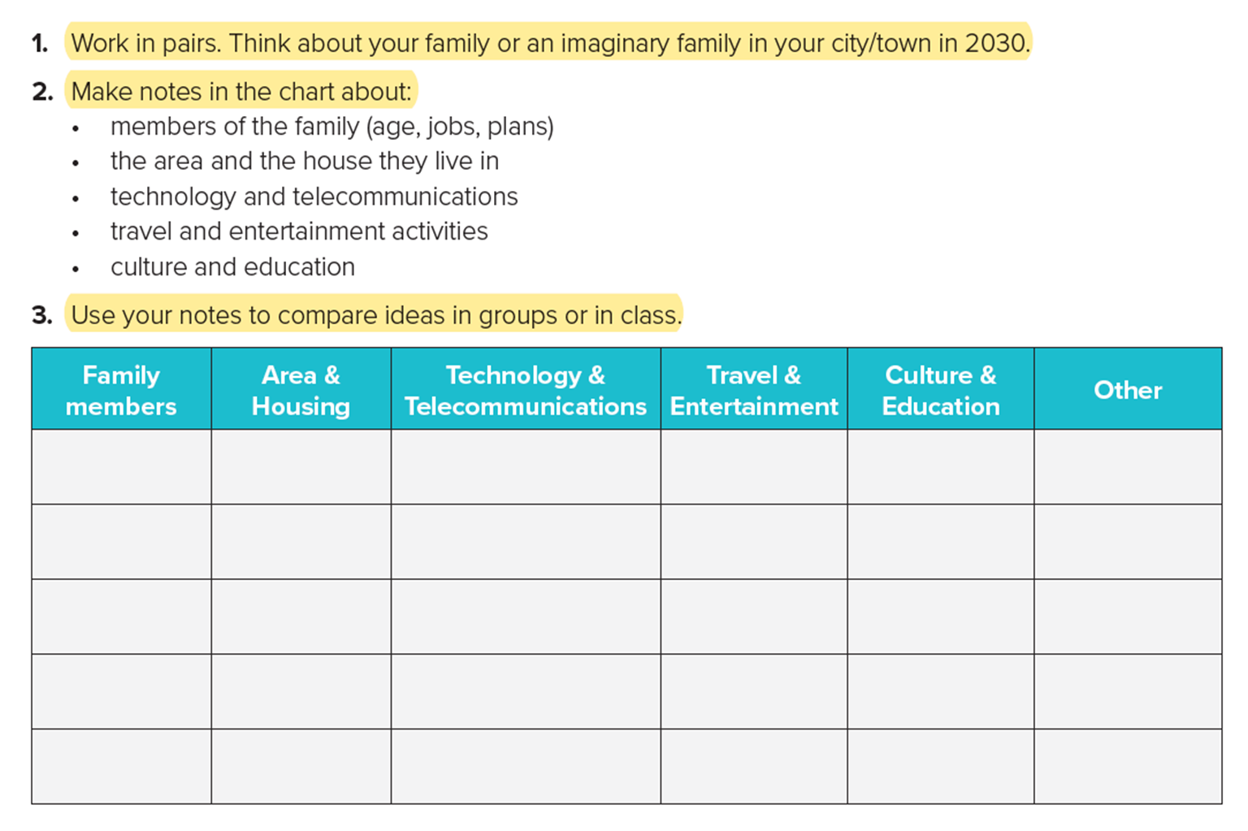

Slide 17


Slide 18
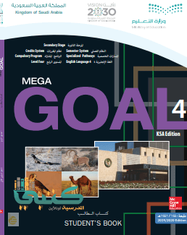
Homework
page.(5), exercise ( j)

Slide 19

THANKS
Have
a nice
day

