Slide 1
Unit4
The Sporting Life
Mega Goal 2.2
writing
Done by: Entisar Al-Obaidallah

Slide 2
Lesson Objectives
Analyze
Write
01
02
Label
Organize
03
04
a text to its main points correctly
notes about a sport correctly
the parts of the ice hockey rink correctly
Sport / activity steps correctly

Slide 3

Open
Student’s book , p.(52)

Slide 4
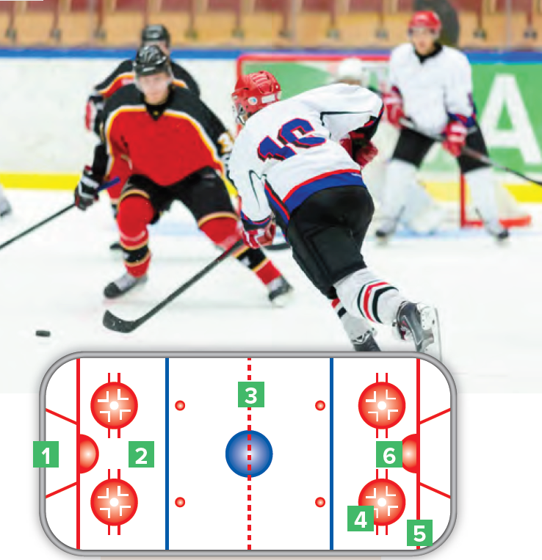
Warm up
Can you guess the sport?
Ice hockey
Where is ice hockey played on?
on an ice-skating rink with lines .
Do you know how ice hockey is played ?
Two opposing teams use ice hockey sticks to control and shoot a closed rubber disc called a ‘’ puck ‘’ into the other team’s goal .

Slide 5
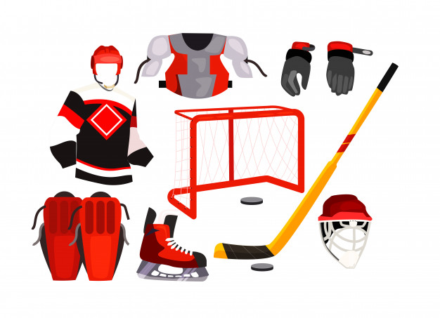
Warm up
Can you name these equipment?
Shoulder pads
gloves
jersey
stick
net
puck
Knee pads
helmet
skate

Slide 6
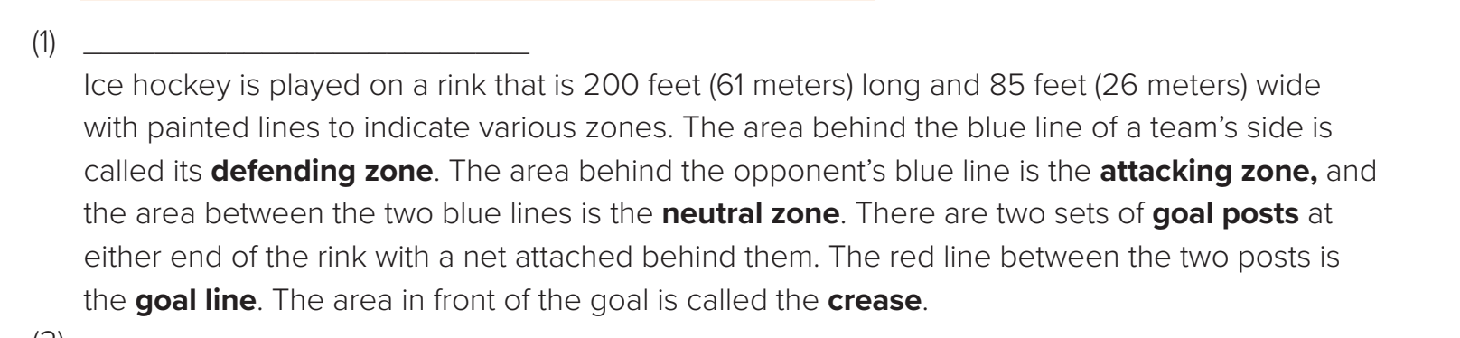
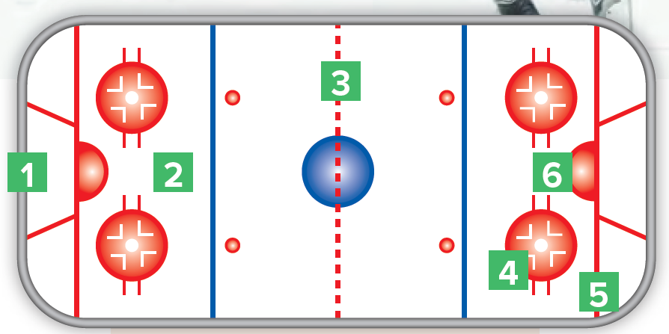
Read and Label the different parts of the ice hockey rink
(your team is on the left).
goal post
defending zone
the neutral zone
the attacking zone
the goal line
the crease

Slide 7
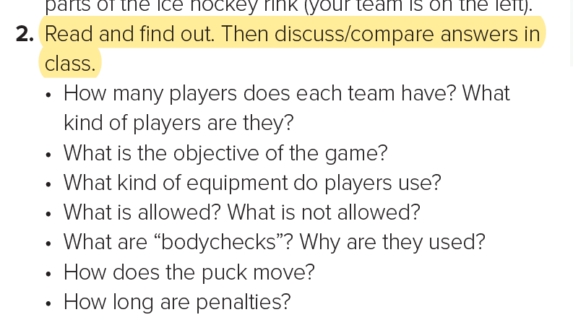
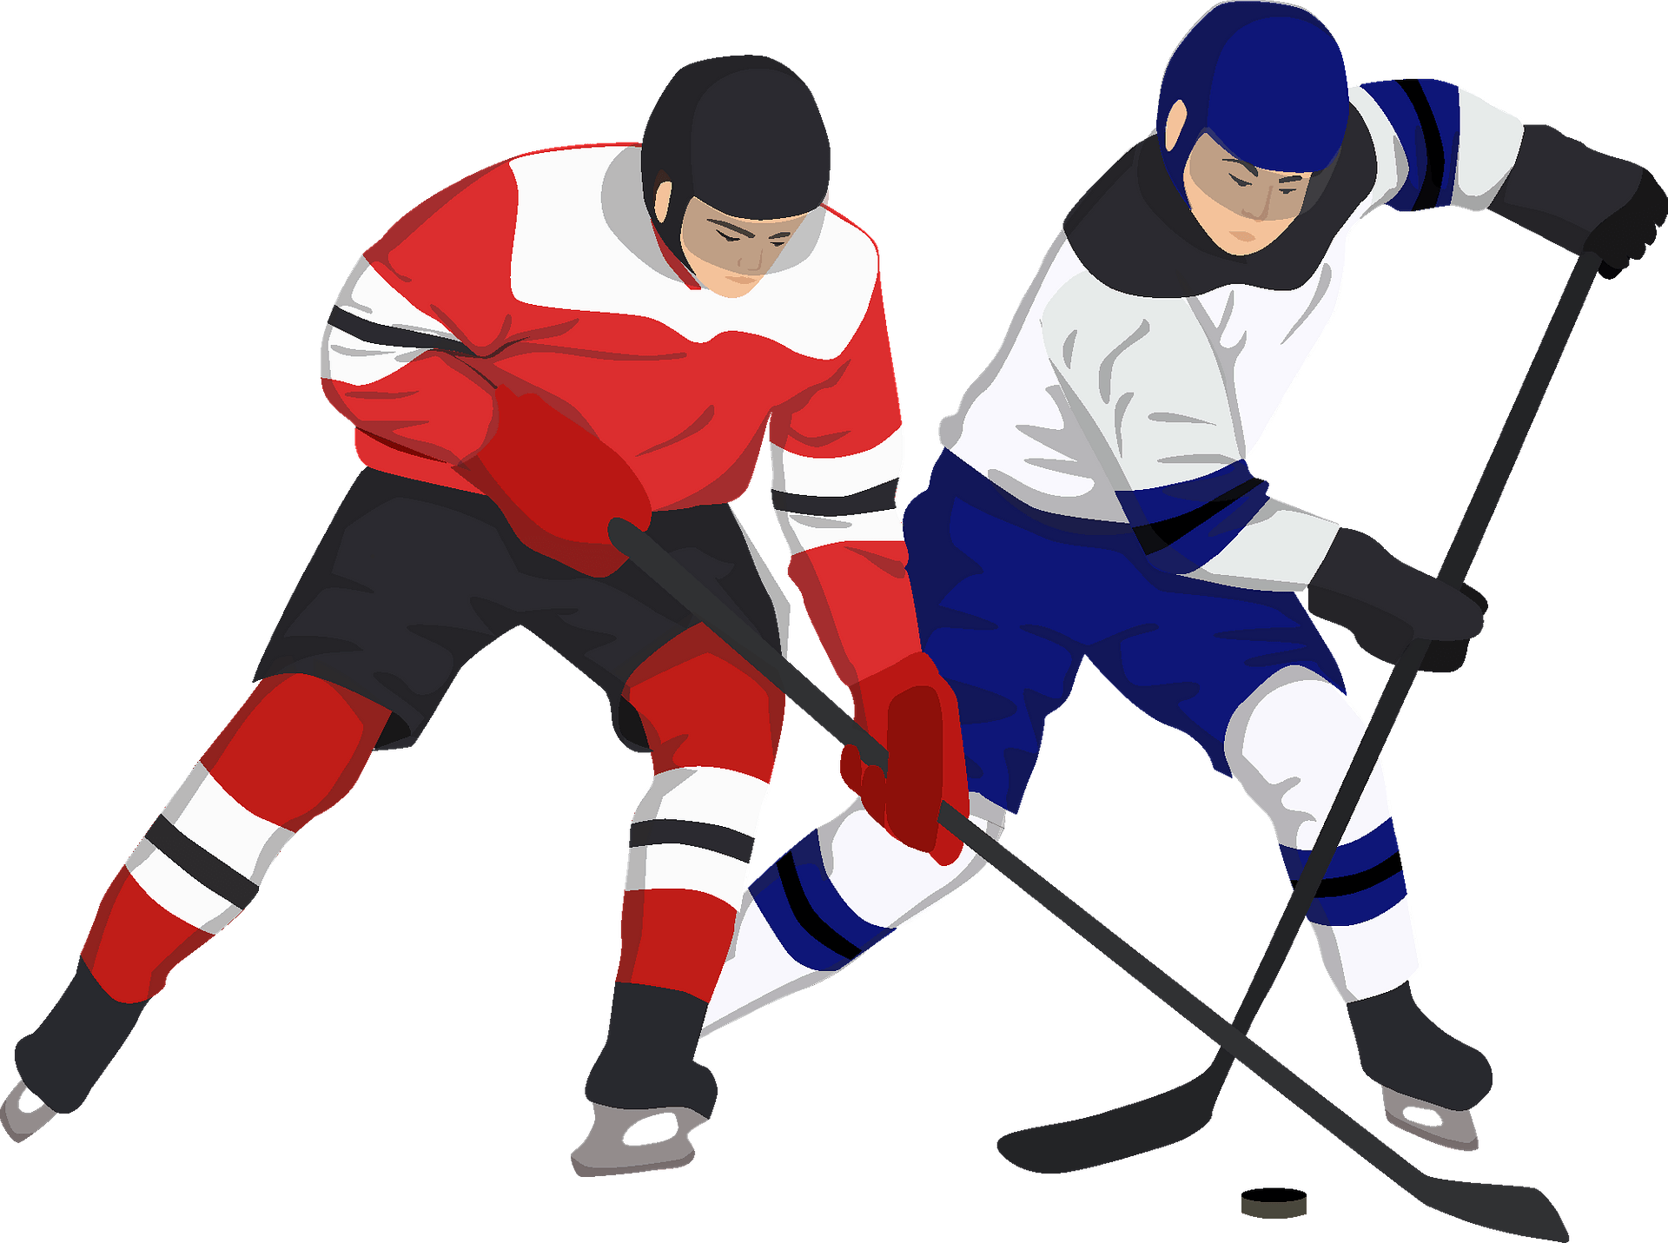
1- Each team has six players; three forwards, two defensemen and a goaltender.
2- to score goals by shooting the puck into the opponent’s net.
3- a stick, a helmet and padding
4- Players are not allowed to use their hands in order to redirect the puck unless they are in the defensive zone. They may redirect it with any other part of their body but not kick it.
5- “bodychecks” are moves that involve pushing opponents against the boards that surround the rink.
6- The puck is pushed with a stick by players towards the opponent’s net, or redirected with the players’ bodies but neither kicked nor pushed by hand.
7- 2 to 5 minutes

Slide 8
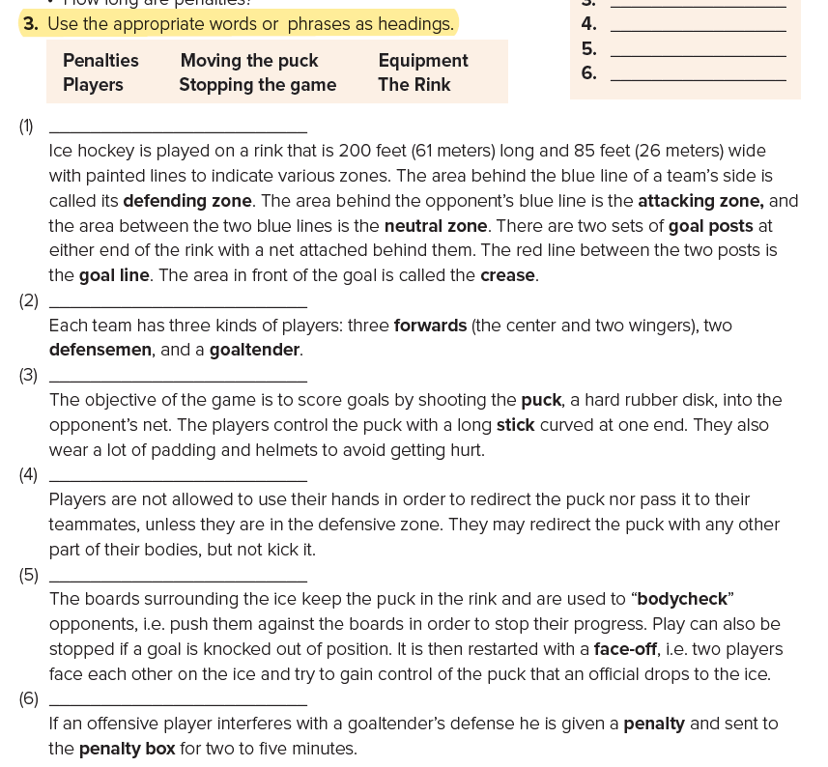


The Rink
Players
Equipment
Moving the puck
Stopping the game
Penalties

Slide 9
Open
Student’s book , p.(53)

Slide 10
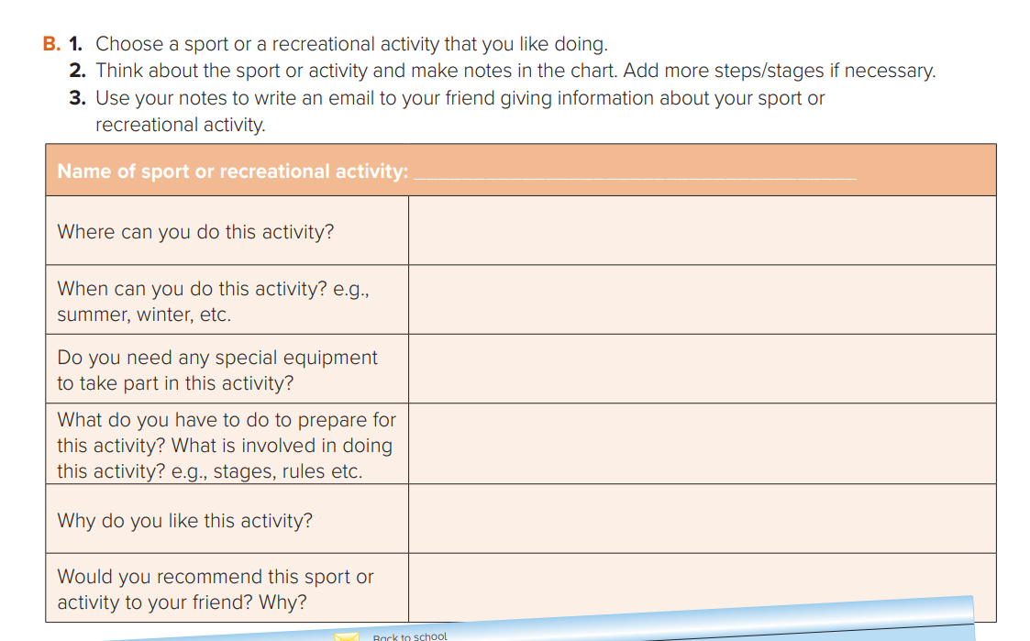
Fishing
At the sea, river and ocean .
Both Summer and winter
Line, bite, net stick
Equipment, boat, spot
Skills and manners
Yes, to learn how to be a good fisher and patient

Slide 11
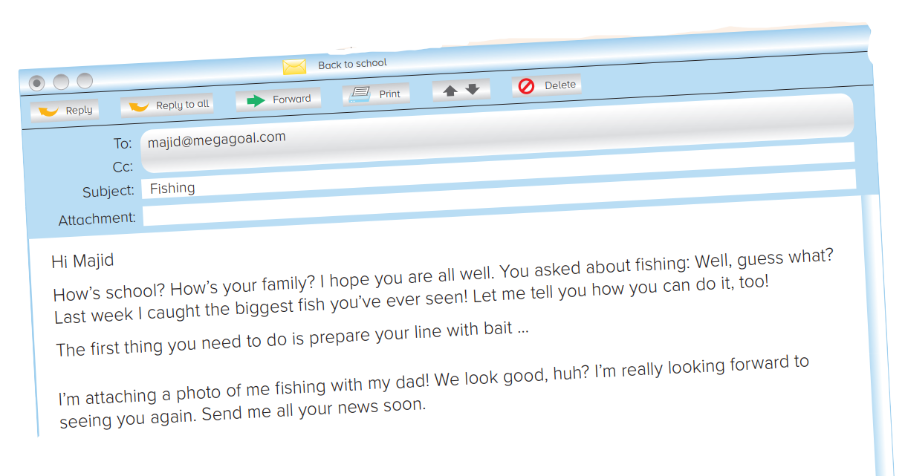
write an email to your friend giving information about your sport or recreational activity.

Slide 12
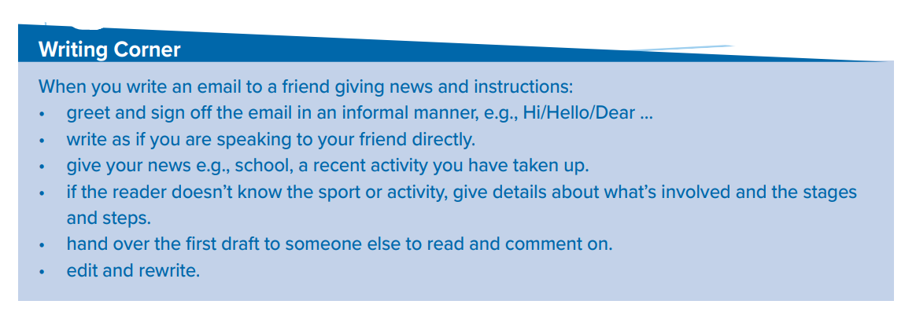
Follow these steps to write email to a friend giving news & instructions

Slide 13

Developments in Saudi Sports following
Saudi Vision 2030
One of the goals of Saudi Vision 2030 is ‘creating a vibrant society with fulfilling lives’ through amongst other things ‘the promotion of physical and social wellbeing and healthy lifestyle’.
Hosting various sporting events comes on top of the most important goals that have been achieved in a short period of time, until Saudi Arabia has become a compass for athletes around the world to participate in events being held in the Kingdom.
we aspire to excel in sports and be among the leaders in selected sports regionally and globally’.

Slide 14

Remember

Slide 15
Homework
Workbook p.(114), exercise (L)

Slide 16

Thanks!

