Slide 1


Unit 5 for Working 9 t0 5
Writing
Mega Goal 2.2
Done by: Entisar Al-Obaidallah

Slide 2
Lesson Goals
01
02
03
04
Complete
Elicit
a job title using giving information.
The main idea of each paragraph
Answer
Write
Some questions about the text
an essay about an unusual job.

Slide 3

Book Open
Pages ( 10-11)

Slide 4
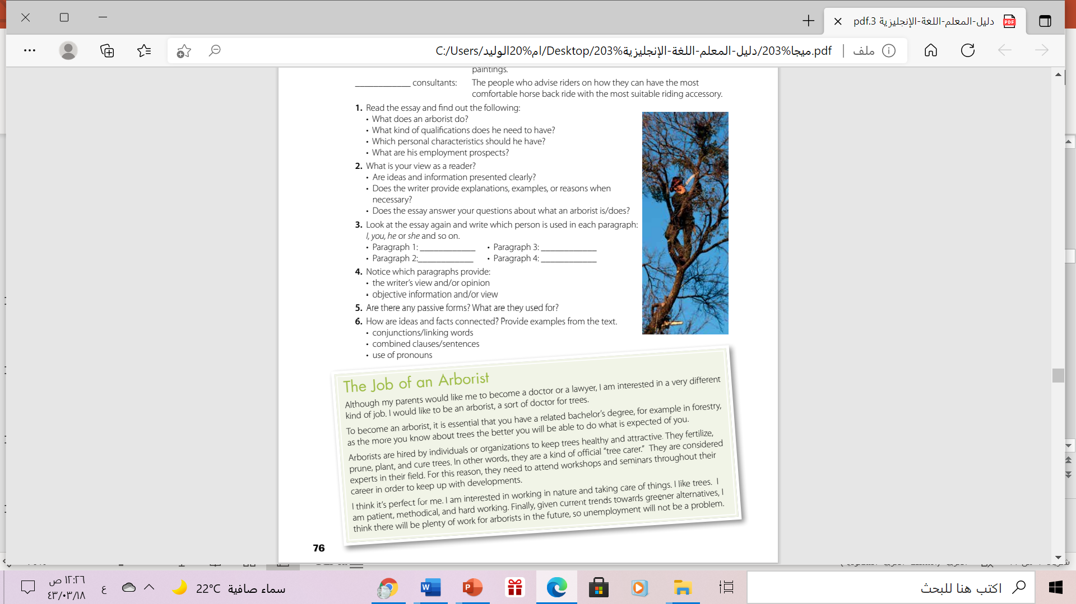
What is the title of the passage?
How many paragraphs are there?
A man on the tree
What does the picture show?
1
2
3
4

Slide 5


Read as long U listen

Slide 6
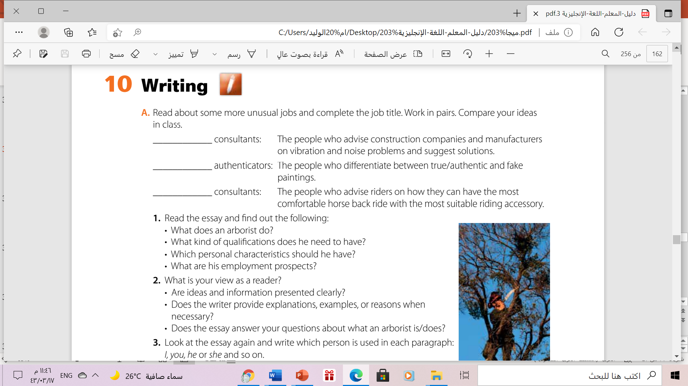
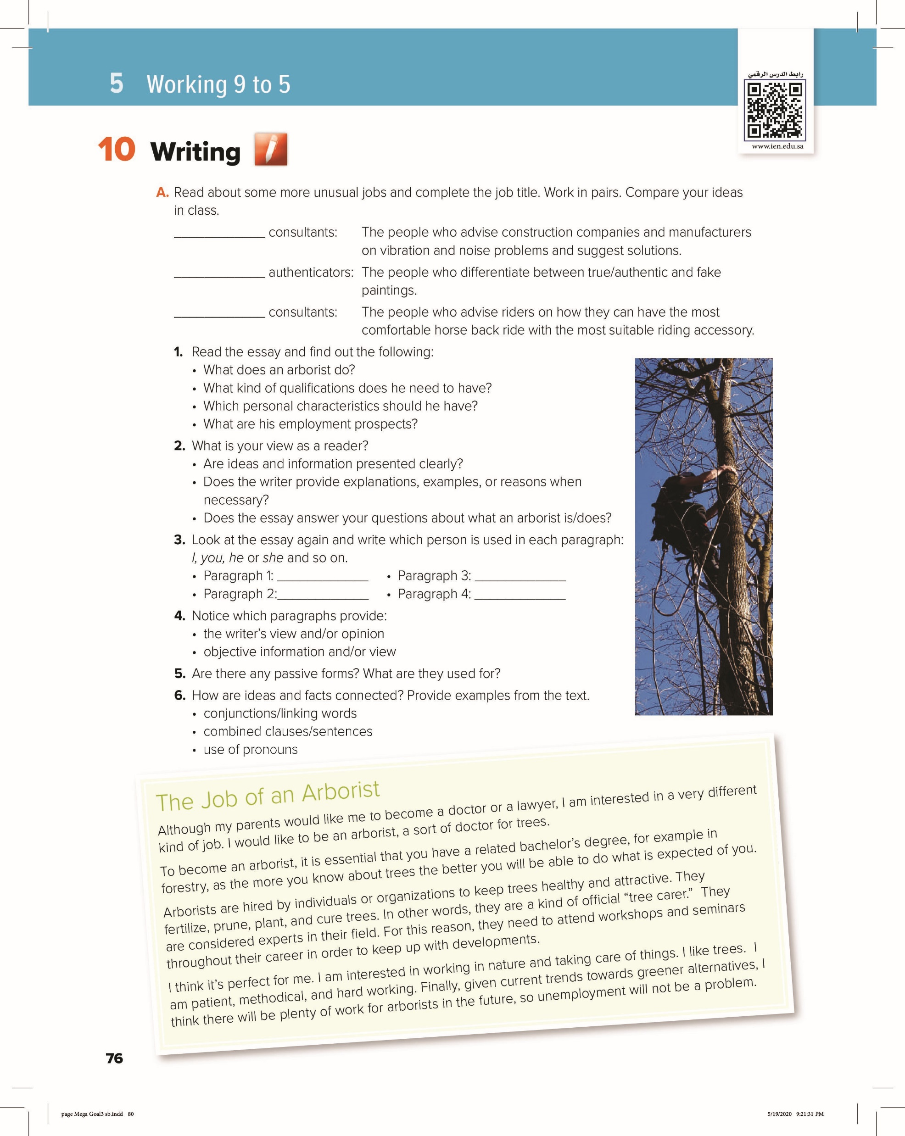
noise
art/ painting
riding

Slide 7



An arborist is a kind of official “tree carer” or tree doctor.
He fertilizes, prunes, plants , and cures trees.
An arborist needs to have a related bachelor’s degree, for example in forestry and attend seminars and workshops throughout his career.
He should be patient, methodical, and hard working. He should also be interested in working in nature and taking care of things
His employment prospects are quite promising due to current trends and greener alternatives.

Slide 8




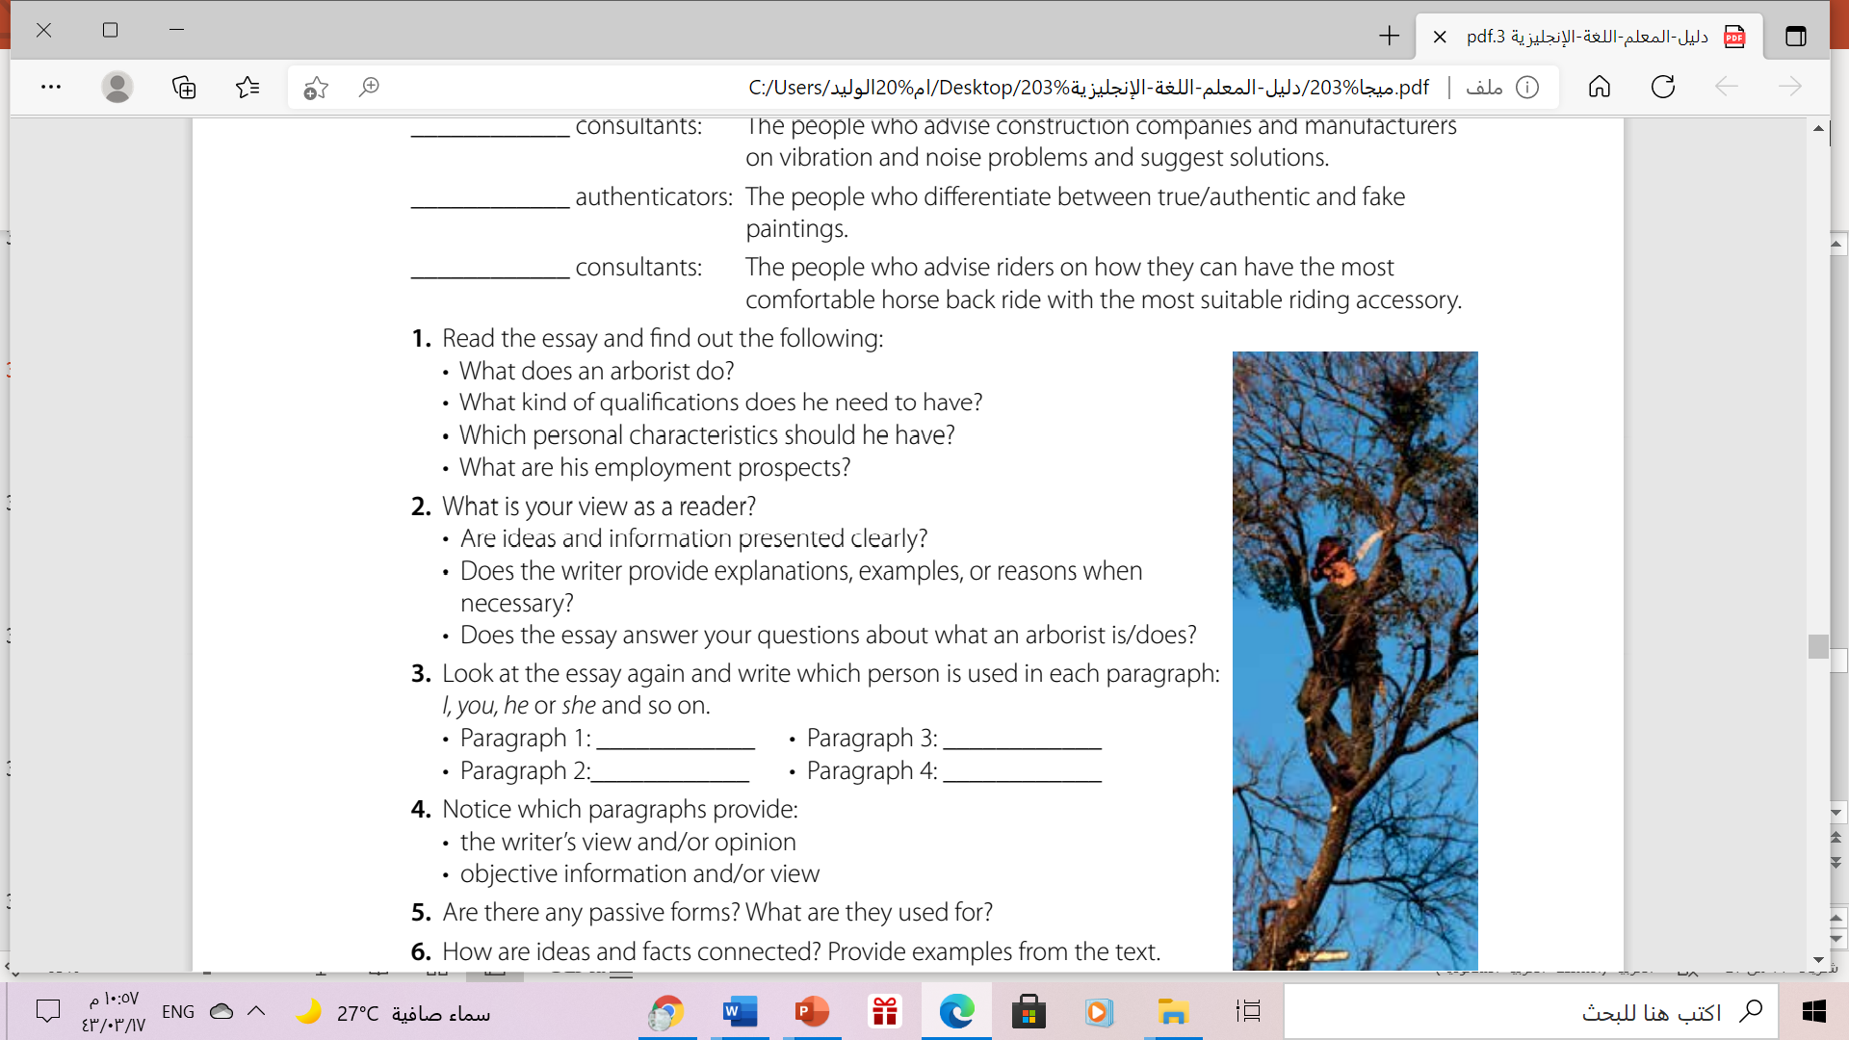
Yes, ideas and information are presented clearly.
Yes, he does. For example, …a related bachelor’s degree, for example in forestry , as the more you know about trees the better you will be able to do what is expected of you.
Yes, it does.

Slide 9
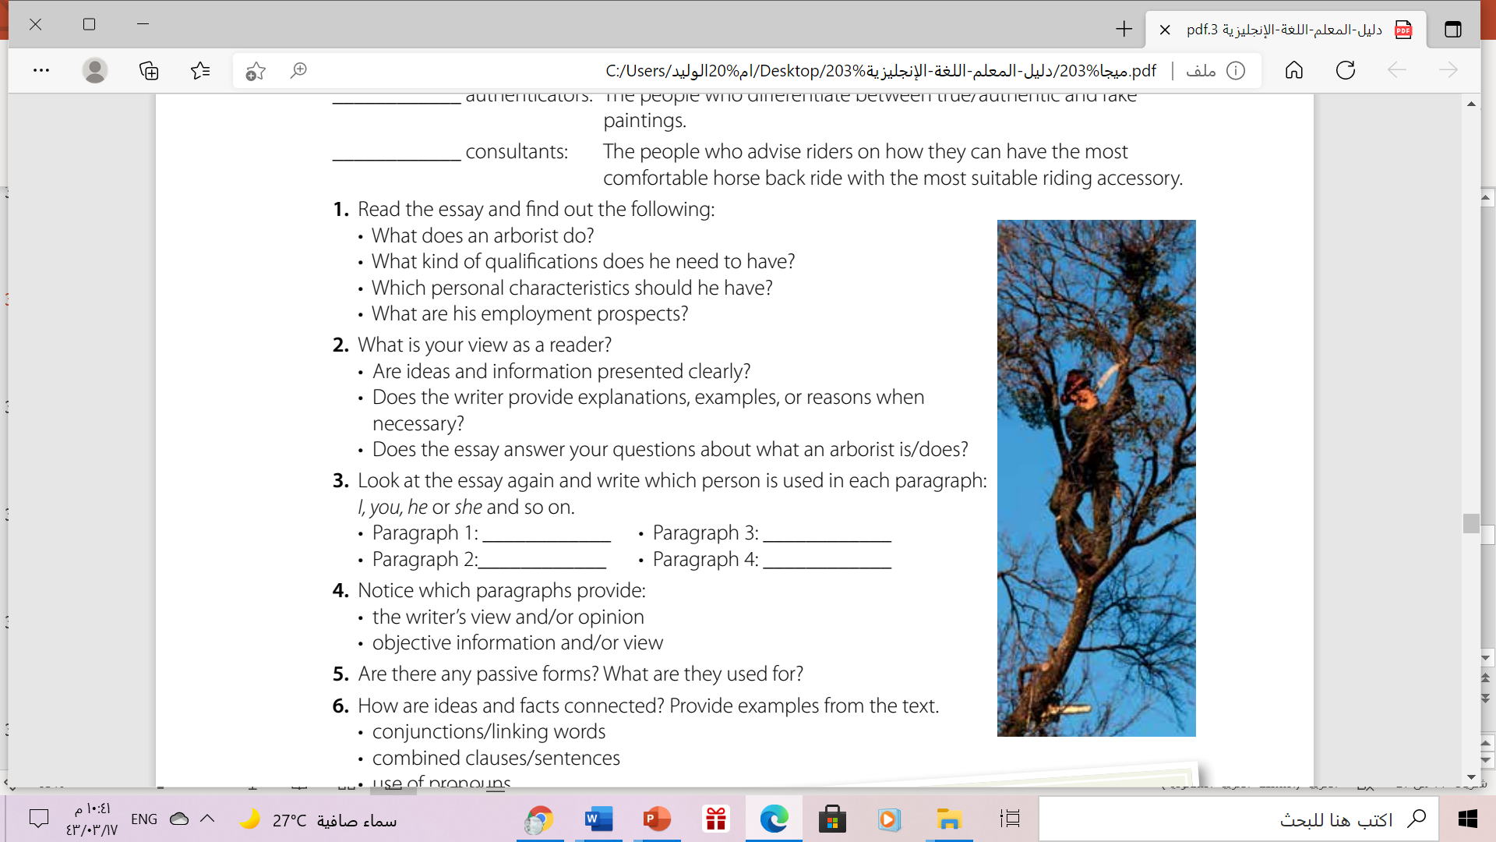
I
Arborists/ They
you (to mean one)
I

Slide 10
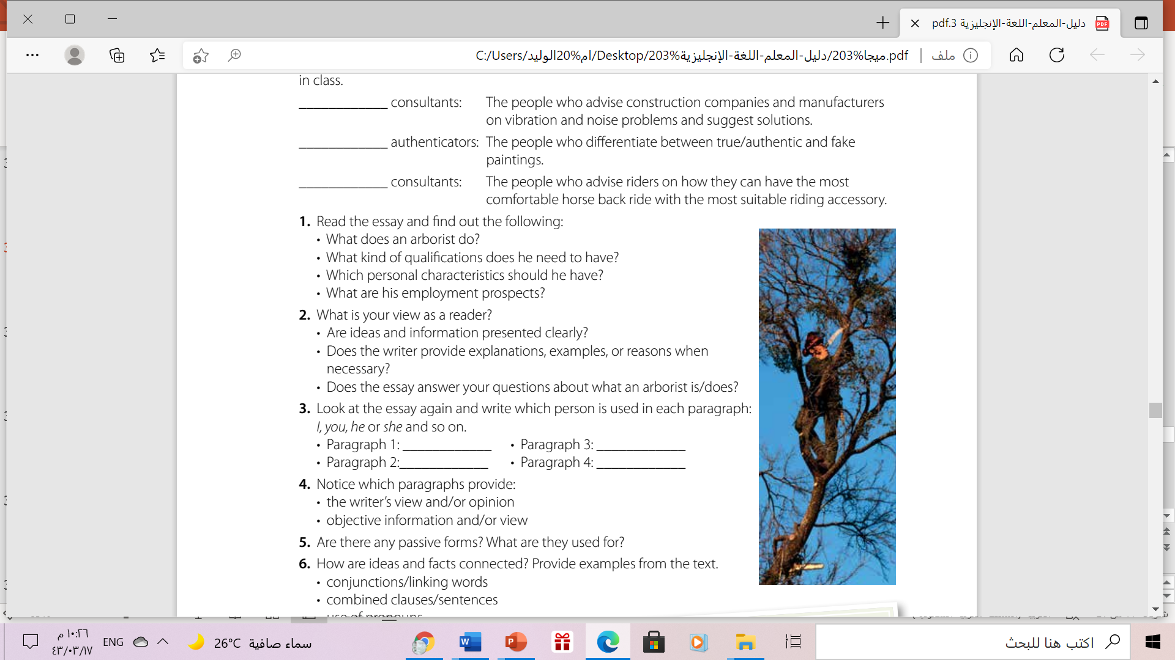
The writer’s view and opinion are presented in paragraphs 1 and 4.
Objective information is presented in paragraphs 2 and 3.

Slide 11
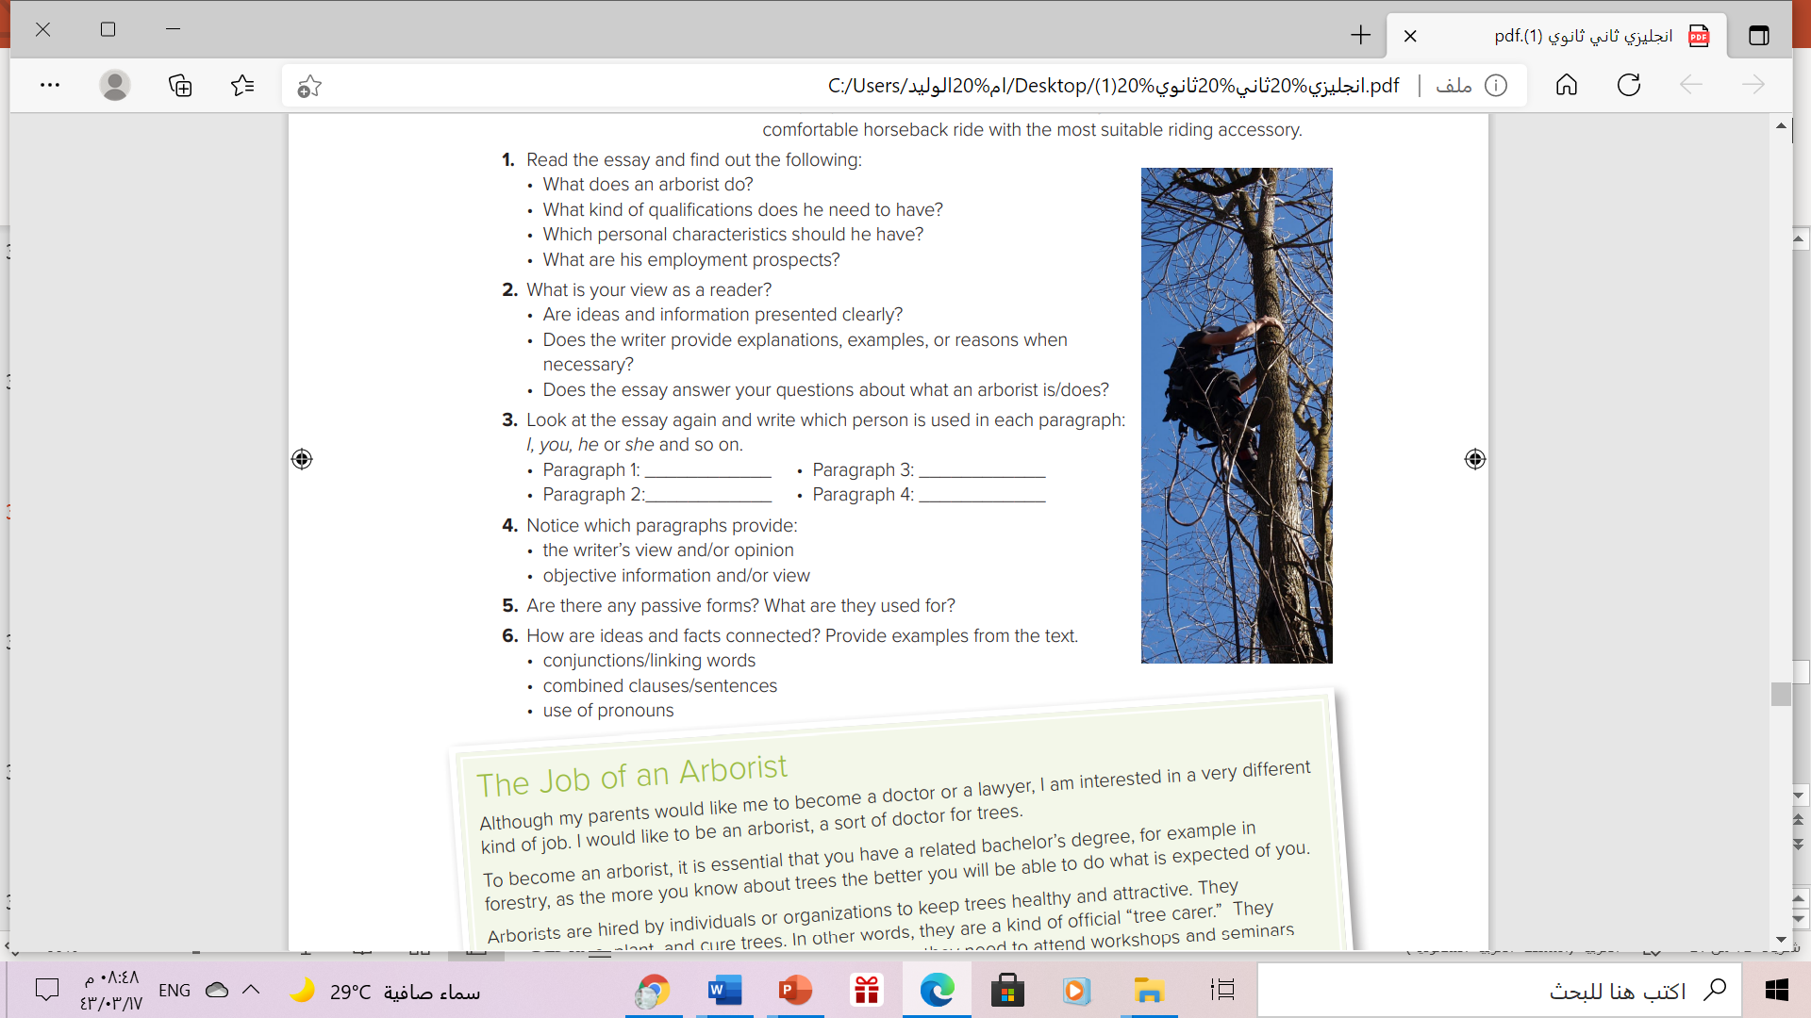
Passive forms are used to present objective/impersonal information
Conjunctions: for example, although, and, in other words
Combined clauses/sentences: to become an arborist, it is essential that …given current trends towards greener alternatives, I think …

Slide 12

Book Open
Page (11), exercise (B)

Slide 13
Writing an opinion essay
Which job? what do you do?
1
Qualifications you need to have
2
3
Information/ reasons/ examples
4
Helpful characteristics/skills

Slide 14
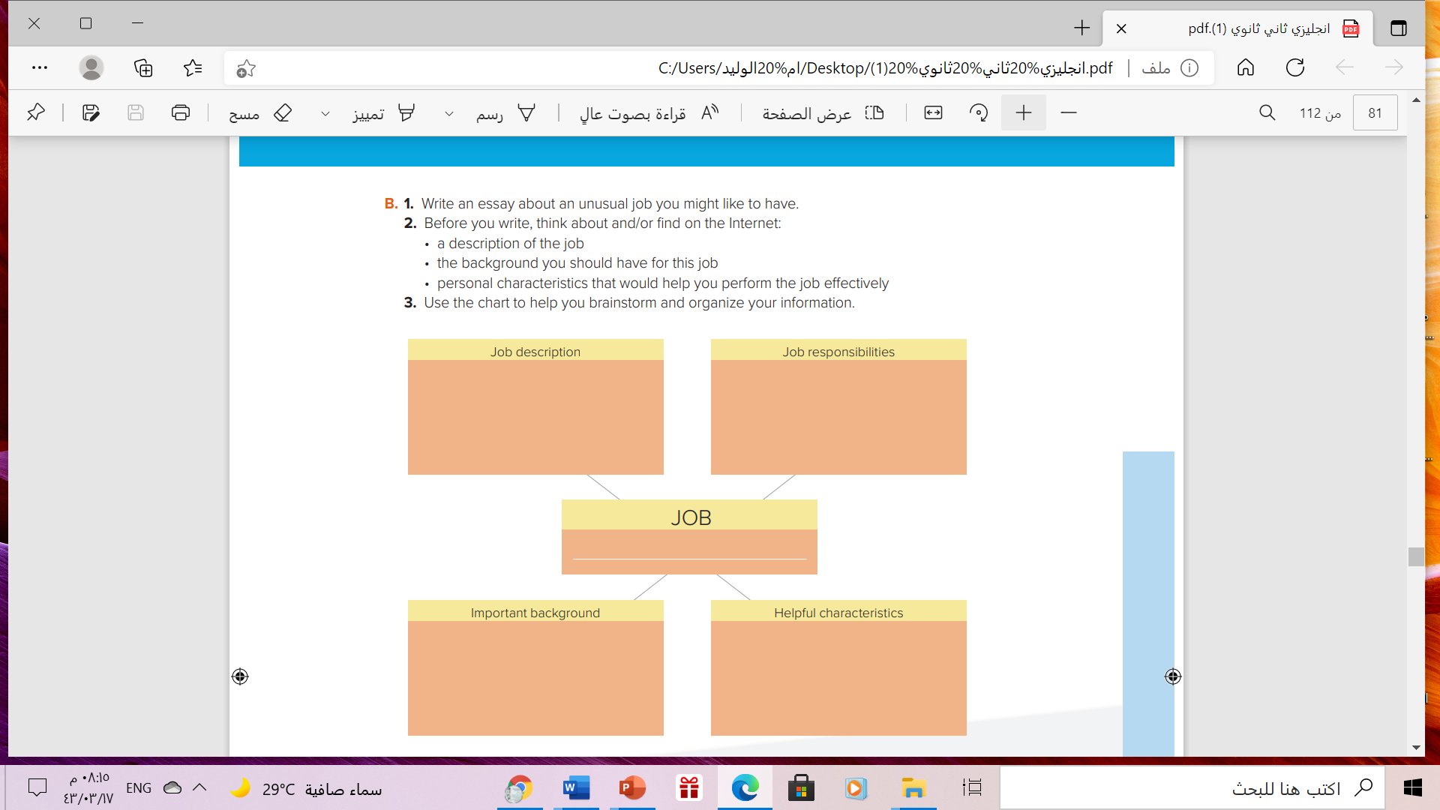



Slide 15



Slide 16
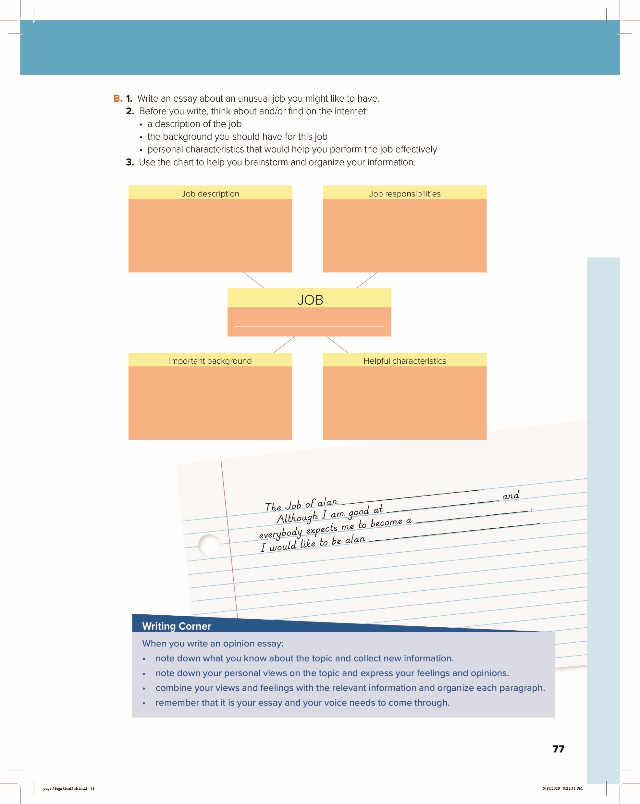
Play through unfinished versions
of game and reporting errors programmers can fix before its
final release to the public.
- Test a video game.
- Uncover bugs and glitches.
- Write a report to the company.
Video games tester
-Degree in Compare science or
game design
-An aptitude for playing video games on a multitude of platforms. .
Attention to details
communication and analysis skills for reporting
Creative skills

Slide 18

Remember

Slide 19
Homework
Page (84) , exercise ( L)

Slide 20

Thanks!

