Slide 1
Unit 2
Going Green
Mega Goal 2.2
Reading
Done by : Entisar Al-Obaidallah

Slide 2
Lesson Goals
Read
Describe
Answer
Deduce
Discuss
For specific information
the pictures correctly
questions about the passage
The meanings of the new words
the topic of “Living of the Grid”

Slide 3
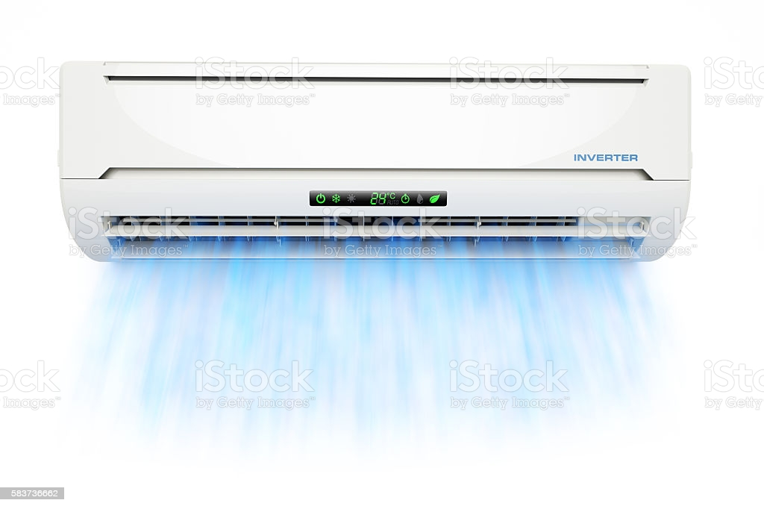
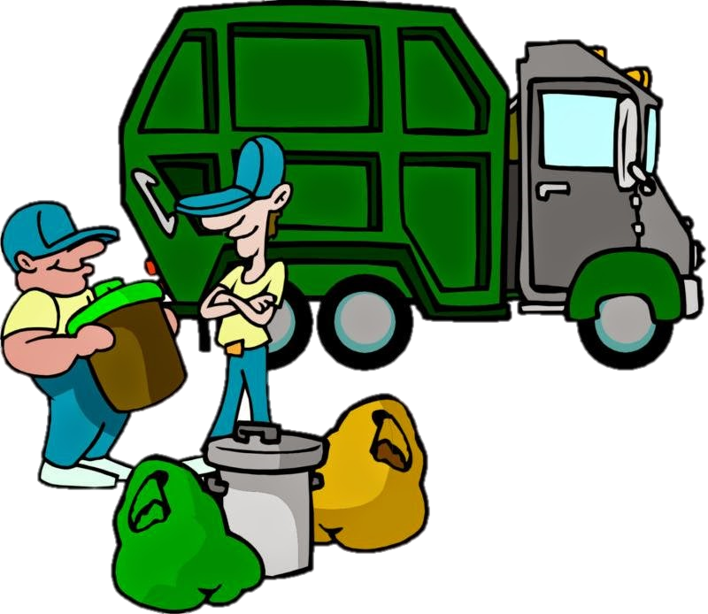


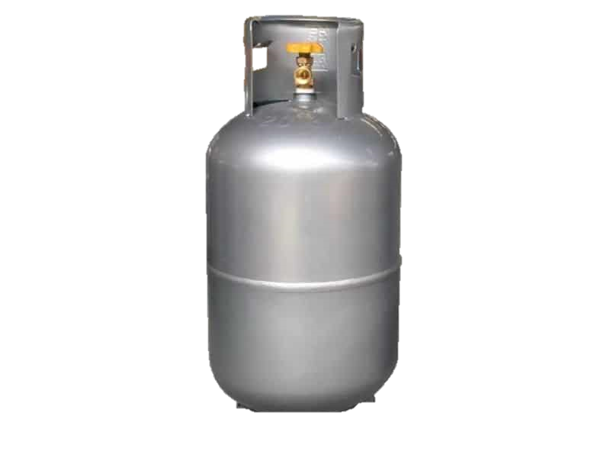
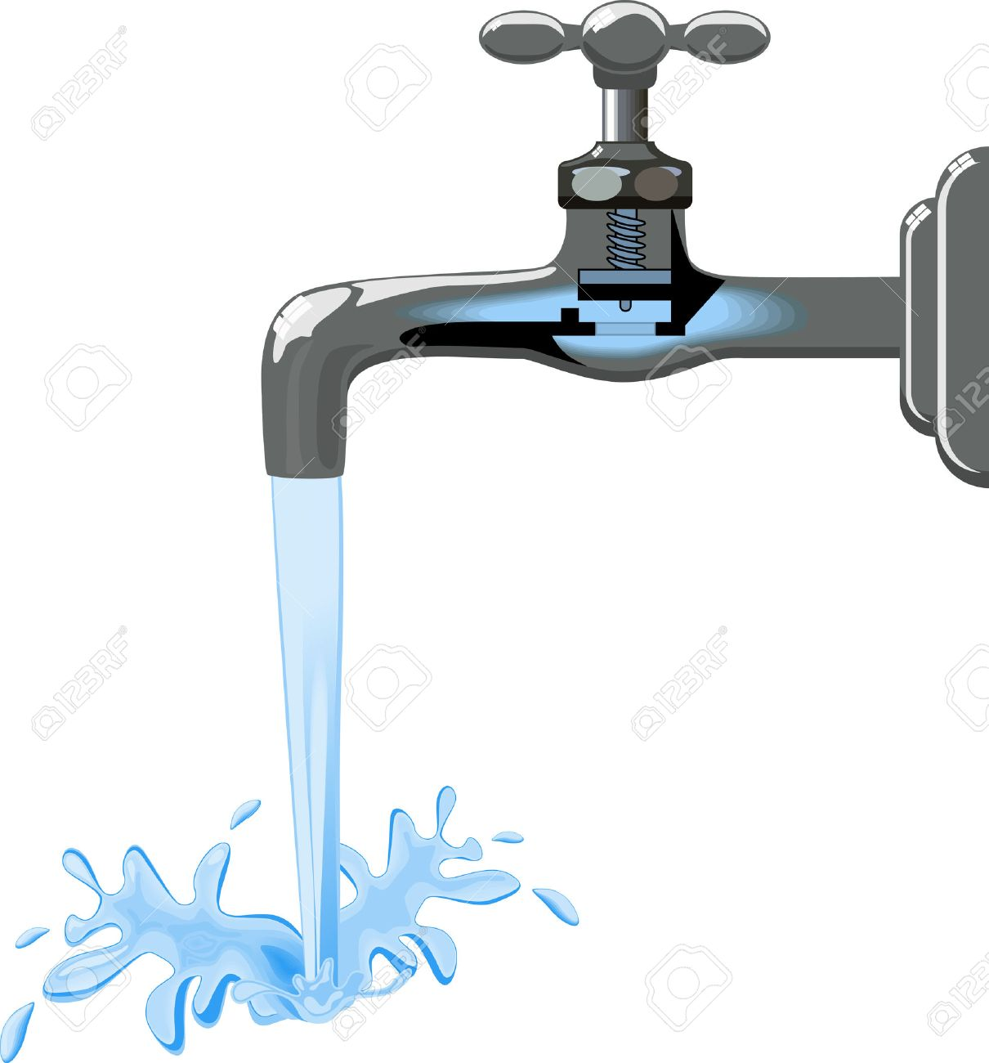

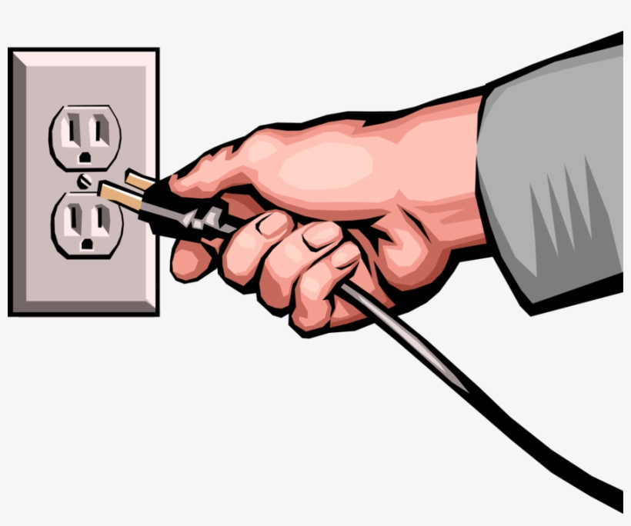
Book Closed
What do you think has been happening without these utilities?

Slide 4
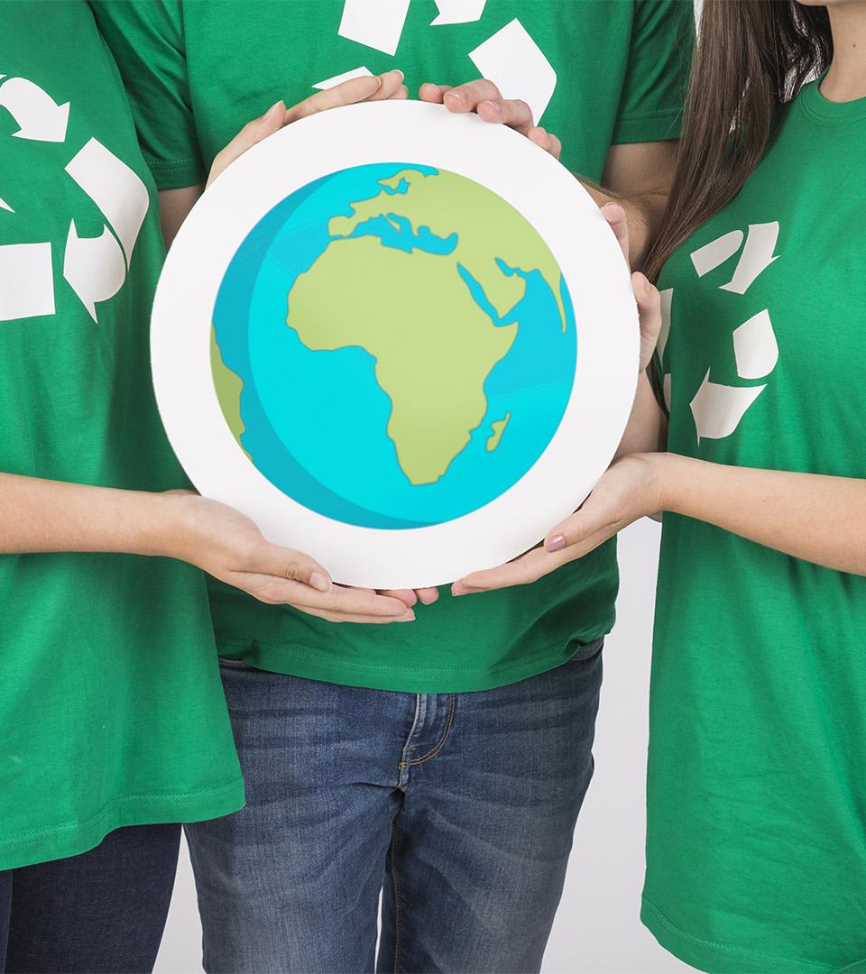
Book Open
Pages (88-98)

Slide 5
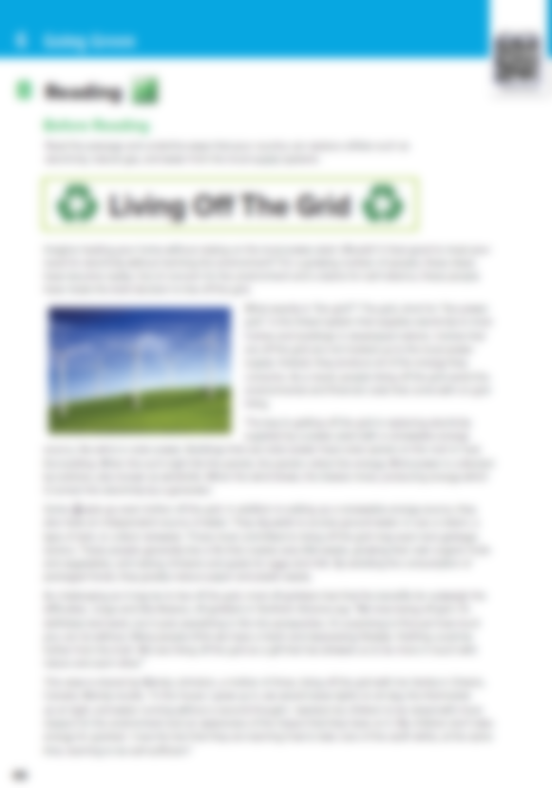
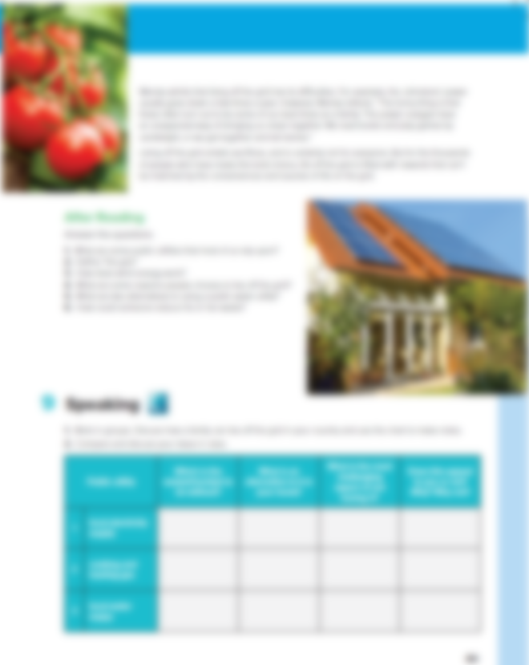

Open UR book p.(88-89)

Slide 6
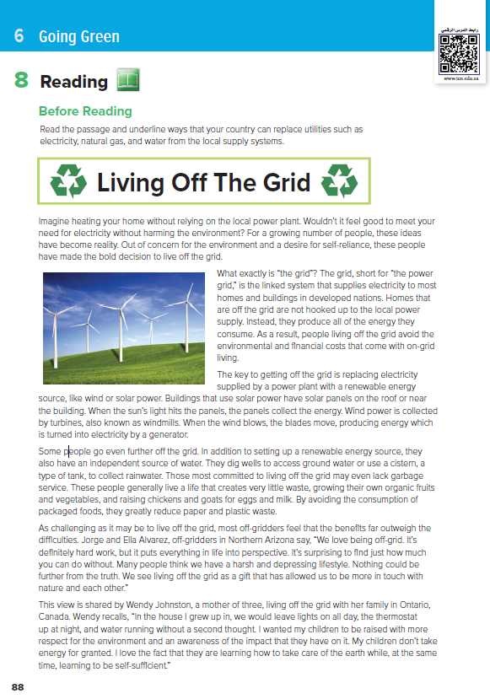
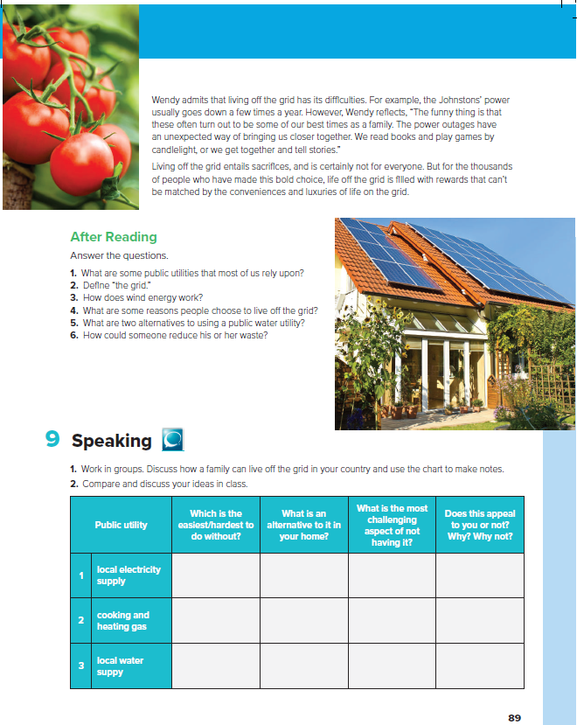
7
8
1
What is the title:
2
windmill
3
House with Solar energy panels
4
How many persons are there?
5
What does each picture show?
6

Slide 7

Open UR book p.(88-89)
Read along as you listen

Slide 8
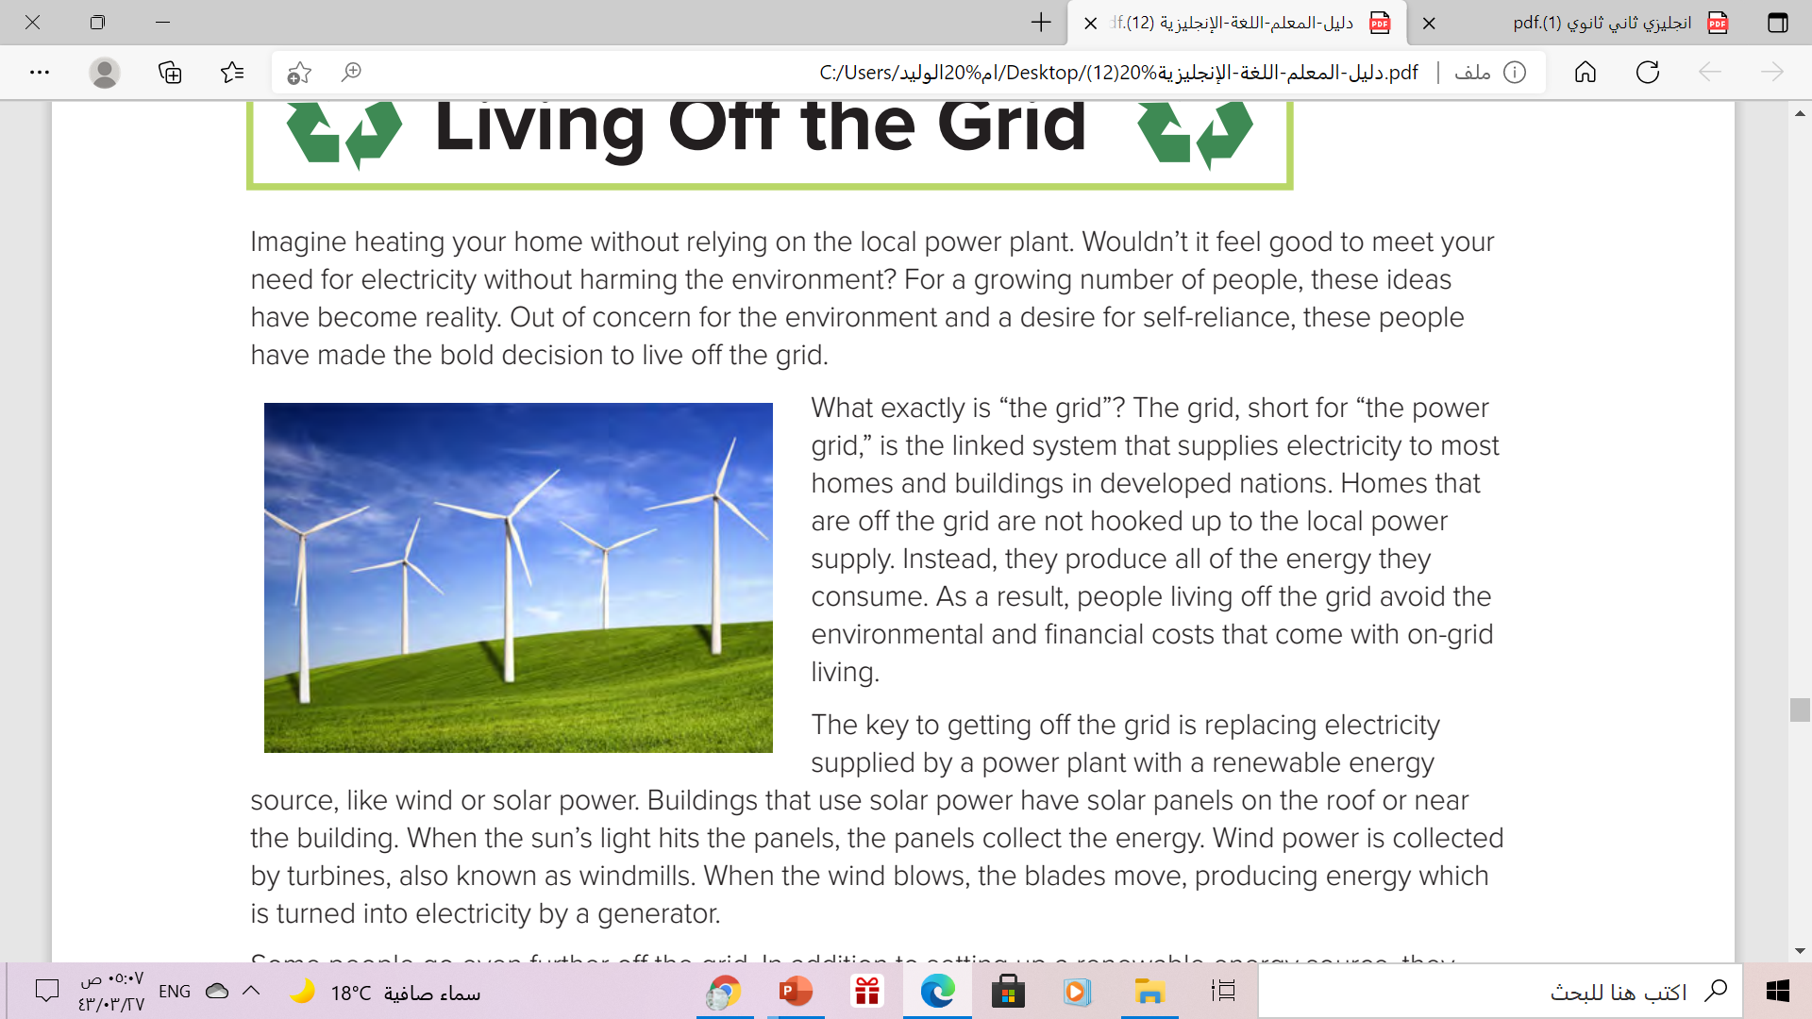
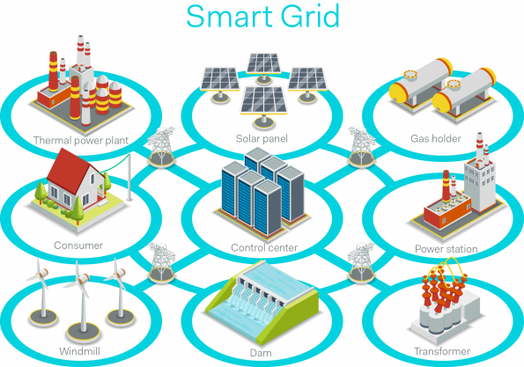
What is “the grid”?
What does it
mean to live off the grid?
2

Slide 9
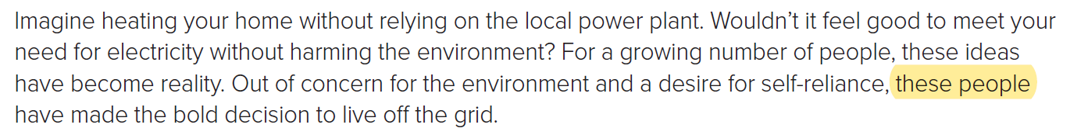
Who are “these people”?
1
What are two reasons they have decided to live off the grid?

Slide 10
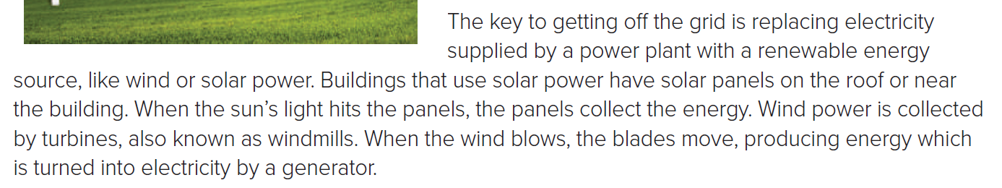
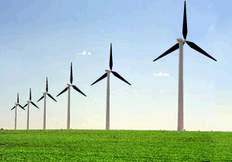
3
How does a windmill produce electricity?
What are the blades?
the part of the windmill that moves
windmill

Slide 11
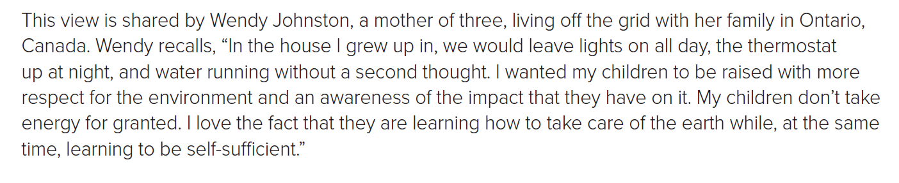
6
Who does the pronoun “they” refer to?
What are two things Wendy wants for her children?
Wendy Johnson’s children

Slide 12
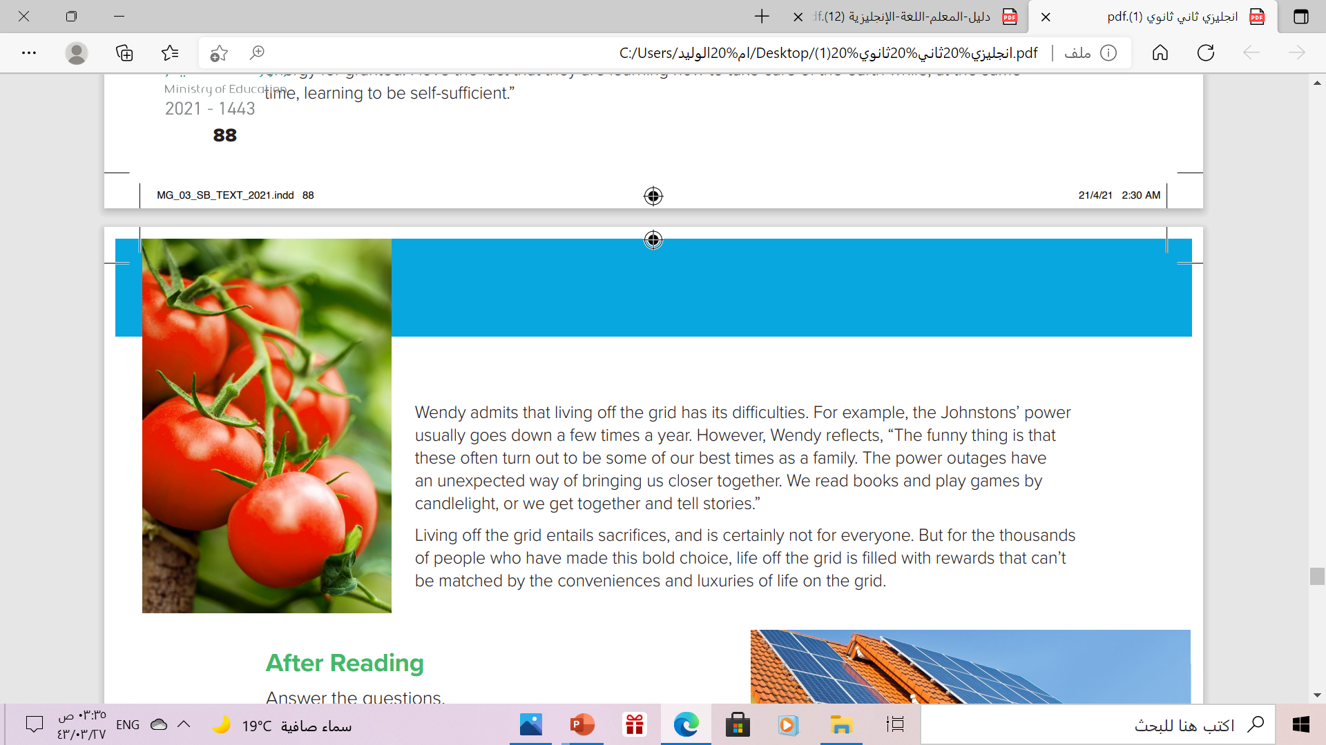
What is the “bold choice” referred to?
The decision to live off the grid
8
What does… “can’t be matched” means?
Not like; one thing is much better than another

Slide 13
Book Open
Page ( 22-23)

Slide 14
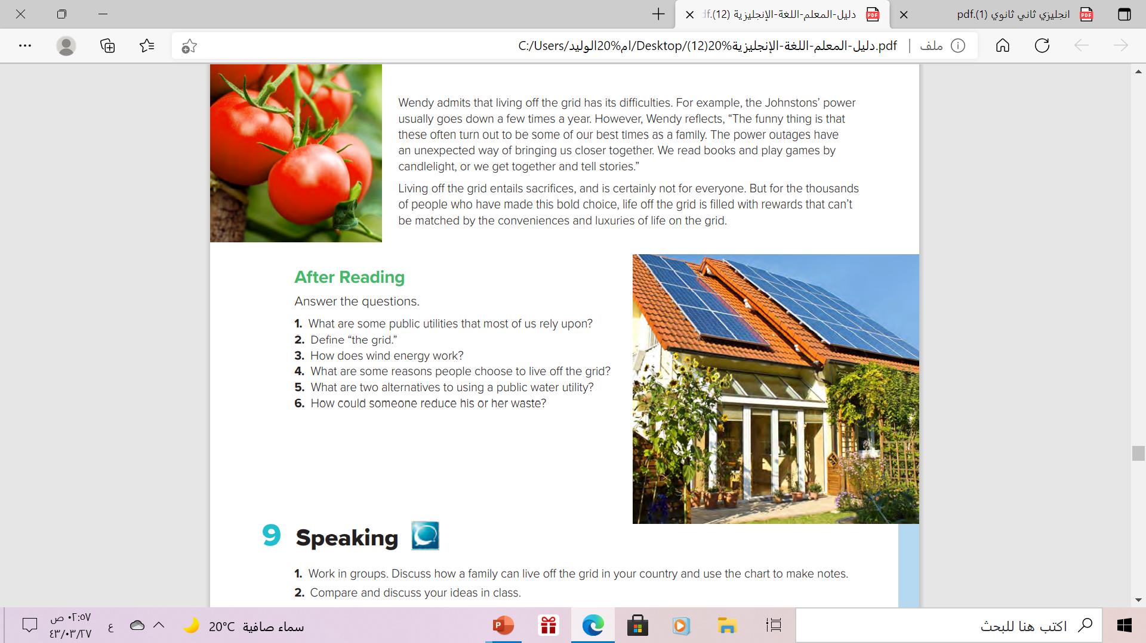
electricity, natural gas, and water.
the linked system that supplies electricity to most homes and buildings in developed nations
When the wind blows, windmills turn, producing energy which is turned into electricity by a generator
concern for the environment and a desire for self-reliance
a private well or a cistern to collect rainwater.
by growing their own fruits and vegetables, and raising and tending animals for food

Slide 15
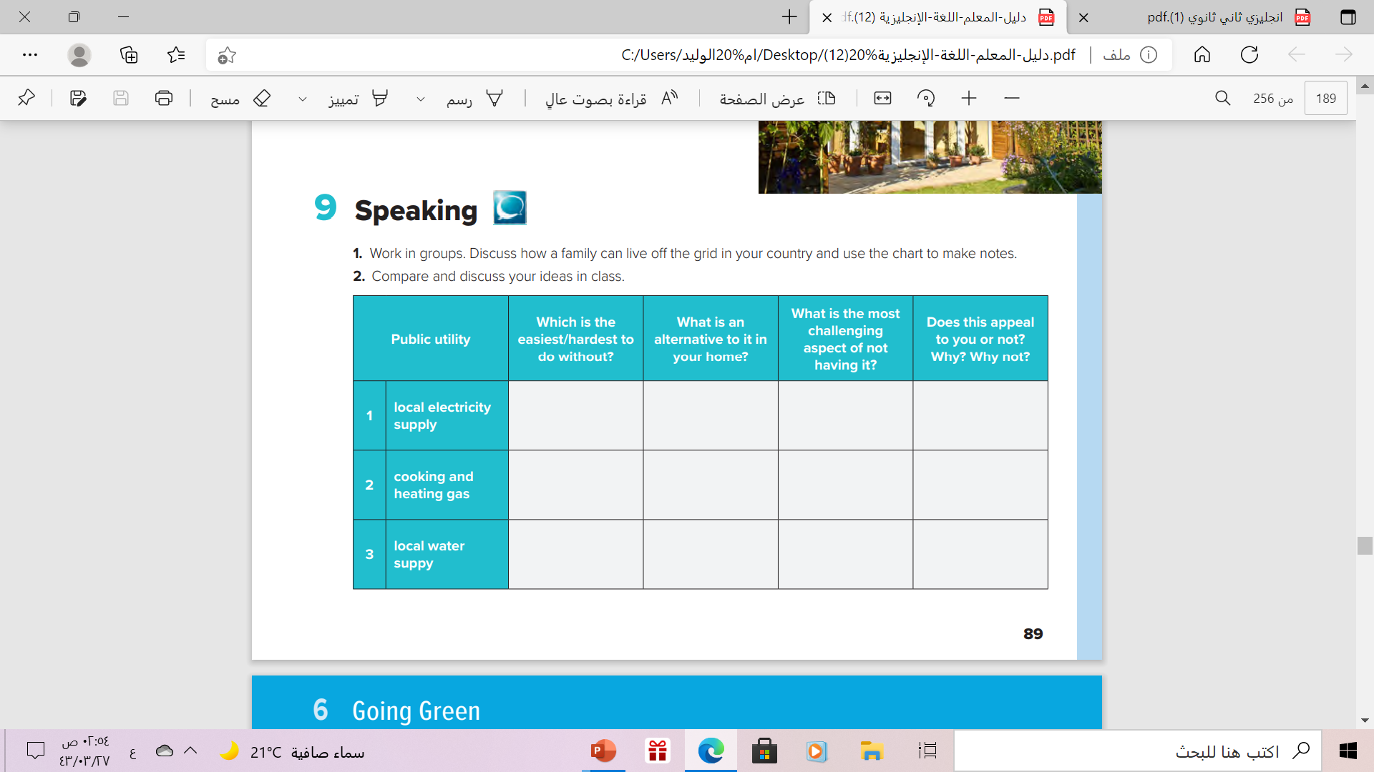

Slide 16

Remember

Slide 17
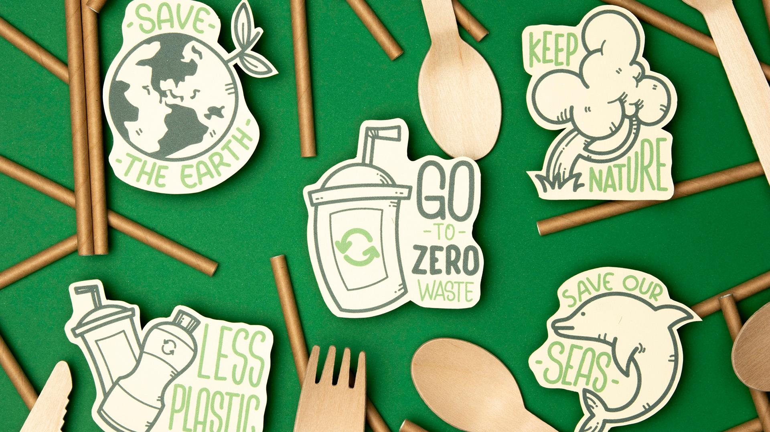
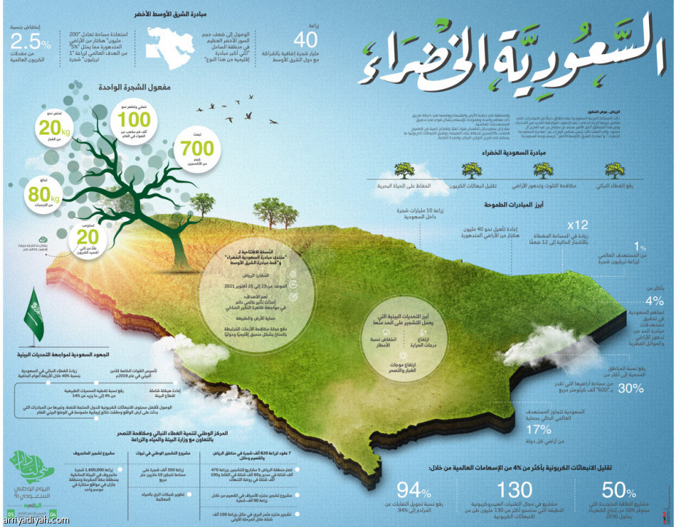

Slide 18
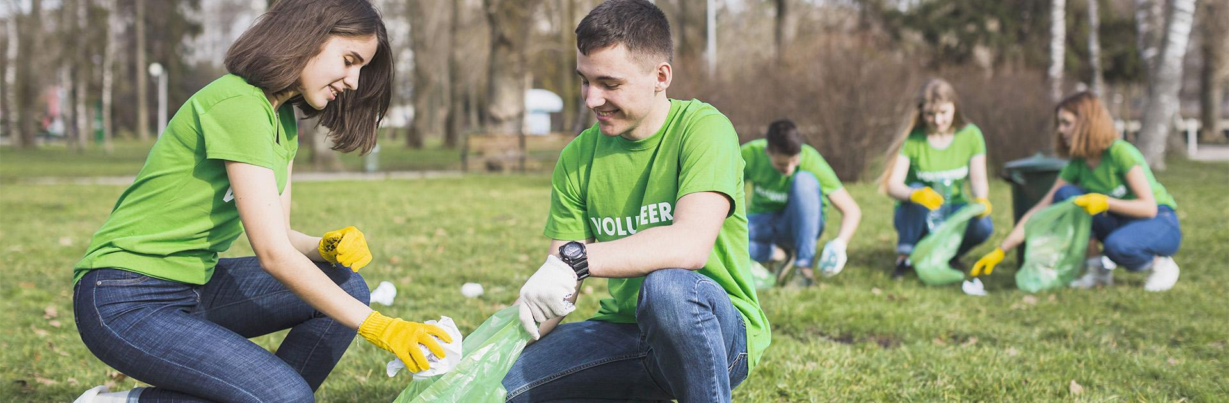
Homework
Workbook page ( 91) , exercise ( I)

Slide 19

Thank You!

