Slide 1




Unit6
GOING GREEN
Mega Goal 2.2
Form , Meaning & Function
Done by : Entisar Al-Obaidallah

Slide 2
Lesson GOALS
3
4
1
Form
Make
Practice
2
Use
Using I’d Rather
Sentences using present simple tense
Correct sentences using present progressive
Conditional sentences with Present and Future forms

Slide 3

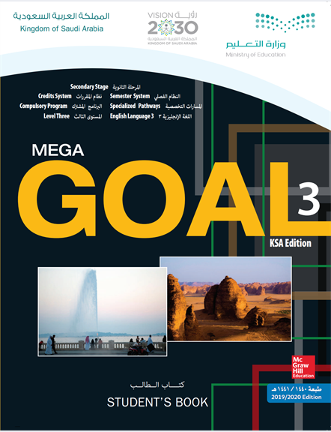
Book Open
Page (26)

Slide 4
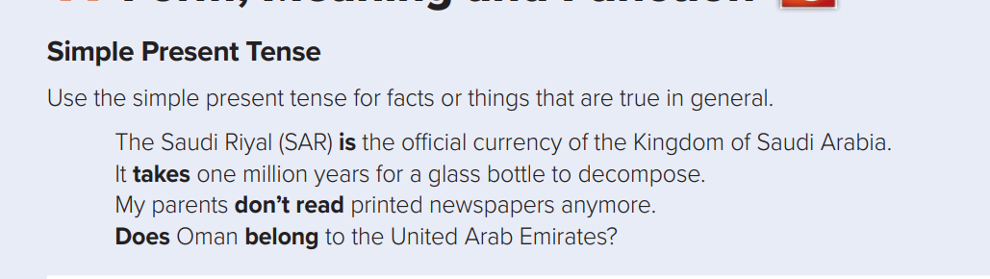
Use
Form:
Affirmative(+)
Subject (She- He –It – singular)
V ( s- es- ies)
Examples:
He cleans his room.
He goes to school by car.
He studies English
Subject (I -you - we - They - plural)
V ( infinitive)
Examples:
I clean my room.
They go to school by car.
We study English

Slide 5
Form:
Negative (-)
Subject (She- He-It -singular)
Doesn’t +V ( base form)
Examples:
He doesn’t speak English.
Subject (I -you - we - They - plural)
Don’t + V ( base form)
Examples:
I don’t speak English.

Slide 6


Form:
Question(?)
Does
Subject (She- He-It -singular)
V( base form)
Examples:
Does he speak English?
Subject (I- You-We-They - plural)
V( base form)
Do
Examples:
Do you speak English?

Slide 7
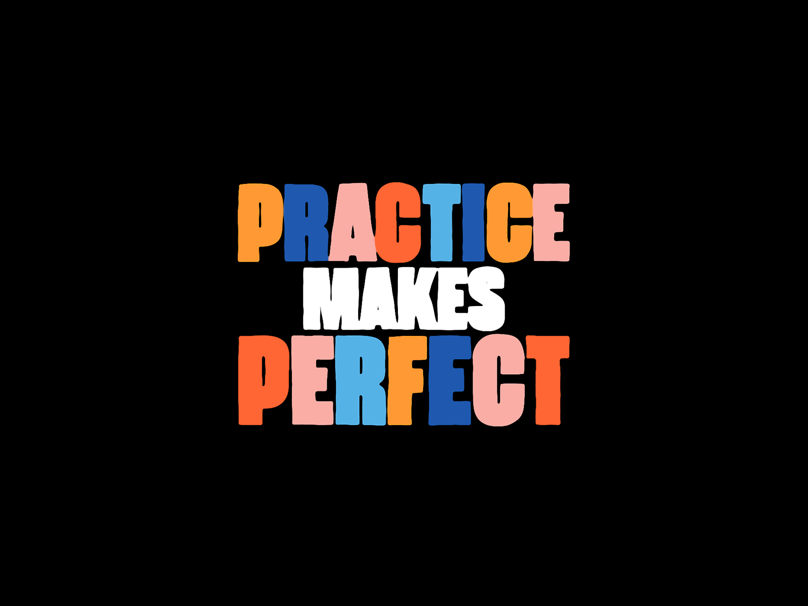

Slide 8

She to school every day
goes
Where does she go every day?

Slide 9
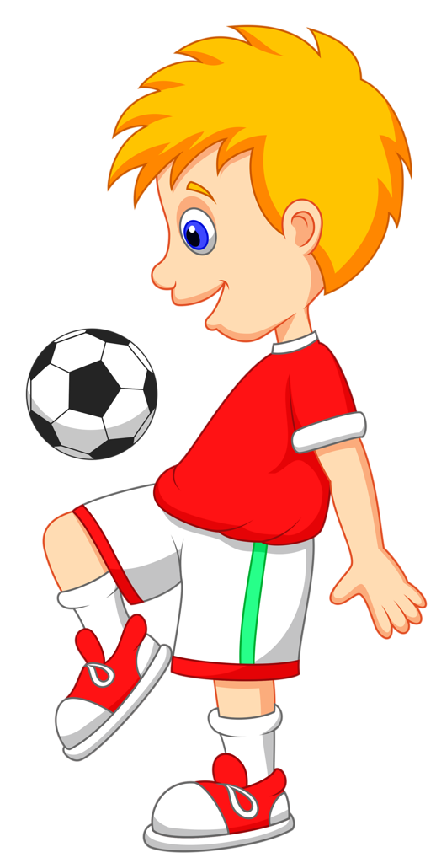
He football every day
plays
What does he do every day?

Slide 10

The moon the Earth
orbits
What does the moon do?

Slide 11



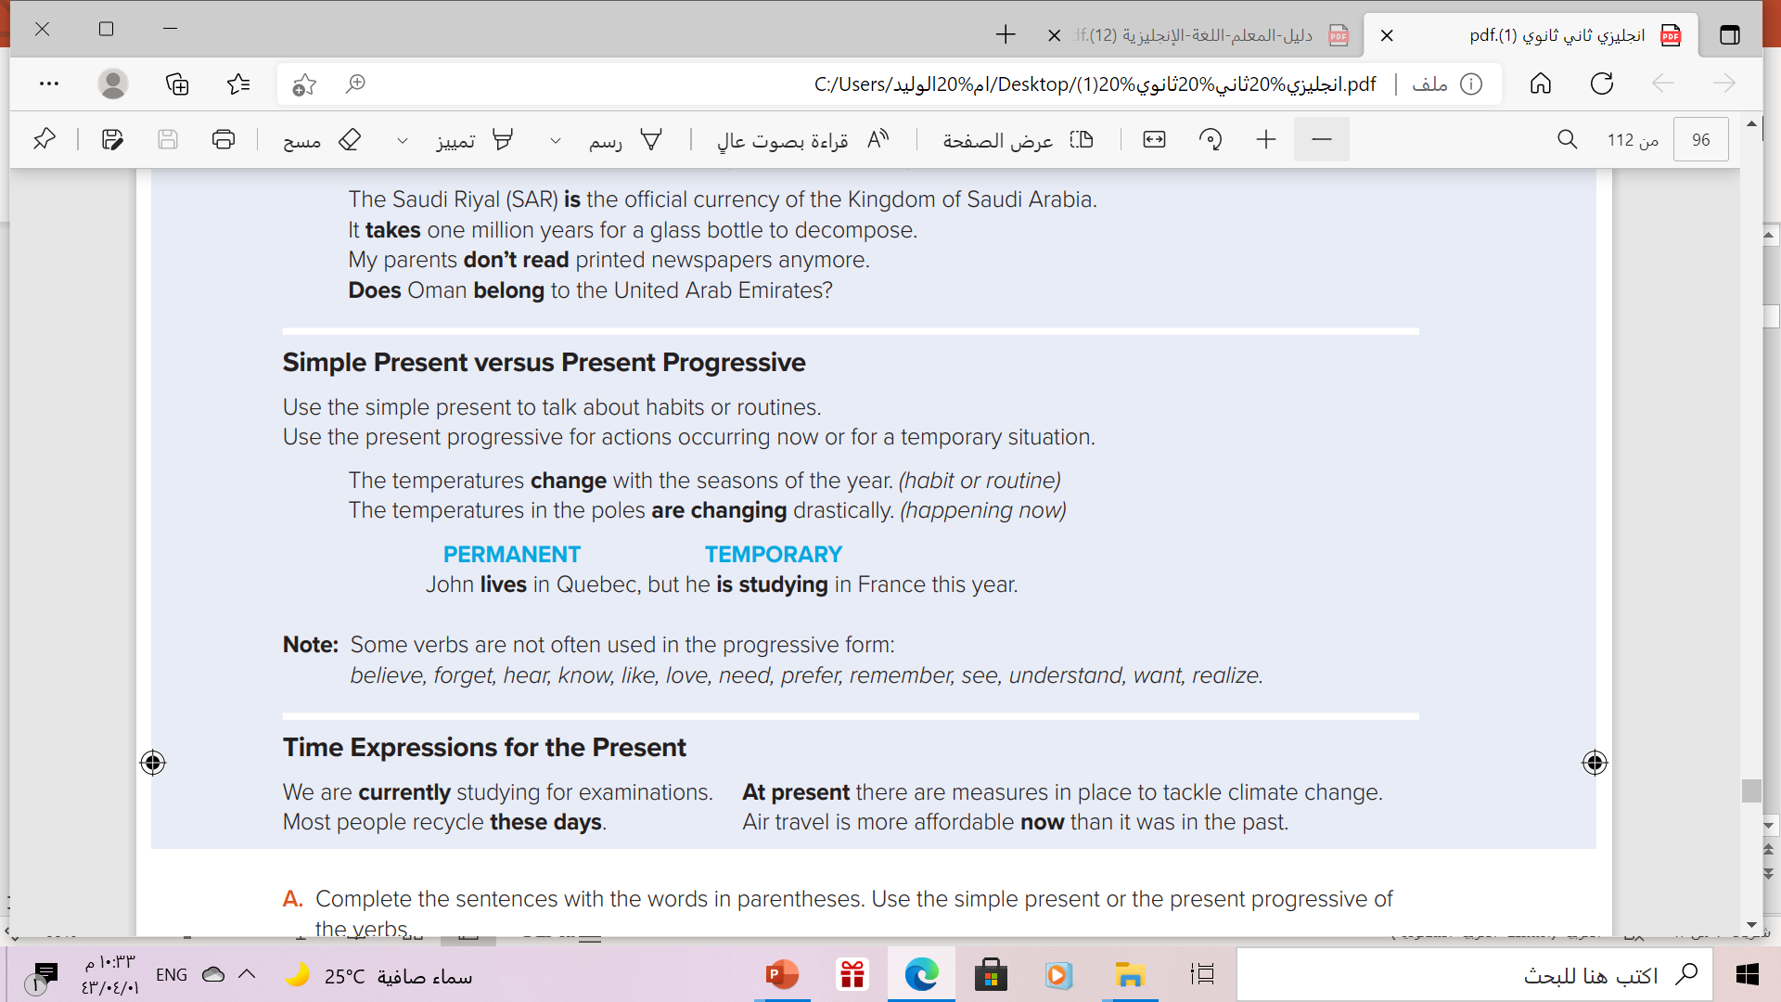



Slide 12
Present Simple vs Present Progressive
Present Tense
Present Simple
Present Progressive
Habits
routins
Actions happenong now
Temporary situation
permenant
Temporary
I usually work in the mornings
I am working this morning

Slide 13
Form of Present Progressive
am + ing
is + ing
are + ing
I
He
She
It
You
We
They
I am reading a new book right now
He can’t talk now . He is brushing his teeth
They are watching a movie at the moment.

Slide 14
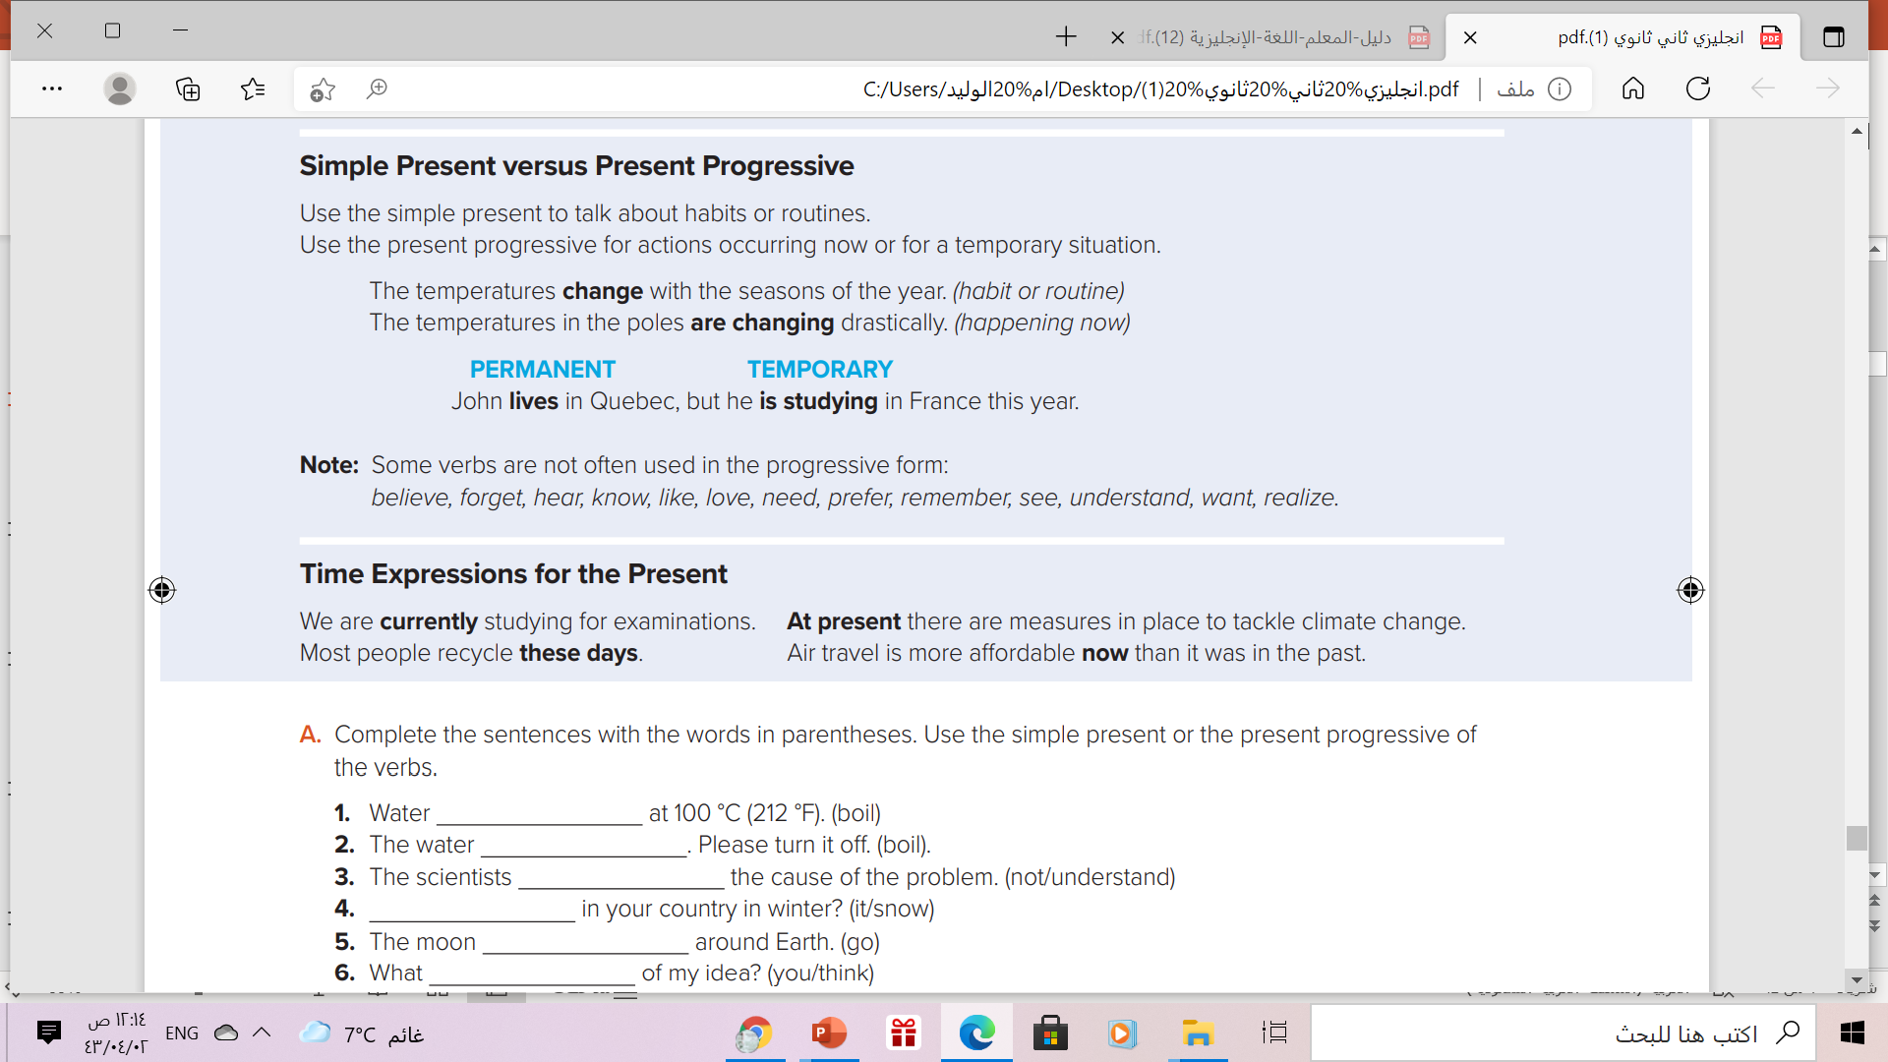

Slide 15
Time Expressions
Present Simple
Present Progressive
always
usually
often
Sometimes
Rarely
Never
ever
every day .. week .. month
On Friday…
once…
Today
right now
now
at the moment
at present
currently
these days
Nowadays
tonight *
RAINBOWS
I go to school everyday .
He usually goes to bed early.
I’m playing football now.
He is working hard these days.

Slide 17
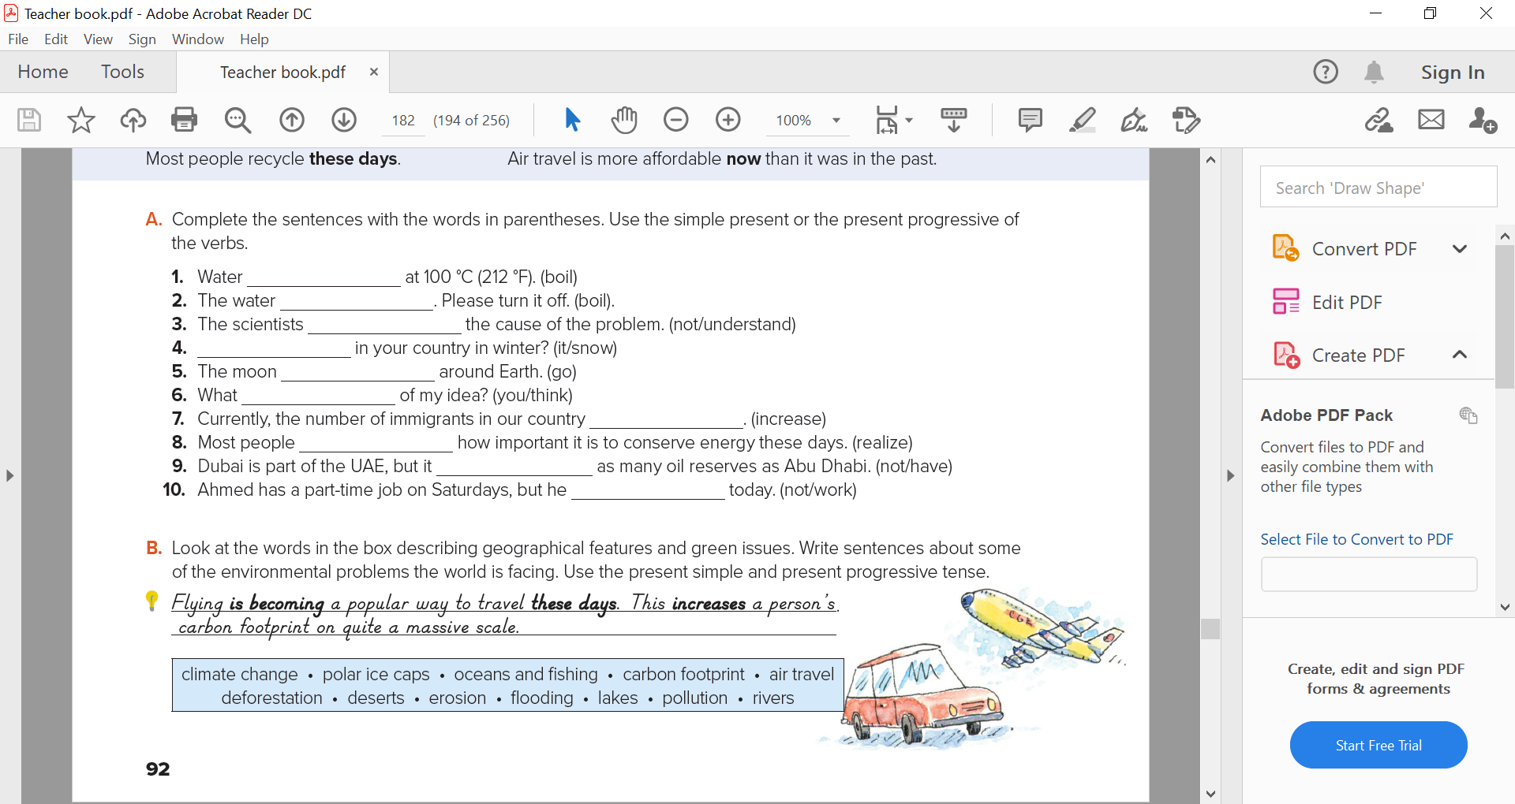
boils
is boiling
don’t understand
Does it snow
goes
Do you think
is increasing
realize
doesn’t have
Isn’t working

Slide 18
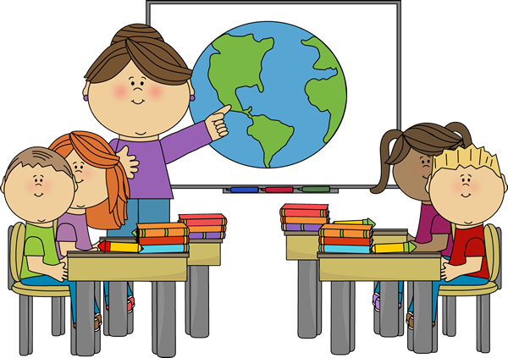
She the students
is teaching
What is the teacher doing right now?

Slide 19

He a book
is reading
What is the boy doing now?

Slide 20
Book Open
Page (27)

Slide 21
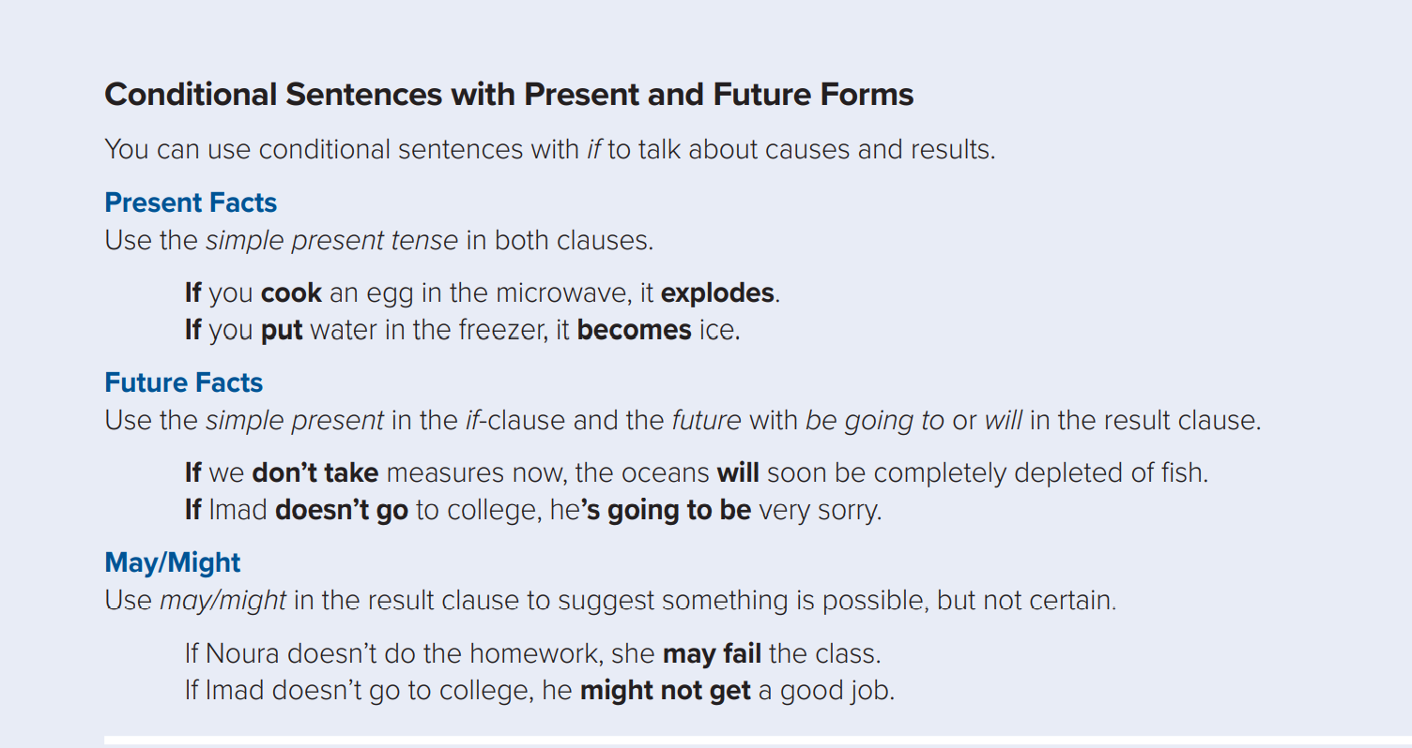

Slide 22
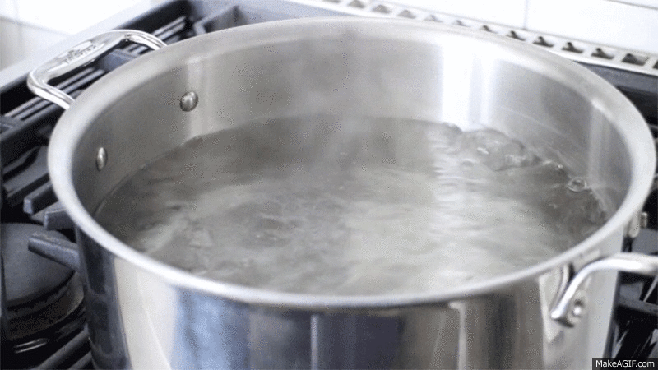
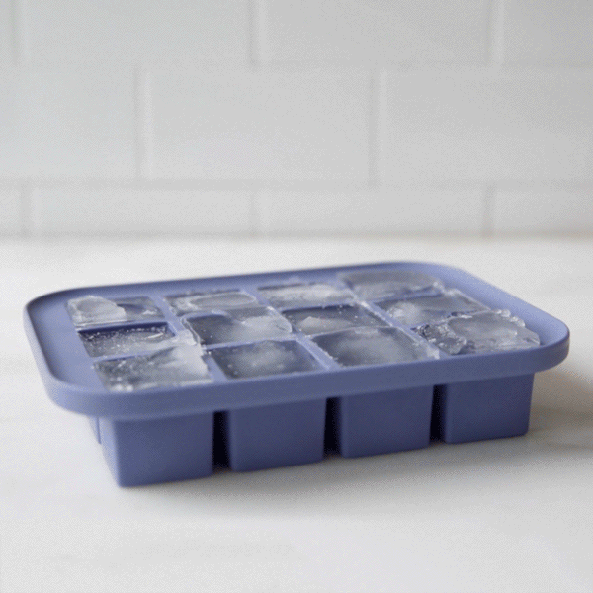
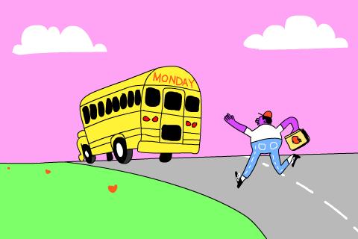
Examples
If you heat water, it boils .
If you freeze water, it becomes ice.
Present facts
If you mix oil with water, oil floats on top
If you wake up late , you will miss the bus
If it rains , we will stay at home
Future Facts
If you study hard , you will pass the exam

Slide 23
If conditional with present facts
,
If
Present Simple
Present Simple
If conditional with future facts
,
If
Present Simple
will
V( infinitive )
If conditional with possibility
,
If
Present Simple
May - might
V( infinitive )

Slide 24
Note
If you study hard , you will pass the exam .
The meaning is the same
You will pass the exam if you study hard
✗
You will pass the exam , if you study hard
No comma before if in the middle

Slide 25
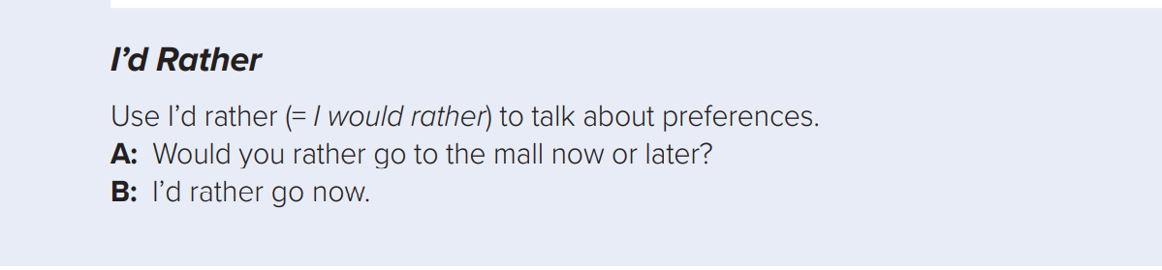
I’d rather = I would rather
Use:
To talk about preferences.
Form
I’d rather + V ( infinitive)
Examples
A: Would you rather go to the mall now or later.
B: I’d rather go now

Slide 27
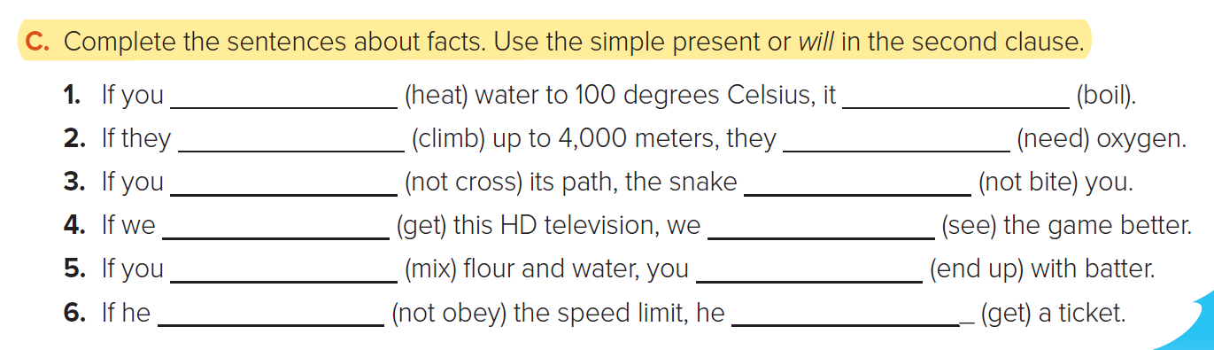
heat boils
Climb will need
don’t cross will not bite
get will see
mix end up
doesn’t obey will get

Slide 28

Homework
Workbook
Page (95) , exercise ( N-O)

Slide 29

THANKS!

