Slide 1
Mega Goal 2.2
Unit 2
Going Green
Writing
Done by : Entisar Al-Obaidallah

Slide 2
Lesson Goals
1
Describe
the pictures using their own words.
2
Read
the essay for specific information
3
Use
the chart to make notes
4
Write
A letter to a newspaper

Slide 3
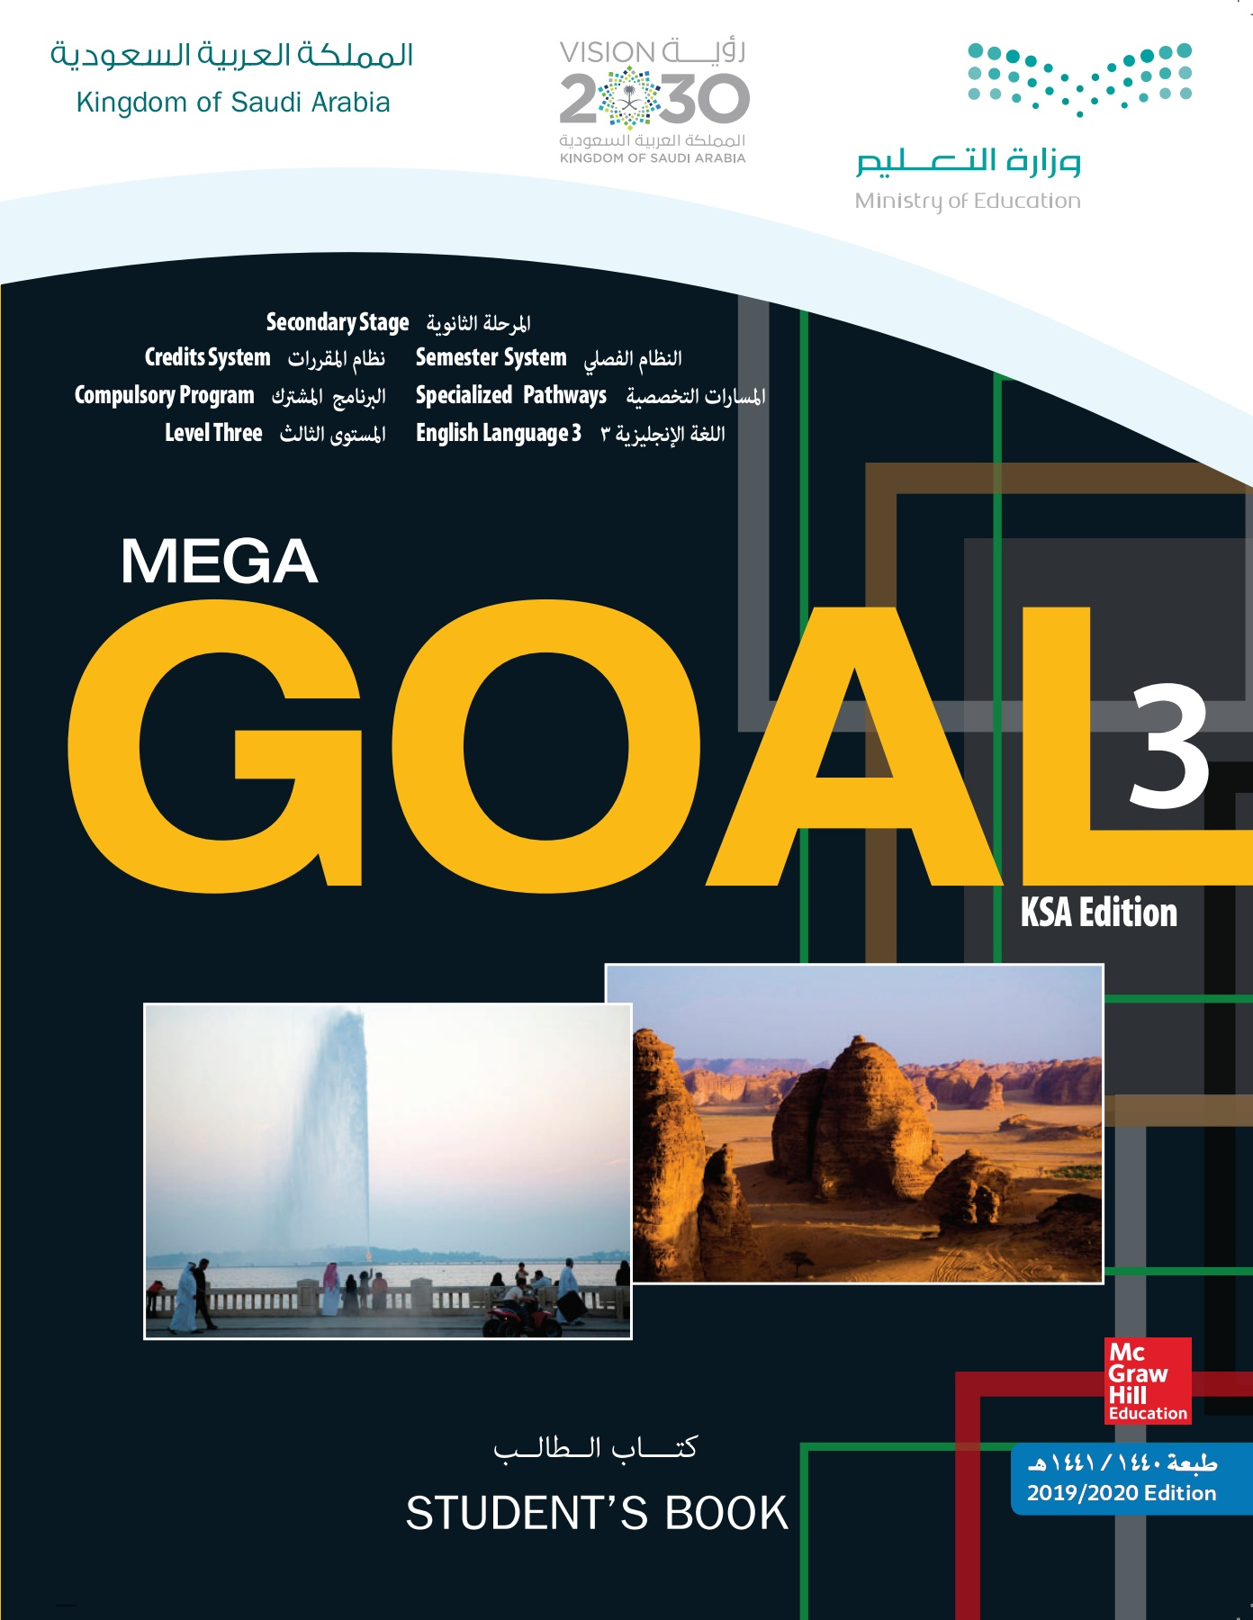
Book Open
Page ( 24 )

Slide 4
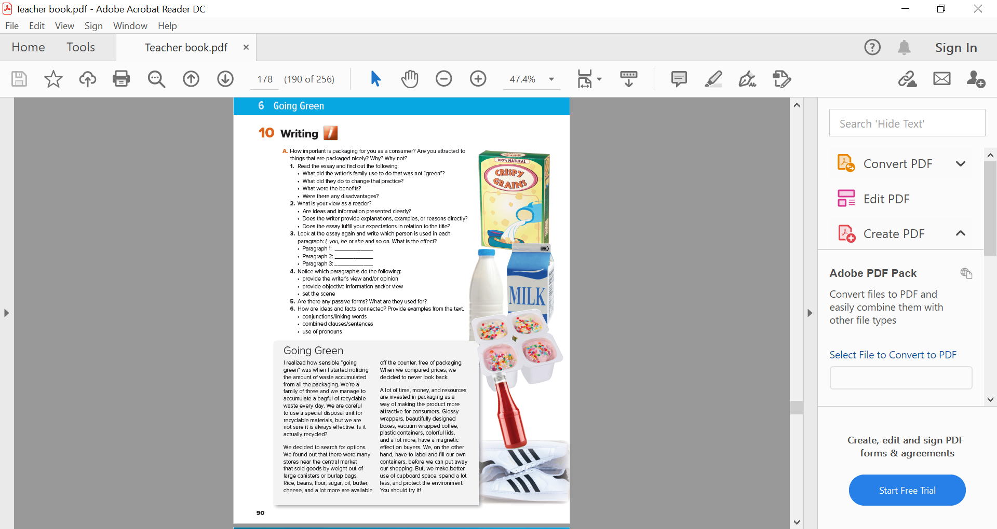

Open UR book p.(24-25)

Slide 5

What can you see in the pictures?
Do they protect the product?
Are they plastic or made of natural materials?
Can they be recycled?

Slide 6
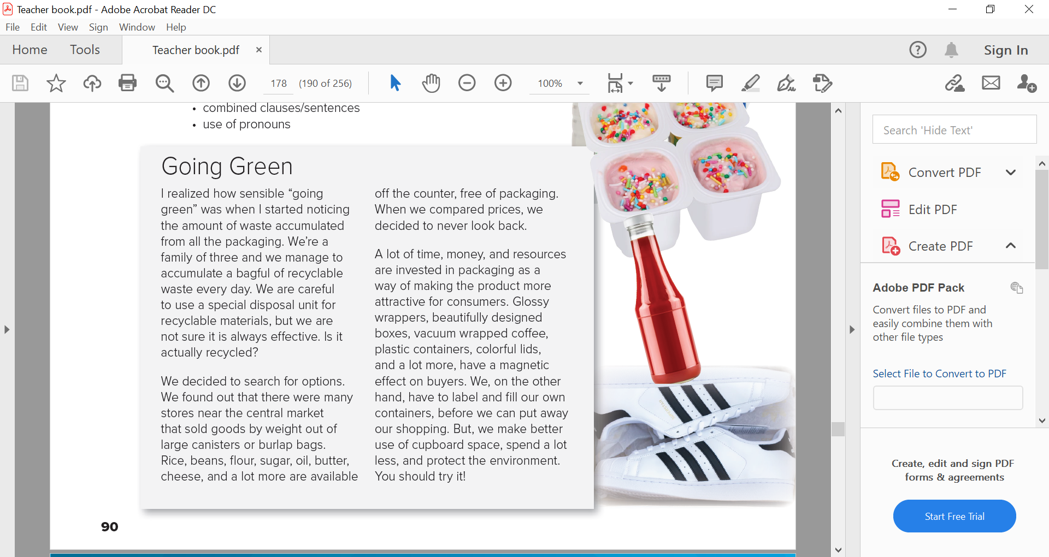

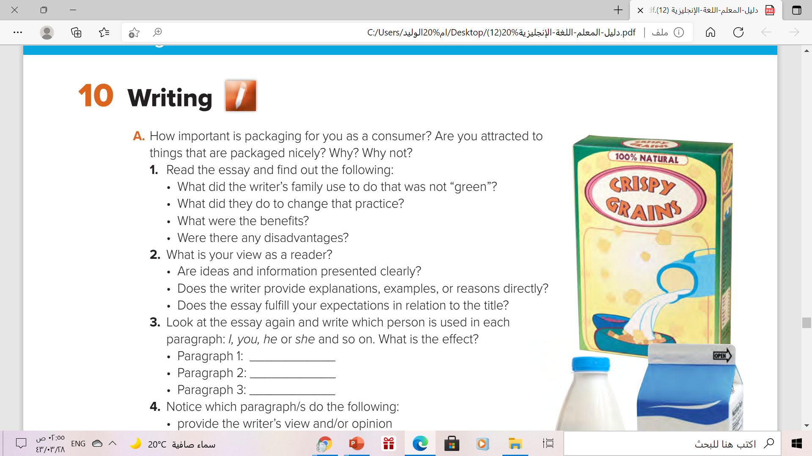
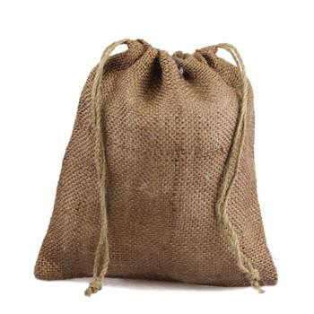
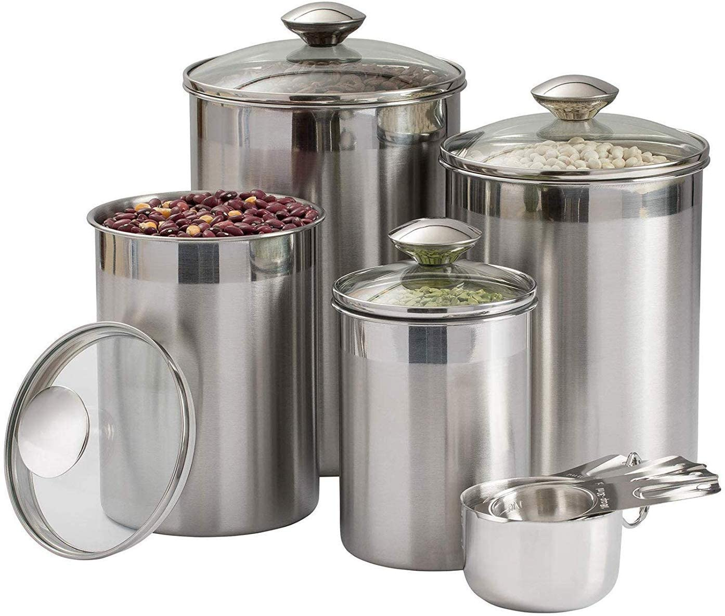
1
3
2
Burlap bag
canisters

Slide 7
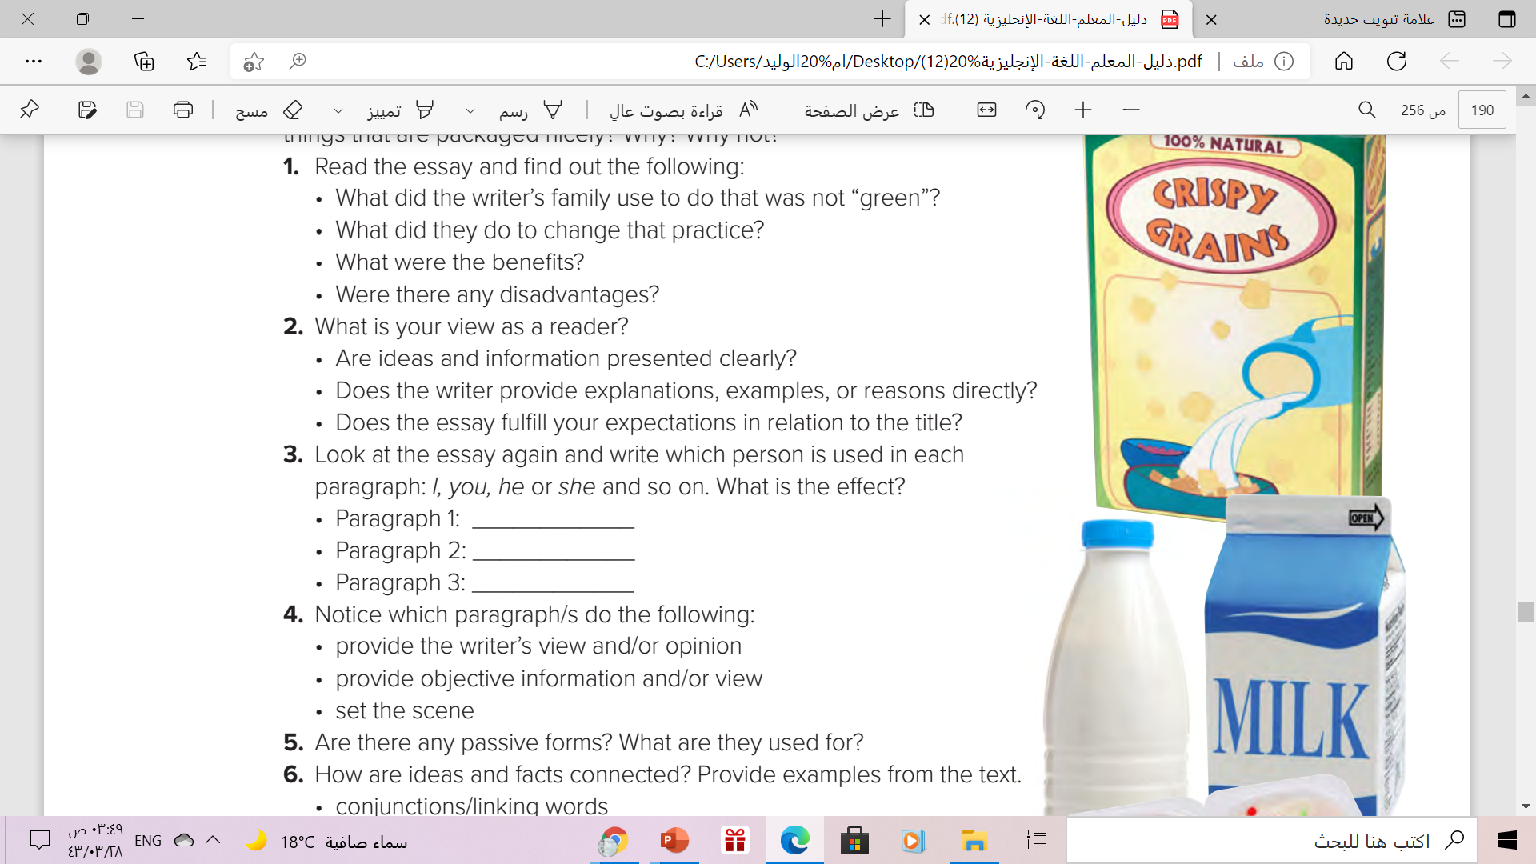
1
3
2
Yes, they are
Yes, he does
yes , it does

Slide 8
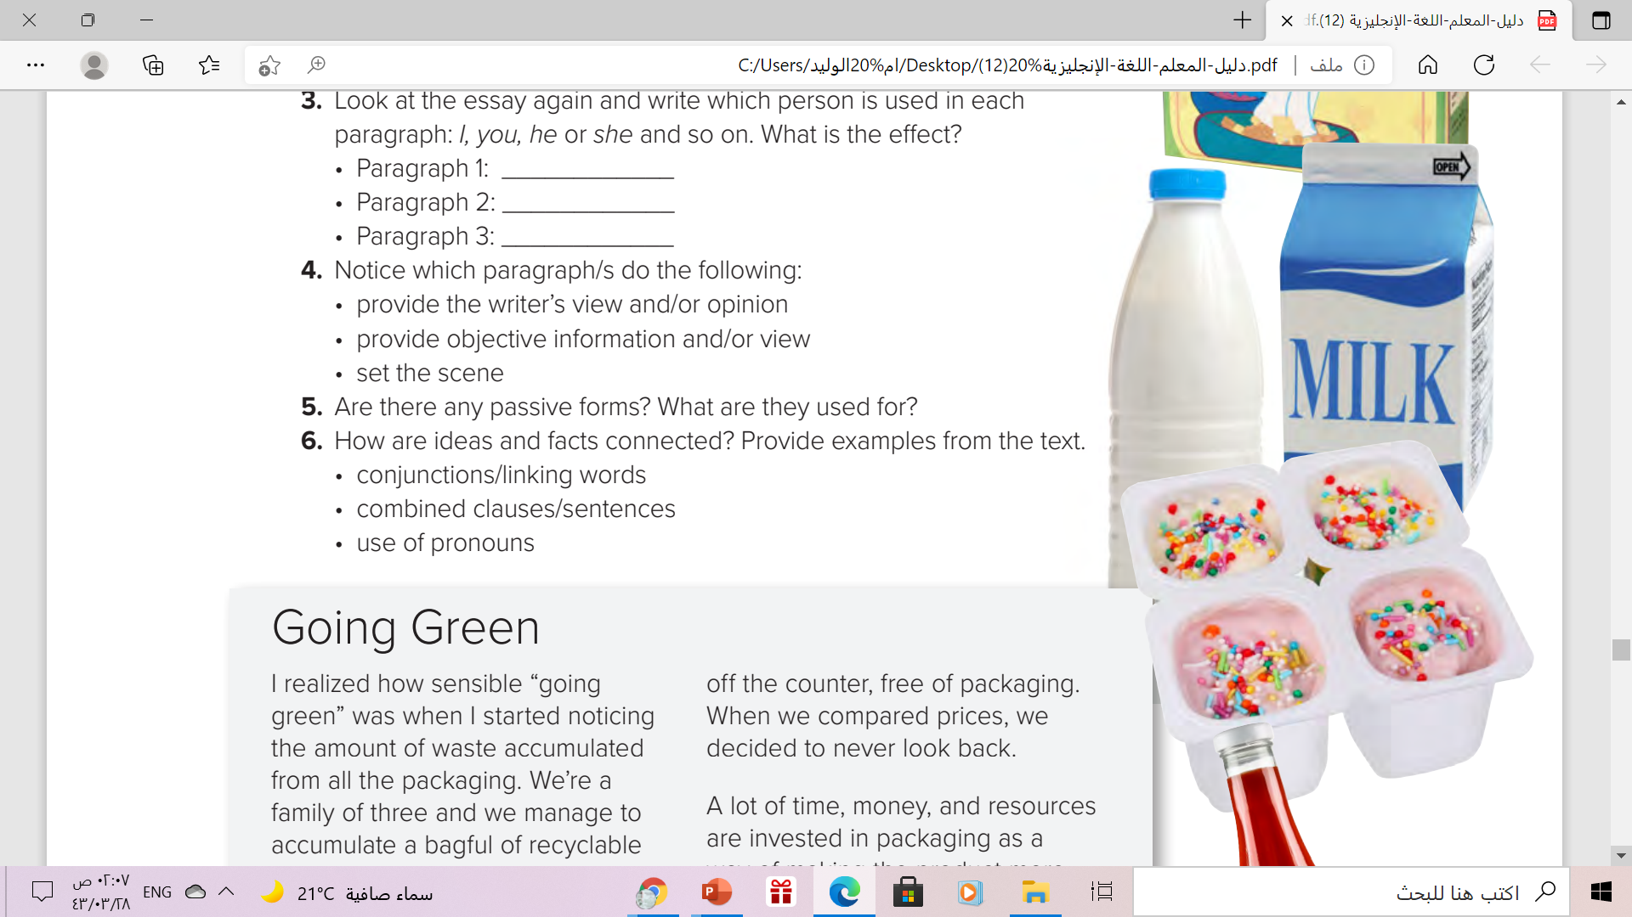
1
3
2
5. Passive forms are used to present information/facts in an objective, detached manner.
6. examples conjunctions/linking words: But, on the other hand ➔combined clauses/sentences: …are invested in packaging as a way of making the product more attractive, we are not sure it is always effective
➔use of pronouns: We , I , it

Slide 9
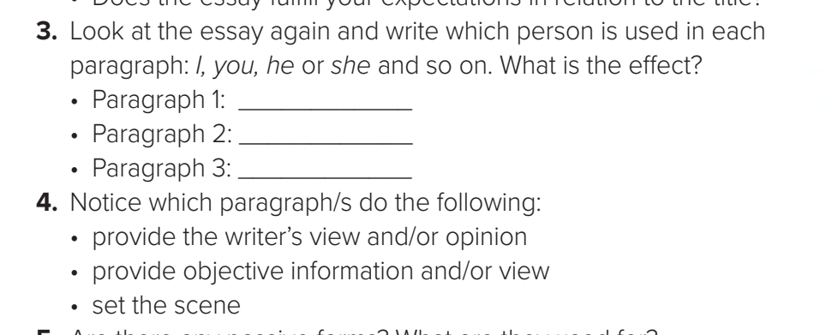
1
3
2
Paragraph 1: I - we Sets the scene/ writer’s view
Paragraph 2: we - Objective information
Paragraph 3: we - Objective information / writer’s view

Slide 10
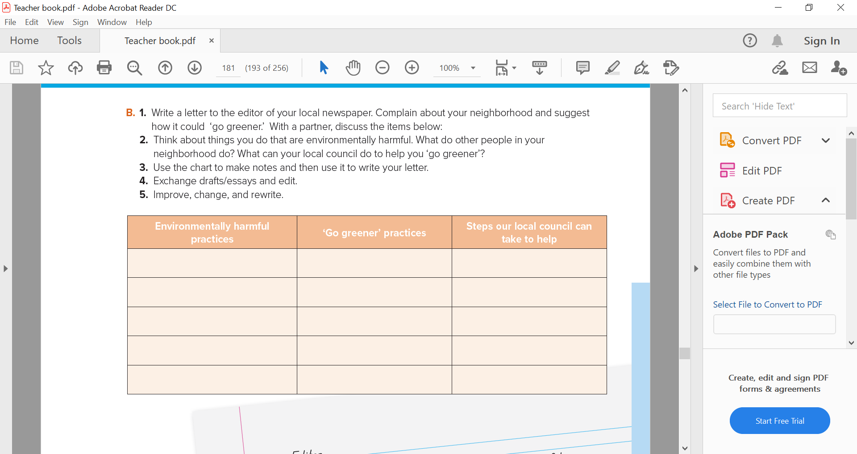

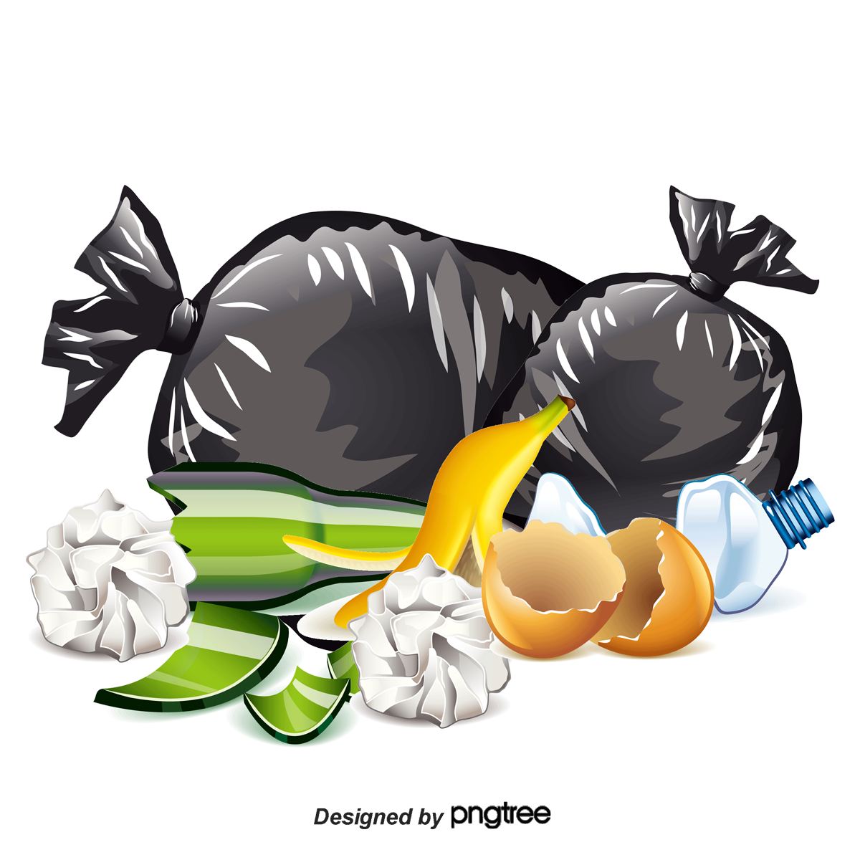

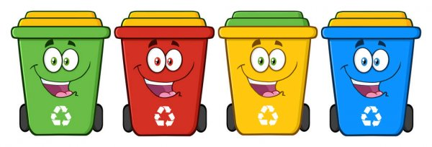
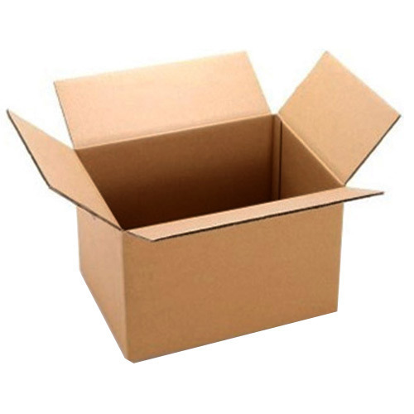
Over flow of garbage
Offer larger bins
Collect more often
Boxes blowing away
Learn people about recycling
Provide recycle bins for glass, plastic and waste food.

Slide 11

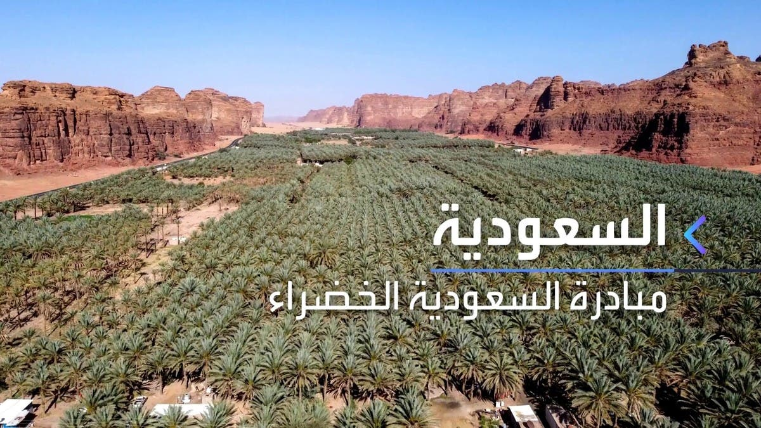

Slide 12


Slide 13
Homework
Work book page (94) , exercise ( M )

Slide 14

Thank You!

